Slide 1

Synthesis, Standardisation, and Next Steps
Friday 21 November 2025

Slide 2
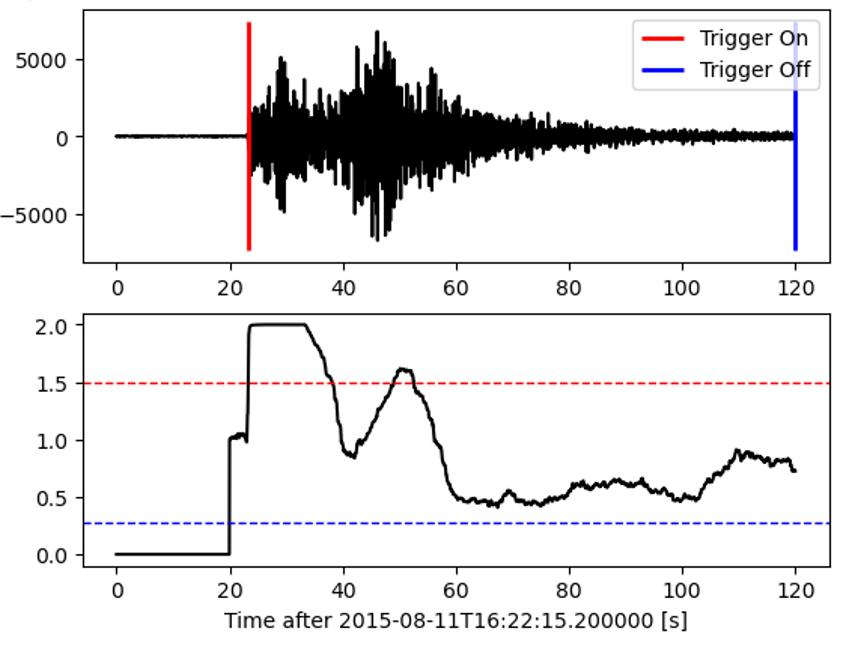

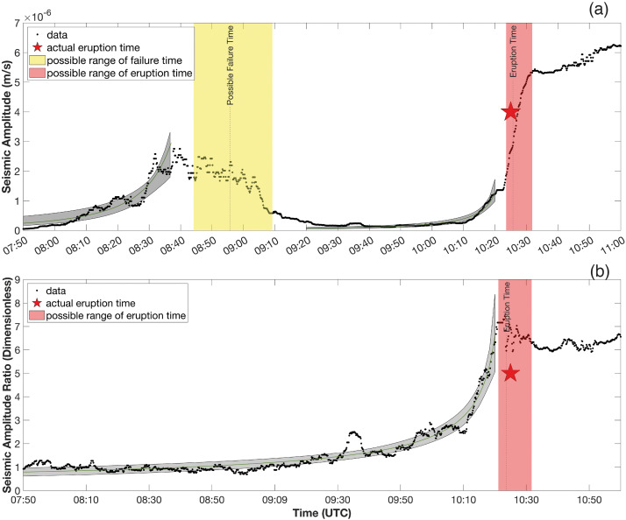
Open Discussion:
Optimising Seismic Data Products for Crisis Response
The role of seismic data products in crisis response:
➔ event detection
➔ escalation assessment
➔ eruption forecasting
Examples of effective products:
  RSAM/SSAM and spectral monitoring
  Automatic event classification and clustering
  Real-time swarm detection and alerting
  Data visualisation dashboards (e.g., interactive monitoring portals)
Aji et al., 2024
Dempsey et al., 2020

Slide 3

OBJECTIVE
How seismic data products can be made faster, more reliable, and more useful for real-time decision-making during volcanic crises.
Reflect on operational needs, processing standards, and communication workflows, aiming to identify practical steps to optimise products such as RSAM, event catalogs, and spectral analyses for emergency response.
Cheap, fast, AND great?
You’re right – it’s too good to be true.
https://www.lookherewriting.com/the-fast-great-cheap-conundrum/

Slide 4
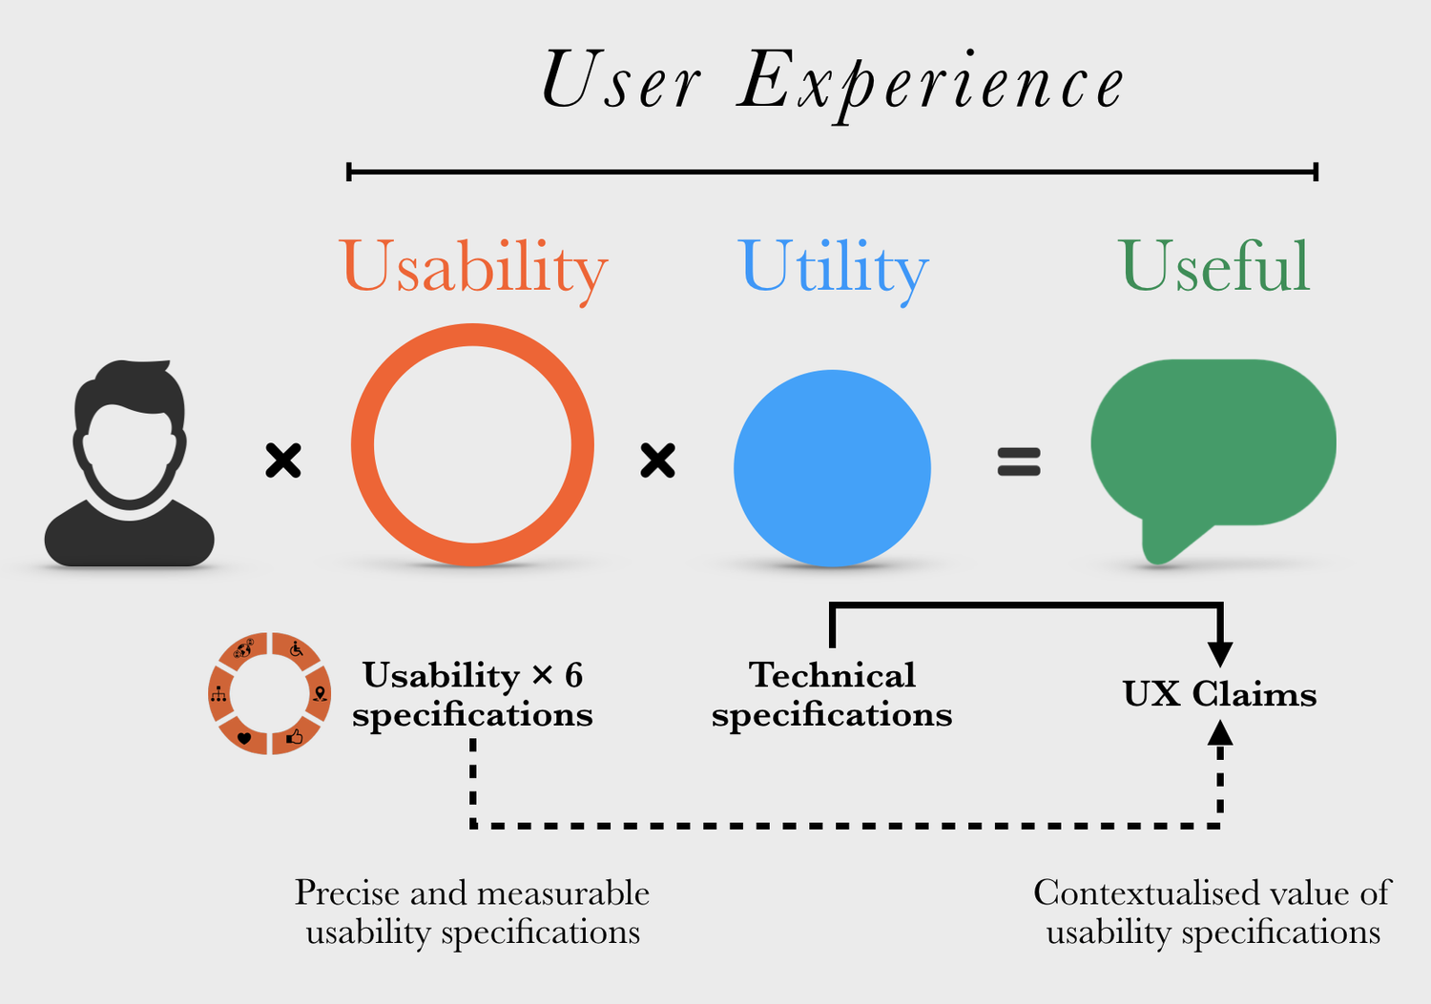
KEY CRITERIA:
1. Data timeliness and automation
  Real-time waveform processing, event detection, and QC pipelines
  Balancing speed and accuracy in crisis contexts
2. Standardisation and comparability
  Ensuring consistent formats and metadata across observatories
  Harmonising RSAM/SSAM and spectral analysis methods
3. Product design and usability
  Communicating uncertainty and trends clearly to decision-makers
  Designing intuitive, visual, and actionable displays
4. Integration with other data streams
  How seismic products complement GNSS, gas, or satellite observations
  Multi-parameter dashboards for rapid situational awareness
https://www.designpsykologi.dk/usability-claims

Slide 5
KEY DISCUSSION QUESTIONS:
What are the most useful products in a crisis?
  ➔ What seismic product has made the biggest difference during a crisis you’ve been involved in?
What limits their reliability or usability?
  ➔ Where are the biggest bottlenecks in producing or interpreting these products?
3. How can we make them more standardised and interoperable?
4. What would your ideal real-time seismic toolkit look like?

Slide 6
sensing → analysis → automation → operations → an actionable collaborative plan
understanding of key operational challenges in using seismic data for crisis response.
List of priority products and workflows for optimisation and standardisation.
Identification of collaborative opportunities (e.g., shared code, open templates, common quality standards).

Slide 7
Framework for standardised and automated
volcano–seismic workflows
Objectives
Review and compare monitoring technologies and case studies across the region.
Share and evaluate detection, classification and ML/forecasting approaches.
Co-design automated, reproducible processing workflows and metadata standards.
Test integration routes into observatory systems and WOVOdat.
Produce a draft action plan and delivery commitments for NRFi follow-up.
Expected outputs
Standardised workflow diagram from raw waveform → processed products → archive/WOVOdat.
Recommendations on metadata fields and QC metrics for interoperability.
A set of candidate automation scripts/tools (VEQTOR, VOISS-Net examples) and hands-on notes.
Actionable list of priorities and responsible parties for follow-up.

Slide 8




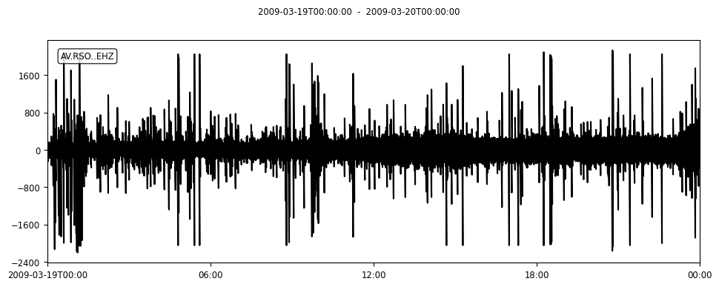



Seismic data processing workflow
Raw waveform
OBJECTIVES:
to develop automated techniques for optimizing warning times before volcanic impacts
to create a standardized model of volcano-seismic unrest, using global volcano seismic waveform data
to develop open-source tools and training programs
to contribute the outcomes to open repository WOVOdat.
Metadata (infrastructure)
DATA PREPARATION
Continuous waveform
PRECONDITIONED.mseed
Metadata (preprocessing)
Obtaining Continuous Waveform Data requiring preconditioning:
  Gaps => fixed number, interpolation, average, folding.
  Pre-filled gaps
  Sampling rate
  Overlaps
  Spikes/big numbers/calibration pulses
  Start-time and End-time not match the metadata
EARTHQUAKE DETECTION,
TREMOR CATALOG, ETC.
SEISMIC TIME SERIES
METRICS
(RSAM, SSAM, Seismic Intensity, etc.)
Detected events & time series (CSV file)
Archiving & managing the datasets:
  Preconditioned (waveform) data
  Metadata
  Processed data: detected events & features, RSAM, SSAM, RMS, Seismic intensity ratios, etc.
  Eruption/unrest phases
Metadata (processing)
FEATURES EXTRACTION
FEATURES EXTRACTION
Features (CSV file)
Metadata (processing)

