Slide 1


Overview of CVGHM Volcano Monitoring Sytem and Data Management
Workshop on “Automatization and Standardization of Volcano Seismic Data Processing Workflows” 17 – 21 November 2025
Earth Observatory of Singapore
Nanyang Technological University (NTU)
Ahmad Basuki, Sulistiyani, Gentur Santoso,
Devi K. Syahbana

Slide 2
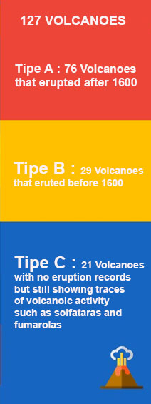
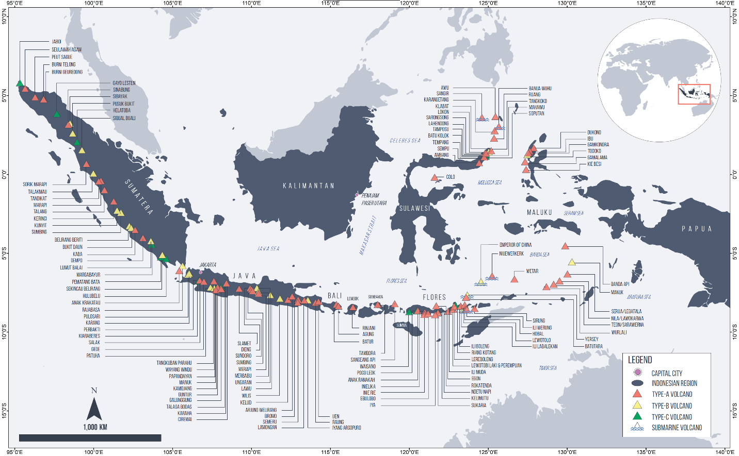
1
VOLCANOES IN INDONESIA

Slide 3
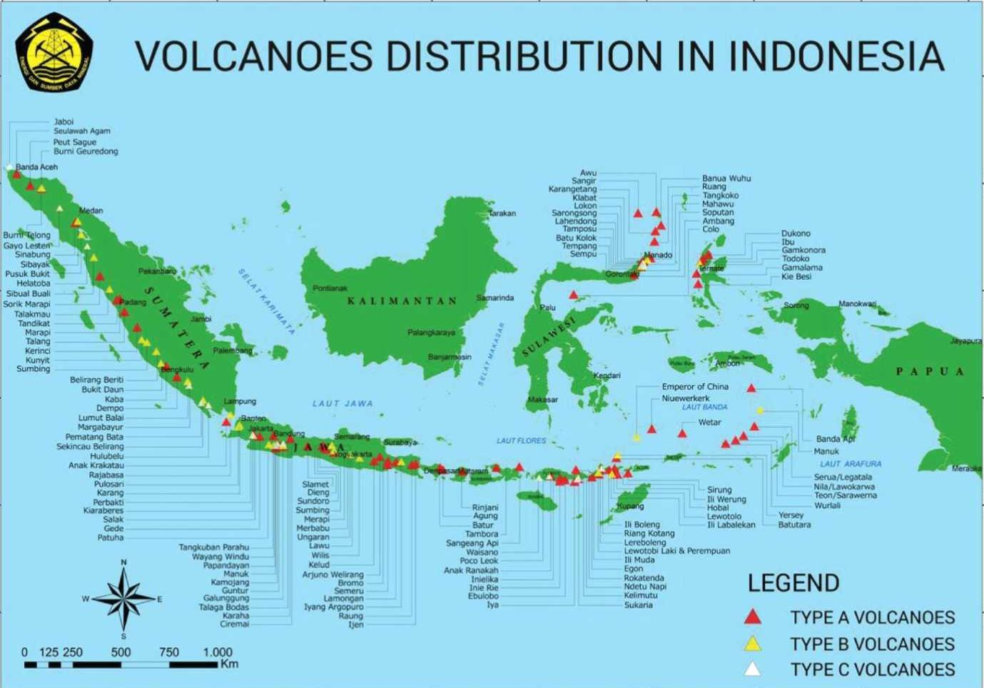
7 Volcanoes of Type A still not monitored
Sangir
Banua Wuhu
Sangir (Sub Marine) last eruption 1922
Banua Wuhu (submarine) last eruption 1919
Teon (655 m a.s.l) last eruption 1904
Nila (781 masl) last eruption 1976
Serua (641 m.asl) last eruption 1921
Wetar (282 m.asl) last eruption1699
Nieuwerkerk (Sub Marine -2285 m) last eruption 1926
Nieuwerkerk
Wetar
Serua
Nila
Teon

Slide 4
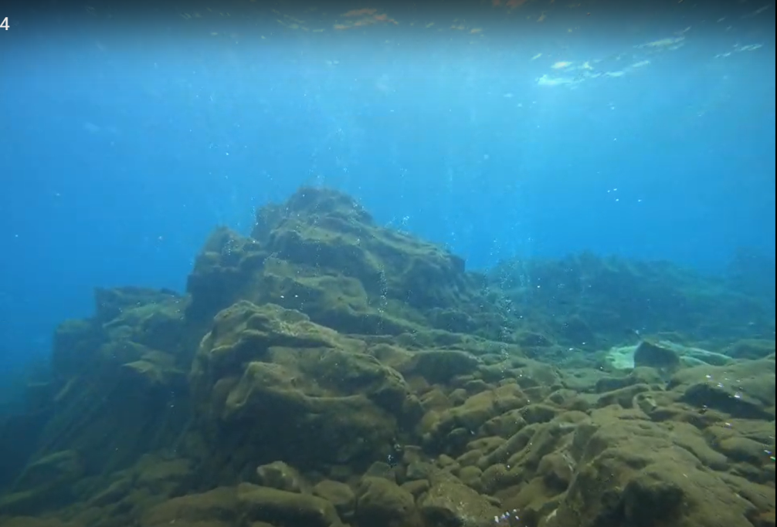
Sumber : Devy K. Syahbana, 2022

Slide 5
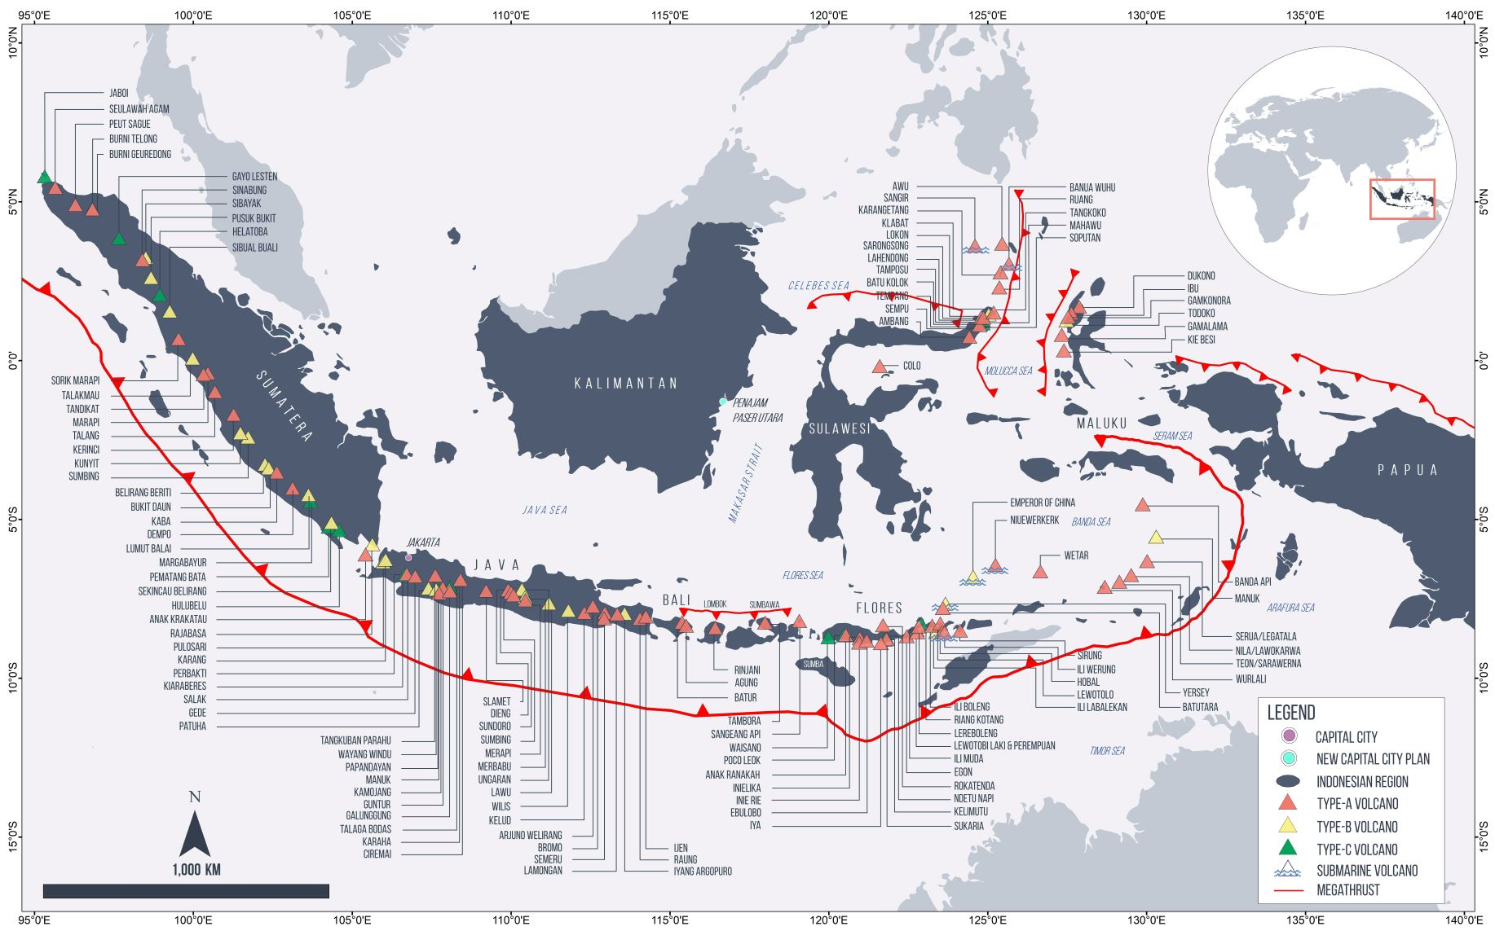
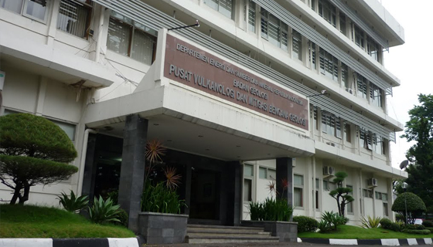
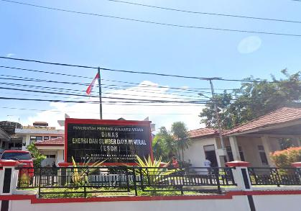
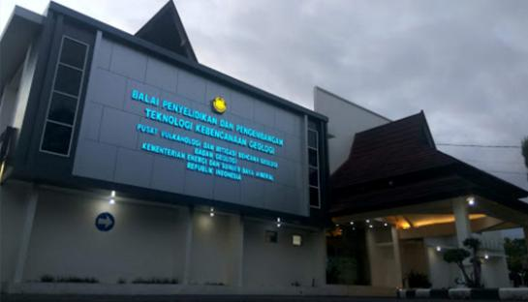
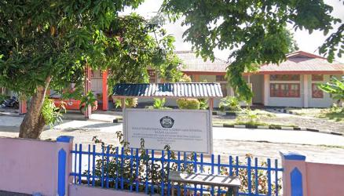
CENTER FOR VOLCANO
MONITORING IN
SULAWESI
CVGHM in Bandung
CENTER FOR VOLCANO
MONITORING IN
NUSA TENGGARA
BPPTKG JOGJAKARTA

Slide 6
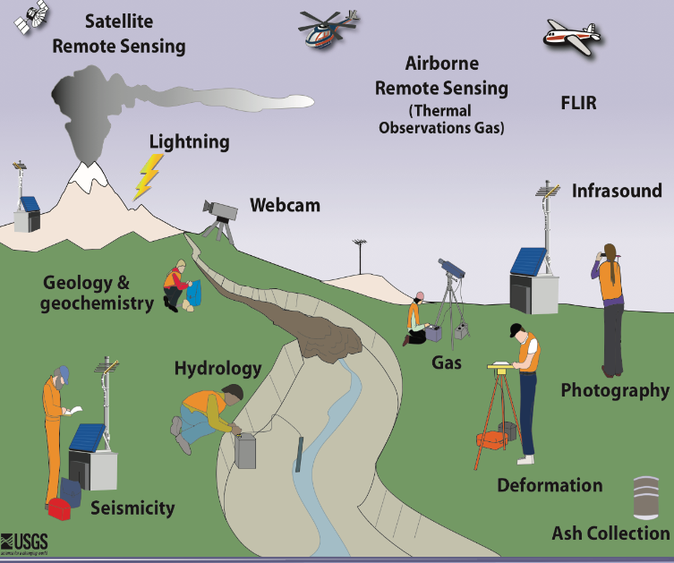
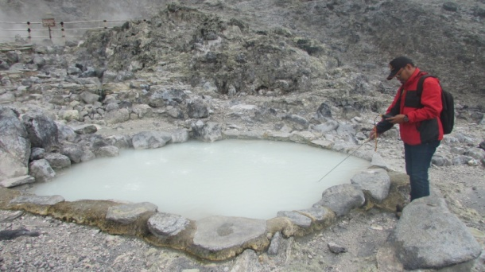
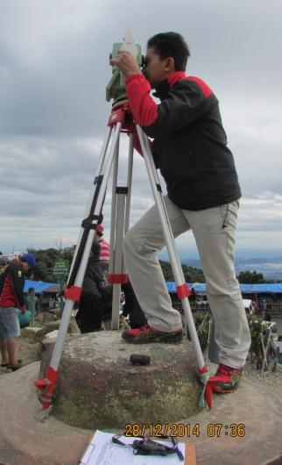
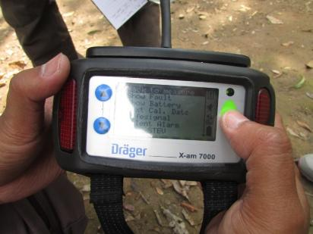
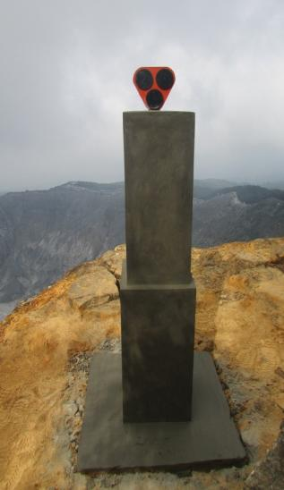
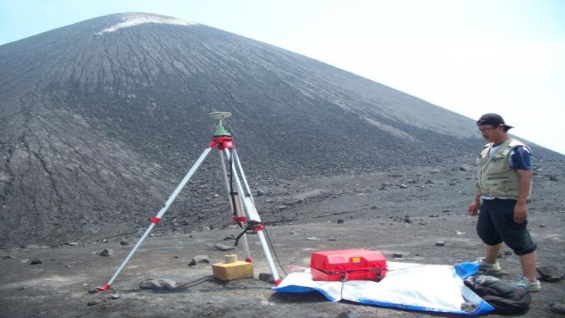
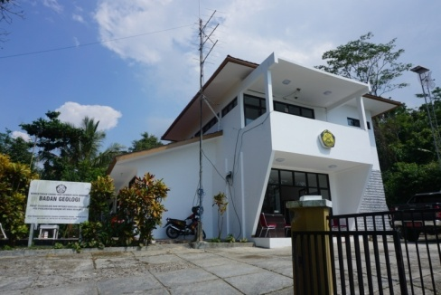
Besides Merapi
127 Volcanoes
Monitored
Volcanoes
Observatories
209 Observers
256 Seismic
103 GPS
6 DOAS
68 Monitoring
Camera
Rain Gauge
Tiltmeter
10 Infrasound
CTD
10 Multigas
10 EDM

Slide 7
Field activity program for volcano monitoring
Quick Response Team : 4 people (Scientist and Observer) went to the volcano that was erupting
Early Warning Team : 4 people went to the volcano which experienced increased activity or an increase in alert level to level II.
Monitoring Team : 4 people went to the volcano which was at level I (normal)
Seismic Investigation, Deformation investigation, Geochemistry Investigation Team
Geological mapping team :geologists go into the field to produce geological maps
Hazard mapping team :geologists go into the field to produce hazard maps or update maps
Drone Interferometry Team : the team tasked with producing the latest DEM using drones for modelling
Annual information dissemination : carried out by volcano observers to schools around the volcano

Slide 8
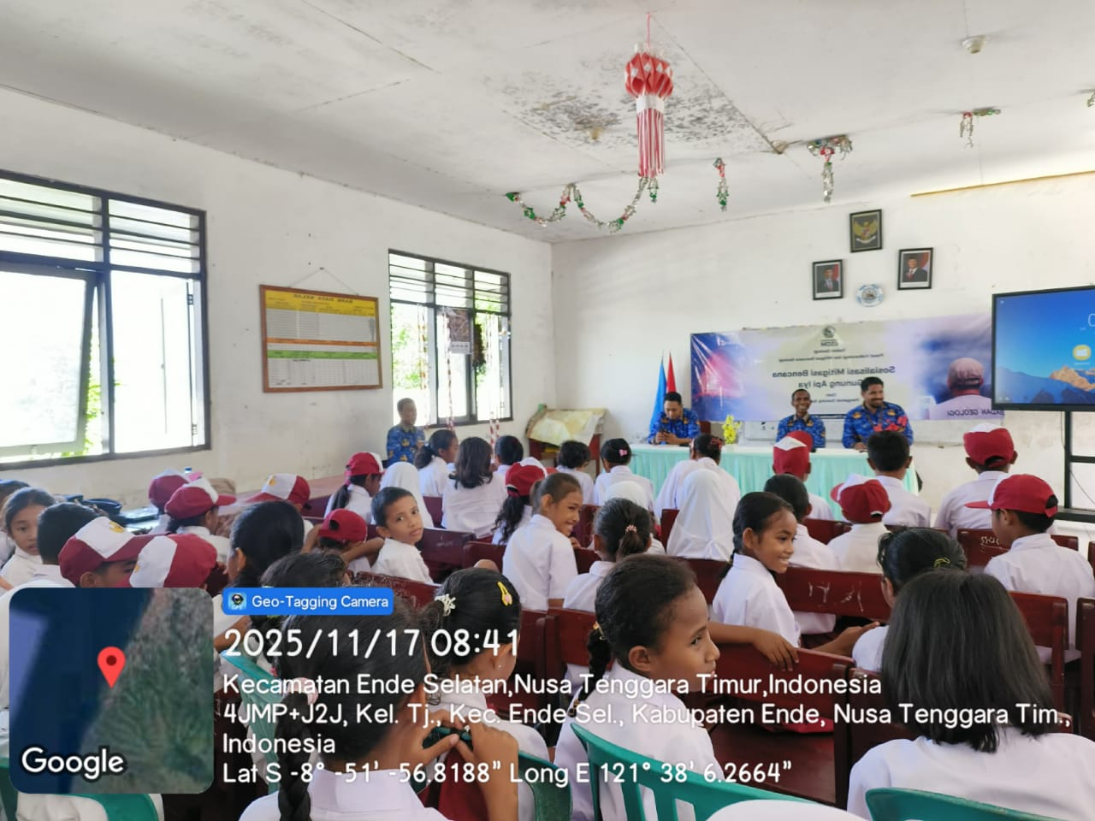
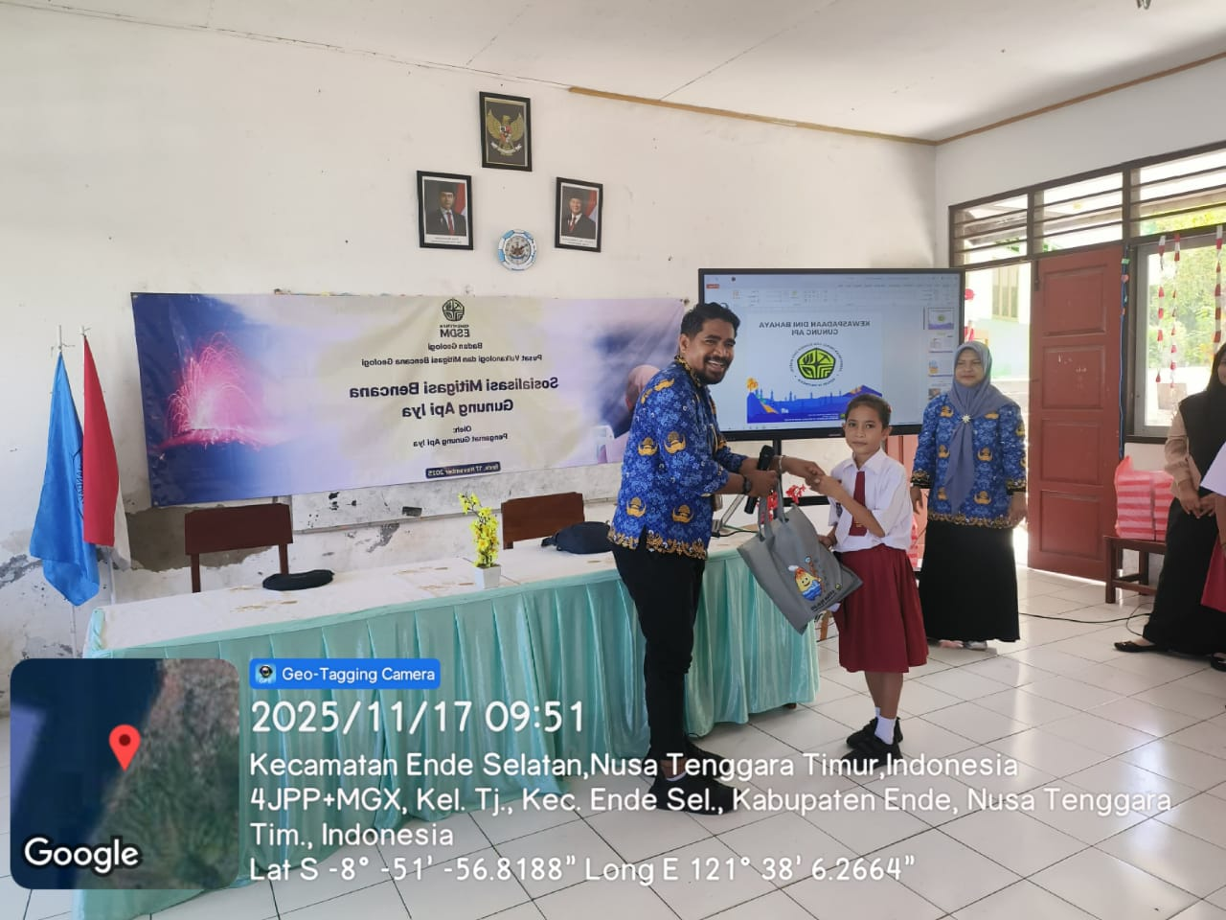
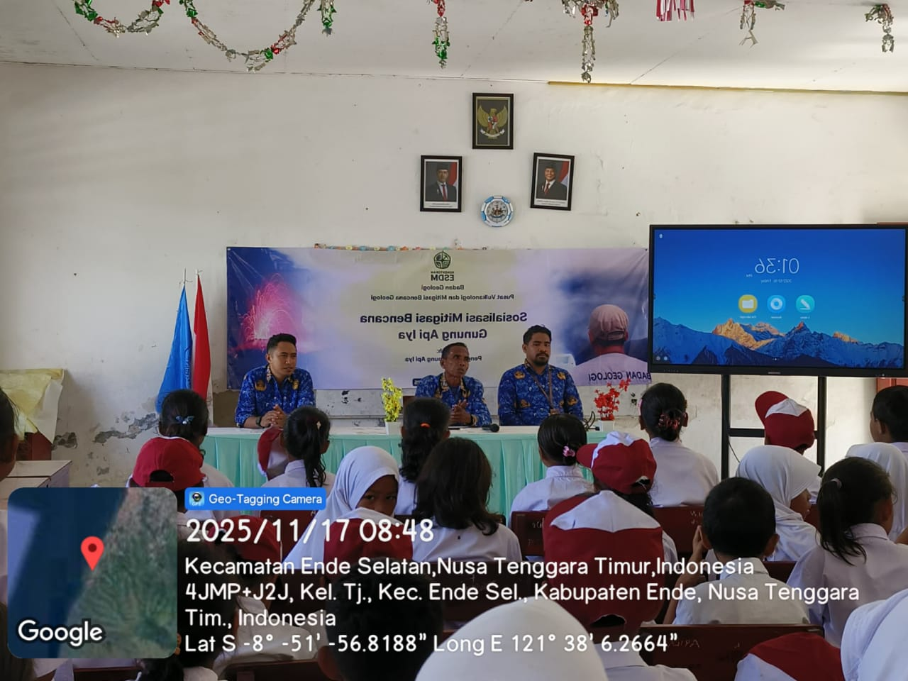
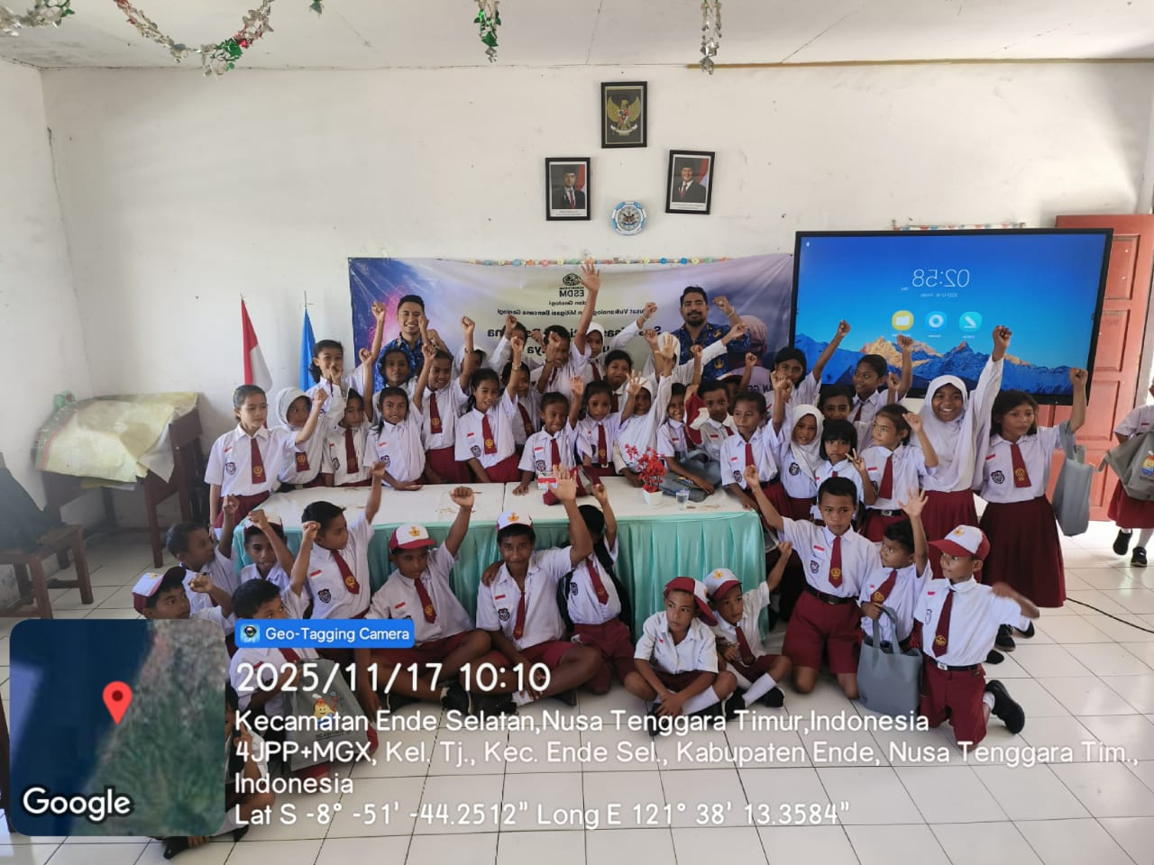
Outreach at Iya Volcano November 17, 2025

Slide 9
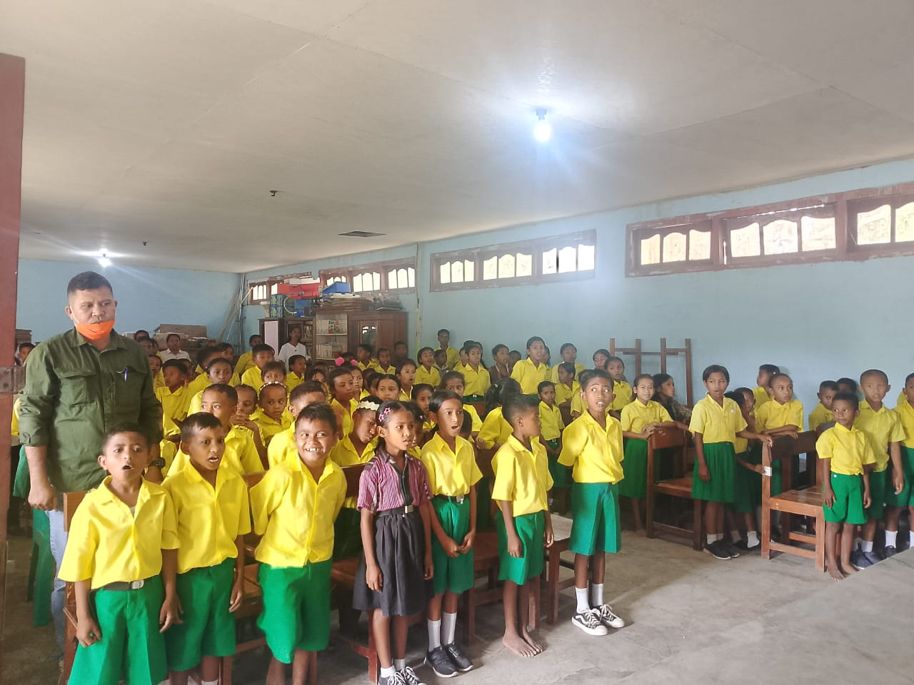
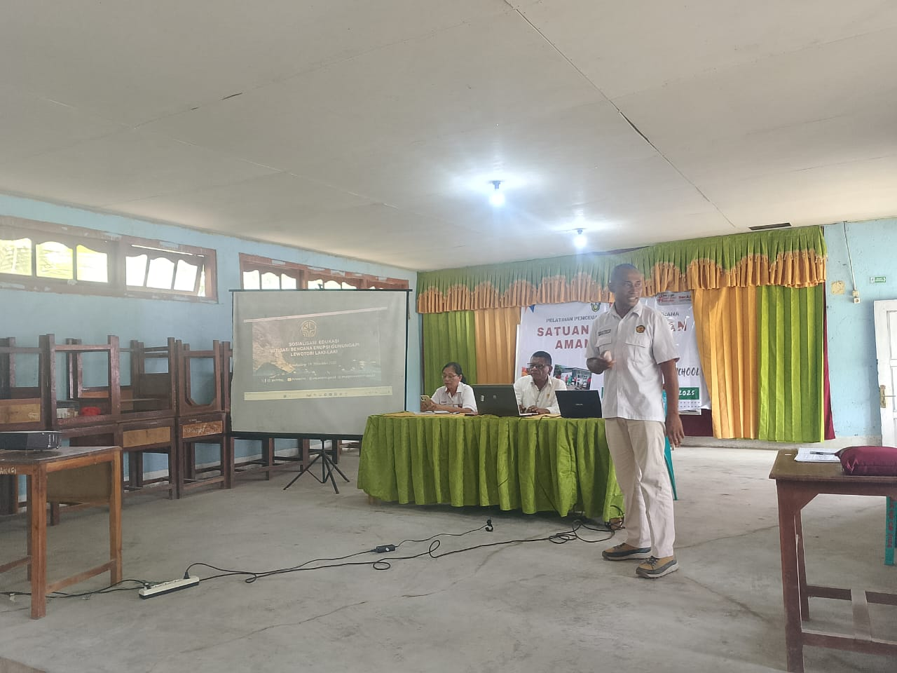
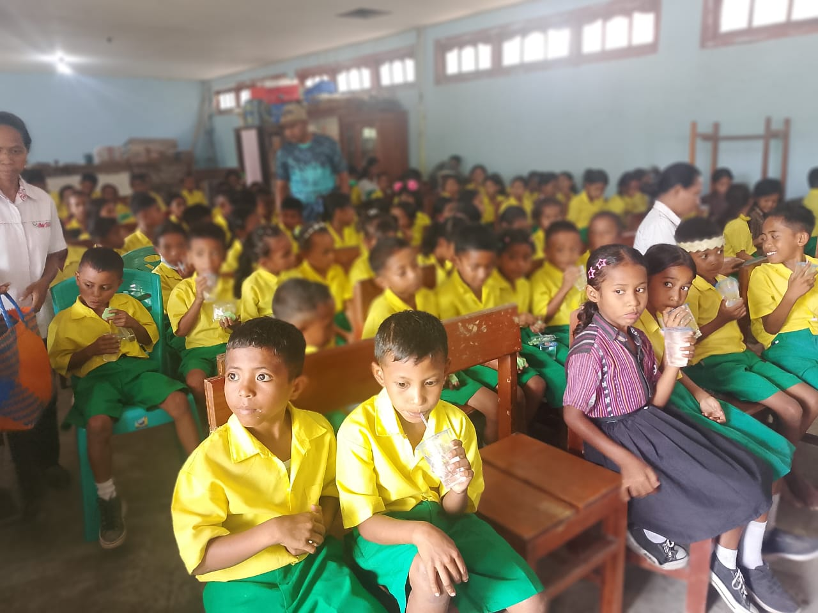
Outreach at Lewotobi Volcano

Slide 12
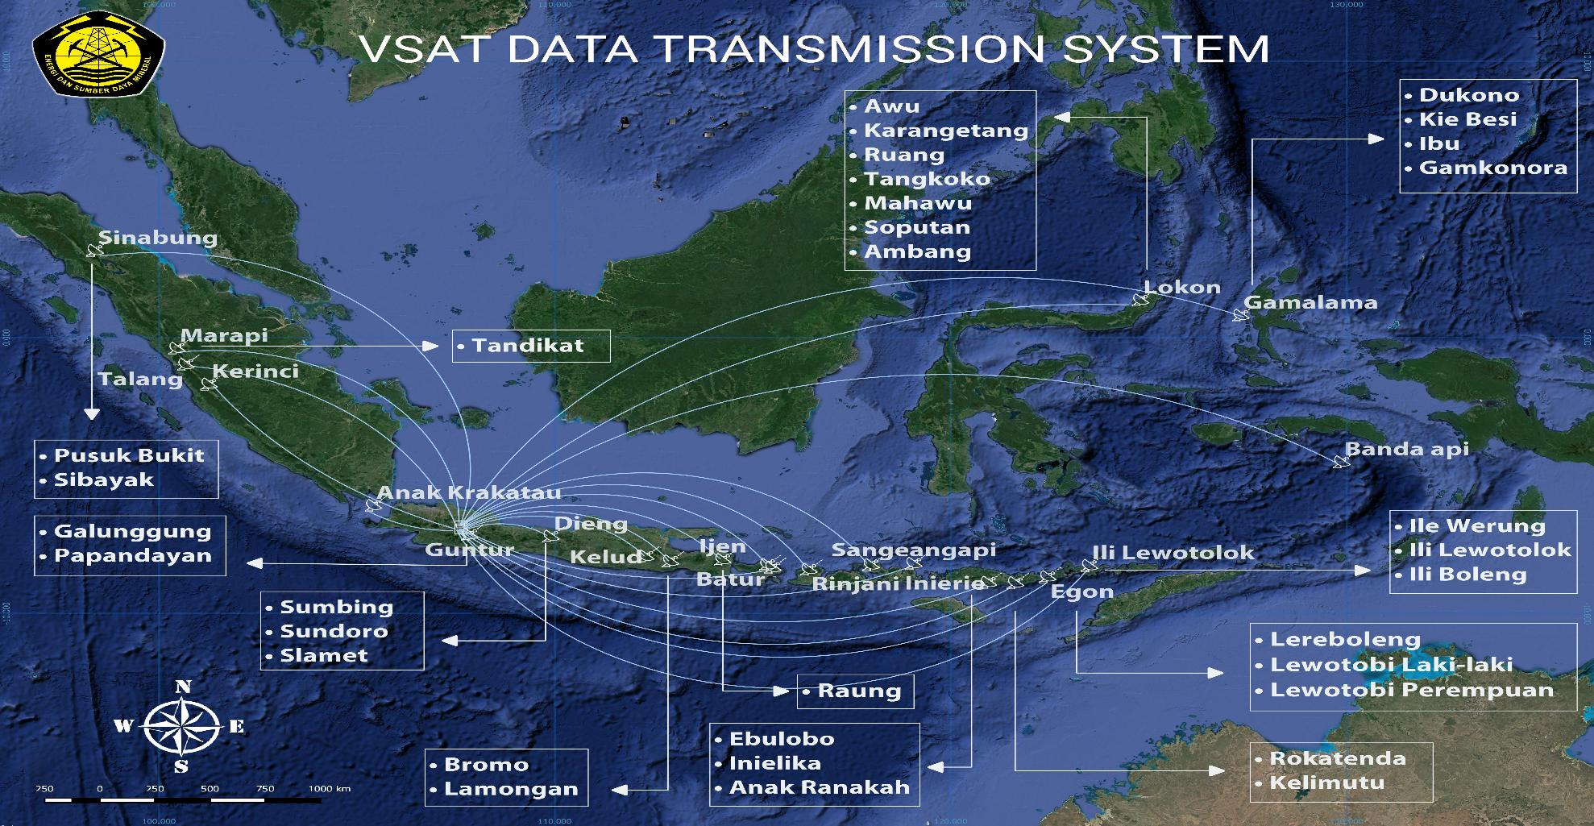

Slide 14
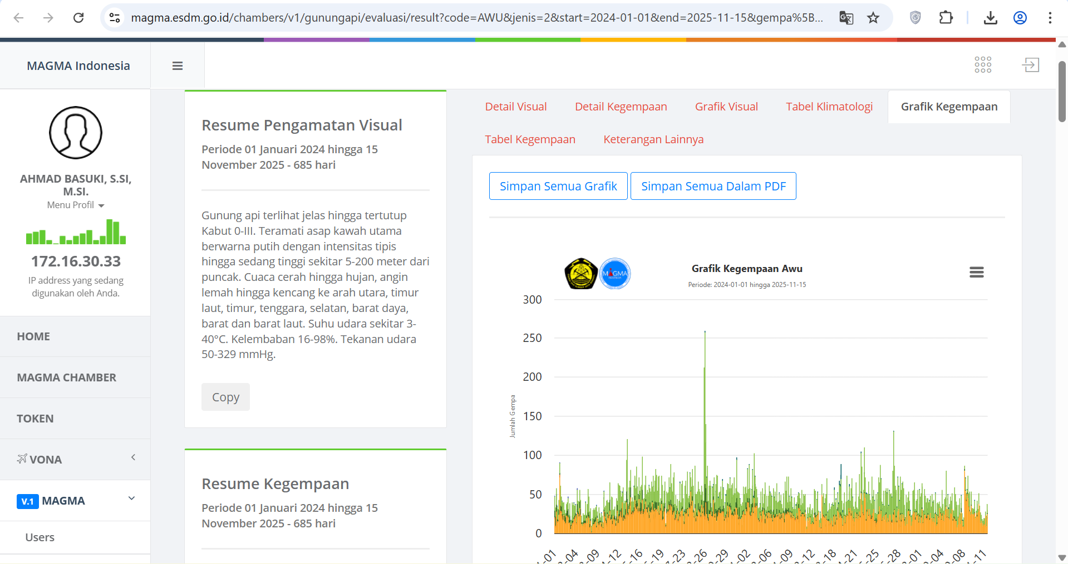
DAILY DATA EVALUATION

Slide 15
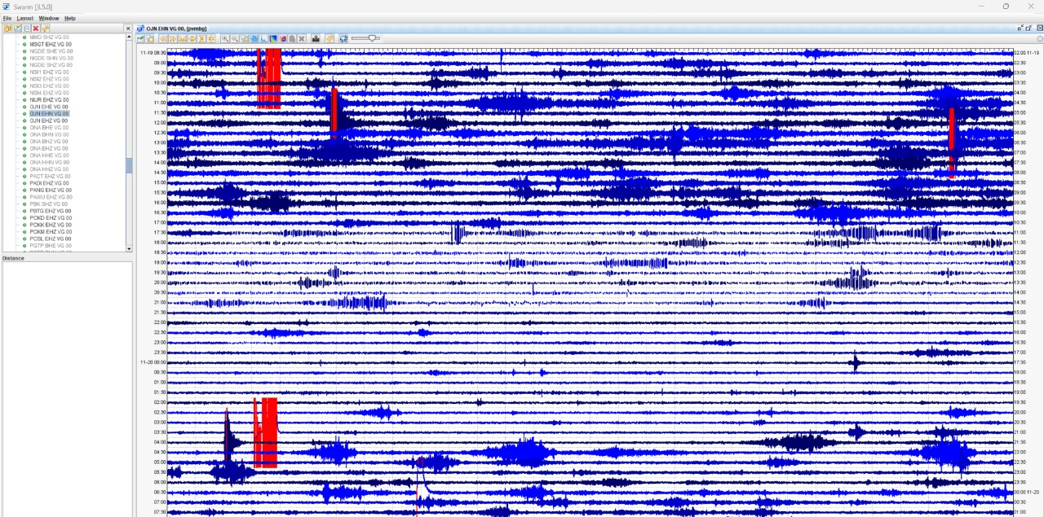
DAILY EARTHQUAKE EVALUATION

Slide 16
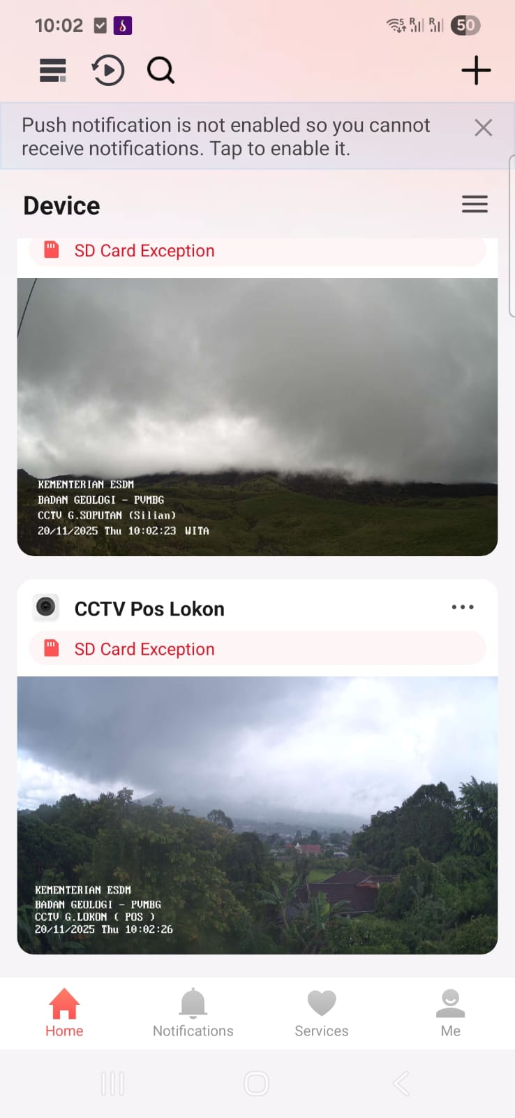
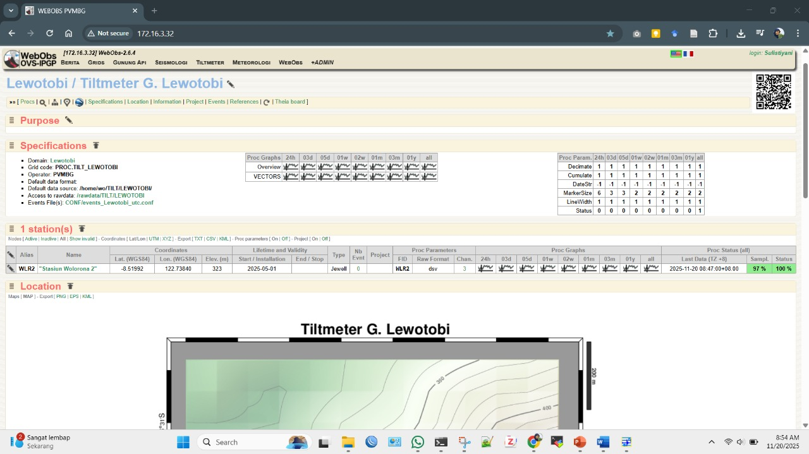
DAILY VISUAL OBSERVATION (MOBILE PHONE, MAGMA) AND DEFORMATION VIA WEBOBS

Slide 17
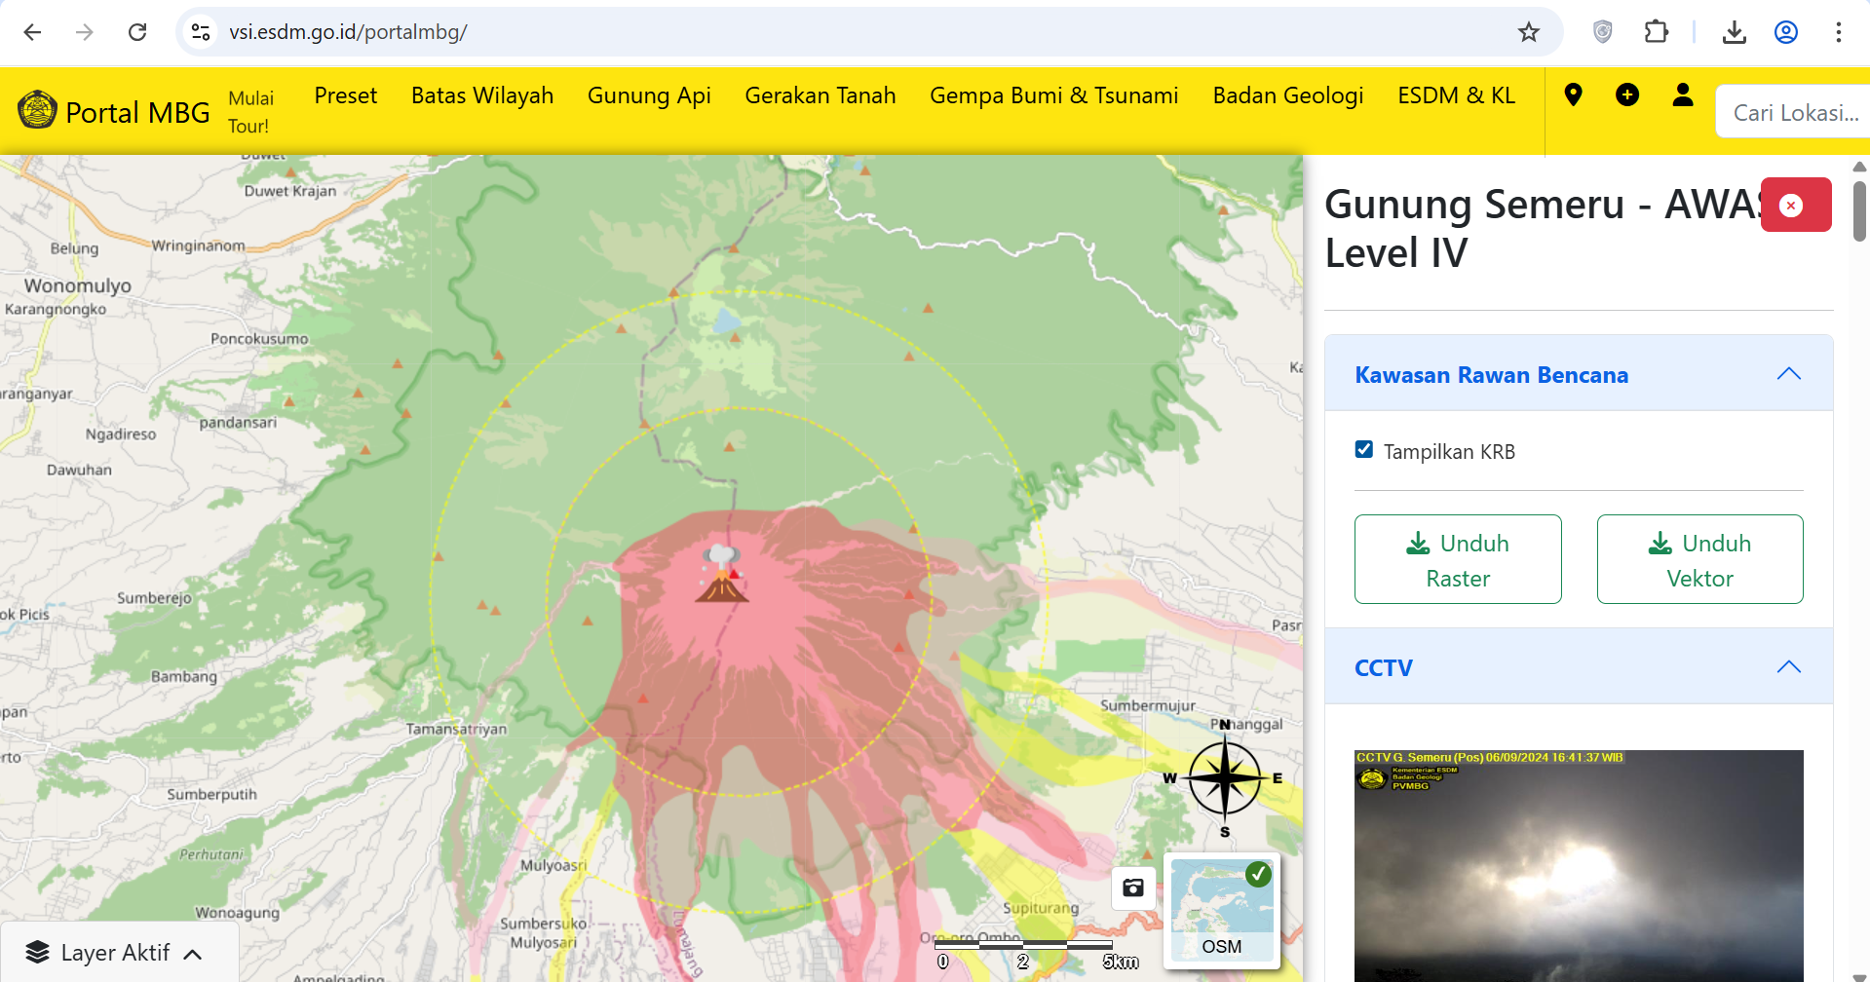

Slide 18
DATA MANAGEMENT :
Challenges Faced Today
CVGHM (Volcano Team) is a government agency at the grassroots level that must manage volcanoes throughout Indonesia. All of its resources are spent monitoring volcanic activity, Mapping Hazard Zone, Making Geological Map, Dissemination Information with little focus on data management.
Data keep in observatories
Analog data
Change to digital data
Transmitted to Center Office
in Bandung
---------------------------------2007 ----------------------------------------------- NOW

Slide 19
Problems at Monitoring Station
Problems | Recommendations/Proposed Action Plan
Complete station information is not yet available (location, sensors, acquisition systems, digitizers, gain, etc.). Very little station metadata has been created. Station naming standards . Gap between analog and digital generations among observers Difficulty converting seismic amplitudes between analog and digital. Amplitudes reports still using mm Data Format | Create a complete and detailed station information list. Create station metadata based on the station information list. Currently, only a few metadata files are available. Begin teaching/introducing seismic/digital seismometers to observers. Once station metadata is available, convert the amplitude

Slide 20
Transmission Problems
Problems | Recommendations/Proposed Action Plan
How do you maintain data storage continuity at both the post office and the PVMBG? Do you need backup transmissions other than VSAT? | Issue a memorandum for observers to check the data and data sending modules daily (?). Appoint a PIC to monitor the data daily. Several observatory already have an Fiber Optic network. This needs to be maximized to assist in sending data to the PVMBG. Is it possible to use VSAT as the backbone, with FO as the secondary link?

Slide 21
Problems in Data Storage and Display
Problems | Recommendations/Proposed Action Plan
How do you maintain data storage continuity at both the post office and the PVMBG? Do you need backup transmissions other than VSAT? | Issue a memorandum for observers to check the data and data sending modules daily (?). Appoint a PIC to monitor the data daily. Several observatory already have an Fiber Optic network. This needs to be maximized to assist in sending data to the PVMBG. Is it possible to use VSAT as the backbone, with FO as the secondary link?

Slide 22
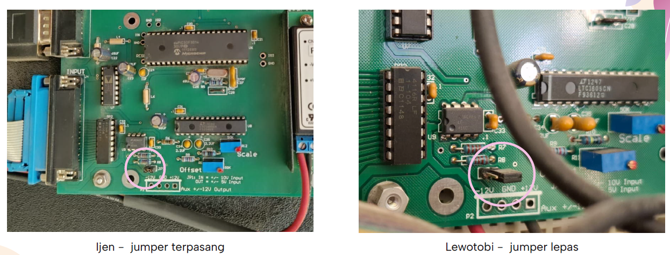
Some of the input jumpers on the PSN are installed and some are removed
Not to mention the combination of using a 16-bit PSN ADC and a 24-bit NSI ADC.

Slide 23
Create seismic station metadata
Create station metadata for both short period analog and digital stations.
Please visit: https://smp.gempa.de/

Slide 25
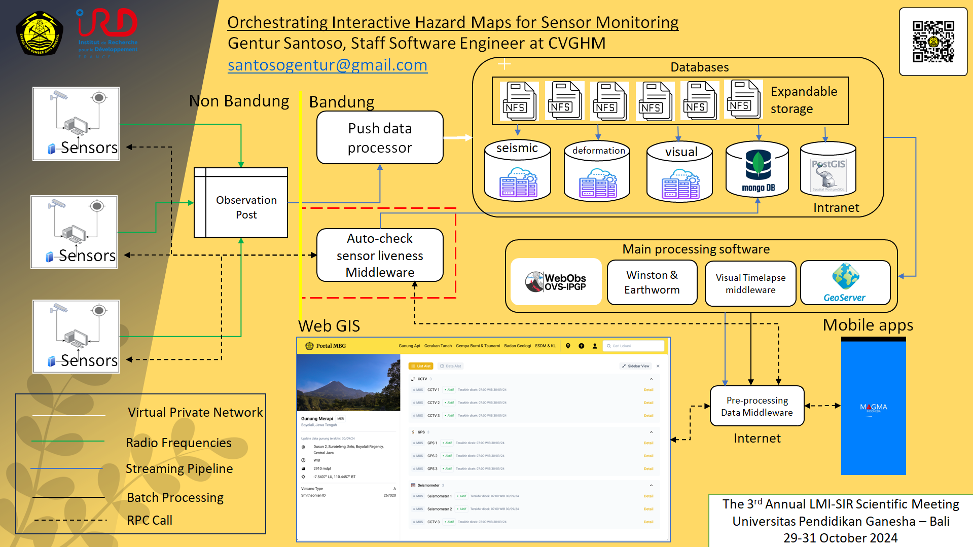

Slide 26
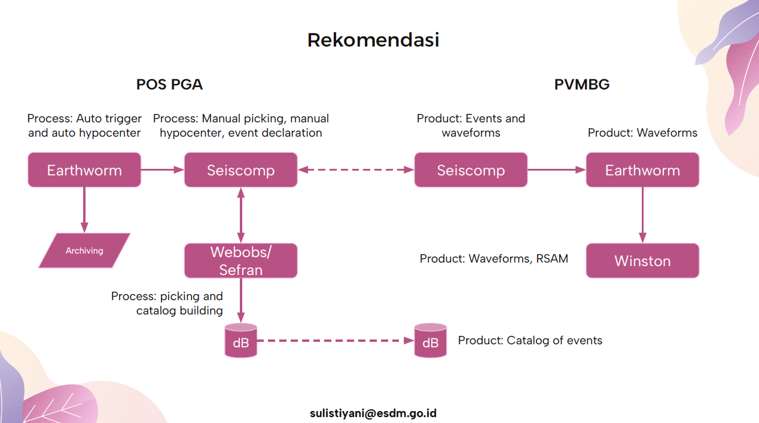
Future Plan
Observatory
CVGHM

Slide 27
SUMMARY
Monitoring volcanic activity in Indonesia is greatly assisted by the VSAT transmission system and the presence of observatories at each volcano, but improvements still need to be made in data management.

