Slide 1
Volcano Research Promotion in Japan:
HVRP, JVDN, and V-net
Tomofumi Kozono
(National Research Institute for Earth Science and Disaster Resilience)
HVRP: Headquarters for the Volcano Research Promotion
JVDN: Japan Volcanological Data Network
V-net: Fundamental Volcano Observation Network

Slide 2
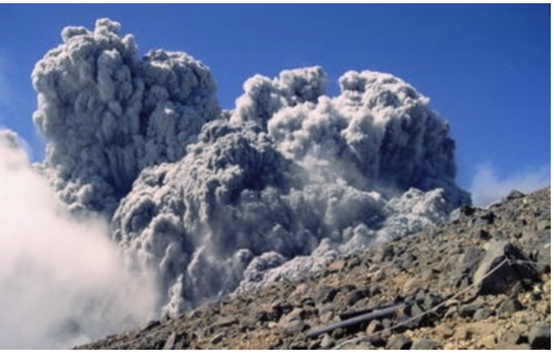
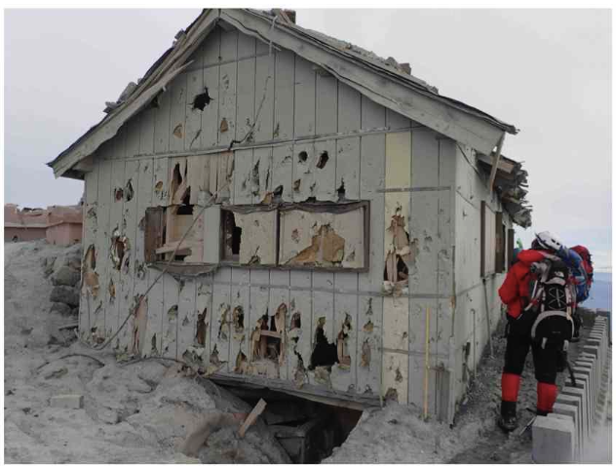
Amendment of the Act on Special Measures for
Active Volcanoes (2023)
The act was enacted in 1973, and amended in 2015 and 2023 (Impact of the Mt. Ontake eruption)
The local mayors' support for the preparation of evacuation plans
Considerations to facilitate the provision of information on climbing dates and routes
Prompt and accurate communication of information
Develop and continuously secure human resources with expert knowledge or skills in volcanic phenomena (even for local government levels)
Establishment of the Headquarters for the Volcano Research Promotion
Setting Volcano Disaster Prevention Day (26 August)
Discussion on how active volcano countermeasures should be taken

Slide 3
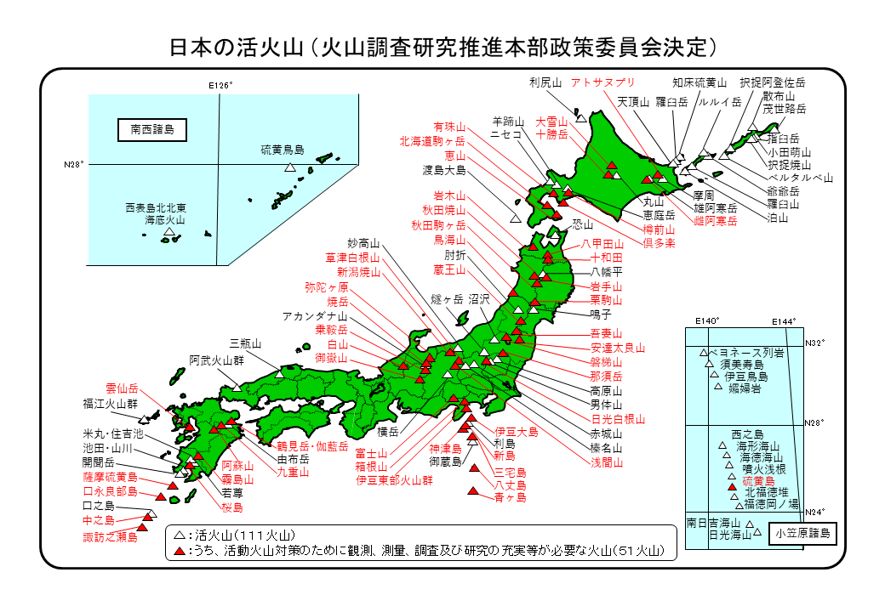
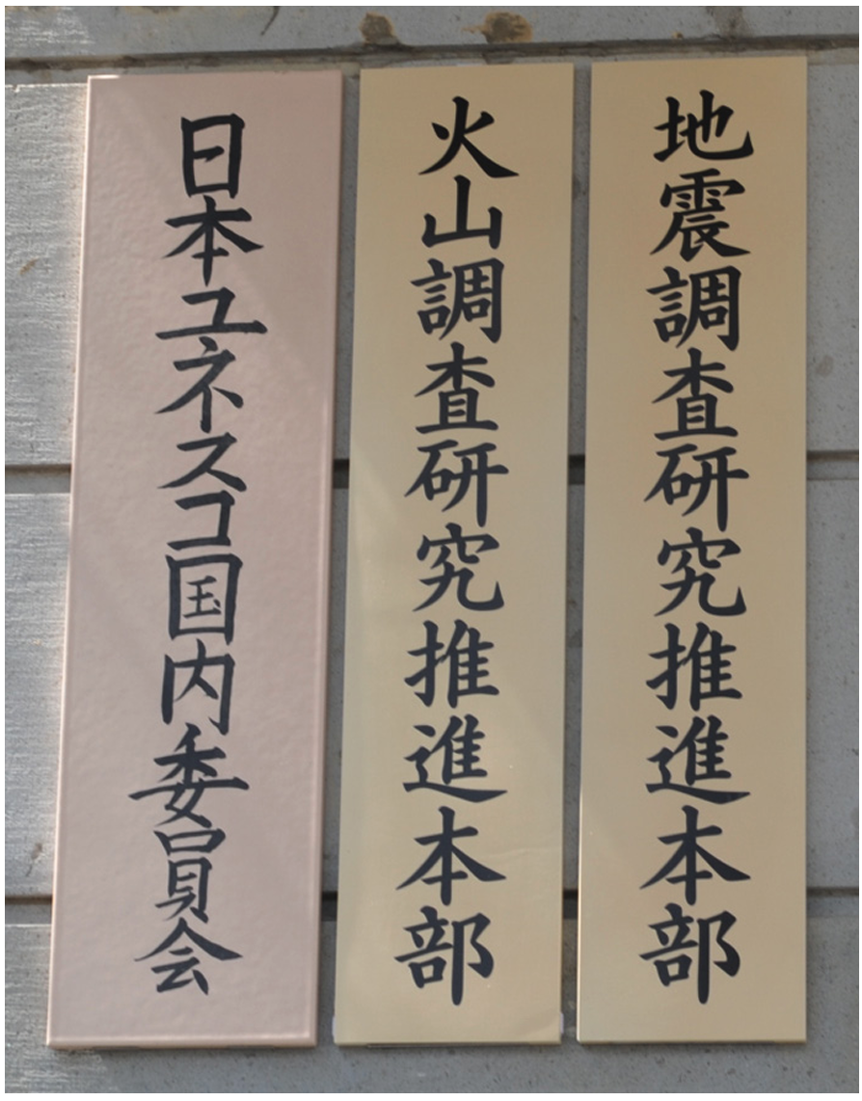
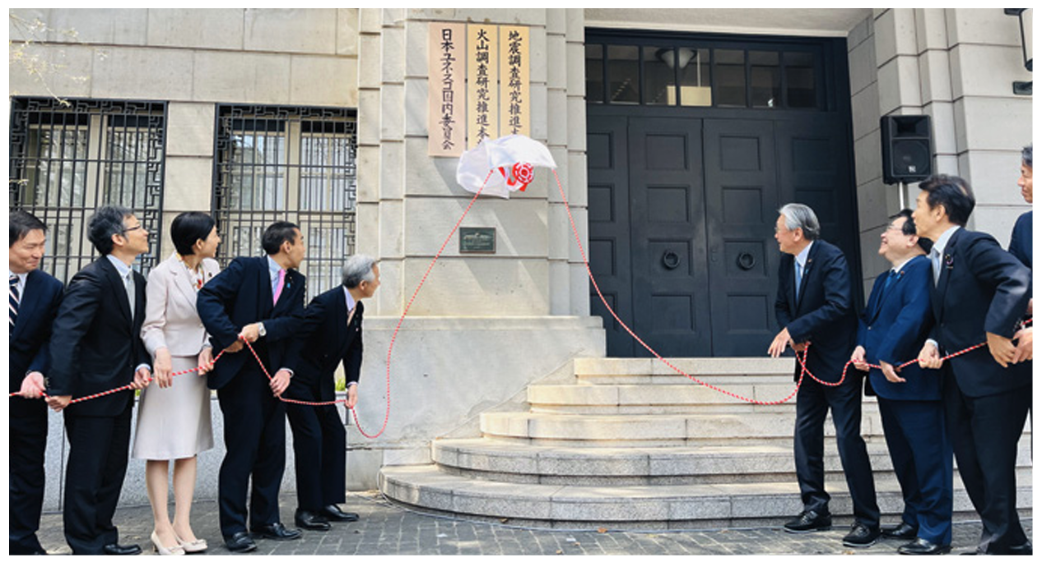
HVRP: Headquarters for the Volcano Research Promotion
Established within MEXT (the Ministry of Education, Culture, Sports, Science and Technology) on April 1, 2024
Headquarters for the Earthquake Research Promotion (30 years old)
Headquarters for the Volcano Research Promotion (one year old)
Active volcanoes (111 volcanoes)
Volcanoes requiring enhanced observation, surveying, investigation, and research (51 volcanoes)

Slide 4
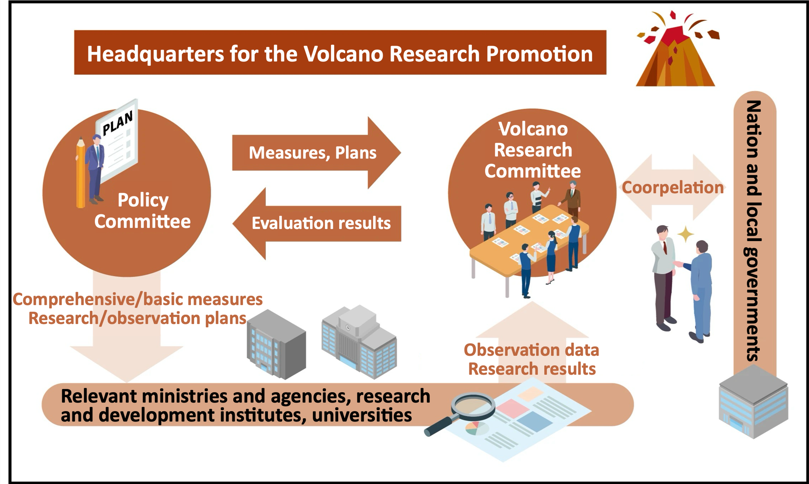
HVRP: Headquarters for the Volcano Research Promotion

Slide 5
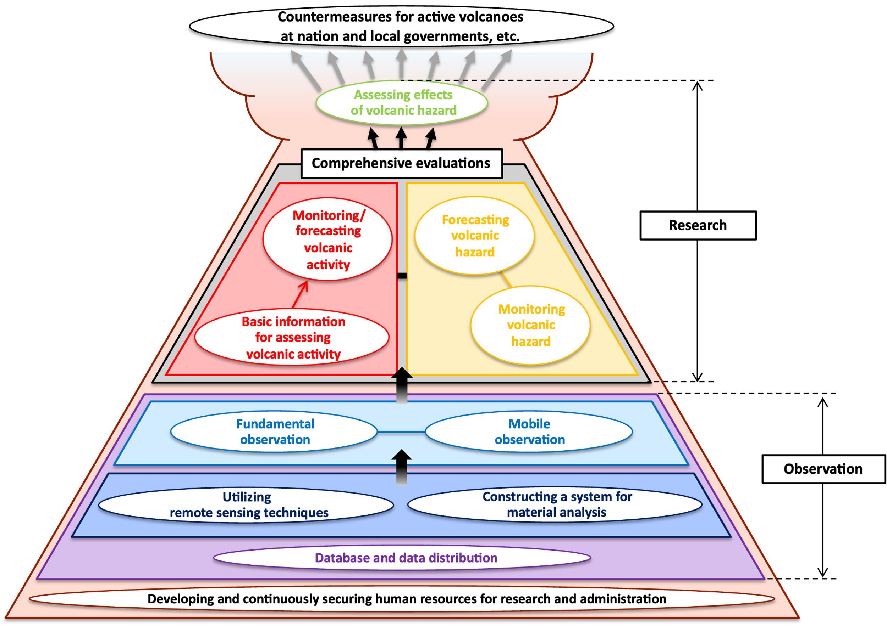
Comprehensive/basic measures for the promotion of observation and research
“Standardization of
methods for assessments of
volcanic activities and hazards”

Slide 6
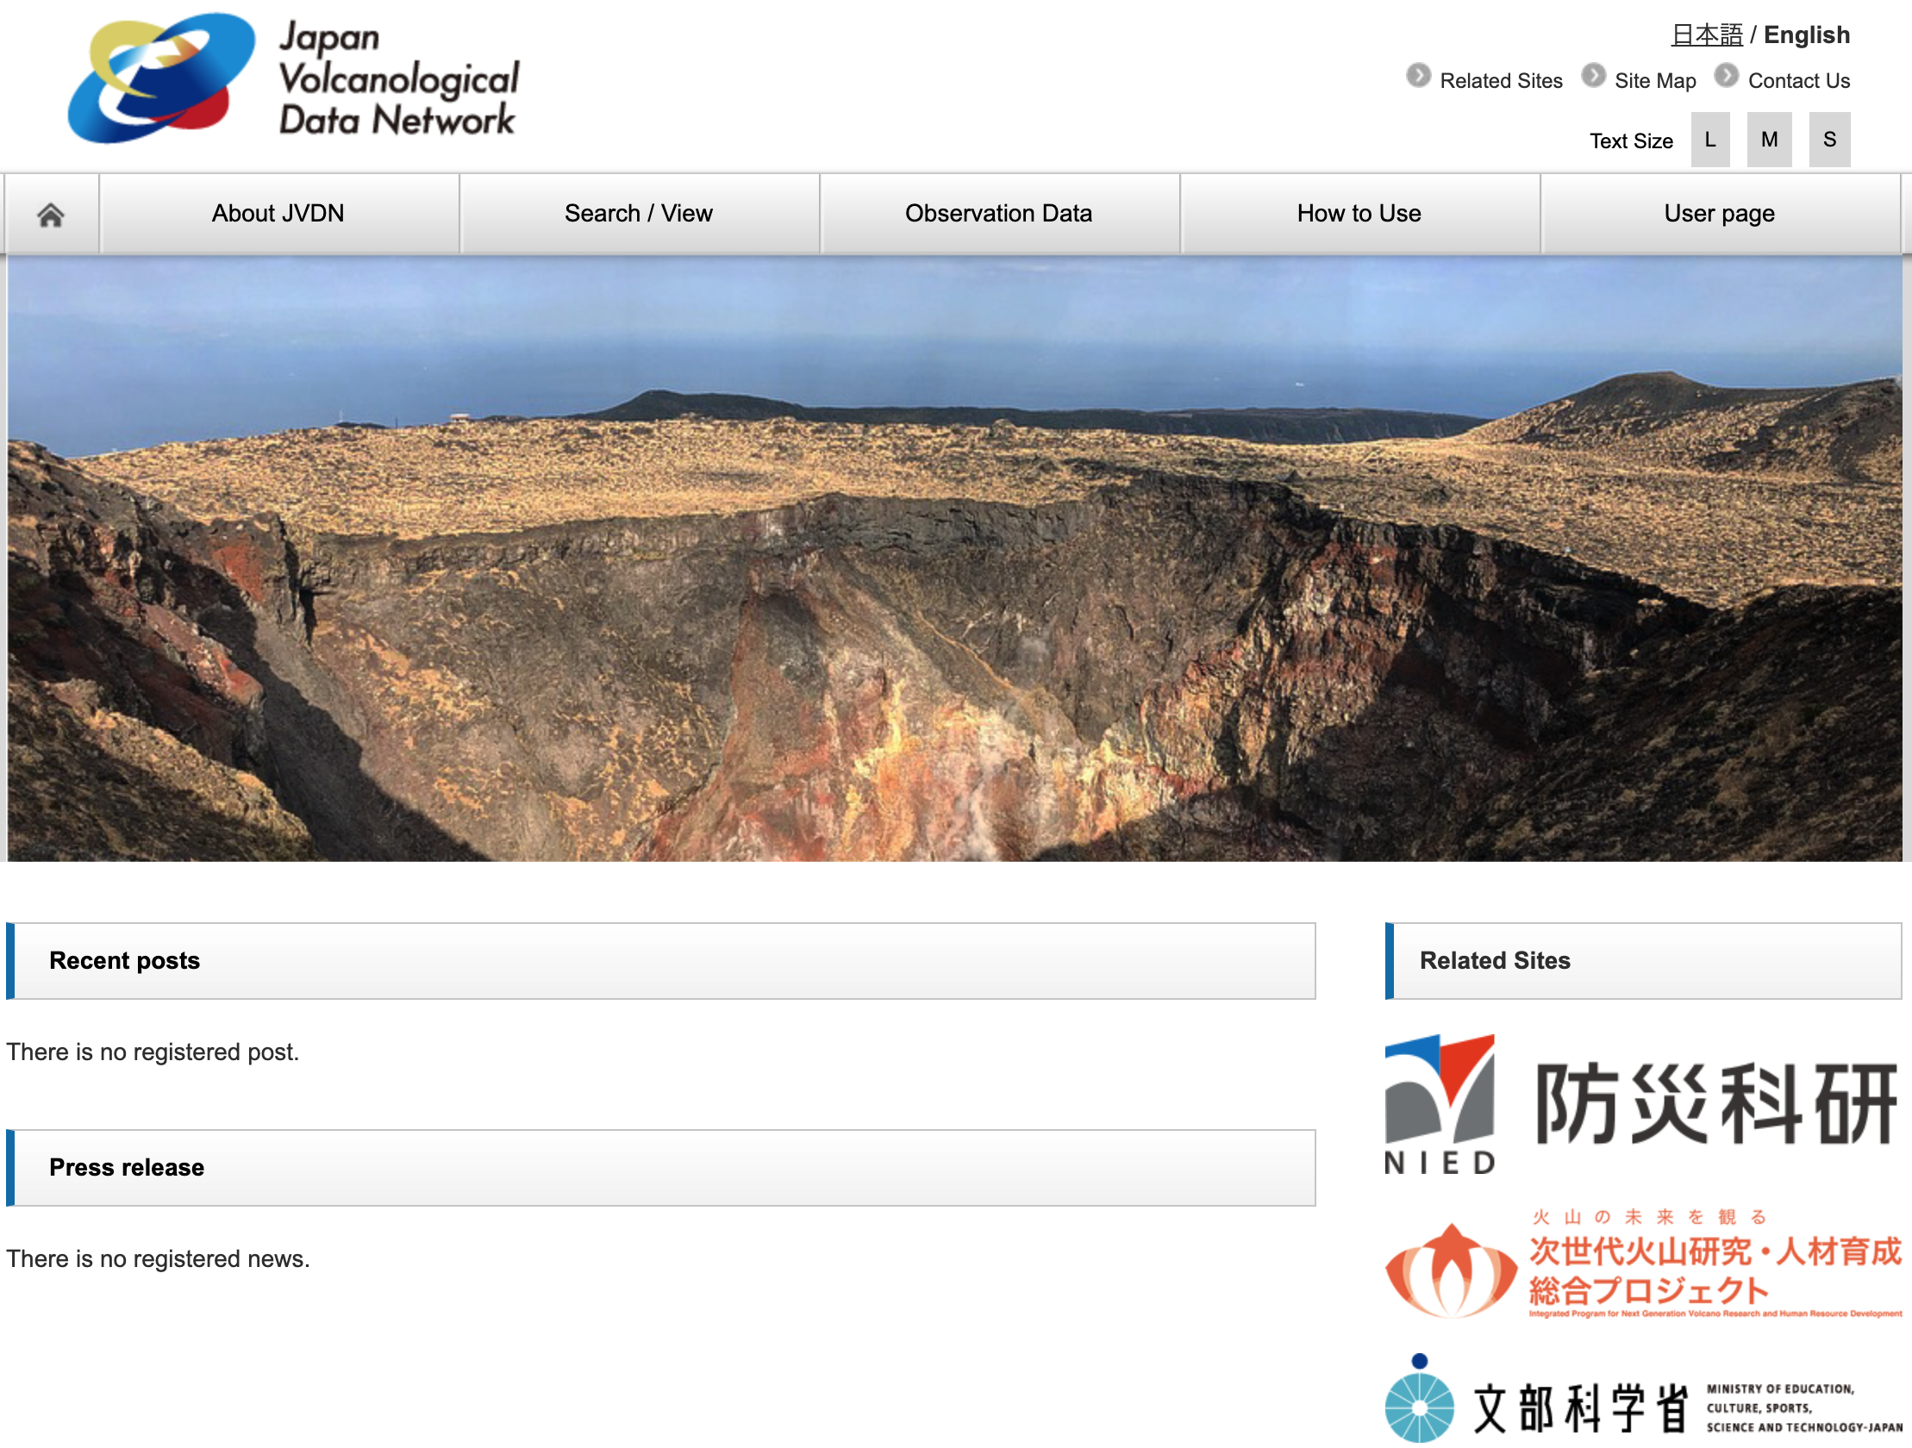
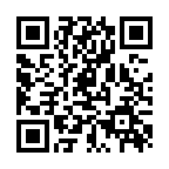

JVDN: Japan Volcanological Data Network
A system for sharing volcanic observation data online among research institutions, universities, government agencies, and other organizations within Japan
Data shared via the JVDN system
  Observation station locations and observation items
  Seismic data (short-period and broadband)
  Infrasound data (infrasound and microbarometric)
  GNSS data
  Tiltmeter data
  SAR data (slant range changes)
  Rock core data
  Tephra fall data
  Photographic data
  Remote camera data, etc.

Slide 7
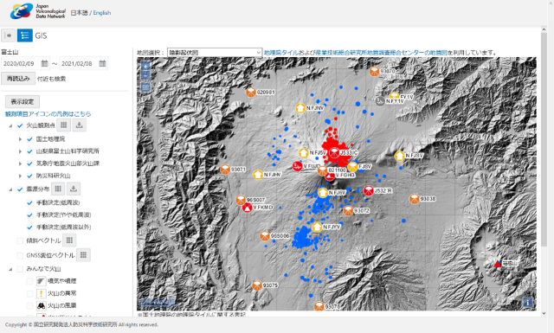
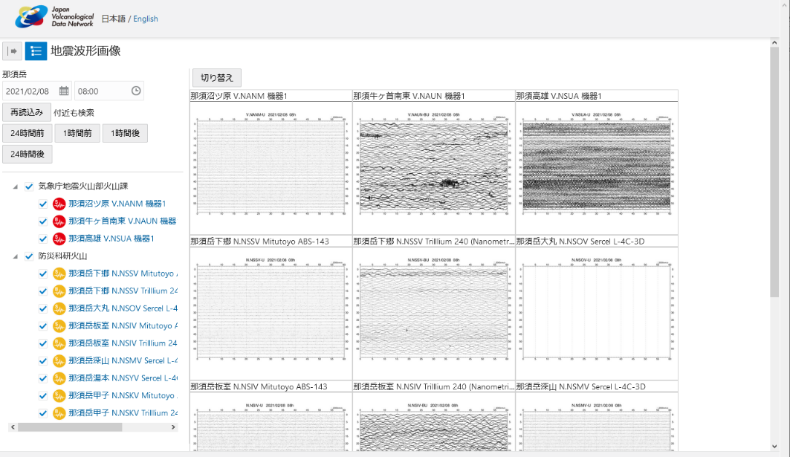
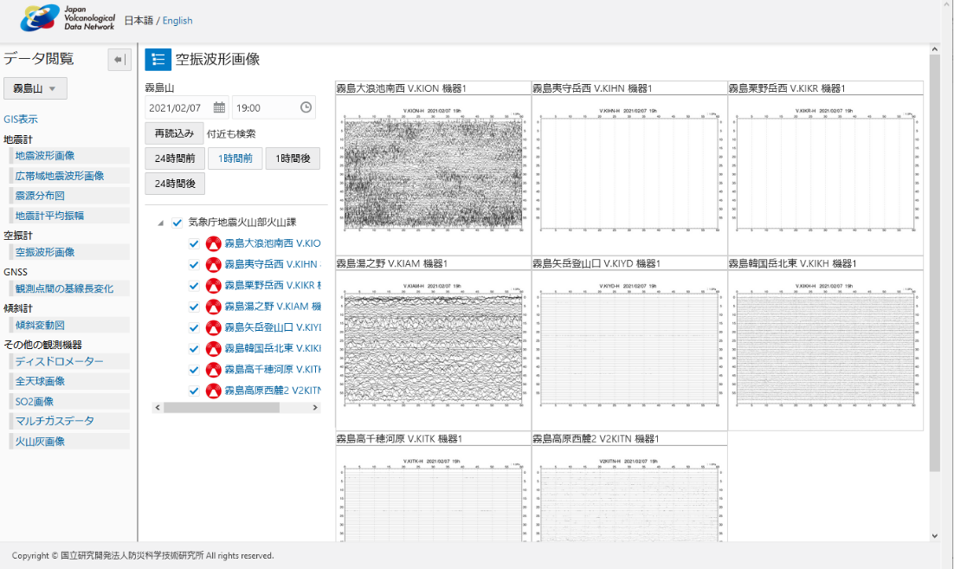
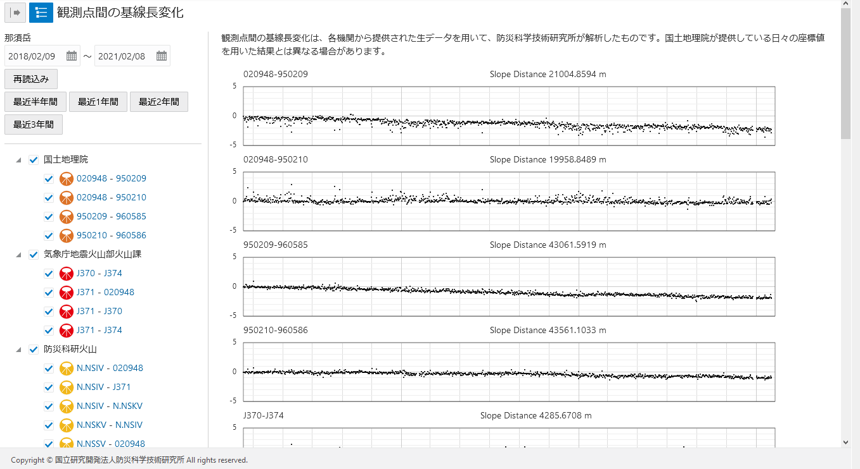
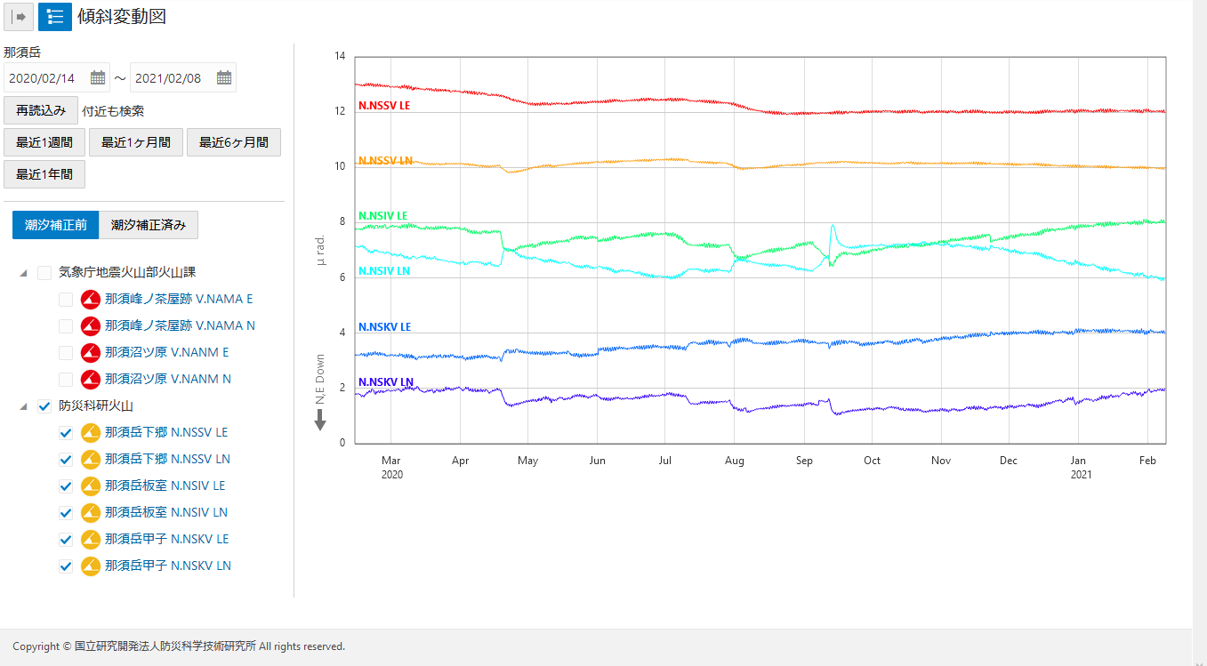
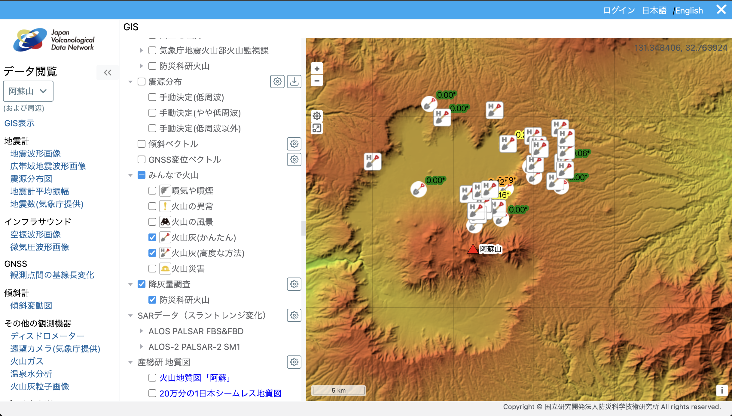
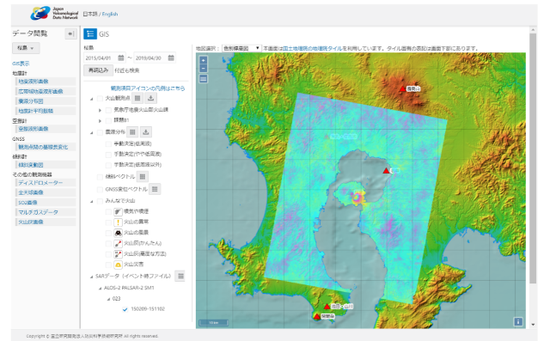
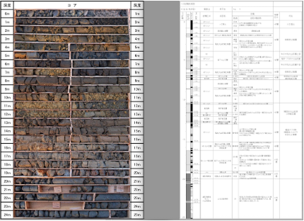
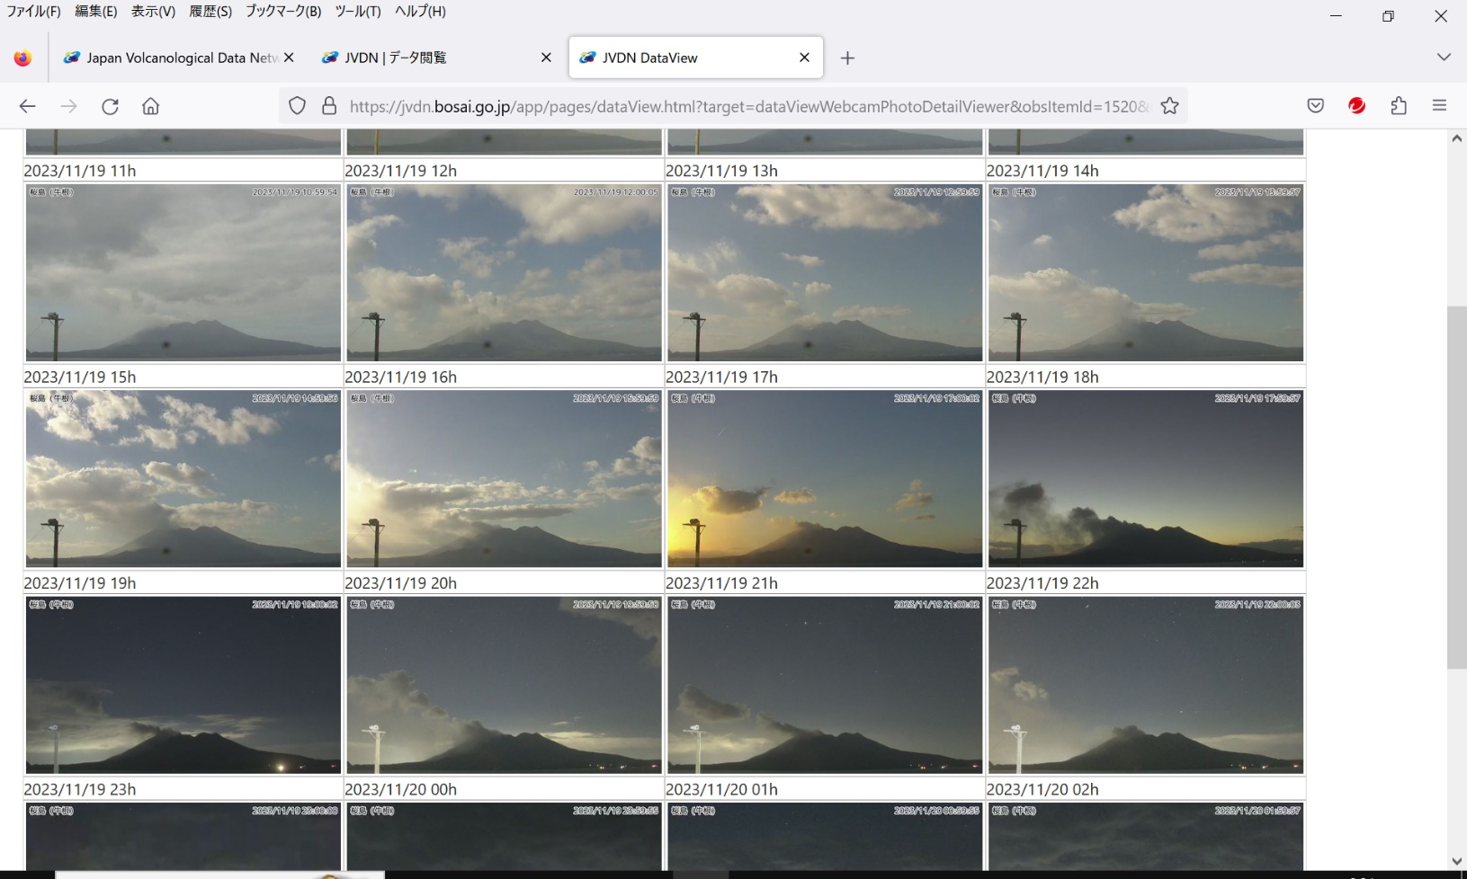
JVDN: Japan Volcanological Data Network
Observation stations, Hypocenter
Seismic data
Infrasound data
GNSS data
Tiltmeter data
Tephra fall
SAR (slant range changes)
Webcam
Rock core

Slide 8
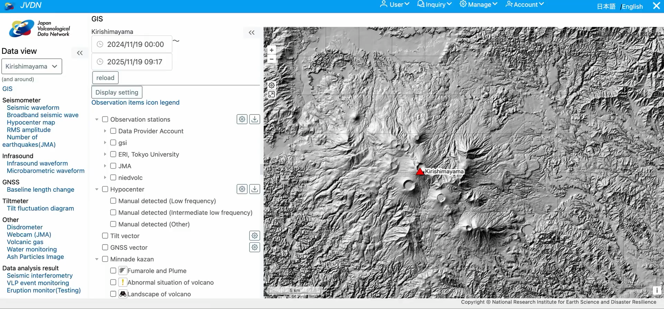
JVDN: Japan Volcanological Data Network

Slide 9
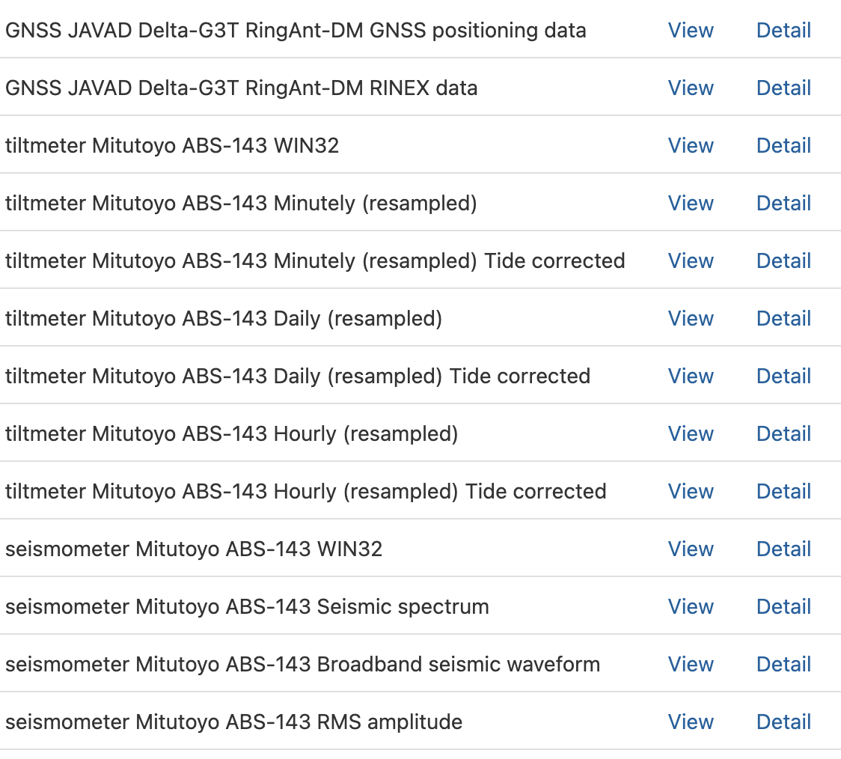
Key functions of JVDN system
GIS data visualization (overlaying multiple information)
Data download available for research purposes (user registration required)
Data sharing functionality for tephra fall surveys, etc.
Links to existing public databases
Registration and provision of arbitrary files, including analysis programs, ad hoc observation data, and supplementary files for published papers
Example of downloadable data list (NIED Kirishimayama)

Slide 10
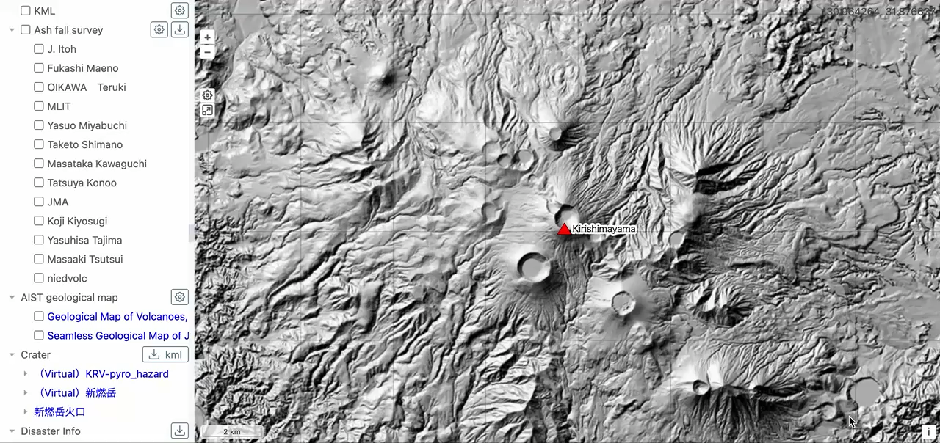
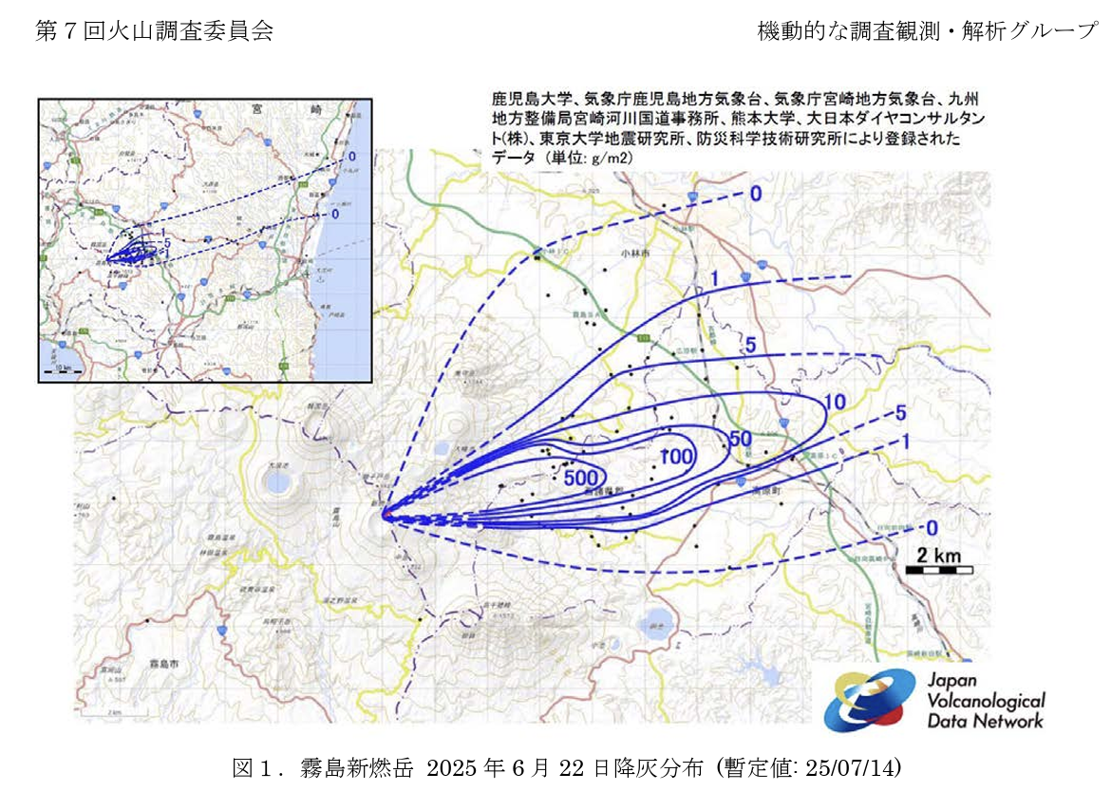
Data sharing functionality for tephra fall surveys
Register tephra fall survey data, display it on maps, and share it with relevant parties.
Data provided by research institutes, universities, private companies, JMA, MLIT, etc.
Utilized during the 2021 Aso eruption and 2025 Kirishima-Shinmoedake eruption
Report of isopach map
for Volcano Research Committee of HVRP

Slide 11
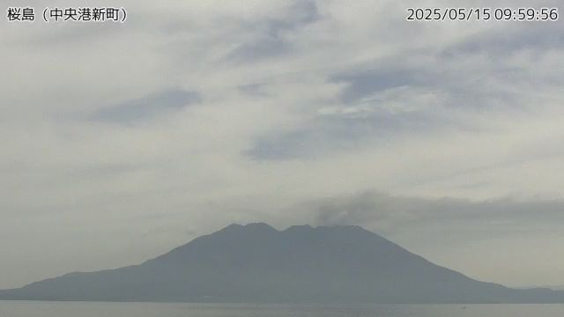
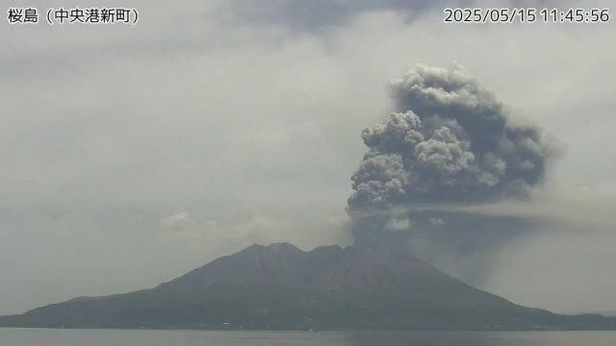
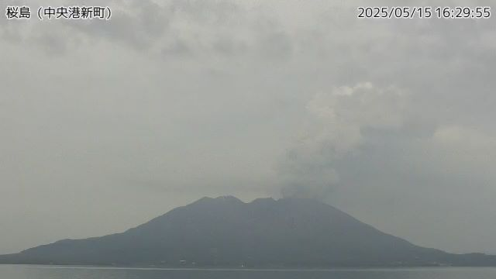
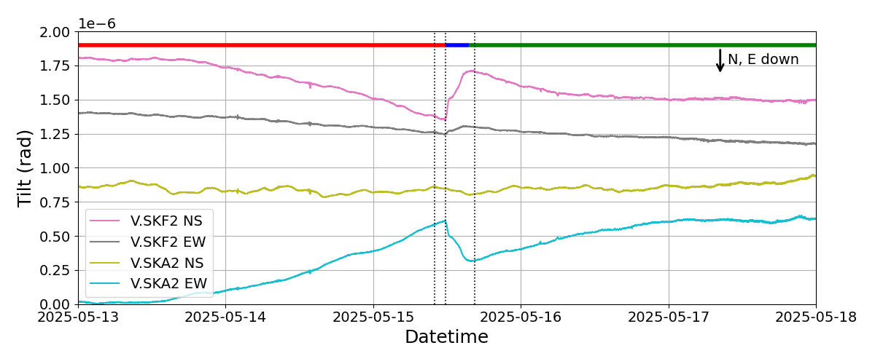
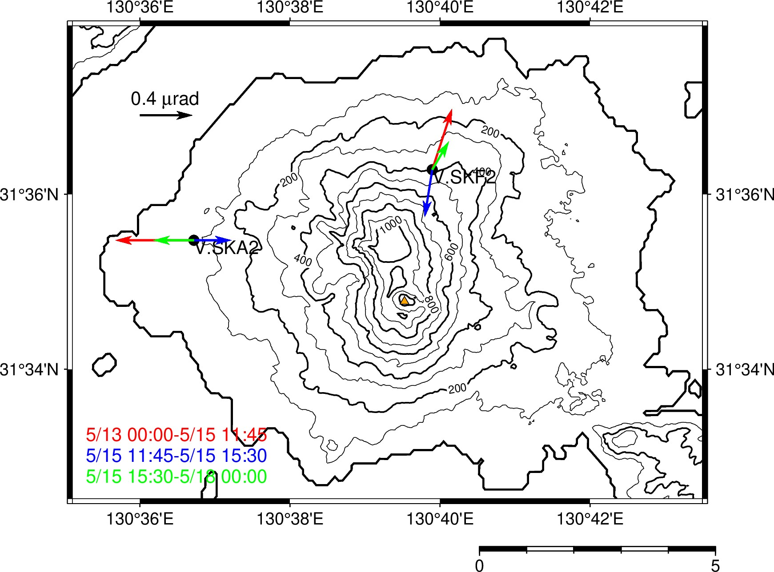
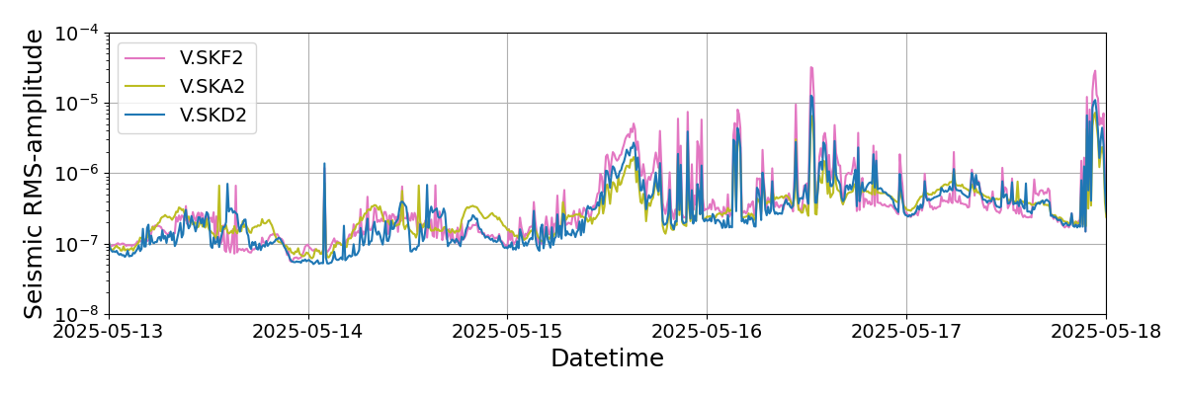
Volcanic activity assessment using JVDN
Continuous column-forming eruption on May 15, 2025 at Sakurajima volcano
Apparent crustal deformation
Formation of grey (ash-rich) eruption columns is associated with deflation
Seismicity is activated during deflation

Slide 12
Comprehensive/basic measures for the promotion of observation and research

Slide 13
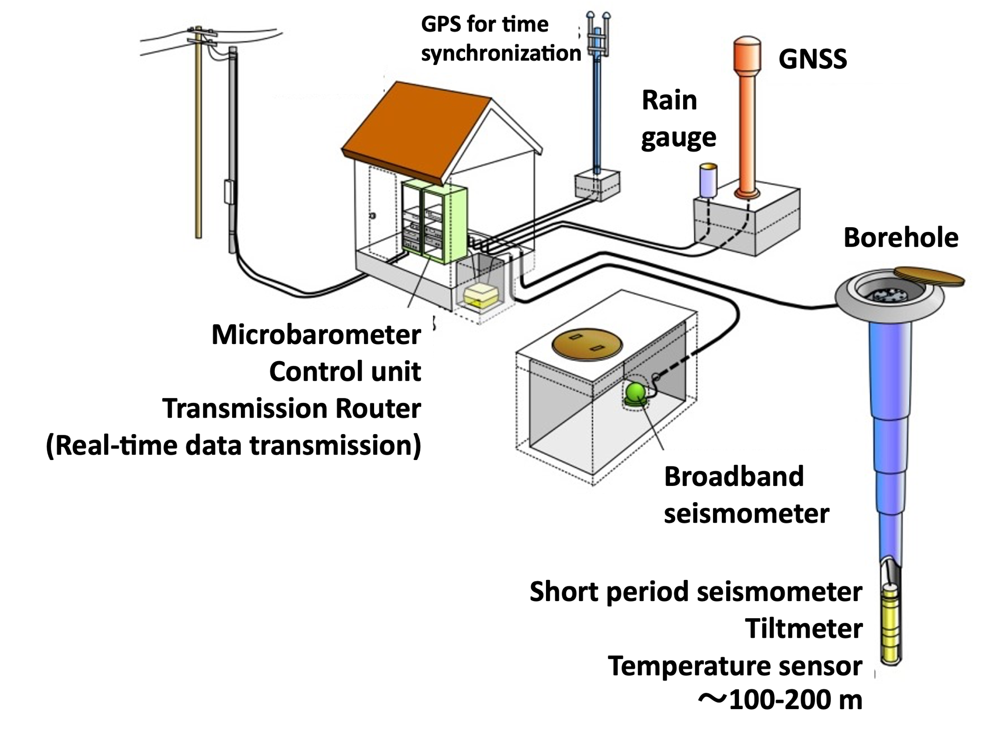
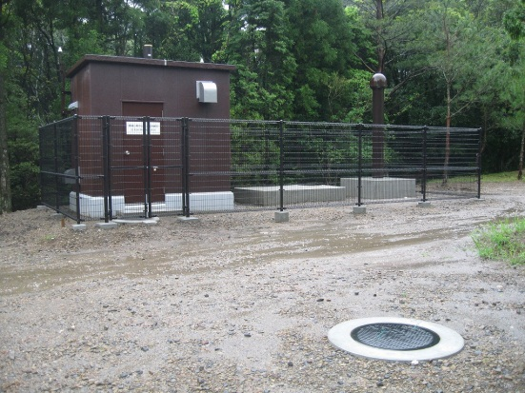
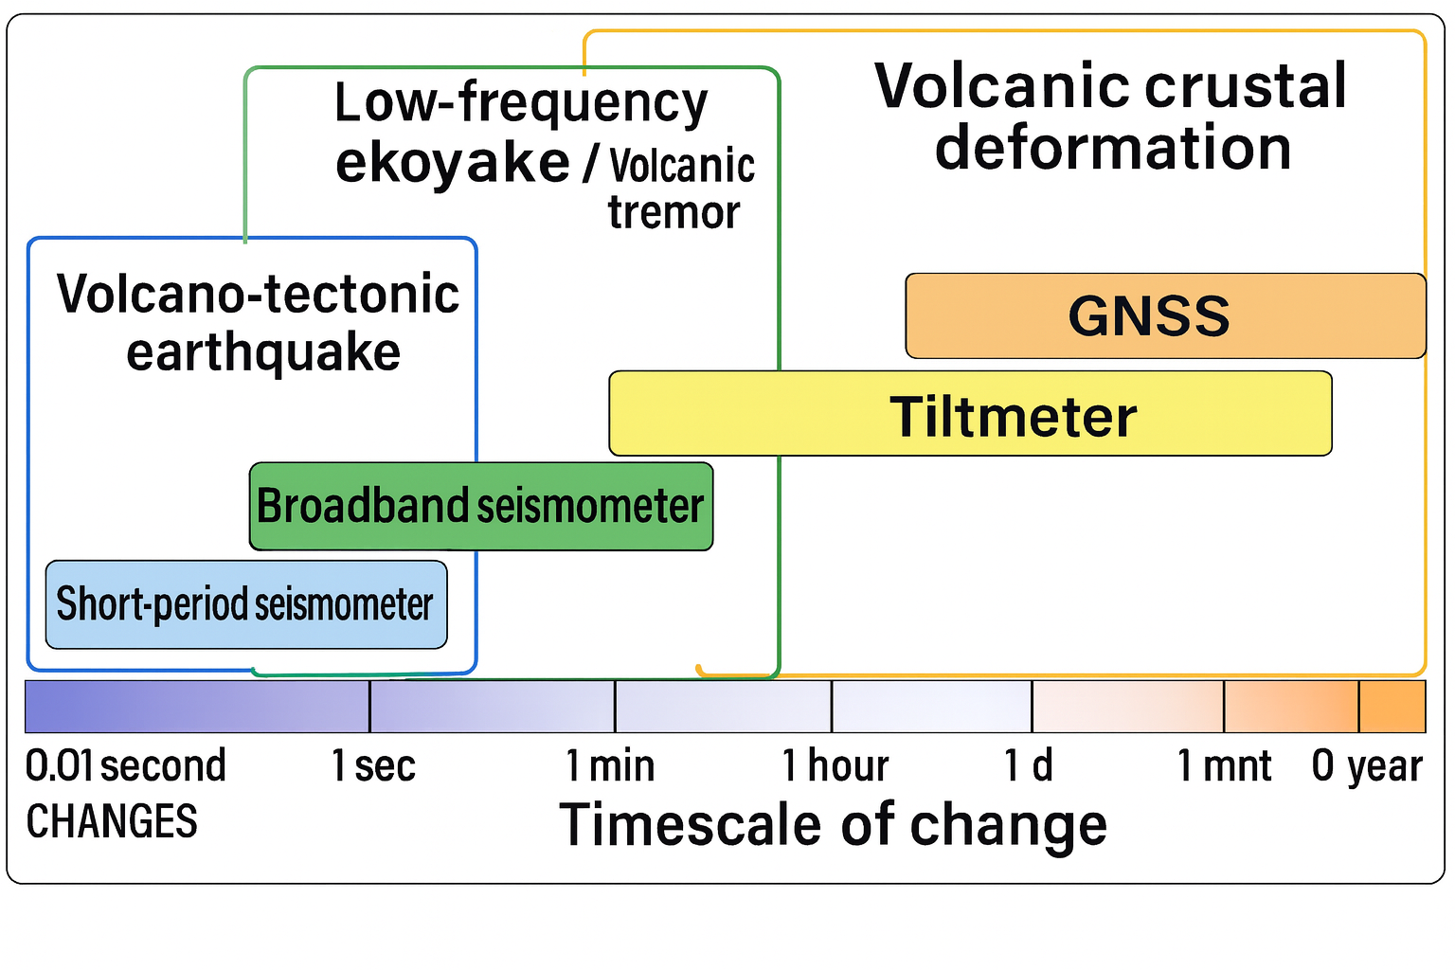
V-net: Fundamental Volcano Observation Network
Maintained and operated by NIED
Low-frequency e.q.
Volcanic tremor

Slide 14
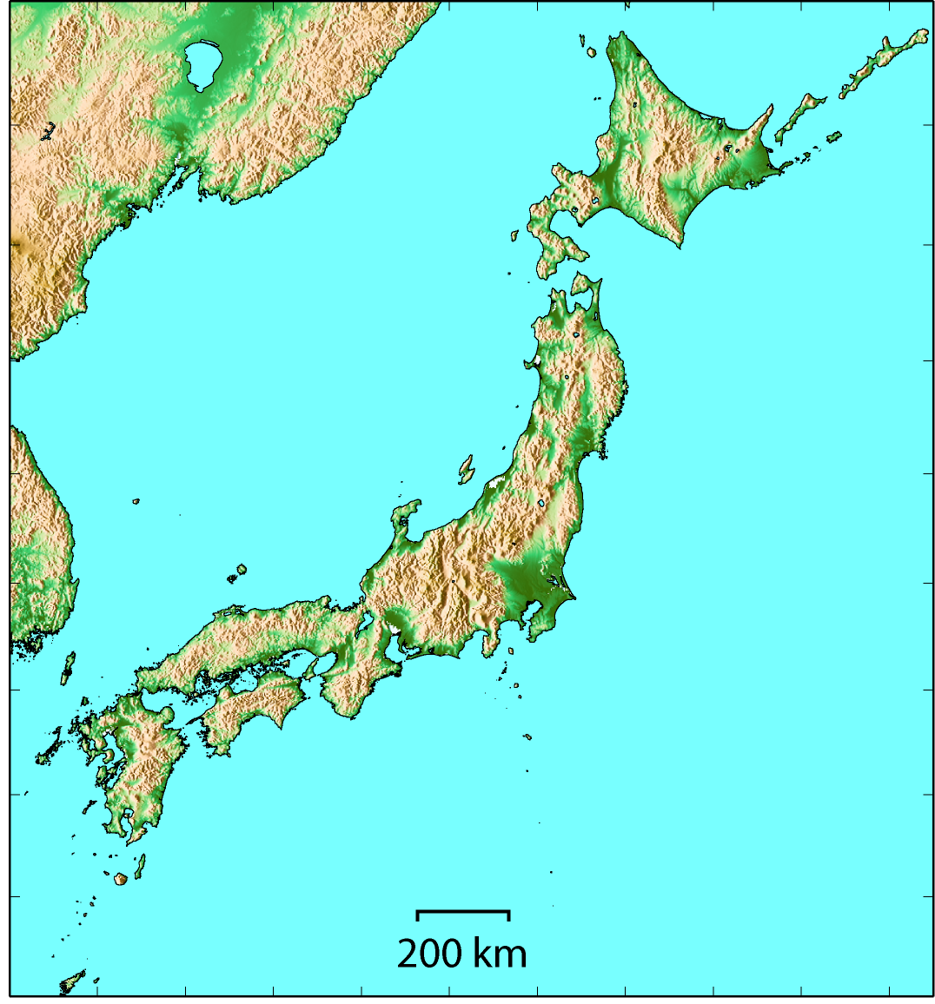
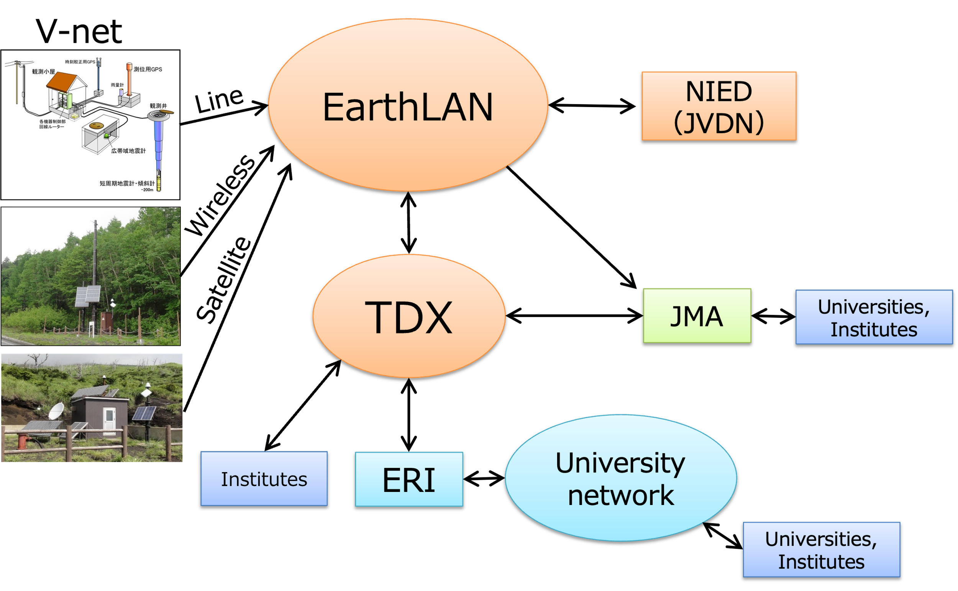
V-net: Fundamental Volcano Observation Network
既設観測施設数（地上型点数）
令和5年度補正での増設観測点数（地上型点数）
“Borehole” type: 56 stations at 18 volcanoes
“On-ground” type: 32 stations at 25 volcanoes
大雪山(1)
アトサヌプリ(1)
十勝岳3
有珠山3
雌阿寒岳(1)
北海道駒ヶ岳3
樽前山3
倶多楽(1)
恵山(1)
岩木山(1)
八甲田山(1)
秋田焼山(1)
十和田(1)
Real-time network of volcanic observation data
秋田駒ケ岳(1)
岩手山3
鳥海山(1)
栗駒山(1)
草津白根山3
磐梯山(1)
蔵王山(1)
新潟焼山(1)
吾妻山(1)
弥陀ヶ原（1）
安達太良山(1)
焼岳(1)
那須岳 6(3)
白山(1)
日光白根山(1)
乗鞍岳(1)
雲仙岳3+3
鶴見岳・伽藍岳(1)
浅間山3
箱根山(1)
御嶽山(1)
伊豆大島 4
九重山 4
富士山 6
阿蘇山 4
三宅島 4
八丈島(1)
霧島山2
桜島3
口永良部島2
小笠原硫黄島(3)

Slide 15
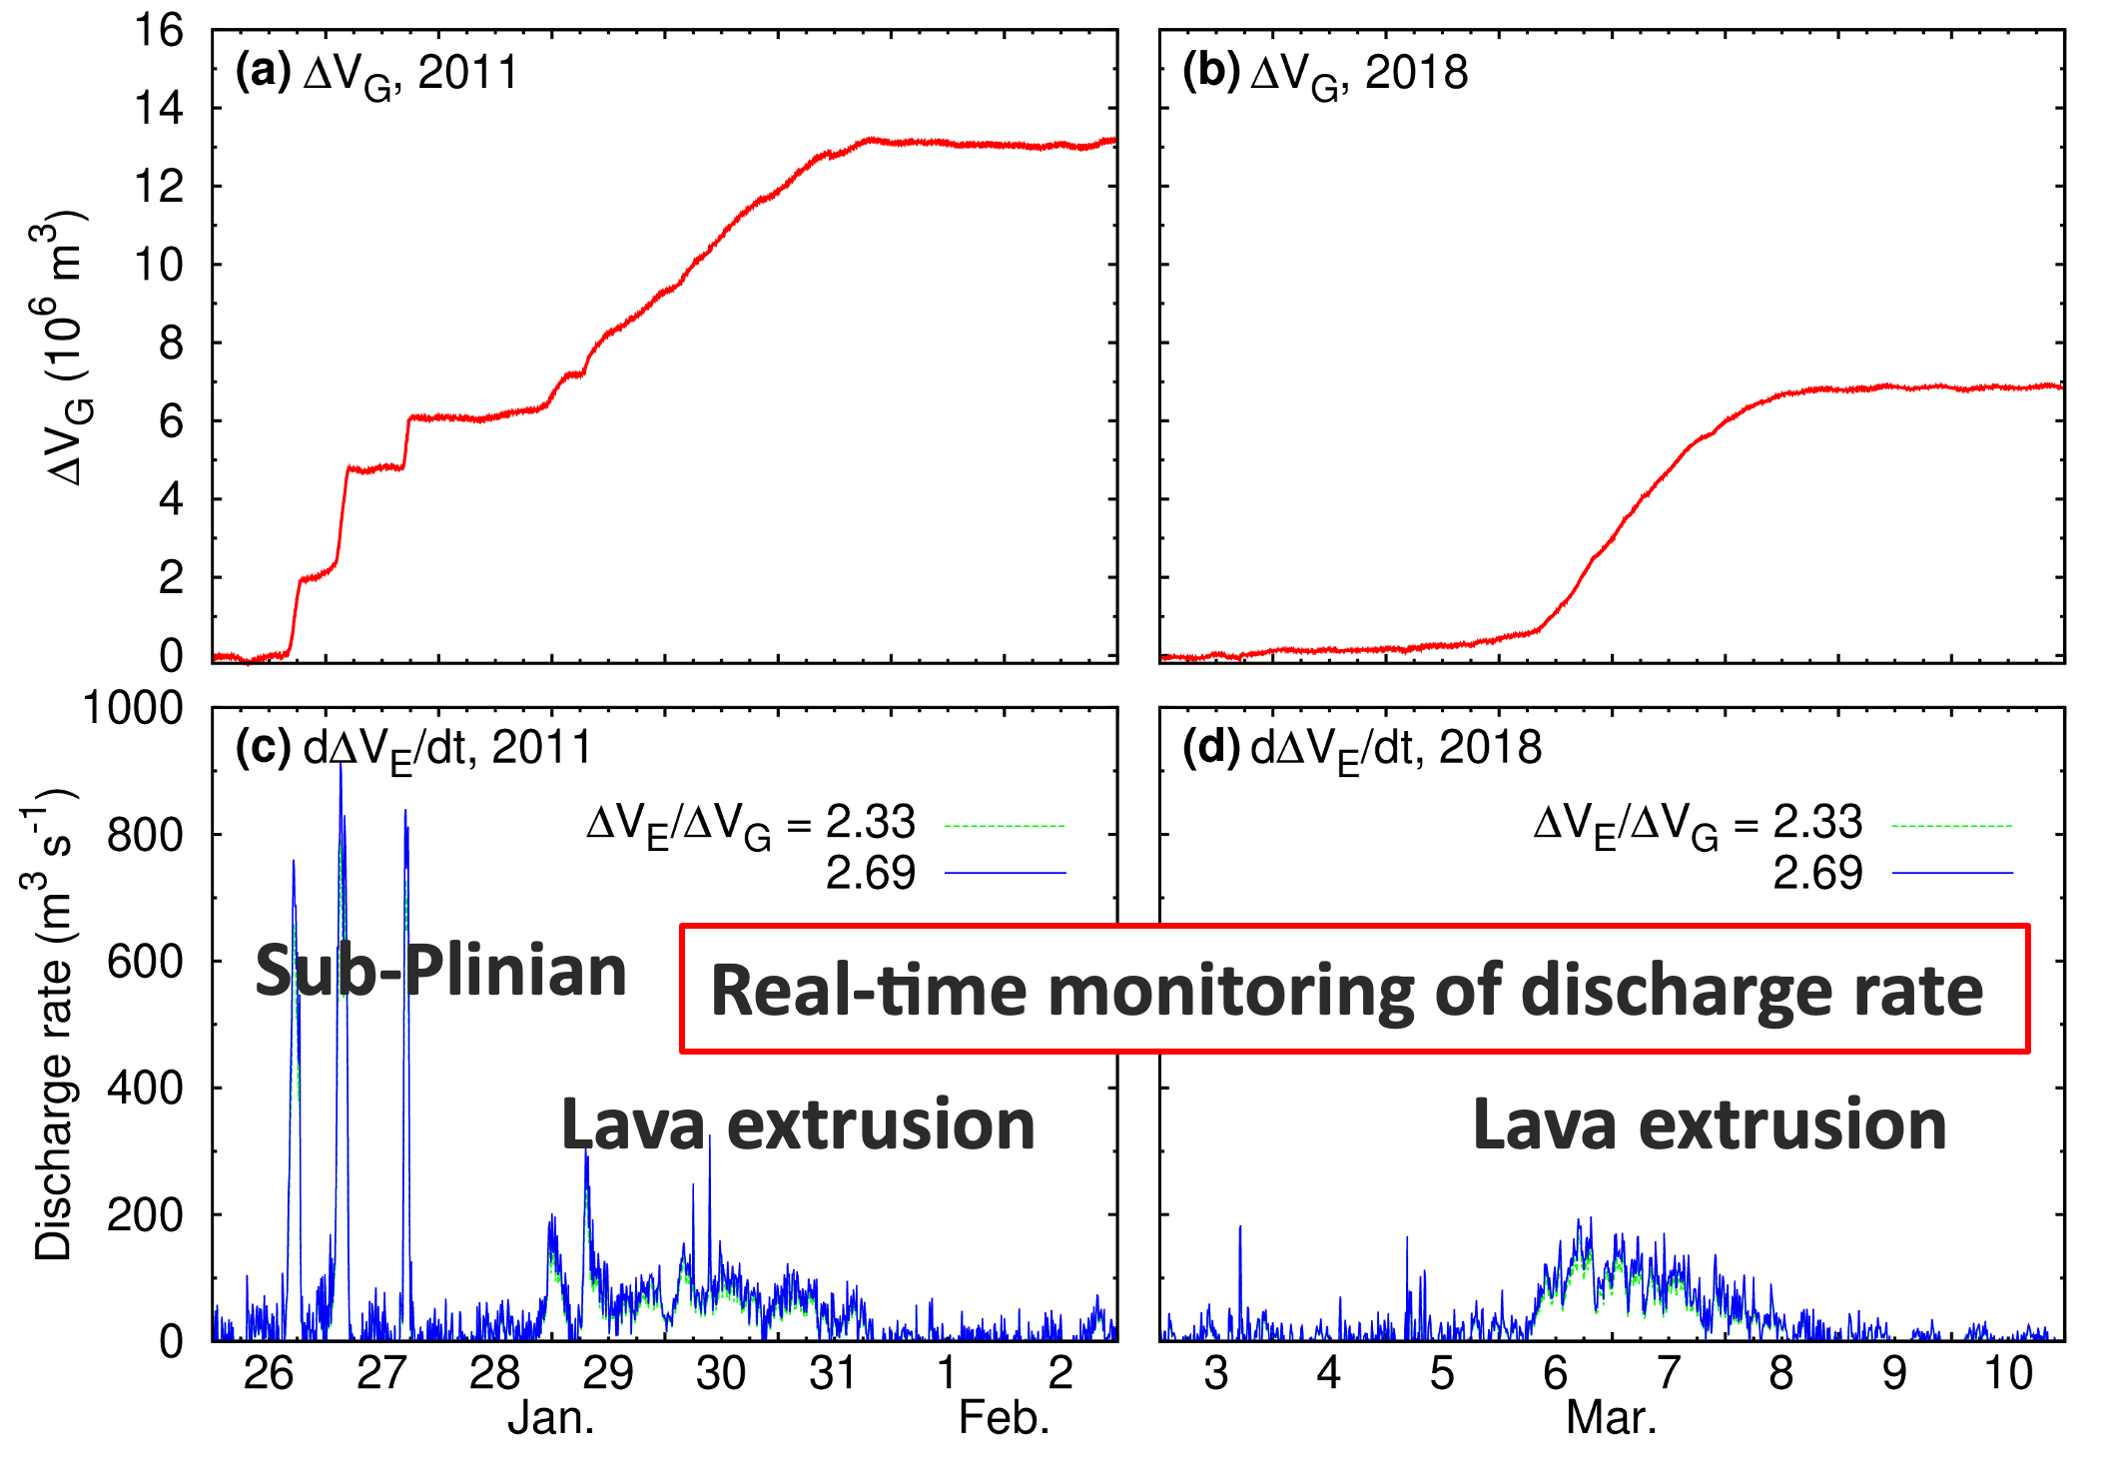
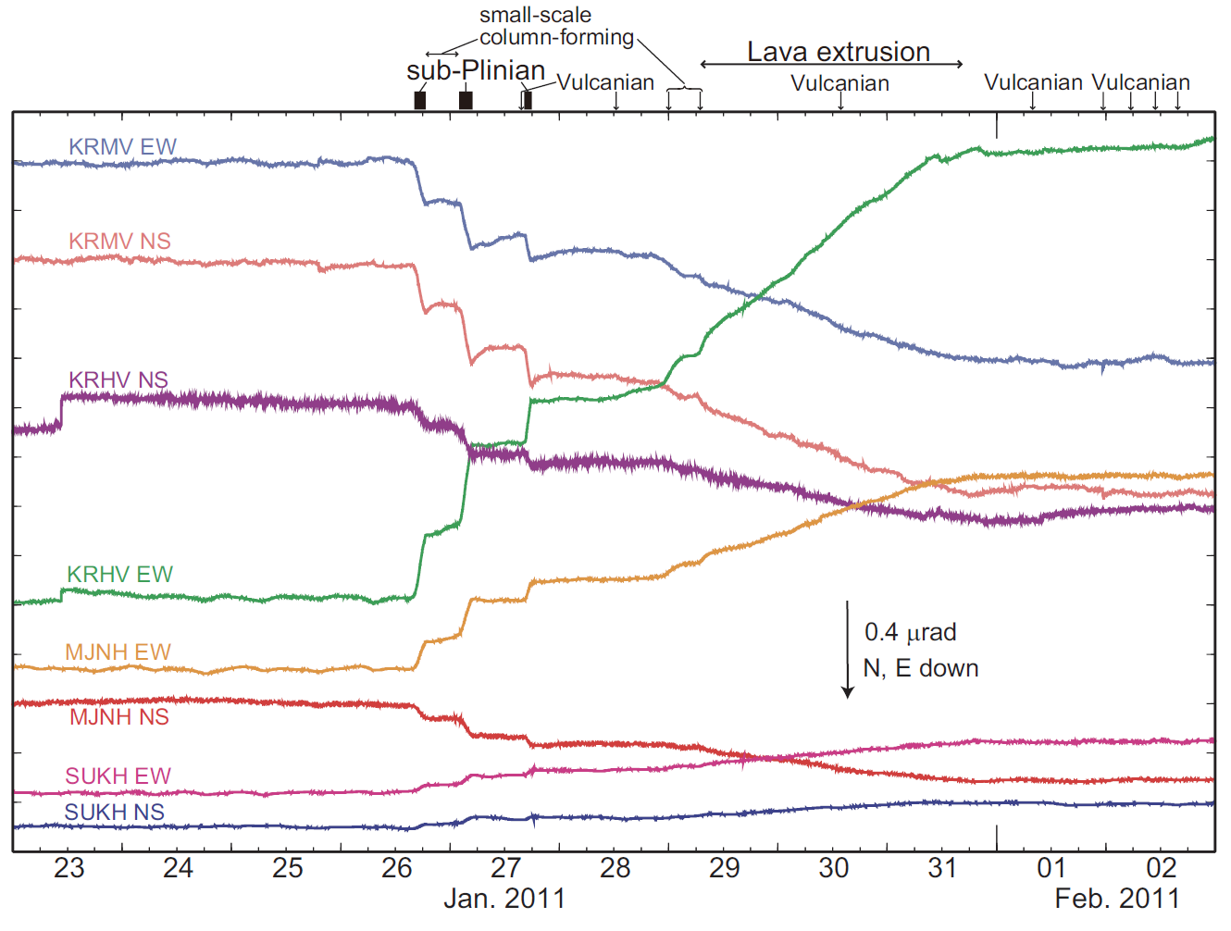
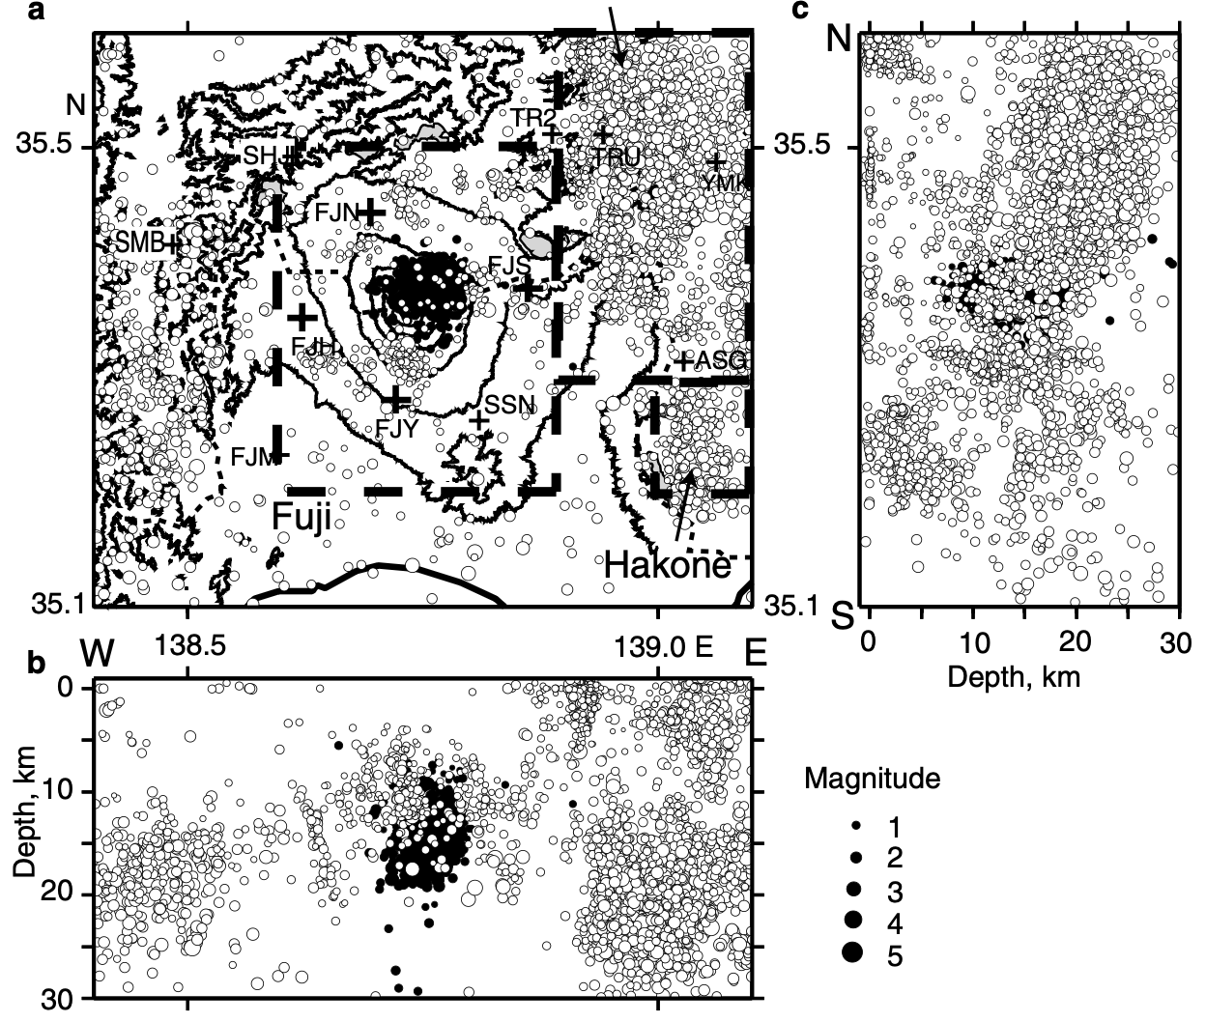
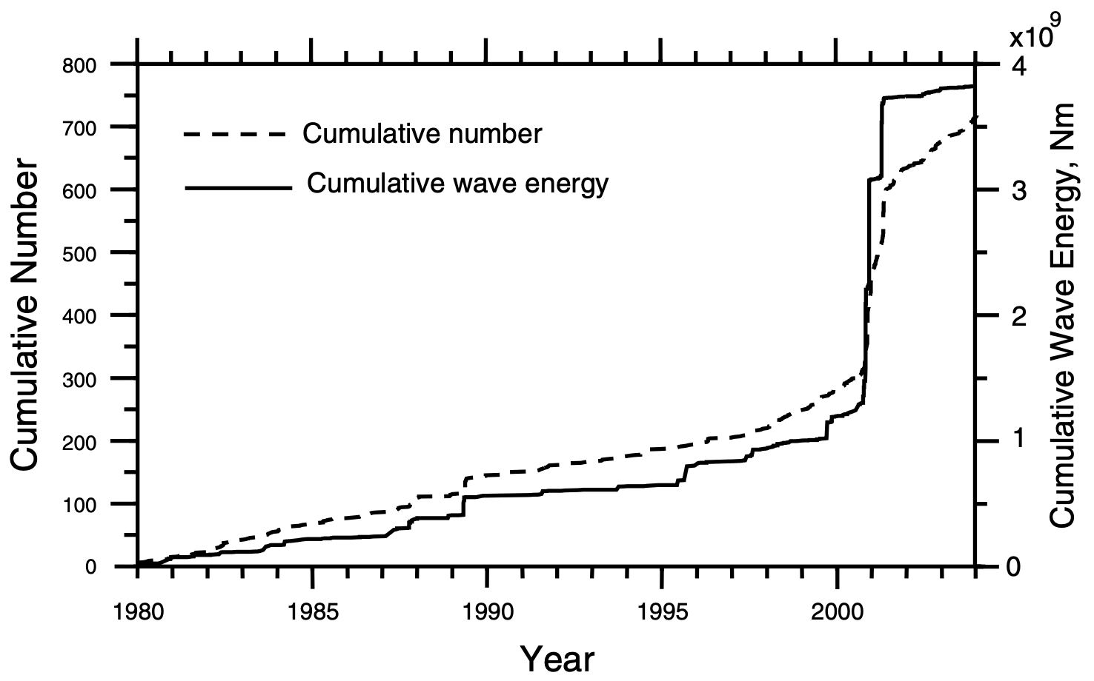
Examples of V-net outcome
Activation detection of deep low-frequency earthquakes at Mt. Fuji in 2000-2001
Capturing eruption processes based on tiltmeter data at Shinmoedake volcano
(Kozono et al., 2013, 2014, 2023)
(Ukawa, 2005)

Slide 16
Summary and Future prospects
Headquarters for Volcano Research Promotion (HVRP) has been established in response to the amendment of the act on special measures for active volcanoes.
Japan Volcanological Data Network (JVDN) enables researchers to comprehensively utilize multi-observation data on active volcanoes throughout Japan.
V-net is mainly composed of borehole-type seismometers and tiltmeters, and it contributes to understanding and monitoring volcanic activity in real time.
Future prospects
  Enhance data in JVDN (e.g., geochemical, petrological, and volcanic hazards)
  Distribution of data analysis results (should be based on standardized methods)
  Development of data analysis platform (should be composed of standardized methods)

Slide 18
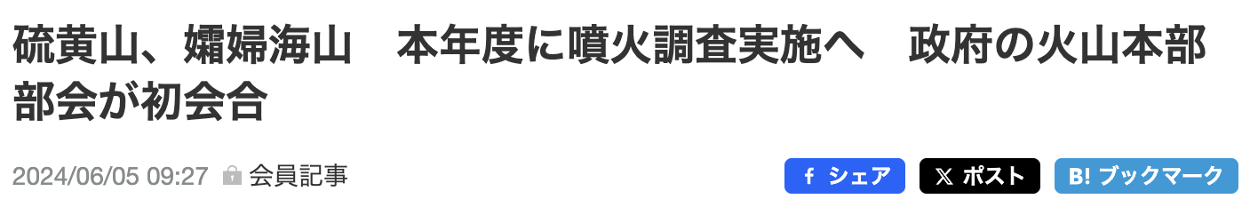
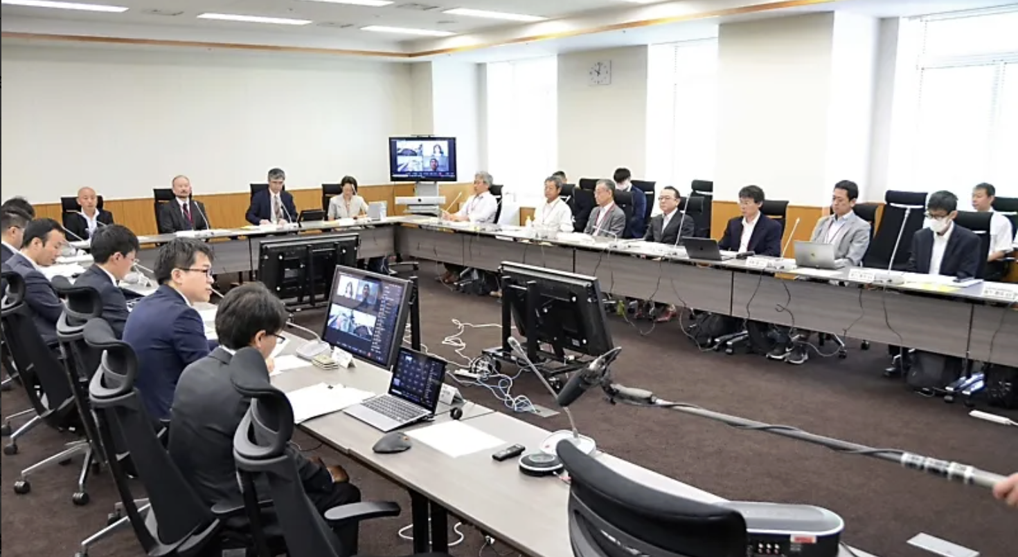

Slide 19
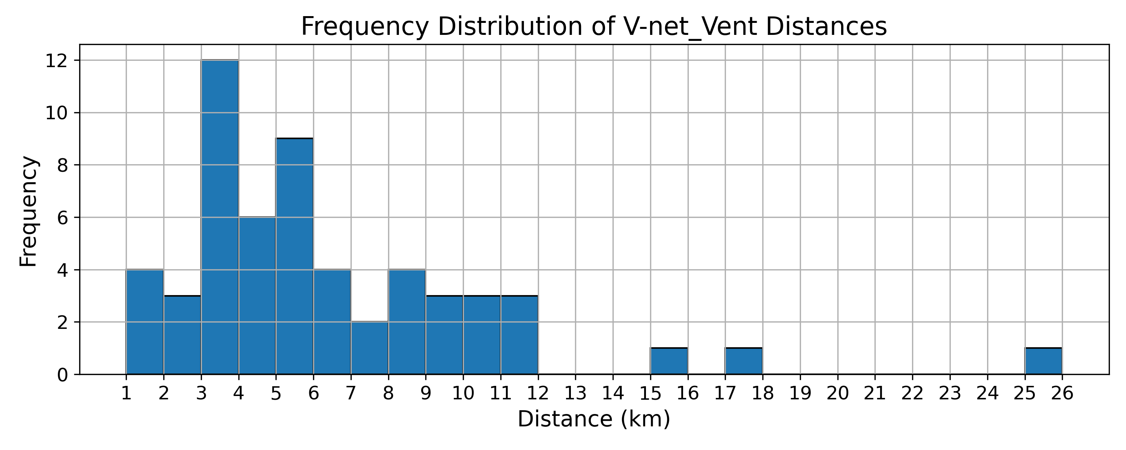
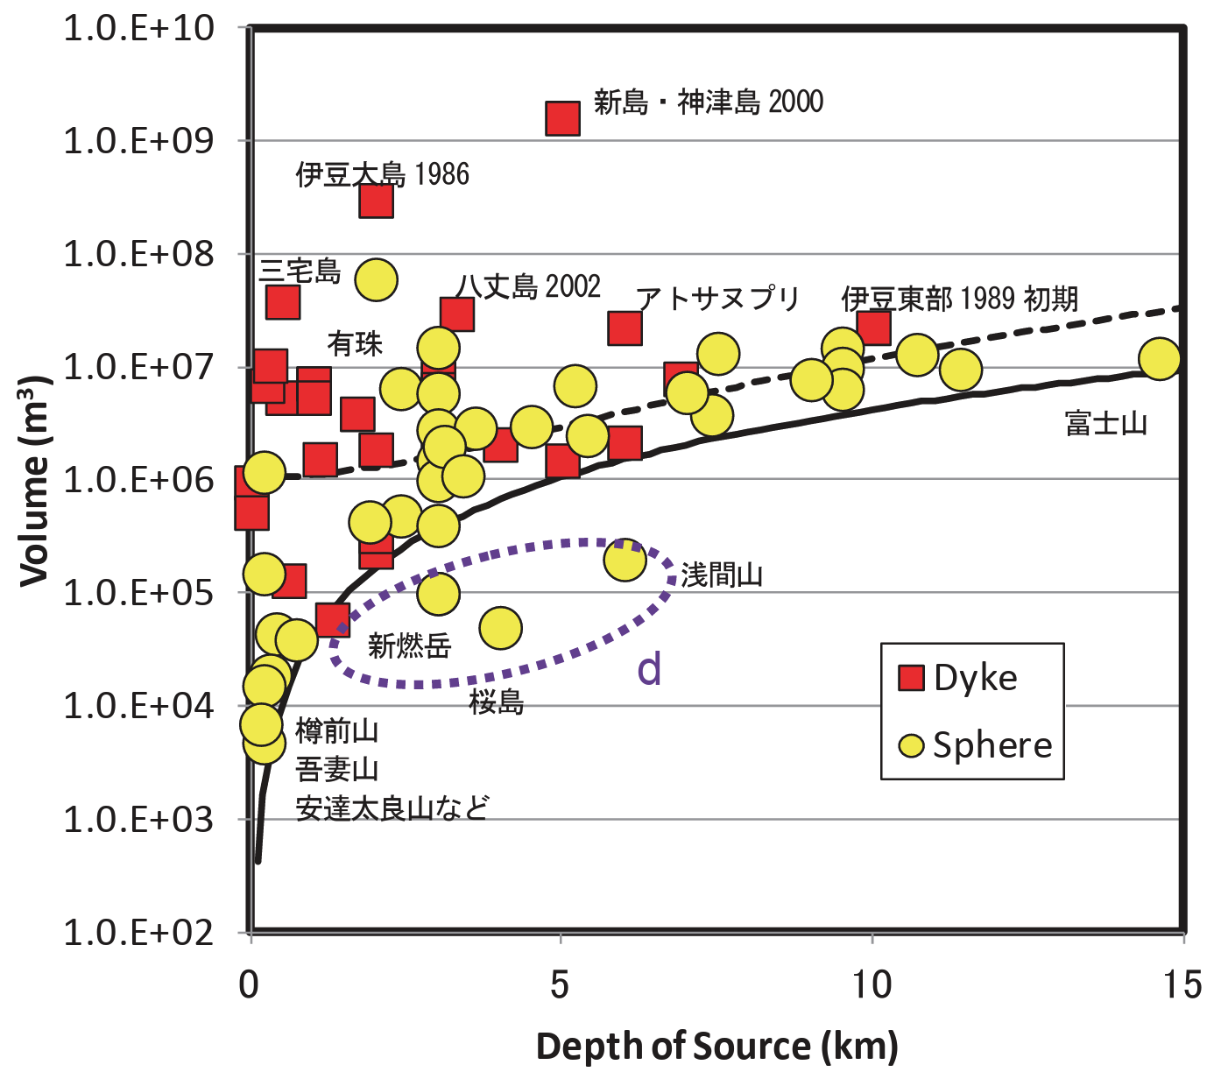
Distribution of V-net
Compilation of crustal deformation sources in Japanese volcanoes
Usu, Izu-Oshima, Miyakejima, Kuchinoerabujima
Distance (km) between each volcano‘s main crater and V-net stations
Although some stations are located 1 to 2 km from the crater because of geographical constraints on the island etc., approximately 75% are distributed within a range of 2 to 10 km.
(Report of MRI-JMA, 2013)
Conducting long-term stable monitoring (with real-time network)
(Mainly) Detecting fluctuations in magma reservoirs at depths of 3 to 10 km

Slide 20
HVRP: Headquarters for the Volcano Research Promotion
Nation and Local governments, etc.
Strengthening countermeasures for active volcanoes based on comprehensive evaluation, etc.
Coorpelation
Headquarters for the Volcano Research Promotion
Chaired by Minister of Education, Culture, Sports, Science and Technology (MEXT)
Policy Committee
Volcano Research Committee
Planning of comprehensive/basic measures for the promotion of observation and research
Coordination of the budgets and other administrative matters related to volcano research by the relevant administrative agencies
Formulation of comprehensive research and observation plans
Publicity based on comprehensive evaluation
Measures,
Plans, etc.
Collection of observation and research results from government agencies, universities, etc, and their analysis and comprehensive evaluation based on them.
Evaluation
results, etc.
Comprehensive/basic measures
Research and observation plans
Observation data
Research results
Relevant ministries and agencies, research and development corporations, universities, etc.
Conducting observation and research

