Slide 1



Overview of Earthworm and its Core Functionality for Standardizing and Automating workflows
Dannie Hidayat
Earth Observatory of Singapore, Nanyang Technological University

Slide 2
  Earthworm is an open-source, modular software system for real-time seismic data acquisition and automated earthquake processing, originally developed by the USGS. It standardizes workflows through a system of independent modules that communicate via shared memory regions, or "transport rings", and automates tasks such as event detection, location, and data exchange.
Overview of Earthworm
Modular Architecture: Earthworm is designed as a collection of nearly 200 independent modules. Each module is specialized for a specific task (e.g., data acquisition, processing, archiving, system control), allowing for flexibility and customization to meet specific network requirements.
Real-time Processing: The system is optimized for real-time applications in regional and local network seismology and volcano monitoring, providing rapid, automatic earthquake detection and location capabilities as events occur.
Open Source & Community Supported: Developed primarily in the C programming language, Earthworm is open source with an active international community of users and developers. This facilitates widespread adoption and continuous improvement through community contributions, with maintenance and new releases coordinated by ISTI (Instrumental Software Technologies, Inc.).

Slide 3
Core Functionality for Standardizing and Automating Workflows
Earthworm standardizes and automates seismic workflows through its data flow architecture and specific processing modules:
Data Acquisition and Exchange: Data acquisition PCs receive continuous data streams from various seismic sensors, digitizers (e.g., Quanterra Q330, Guralp SCREAM servers), and external networks via standard protocols like SeedLink or LISS.
Automatic Processing Pipeline: A series of interconnected modules creates an automated processing pipeline:
  Picking: The pick_ew module continuously analyzes waveform data in the "wave ring" to automatically identify P and S phase arrivals.
  Association: The binder_ew module organizes these phase picks from multiple stations into coherent seismic events and performs a preliminary location using a simple crustal model.
  Location: The hyp2000_mgr module then manages the data flow to the Hypoinverse earthquake location software, which computes a more refined and final location and magnitude for the event.
System Management and Robustness: The statmgr module provides automation by monitoring the health of all other Earthworm modules, automatically restarting any that fail and sending email alerts to operators, ensuring continuous, reliable operation.
Data Archiving and Distribution: Other modules automate the conversion and saving of event files (e.g., into SAC or miniSEED formats) to disk and facilitate data exchange with other data centers using standard protocols.

Slide 4
Core Functionality for Standardizing and Automating Workflows
Earthworm standardizes and automates seismic workflows through its data flow architecture and specific processing modules:
Data Acquisition and Exchange: Data acquisition PCs receive continuous data streams from various seismic sensors, digitizers (e.g., Quanterra Q330, Guralp SCREAM servers), and external networks via standard protocols like SeedLink or LISS.
Automatic Processing Pipeline: A series of interconnected modules creates an automated processing pipeline:
  Picking: The pick_ew module continuously analyzes waveform data in the "wave ring" to automatically identify P and S phase arrivals.
  Association: The binder_ew module organizes these phase picks from multiple stations into coherent seismic events and performs a preliminary location using a simple crustal model.
  Location: The hyp2000_mgr module then manages the data flow to the Hypoinverse earthquake location software, which computes a more refined and final location and magnitude for the event.
System Management and Robustness: The statmgr module provides automation by monitoring the health of all other Earthworm modules, automatically restarting any that fail and sending email alerts to operators, ensuring continuous, reliable operation.
Data Archiving and Distribution: Other modules automate the conversion and saving of event files (e.g., into SAC or miniSEED formats) to disk and facilitate data exchange with other data centers using standard protocols.

Slide 5

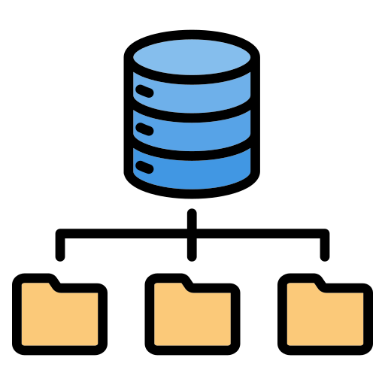






Data acquisition, transmission, archiving and sharing
Process & analyze by researchers
Process & analyze by observers
Via internet
CVGHM SERVER
Seismic
Infrasound
Via
radio-telemetry
GPS
Gas
Process & analyze by researchers
DATA SERVER
At Observatory post
(Marapi, Gede, & Anak Krakatau)
Via internet
Tilt
MONITORING
STATIONS
EOS SERVER

Slide 6
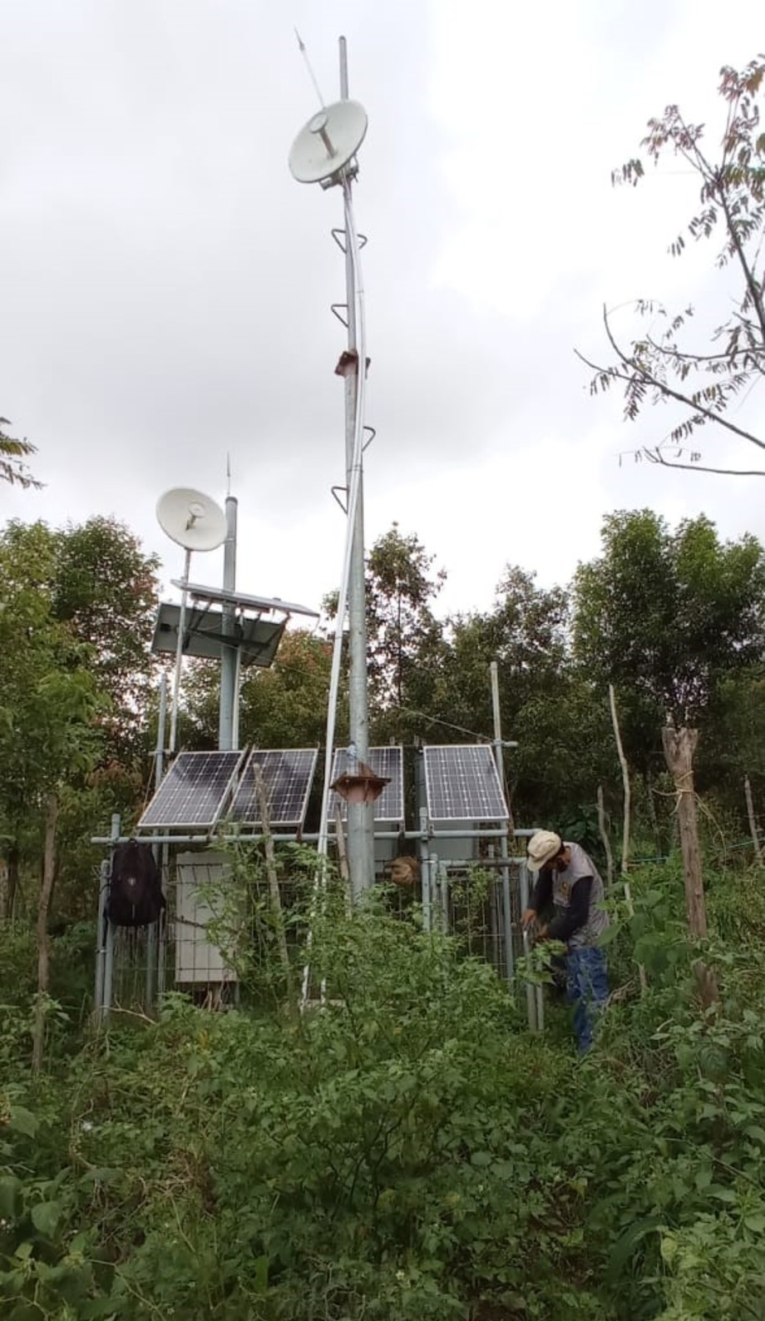
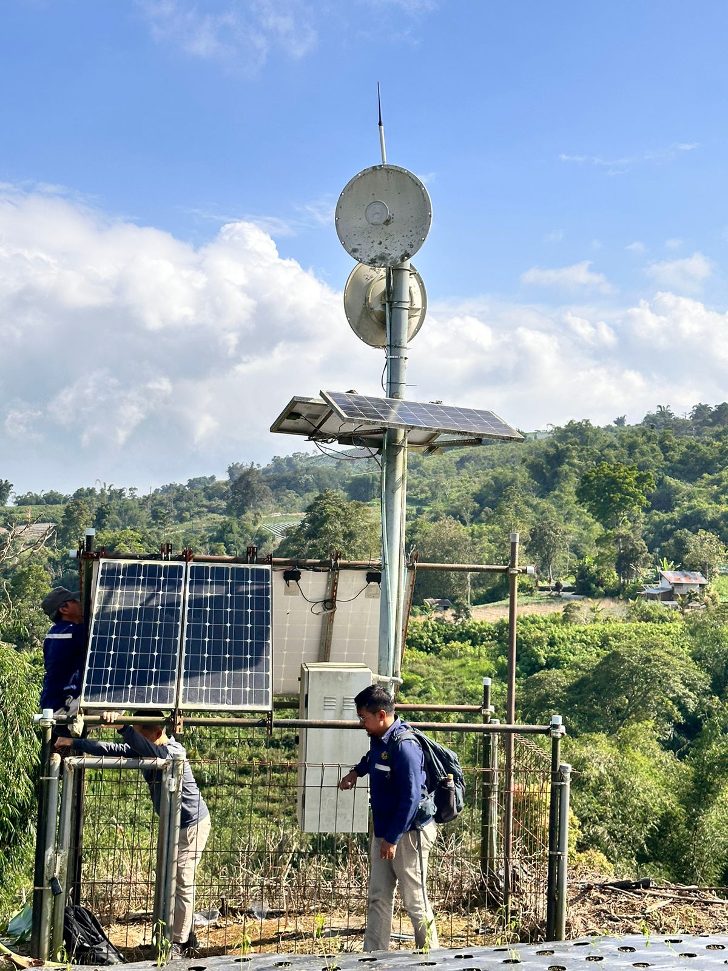
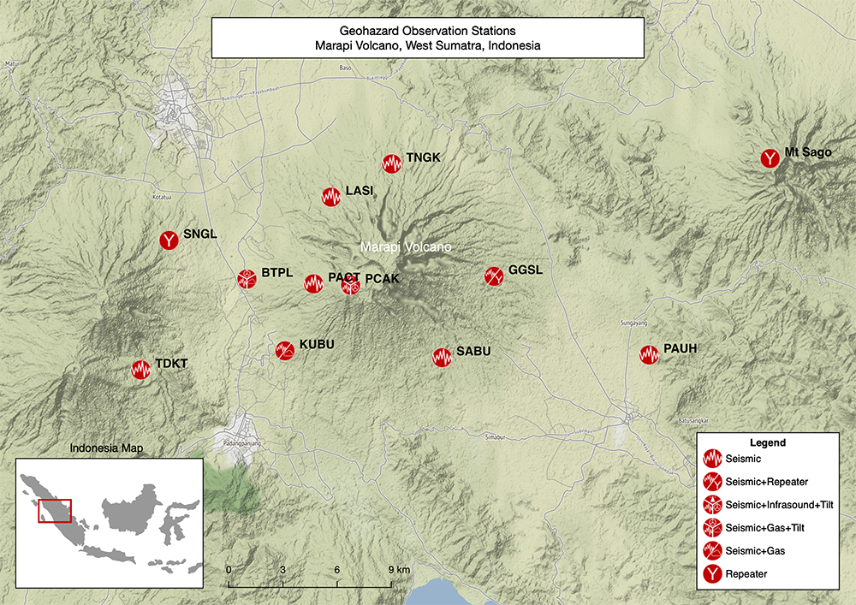

Marapi volcano monitoring system
x
x
SNGL repeater
GGSL station
8 seismic stations
  5 broadbands (EOS)
  3 short-periods (CVGHM)
3 telemetry repeaters
2 tilt stations
1 multigas station
5 infrasounds
Digital radio telemetry
Analog radio telemetry
x
Temporary suspended
Observatory post

Slide 7
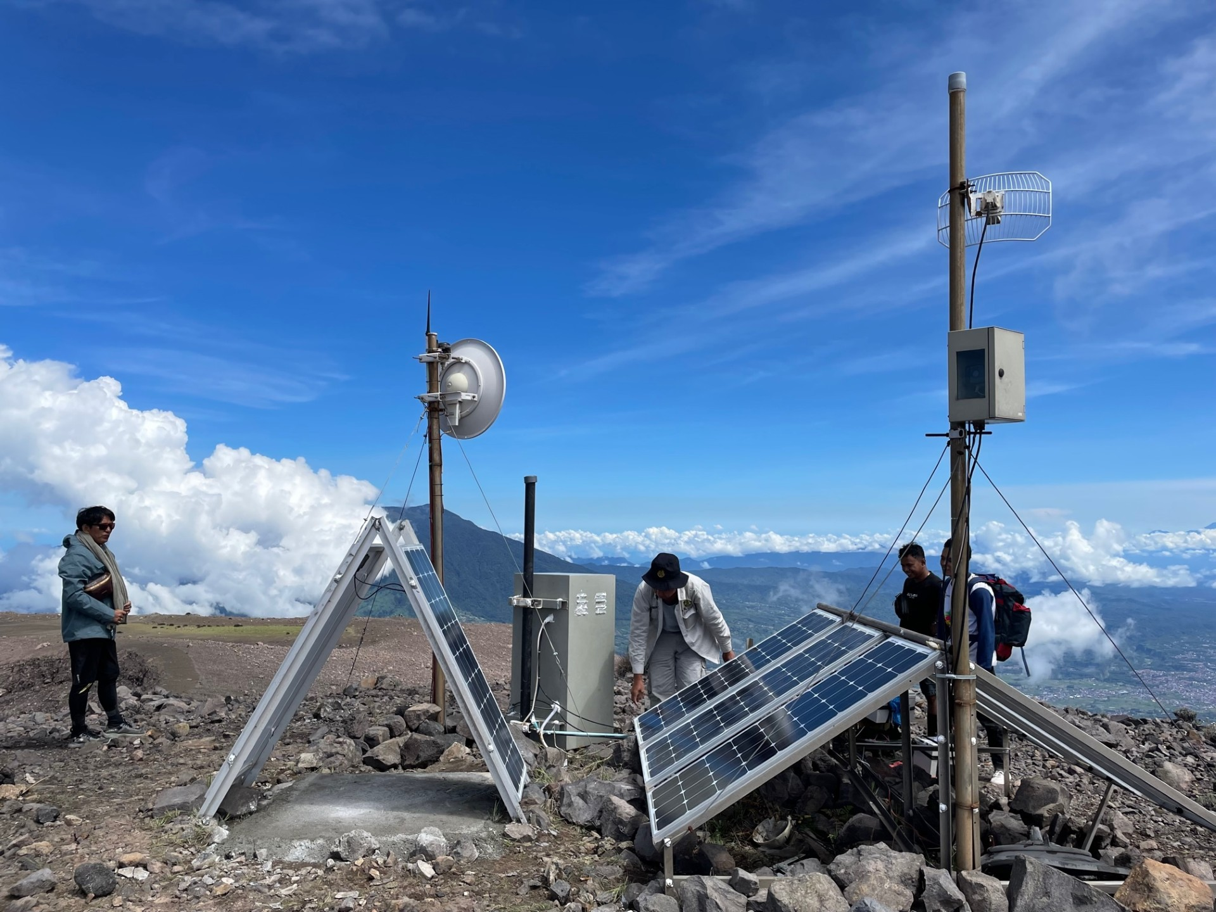
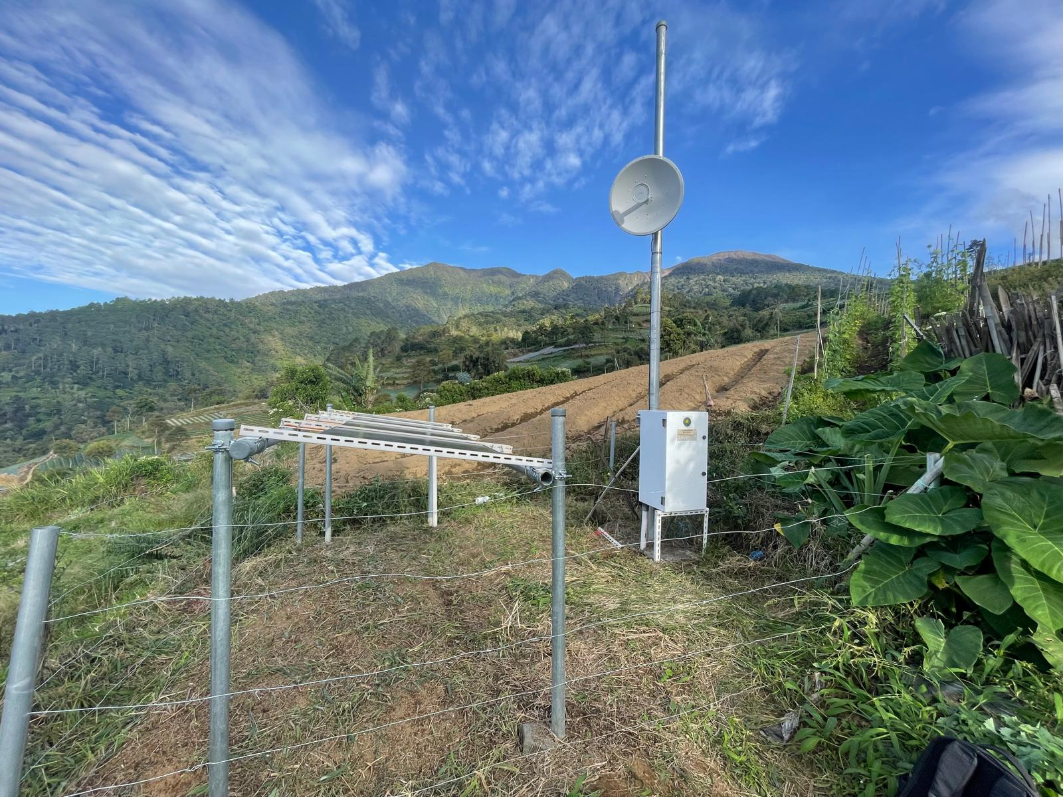
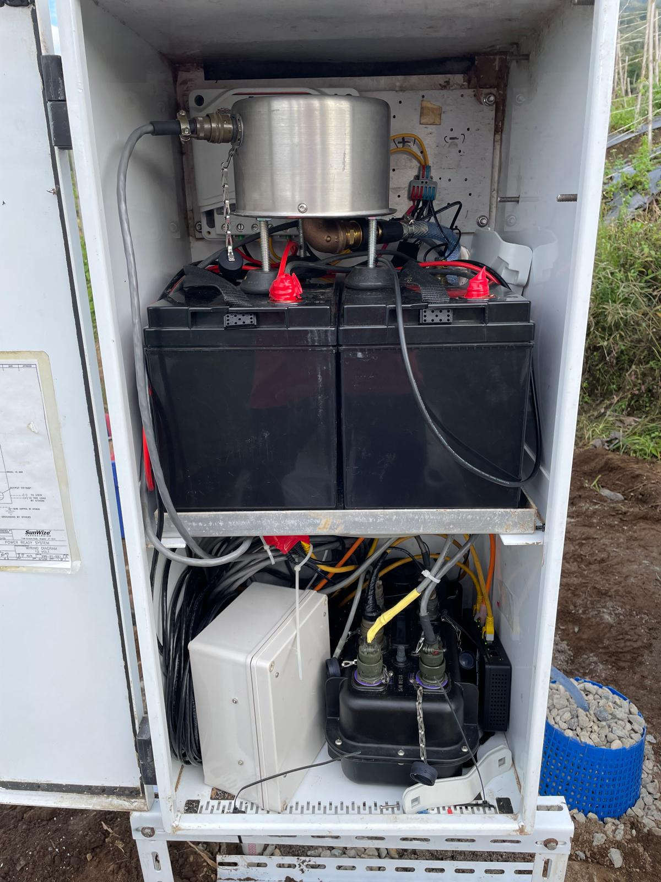
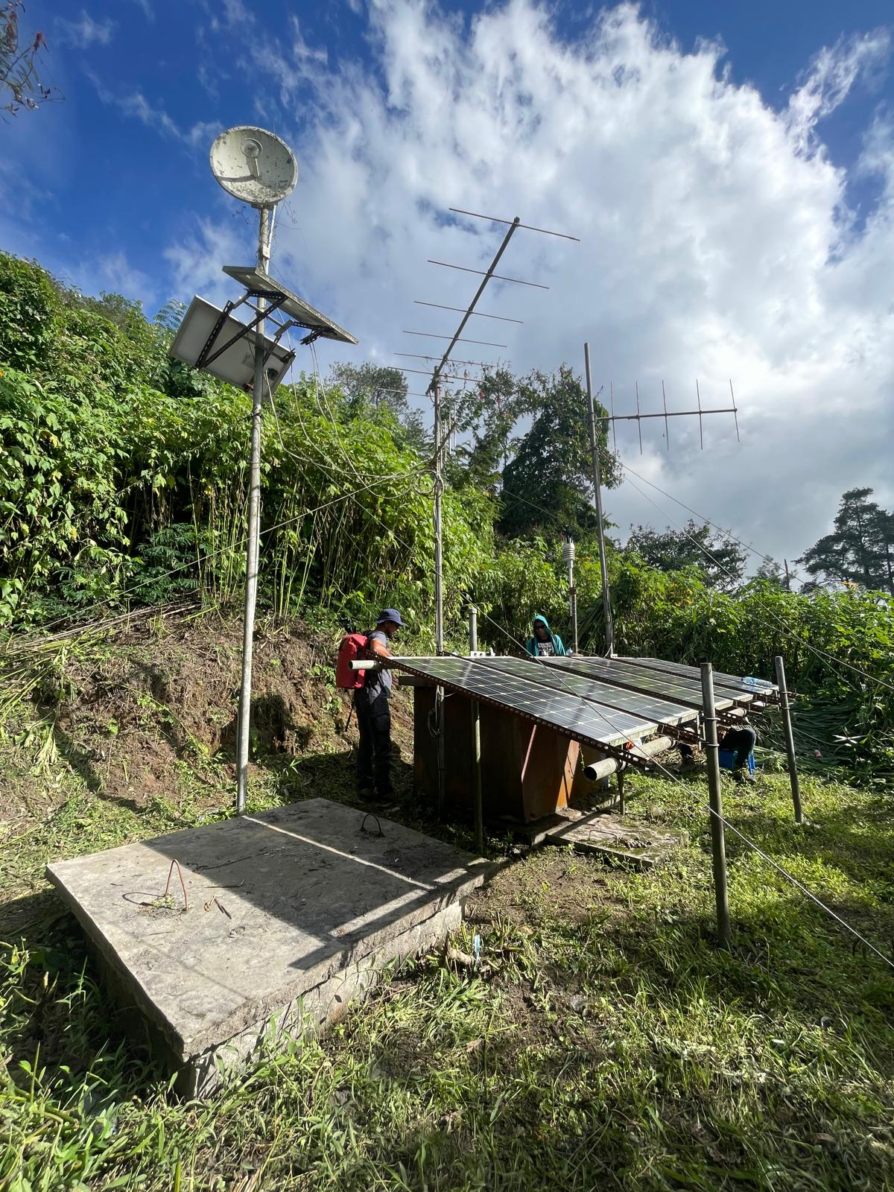
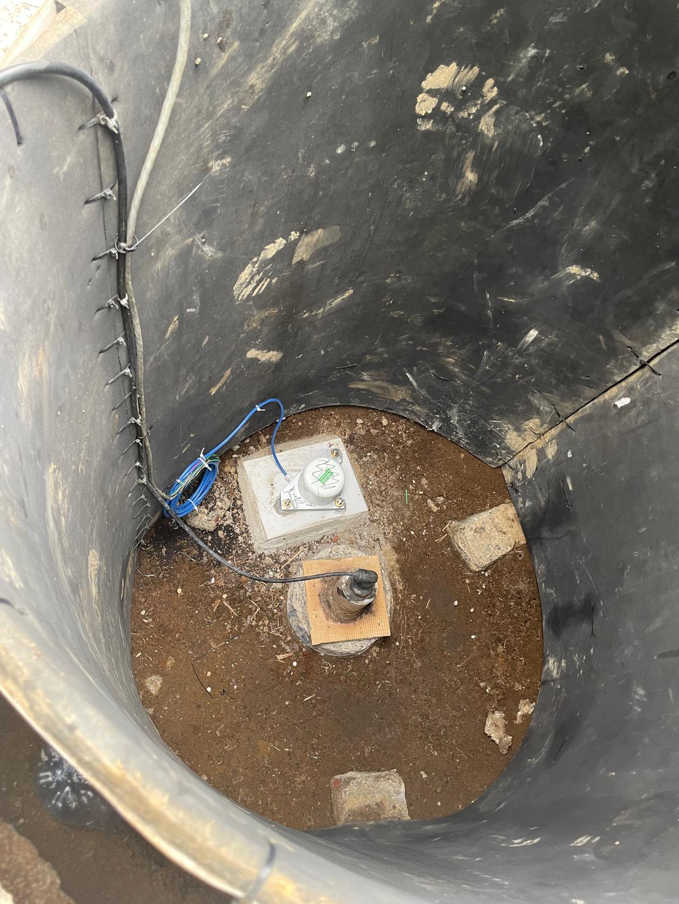
Marapi infrastructure
Station | Seismic | GPS | Tilt | Infrasound | Gas/multigas | Repeater
BTPL |  |  | 1 |  | 1
GGSL | 1 |  |  | 1 |  | 1
KUBU | 1 |  |  | 1
PCAK | 1 |  | 1 | 1
PAUH | 1 |  |  | 1
SABU | 1
SAGO |  |  |  |  |  | 1
SNGL |  |  |  |  |  | 1
TNGK | 1 |  |  | 1
BDAI | 1 |  | 1 | 1
Total | 7 | 0 | 3 | 6 | 1 | 3
Number of stations: 9
PCAK
BDAI
BTPL

Slide 8
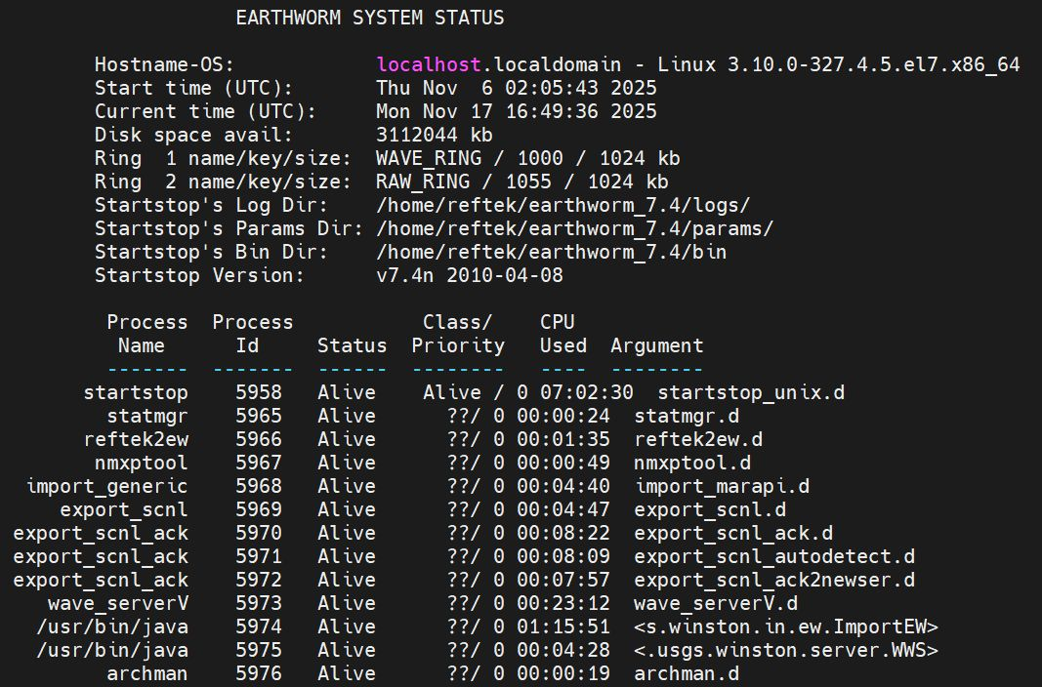
Earthworm Setup in Marapi Network
}
Input data
}
Transport data
}
Data buffer/storage
Data writing to
standard format

Slide 9
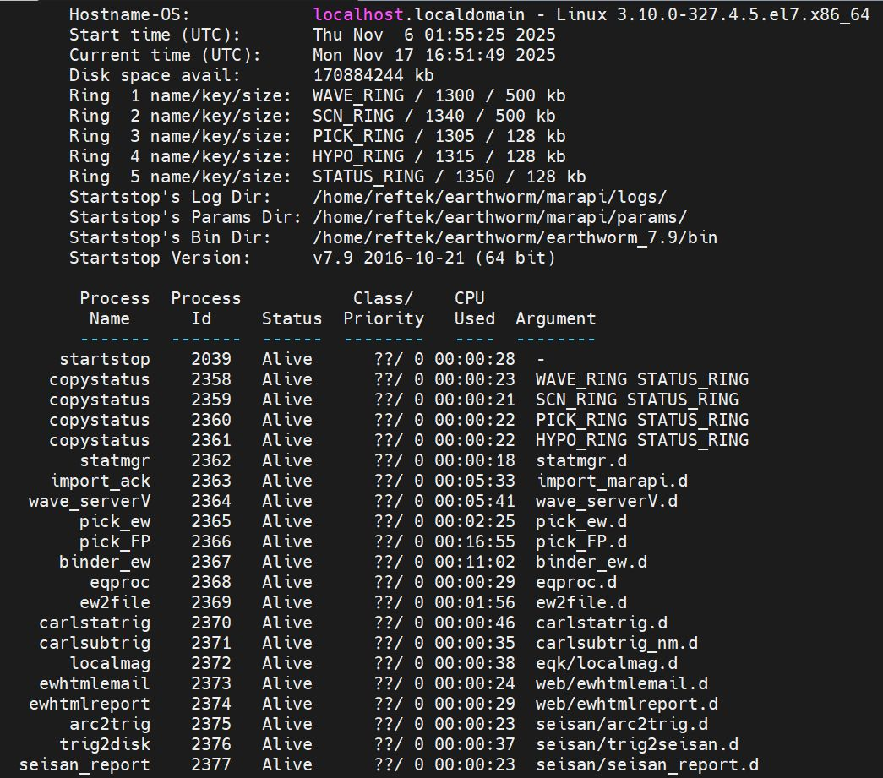
Earthworm Setup in Marapi Network (cont.)
Autodetect
Location &
Magnitude
Reporting
&writing
detected event

Slide 10
Earthworm wave_serverV vs Winston
Different functions regarding data storage and access:
wave_serverV is a C-based module providing real-time access to a temporary, disk-based circular buffer of recent waveform data.
Winston is a Java-based suite that uses a relational database (typically MySQL) for permanent, long-term data archiving and serving.
Feature | wave_serverV | Winston
Primary Role | Real-time access to recent data | Long-term data archive and service
Technology | Written in C | Java-based (using a wrapper)
Data Storage | Flat files (tank files) in a circular buffer | Relational database (MySQL)
Data Longevity | Temporary; data is eventually overwritten | Permanent; archived as long as needed
Functionality | Focuses on real-time data serving | Offers sophisticated data management and querying
Client Access | Direct connection via defined protocol | Emulates the wave_serverV protocol for compatibility

Slide 11
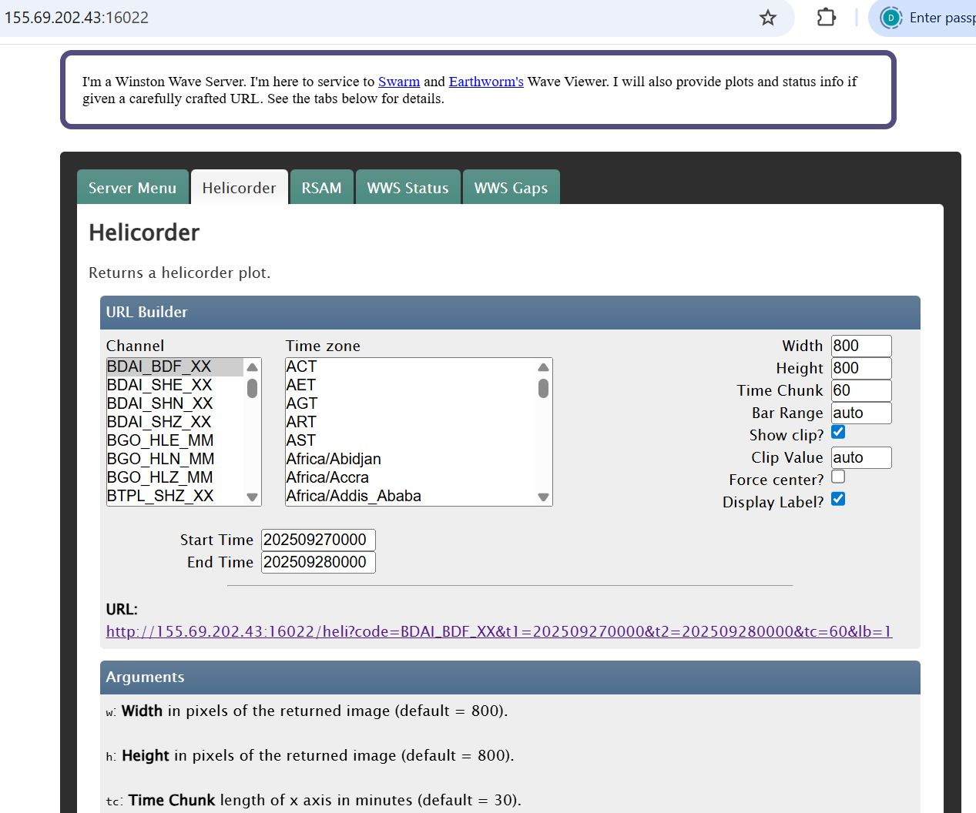
Winston Wave Server at EOS
Earthworm data
Via internet
EOS SERVER

Slide 12
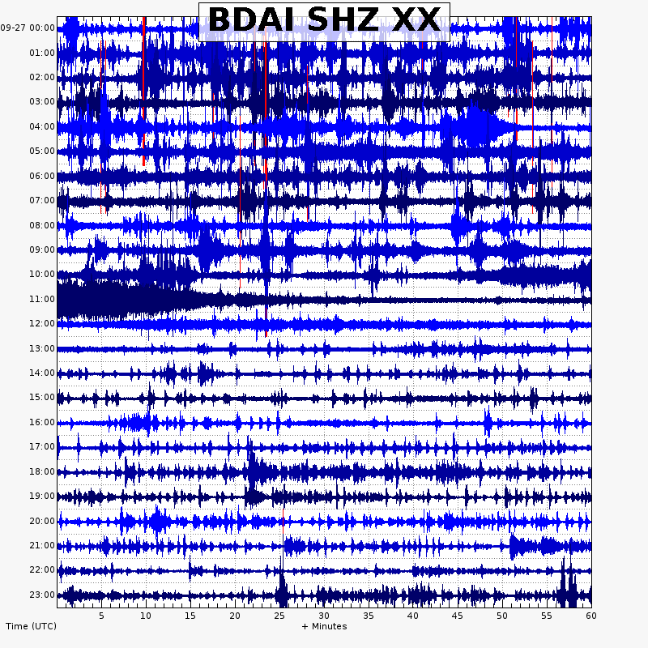
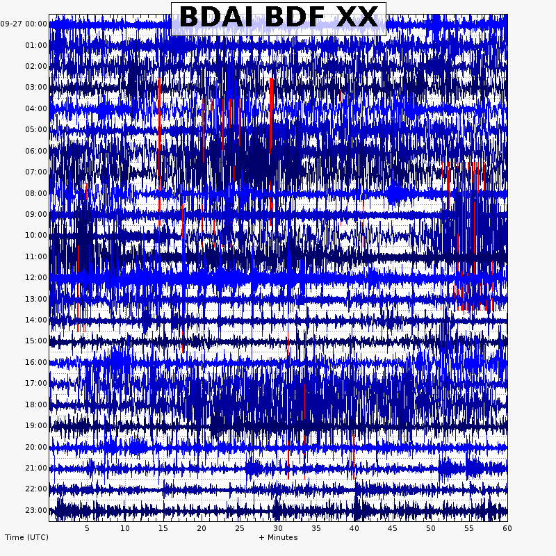
Helicorder plots

Slide 13
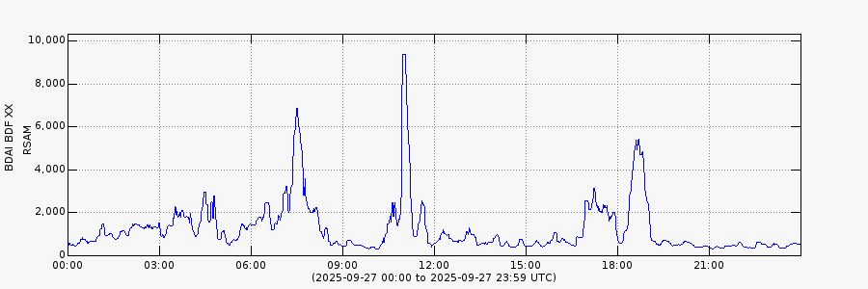
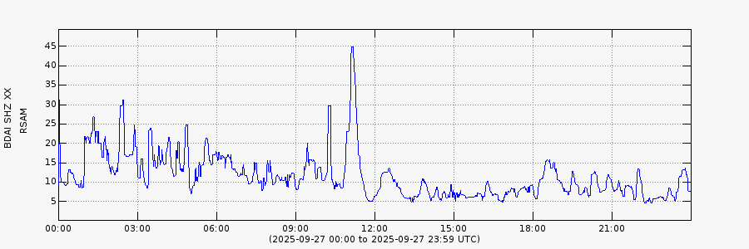
RSAM Plots

Slide 14
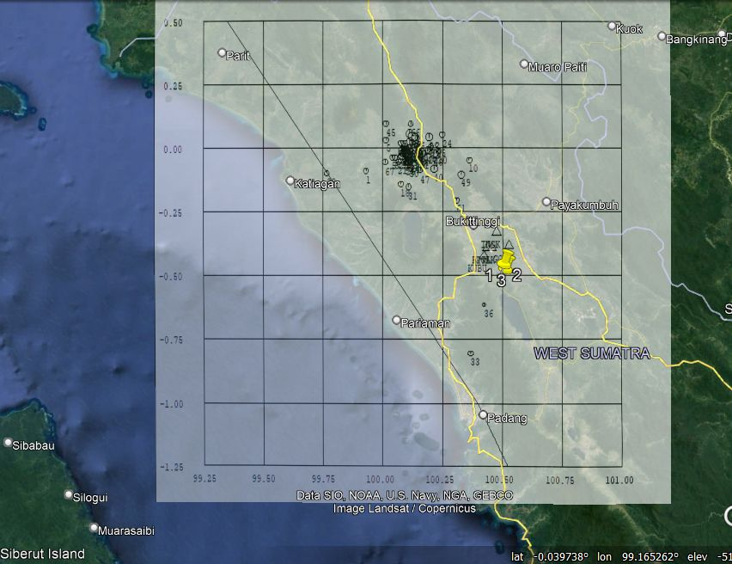
Earthquake: automatic detection and reviewed location
In addition to regular earthquake identification/counts, automatic earthquake detection can be implemented in Earthworm installation. Example of the recent detection and reviewed earthquakes locations shown (below)
Pasaman, W. Sumatra
EQs 25 Feb-2Mar 2022
Marapi Seismic
Network

Slide 15
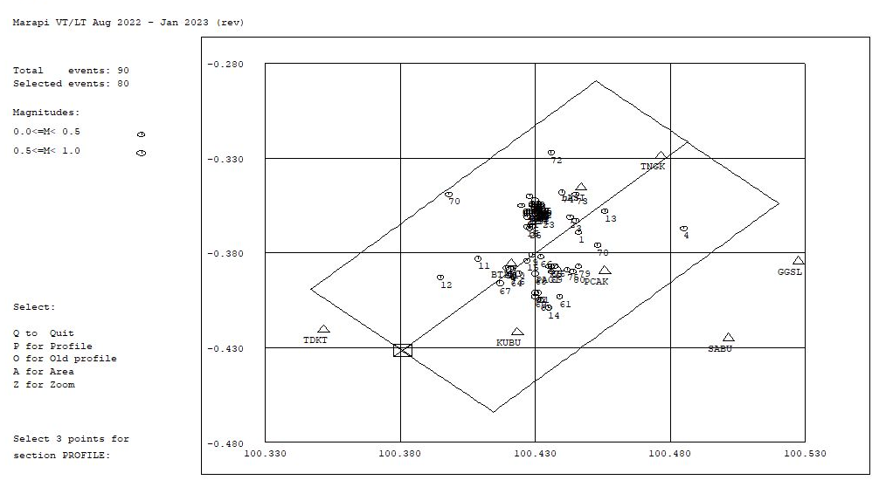
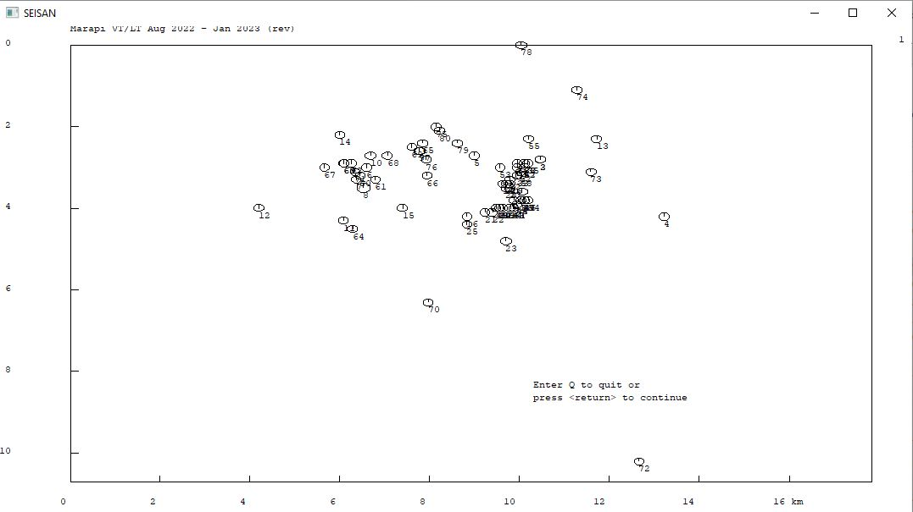
Pre – Phase 1
(a)
Subtle changes in seismicity were observed during the seismic swarms of September 2022. The events (left) were located 2–4 km deep, northwest of the active crater.
(b)
Hypocenters of earthquakes Aug - Dec 2022:
(a) Seismic swarm events in September 2022 (red circle).
(b) Earthquake depths projected along
a SW–NE cross-section.

Slide 16
Can earthworm be used for event classification on volcanoes?
While Earthworm is highly effective for basic earthquake detection and location, its core modules do not inherently perform sophisticated, automatic classification of diverse volcanic event types like volcano-tectonic (VT), long-period (LP), very-long-period (VLP), or tremor events.
Earthworm's primary automated functions focus on:
Detection of phase arrivals (P and S waves).
Association of these arrivals into locatable events.
Location and magnitude calculation for standard, impulsive earthquakes (primarily VTs).
Event Classification Capabilities
The capabilities within the standard Earthworm distribution for classification are limited to:
RSAM (Real-time Seismic Amplitude Measurement): Monitoring general background amplitude levels, which is a key tool in volcano monitoring, but not a classification of specific event types.
Swarm Alarms: Triggering alerts based on an increased rate of detected events, rather than the type of event.

Slide 17
Enhancing Classification Capabilities
To achieve automatic event classification in an Earthworm environment, volcano observatories typically employ supplementary methods:
Human Review: The most common approach involves human analysts using client software like SWARM to visually inspect waveforms, classify events manually, and refine the automatic solutions.
External Software Integration: Researchers often use dedicated external software packages (e.g., in Python, such as ObsPy or EQCorrScan) to perform template matching on historical waveform data, including data archived from Earthworm systems (e.g., from a Winston database or SAC files). The results (new event times, picks) can then be imported back into Earthworm for location and archiving.
Custom Modules: Observatories may develop their own custom Earthworm modules tailored to the specific characteristics of the local volcano, but these are not part of the generic Earthworm distribution.
Machine Learning Integration: Research has shown that machine learning (ML) algorithms (such as Neural Networks or Hidden Markov Models) can achieve high accuracy in classifying different volcanic event types (Type A/B, LP, VLP, Tremor). These ML-based classifiers are often developed as external tools or "wrappers" that interface with Earthworm's data streams and products, rather than being built-in standard modules.

