Slide 1


Intro on FDSN compliant format for seismic waveform data
& seismic station metadata
Day-2 Tuesday 18 November 2025 15:45 – 16:15
18 November 2025

Slide 2
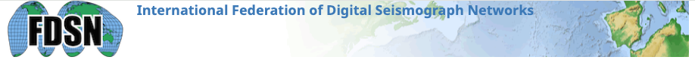
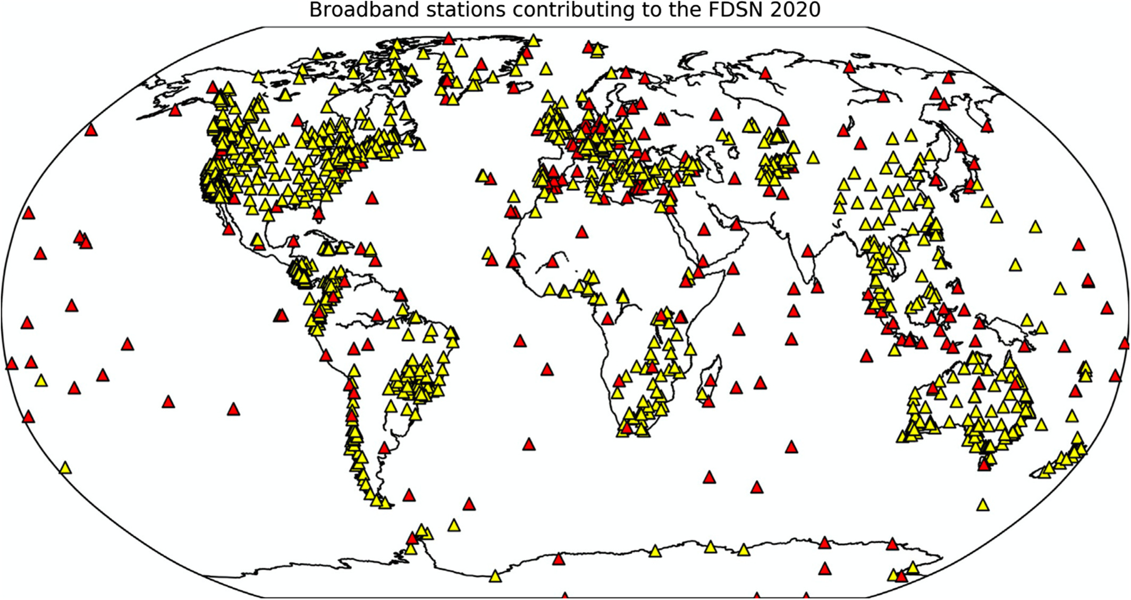
The International Federation of Digital Seismograph Networks (FDSN) is a global consortium of organizations that install and operate broadband seismic stations.
This collaboration supports global seismic monitoring and advances Earth science.
FDSN establishes standards for high-quality seismic networks, including globally distributed stations, continuous 24-bit recordings, and sampling rates of ≥20 Hz.
It also developed the universal data-distribution standard SEED (Standard for the Exchange of Earthquake Data) for sharing broadband waveform data and parametric information.
FDSN operates as a commission of IASPEI and promotes interoperability and consistency across global seismic networks.
The primary FDSN-compliant formats are:
  miniSEED for waveform data
  StationXML for station metadata.
The Federation of Digital Seismograph Networks (FDSN) stations as of 2020. From B. A. Romanowicz (2021).

Slide 3

miniSEED is the standard format for the efficient exchange and archival of continuous or event-based digital seismic time series data.
It is a data-only format, meaning it primarily contains the raw digital time series (waveform) data and essential header information like station and channel identifiers, sample rate, and timing, but generally excludes detailed instrument response information.
Key characteristics:
  Efficiency: Designed for the transmission of large volumes of data, including real-time data streaming (often using the FDSN SeedLink protocol).
  Primary Use: The standard for most raw data in seismic data archives.
  Version 3: FDSN miniSEED 3 is the latest version, an independent enhancement relative to the miniSEED defined in the original SEED 2.4 standard.
https://docs.fdsn.org/projects/miniseed3/en/latest/
miniSEED v3 rev. 2023-01-18.

Slide 4
A MiniSEED file contains only seismic time-series data and minimal header information.
It is a compact, binary subset of the broader SEED standard, designed specifically for efficient storage and exchange of waveform data.
A MiniSEED file contains:
1. Binary Time-Series Data (the main content)
  MiniSEED stores ground-motion samples recorded by seismic sensors.
  These samples are usually integers (e.g., 32-bit) and may be compressed using formats such as:
    Steim-1
    Steim-2
    Uncompressed integer formats
  The time series is usually split into fixed-length data records (commonly 512 or 4096 bytes), each containing a fixed number of samples.
2. Minimal Header Information (per record)
  Each data record includes a short header with essential metadata needed to interpret the waveform:
  Required identification fields:
Network code (e.g., IU, GE, II)
Station code
Location code
Channel code (e.g., HHZ, BHN)
Start time of the record
Number of samples
Sample rate

Slide 5
  Data-quality flags
    Record type and quality indicator (e.g., ‘D’ for waveform data)
    Flags for data gaps, timing errors, clipping, etc.
  Blockettes (MiniSEED v2 only)
  Compact metadata blocks (optional) such as:
    Blockette 100 – sample rate as a floating-point
    Blockette 1000 – encoding/compression format, byte order
    Blockette 1001 – microsecond timing, data quality flags
  Note: MiniSEED does NOT include full station metadata (responses, coordinates, instrument details).
  Those are stored separately in StationXML, RESP, or full SEED volumes.
3. What MiniSEED does NOT contain
  MiniSEED is intentionally minimal.
  It does not store:
          Sensor response or calibration information
          Instrument type, gain, poles & zeros
          Station coordinates or site metadata
          Channel orientation details
          Event information (origin, magnitude, picks)
  This is why MiniSEED must be paired with StationXML for proper scientific processing (e.g., removing instrument response).

Slide 6

The IRIS miniSEED data repository uses the SeisComp Data Structure (SDS) file naming convention for local data files. This directory structure is organized hierarchically by network, station, location, and channel, typically down to the day-level files.
The common directory and file naming structure is as follows:
[base_directory]/[NETWORK]/[STATION]/[LOCATION]/[CHANNEL].[TYPE].[YEAR]/[NETWORK].[STATION].[LOCATION].[CHANNEL].[TYPE].[YEAR].[DAY]
Key components of the structure:
[base_directory]: The top-level directory where data is stored.
[NETWORK]: The network code (e.g., IU, G, etc.).
[STATION]: The station code (e.g., ANMO, CHTO).
[LOCATION]: The location code (often empty or two characters).
[CHANNEL]: The channel code (e.g., BHZ, BHN).
[TYPE]: The data type, typically 'D' for data records.
[YEAR]: The four-digit year (e.g., 2024).
[DAY]: The three-digit Julian day of the year (e.g., 001 to 365/366).
For example, a file path might look like:
data/IU/ANMO/00/BHZ.D.2024/IU.ANMO.00.BHZ.D.2024.001

Slide 7
Station Metadata Format: FDSN StationXML
StationXML is the FDSN's modern, XML-based standard for describing the comprehensive metadata associated with a seismic station and its instrumentation.
It was developed to overcome the limitations of the older Dataless SEED format and is a key component of FDSN web services for data discovery and access.
Key characteristics:
  Comprehensive Information: Defines the structure for important and commonly used metadata, including station location (latitude, longitude, elevation), instrument type and response (gain, filter information, etc.), and operational history.
  Extensibility: Being XML-based, it is flexible and can be extended with additional fields, which was a significant improvement over the fixed-length limitations of Dataless SEED.
  Interoperability: Facilitates data usability by providing a standardized, machine-readable description of how waveform data was acquired, which is essential for data processing and analysis.
https://www.fdsn.org/xml/station/
https://www.fdsn.org/xml/station/fdsn-station-1.1.xsd
XSD | Defines rules for XML | Structure, allowed elements, data types, constraints
XML | Stores structured data | Metadata content (stations, channels, responses, etc.)
Format | Purpose | Contains

Slide 8
XML (eXtensible Markup Language) is a text-based format used to store and structure data in a human-readable and machine-readable way.
Key characteristics:
  Uses tags (like HTML) to organize data.
  Hierarchical structure → elements inside elements.
  Flexible and self-descriptive.
  Widely used for metadata, configuration files, and data exchange.
FDSN StationXML:
XML stores station metadata such as:
  Station coordinates
  Channel orientations
  Instrument response (poles, zeros, gains)
  Operational history
  Sensor/datalogger properties

Slide 9
XSD (XML Schema Definition) is a file that defines the rules for an XML file.
It tells you what structure and data types an XML document must follow.
What an XSD specifies:
  Which elements must appear
  Allowed attributes
  Data types (integer, float, string, date)
  Element order
  Optional vs required elements
It ensures the XML content is:
  Valid
  Complete
  Consistent
  Machine-checkable
The FDSN StationXML schema is an XSD file that defines:
  How a station must be represented
  How responses must be structured
  What units, tags, and elements are allowable
Software like ObsPy uses the XSD to validate StationXML files before reading them.

Slide 10
Short Summary
Format | Purpose | Contains
XML | Stores structured data | Metadata content (stations, channels, responses, etc.)
XSD | Defines rules for XML | Structure, allowed elements, data types, constraints
https://www.fdsn.org/xml/station/
https://www.fdsn.org/xml/station/fdsn-station-1.1.xsd

Slide 11
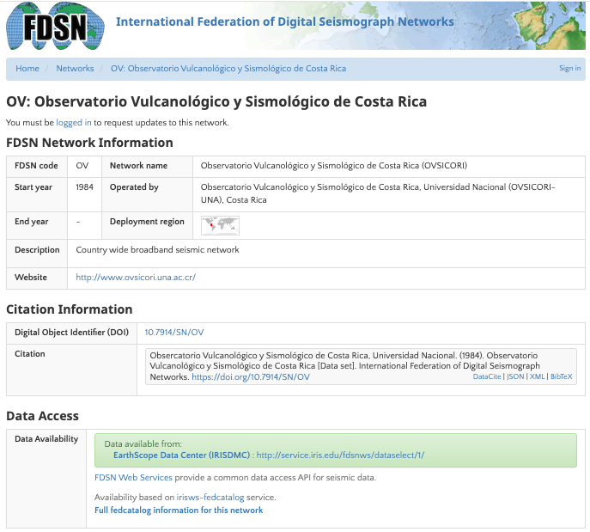
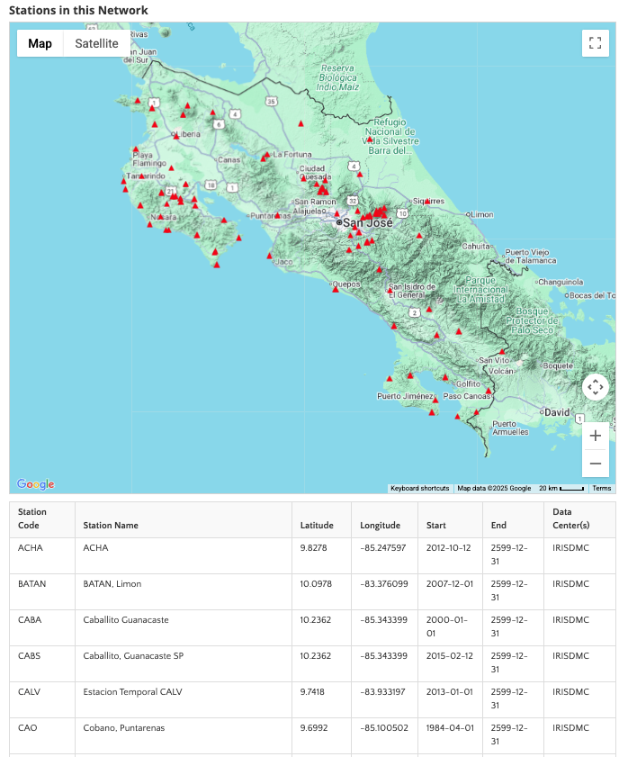
The FDSN was also instrumental in development of a universal standard for distribution of broadband waveform data and related parametric information. The Standard for Exchange of Earthquake Data (SEED) format is the result of that effort.
Network codes (permanent & temporary)are also assigned by the FDSN in order to provide uniqueness to seismological data streams.
https://www.fdsn.org/networks/

Slide 12
Waveform data formats
miniSEED
According to the standards of the FDSN (International Federation of Digital Seismograph Networks), data is archived and available in miniSEED format
Seed Manual, Standard for Earthquake Exchange Data, data only: https://www.fdsn.org/pdf/SEEDManual_V2.4.pdf
miniSEED data is identified by standardized codes for networks (groups of stations), stations (groups of channels), location and channels. This information is present in the file header.
  network code: a 1 or 2-character code identifying the network/owner of the data (e.g., G, FR).
  station code: a 1 to 5-character identifier for the station recording the data (e.g., ECH, RUSF);
  location code: a 2-character code used to uniquely identify different data streams at a single station (often, 00);
  channel code: a 3-character combination used to identify the 1) band and general sample rate 2) the instrument type and 3) the orientation of the sensor (e.g., HHZ, HHE, HNZ, HNE).
  https://ds.iris.edu/ds/nodes/dmc/tools/data_channels/#???

Slide 13
Unique identifiers for data sources exchanged and archived
The FDSN defines, allocates and adopts a number of codes that, when combined in a hierarchy, uniquely identify a data source at a given time.
The identifer is constructed by combining network, station, location and channel codes, where the channel code is further subdivided into band, source and subsource codes.
This single-string identifier uniquely identifies a source in FDSN formats and services.
FDSN:<network>_<station>_<location>_<band>_<source>_<subsource>
Channel codes
Band: Indicates the general sampling rate and response band of the data source. May be empty for non-time series data.
Source: Identifies an instrument or other general data source. Cannot be empty.
Subsource: Identifies a sub-category within the source, often the orientation, relative positon, or sensor type. The meaning of subsource codes are specific to the containing source. May be empty.
https://docs.fdsn.org/projects/source-identifiers/en/v1.0/index.html

Slide 14
Band Code
The band code specifies the general sampling rate and the approximate response band of the instrument (when applicable to the data source).
Band code | Band type | Sample rate (samples per sec) | Lower bound (sec)
J | … | > 5000
F | … | >= 1000 to < 5000 | >= 10 sec
G | … | >= 1000 to < 5000 | < 10 sec
D | … | >= 250 to < 1000 | < 10 sec
C | … | >= 250 to < 1000 | >= 10 sec
E | Extremely Short Period | >= 80 to < 250 | < 10 sec
S | Short Period | >= 10 to < 80 | < 10 sec
H | High Broadband | >= 80 to < 250 | >= 10 sec
B | Broadband | >= 10 to < 80 | >= 10 sec
M | Mid Period | > 1 to < 10
L | Long Period | ~ 1
V | Very Long Period | >= 0.1 to < 1
U | Ultra Long Period | >= 0.01 to < 0.1
W | Ultra-ultra Long Period | >= 0.001 to < 0.01
R | Extremely Long Period | >= 0.0001 to < 0.001
P | On order of 0.1 to 1 day | >= 0.00001 to < 0.0001
T | On order of 1 to 10 days | >= 0.000001 to < 0.00001
Q | Greater than 10 days | < 0.000001
I | Irregularly sampled | irregular
A | Administrative | variable, DEPRECATED
O | Opaque | variable, DEPRECATED

Slide 15
Source and Subsource Codes
Geographic orientation subsource codes
Traditional orientation values of North-Source (N), East-West (E), and Vertical (Z) should only be used when within 5 degress of true directions. Do not use N or E designations if the orientation of horizontal components is known to deviate more than 5 degrees from true North/East.
For orthogonal components that are in nontraditional orientations, if the orientation of the horizontal components is known to deviate more than 5 degrees from true North and East, the respective channels should be named 1, 2 instead of N, E (N->1, E->2).
Subsource codes | Description
N, E, Z | Traditional orientations of North (N), East (E), and Up (Z) When within 5 degrees of true directions
1, 2, Z | Orthogonal components, nontraditional horizontals
1, 2, 3 | Orthogonal components, nontraditional orientations
T, R | For rotated components or beams (Transverse, Radial)
A, B, C | Triaxial (Along the edges of a cube turned up on a corner)
U, V, W | Optional components, also used for raw triaxial output

Slide 16
Seismometer
Measures displacement/velocity/acceleration along a line defined by the the dip and azimuth.
Source Code
H | High Gain Seismometer
L | Low Gain Seismometer
M | Mass Position Seismometer
N | Accelerometer
P | Geophone, very short period seismometer with natural frequency 5 - 10 Hz or higher
Dip/Azimuth: Ground motion vector
Signal Units: m, m/s, m/s**2
Subsource Code
N, E, Z | Traditional orientations of North (N), East (E), and Up (Z) When within 5 degrees of true directions
1, 2, Z | Orthogonal components, nontraditional horizontals
1, 2, 3 | Orthogonal components, nontraditional orientations
T, R | For rotated components or beams (Transverse, Radial)
A, B, C | Triaxial (Along the edges of a cube turned up on a corner)
U, V, W | Optional components, also used for raw triaxial output

Slide 17
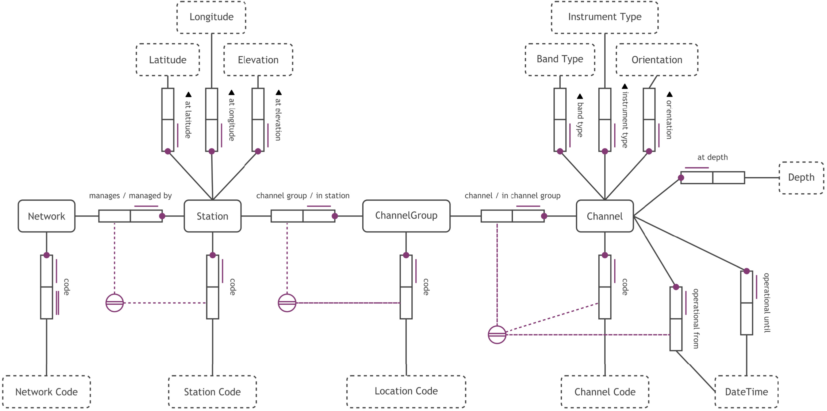
Object-Role Modeling diagram for the station knowledge ontology.
Entity types (e.g., Station) are represented by solid-edged rectangles. Value types (e.g., Elevation) are represented by dashed-edged rectangles. Binary fact types—for example: “Each Station is managed by exactly one Network”—are represented by entity and value types connected to a pair of roleboxes, along with a set of constraints (in violet). Edge names are indicated with text next to the roleboxes. Violet lines next to the roleboxes indicate uniqueness constraints, whereas violet dots indicate mandatory roles. A double violet line indicates a preferred identification scheme. Violet dashed lines leading to violet symbols correspond to an external preferred identification scheme.
Davis, W., and Hunt, C. R. (2024).
Notes:
Davis, W., and Hunt, C. R. (2024). Knowledge graphs for seismic data and metadata. Appl. Comput. Geosci. 21, 100151. doi: https://doi.org/10.1016/j.acags.2023.100151.

Slide 18

How to obtain the waveform & metadata
ObsPy is an open-source project dedicated to provide a Python framework for processing seismological data.
https://docs.obspy.org/
RoutingClient lets you query multiple FDSN data centers through a single interface.
"iris-federator" → queries IRIS and federated FDSN services
"eida-routing" → queries EIDA nodes in Europe
A ready-to-use ObsPy function that queries multiple volcanoes and combines IRIS + EIDA stations automatically
ObsPy inventories include network and station metadata, and you can check for open vs. restricted access because each station/network often has a restricted or restricted-status flag in the FDSN metadata.
While not all FDSN networks explicitly mark restricted stations, we can infer access based on availability fields.
Tests whether waveform data can be downloaded. We can do this by trying a minimal request for a waveform (e.g., 1 second) for each station/channel and catching obspy.clients.fdsn.header.FDSNNoDataException or obspy.clients.fdsn.header.FDSNHTTPException errors. A 403 Forbidden will indicate restricted access.

Slide 19
obspy.clients.fdsn - FDSN web service client for ObsPy
from obspy import UTCDateTime
client = RoutingClient("iris-federator")
st = client.get_waveforms(
channel="LHZ", starttime=UTCDateTime(2017, 1, 1),
endtime=UTCDateTime(2017, 1, 1, 0, 5), latitude=10,
longitude=10, maxradius=25)
print(st)
2 Trace(s) in Stream:
II.MBAR.00.LHZ | 2017-01-01T00:00:00Z - ... | 1.0 Hz, 300 samples
II.MBAR.10.LHZ | 2017-01-01T00:00:00Z - ... | 1.0 Hz, 300 samples
client = RoutingClient("iris-federator")
inv = client.get_stations(
channel="LHZ", starttime=UTCDateTime(2017, 1, 1),
endtime=UTCDateTime(2017, 1, 1, 0, 5), latitude=10,
level="channel", longitude=10, maxradius=25)
print(inv)
Inventory created at 2017-10-09T14:26:28.466161Z
Created by: ObsPy 1.0.3.post0+1706.gef068de324.dirty
https://www.obspy.org
Sending institution: IRIS-DMC,ObsPy ..., SeisComP3 (GFZ,IPGP, IRIS-DMC)
Contains:
Networks (6):
AF, G, II, IU, TT, YY
Stations (10):
AF.EKNA (Ekona, Cameroon)
AF.KIG (Kigali, Rwanda)
G.TAM (Tamanrasset, Algeria)
II.MBAR (Mbarara, Uganda)
IU.KOWA (Kowa, Mali)
TT.TATN (Station Tataouine, Tunisia)
YY.GIDA (Health Center, Gidami, Ethiopia)
YY.GUBA (Police Station, Guba, Ethiopia)
YY.MEND (High School, Mendi, Ethiopia)
YY.SHER (Police Station, Sherkole, Ethiopia)
Channels (11):
AF.EKNA..LHZ, AF.KIG..LHZ, G.TAM.00.LHZ, II.MBAR.00.LHZ,
II.MBAR.10.LHZ, IU.KOWA.00.LHZ, TT.TATN.00.LHZ, YY.GIDA..LHZ,
YY.GUBA..LHZ, YY.MEND..LHZ, YY.SHER..LHZ
https://docs.obspy.org/packages/obspy.clients.fdsn.html

Slide 20
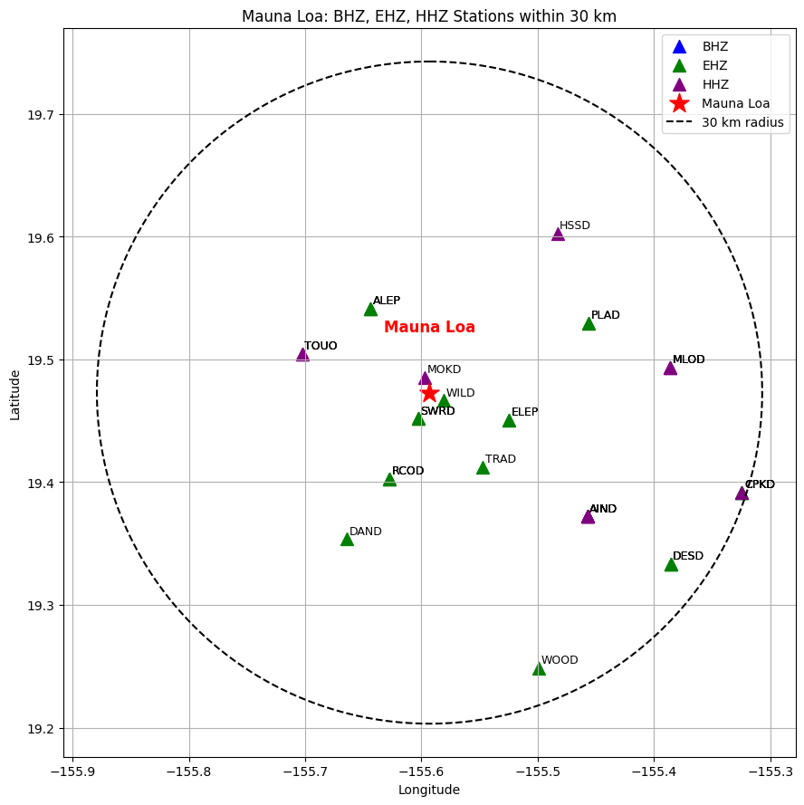
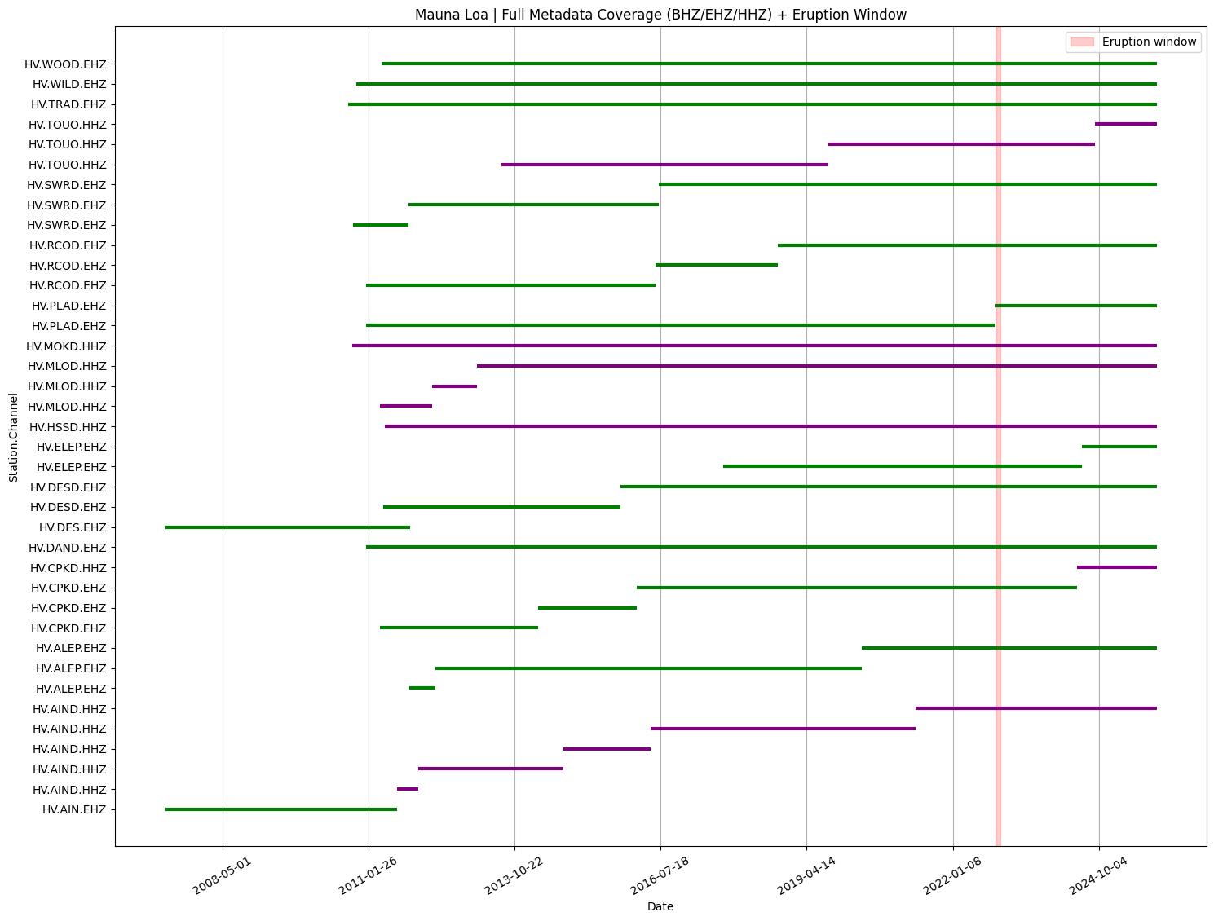
Case Example: Mauna Loa - Hawaii

Slide 21
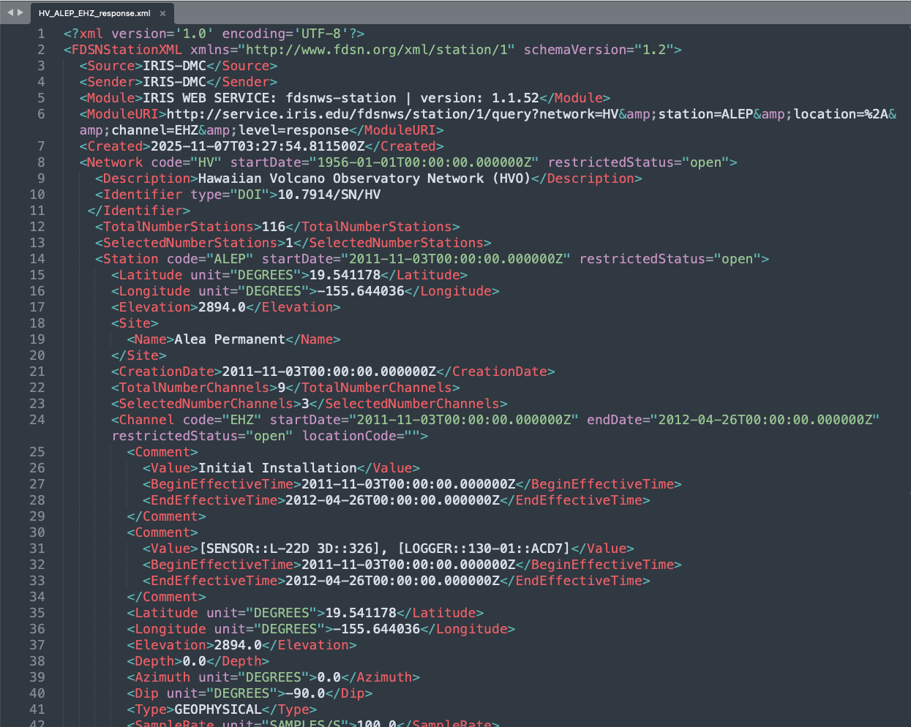
Example (XML):
XML stores metadata such as:
Network information
Station information
Channel information
Operational history

Slide 22
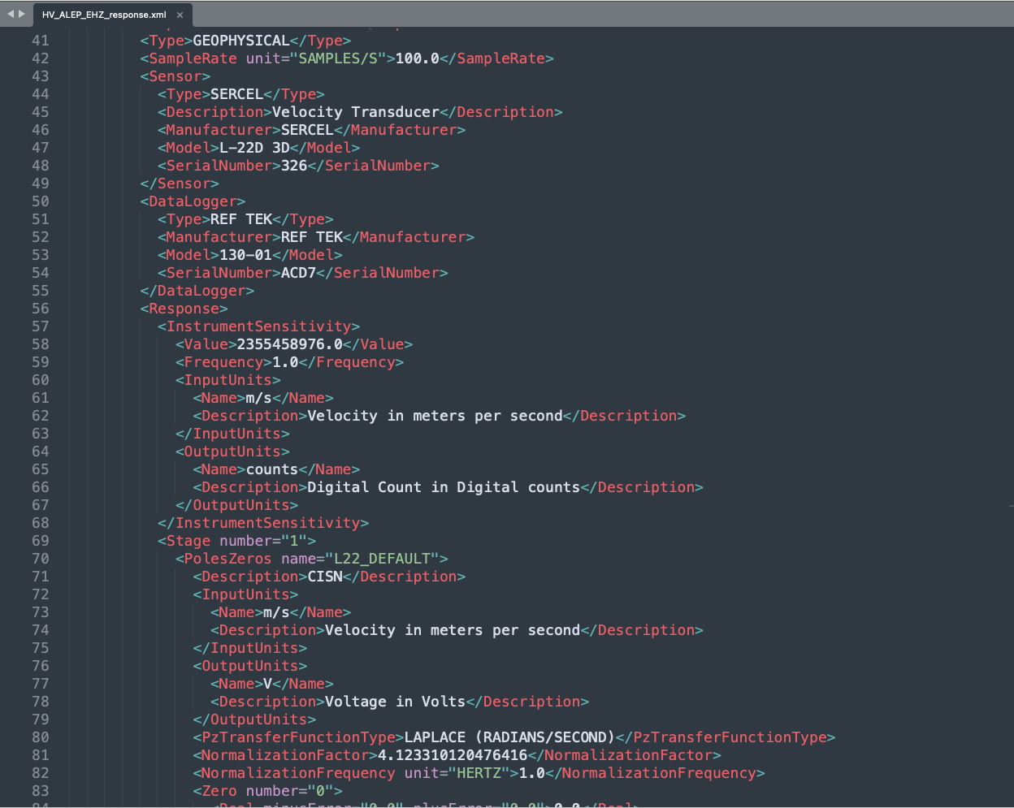
Example (XML):
XML stores metadata such as:
Sensor/datalogger properties
Instrument response (poles, zeros, gains)

Slide 23
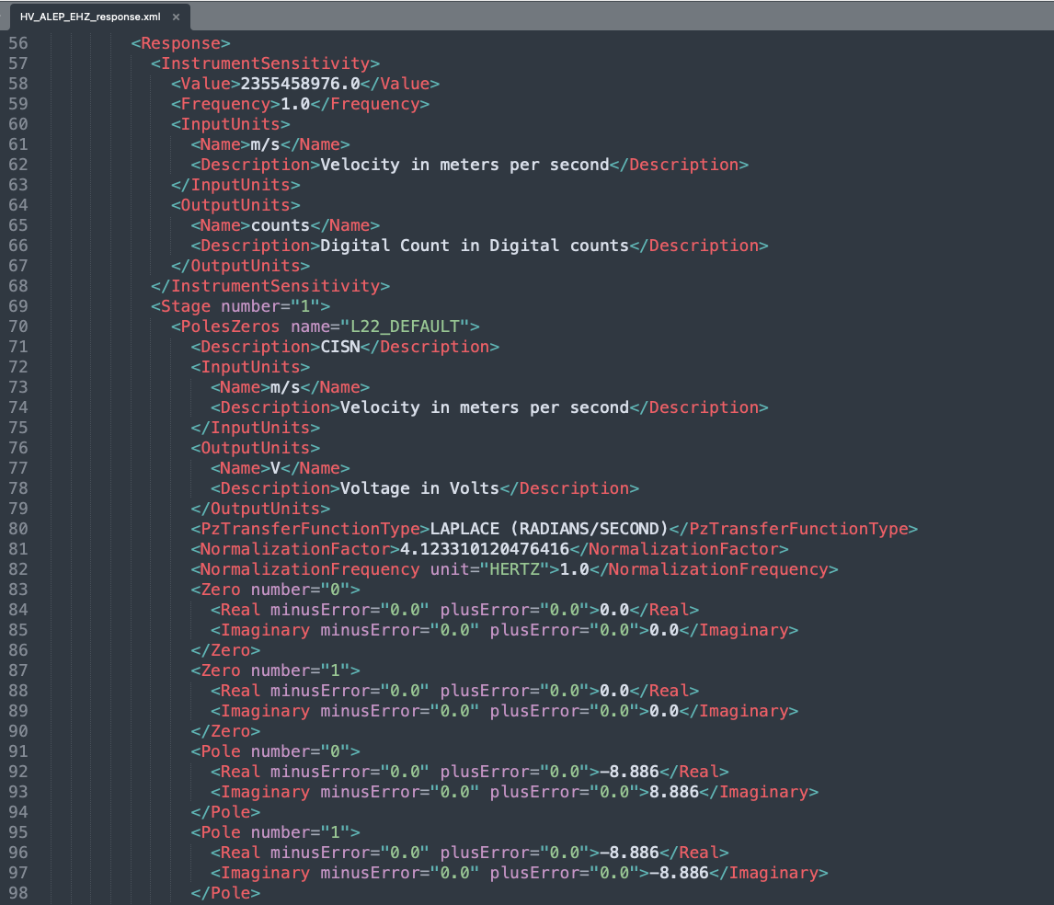
Example (XML):
XML stores metadata such as:
Instrument response (poles, zeros, gains)

Slide 24
=== Stream Metadata ===
1 Trace(s) in Stream:
HV.ALEP..EHZ | 2022-11-28T00:00:00.000000Z - 2022-11-29T00:00:00.000000Z | 100.0 Hz, 8640001 samples
=== Gap Report ===
Source Last Sample Next Sample Delta Samples
Total: 0 gap(s) and 0 overlap(s)
Detected waveform sampling rate: 100.0 Hz
Downloading full StationXML metadata...
Network: HV
Station: ALEP
Channel: EHZ
=============================
FULL STATION METADATA DUMP
=============================
--- Network: HV ---
Description : Hawaiian Volcano Observatory Network (HVO)
Stations : 1
----------------------------------------
Station: ALEP
Latitude : 19.541178
Longitude : -155.644036
Elevation : 2894.0 m
Start Date : 2011-11-03T00:00:00.000000Z
End Date : None
---- Channel ----
Code : EHZ
Location :
Depth : 0.0 m
Azimuth : 0.0
Dip : -90.0
Sample Rate : 100.0 Hz
Start : 2020-04-27T00:00:00.000000Z
End : None
--- Sensor ---
Type : SERCEL
Description : Velocity Transducer
Manufacturer : SERCEL
Model : L-22D 3D
Serial Number : 326
--- Data Logger ---
Type : NANOMETRICS
Description : None
Manufacturer : NANOMETRICS
Model : CENTAUR
Serial Number : 6119
Gain : (gain appears in response stages)

Slide 25
Network: HV
Station: ALEP
Channel: EHZ
--- Response Stages ---
Stage 1: PolesZerosResponseStage
Stage Gain : 117.0 (unit unknown)
Response type: PolesZerosResponseStage, Stage Sequence Number: 1
L22_DEFAULT (CISN)
From m/s (Velocity in meters per second) to V (Voltage in Volts)
Stage gain: 117.0, defined at 1.00 Hz
Transfer function type: LAPLACE (RADIANS/SECOND)
Normalization factor: 4.12331, Normalization frequency: 1.00 Hz
Poles: (-8.886+8.886j), (-8.886-8.886j)
Zeros: 0j, 0j
Stage 2: CoefficientsTypeResponseStage
Stage Gain : 400000.0 (unit unknown)
Response type: CoefficientsTypeResponseStage, Stage Sequence Number: 2
From V (Voltage in Volts) to counts (Digital Count in Digital counts)
Stage gain: 400000.0, defined at 1.00 Hz
Decimation:
Input Sample Rate: 100.00 Hz
Decimation Factor: 1
Decimation Offset: 0
Decimation Delay: 0.00
Decimation Correction: 0.00
Transfer function type: DIGITAL
Contains 0 numerators and 0 denominators
=== Response Summary ===
Channel Response
From m/s (Velocity in meters per second) to counts (Digital Count in Digital counts)
Overall Sensitivity: 4.68e+07 defined at 1.000 Hz
2 stages:
Stage 1: PolesZerosResponseStage from m/s to V, gain: 117
Stage 2: CoefficientsTypeResponseStage from V to counts, gain: 400000
Network: HV
Station: ALEP
Channel: EHZ

Slide 26
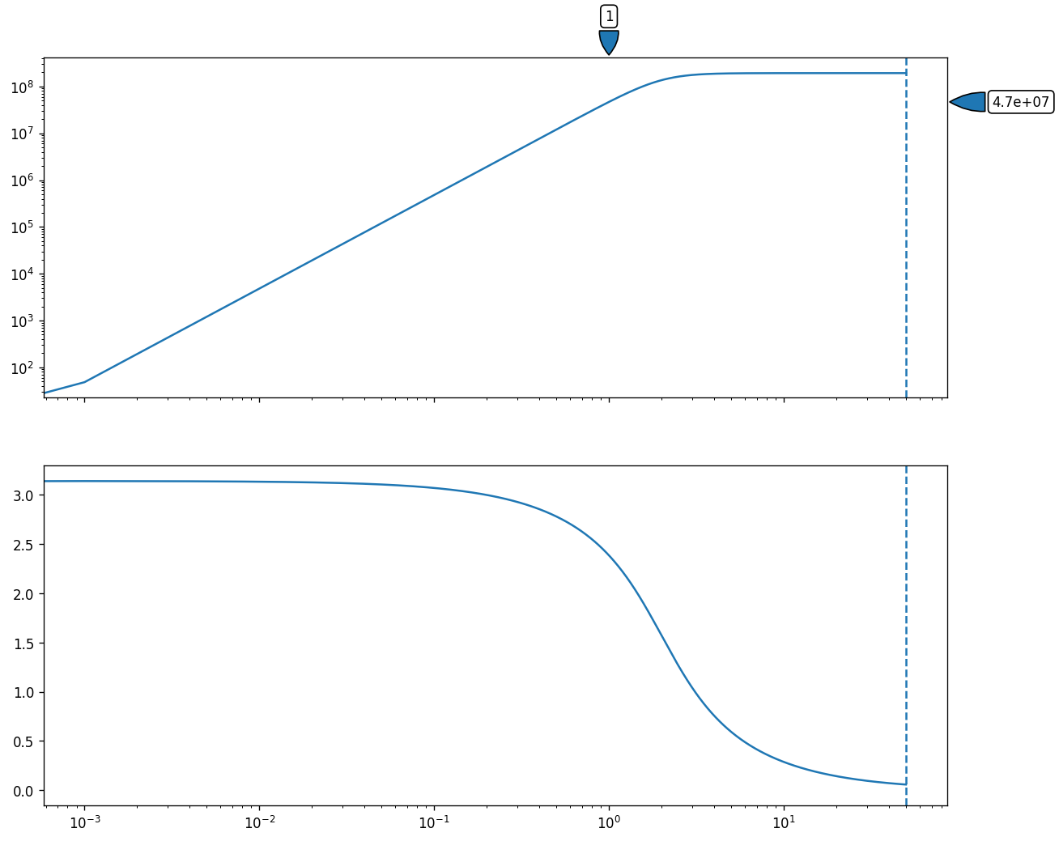
=== Instrument Bandwidth ===
Instrument sample rate: 100.0 Hz
Nyquist: 50.0 Hz
=== Plotting Instrument Response (Velocity) ===
Network: HV
Station: ALEP
Channel: EHZ
Network: HV
Station: ALEP
Channel: EHZ

Slide 27
The Role of the Original SEED
The original Standard for the Exchange of Earthquake Data (SEED) was the foundational international standard that incorporated both waveform data and metadata.
In practice, the full SEED format has largely been separated into its components: the efficient miniSEED for waveforms and the more flexible StationXML for metadata, though Dataless SEED files are still used for metadata conversion.
By adhering to these standards, the global seismological community ensures that data collected by different networks using various instruments can be seamlessly exchanged, processed, and analyzed.

