Slide 1
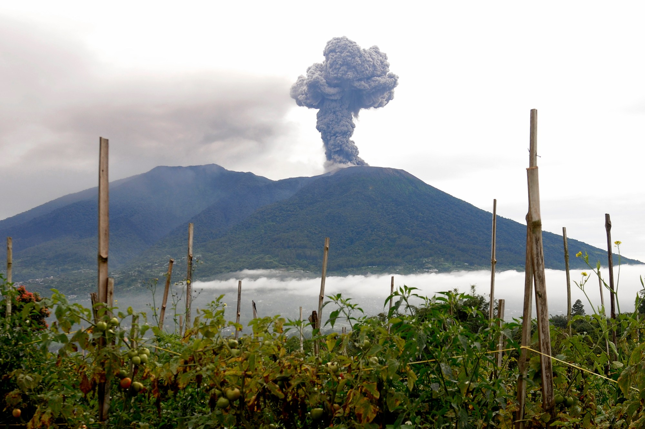

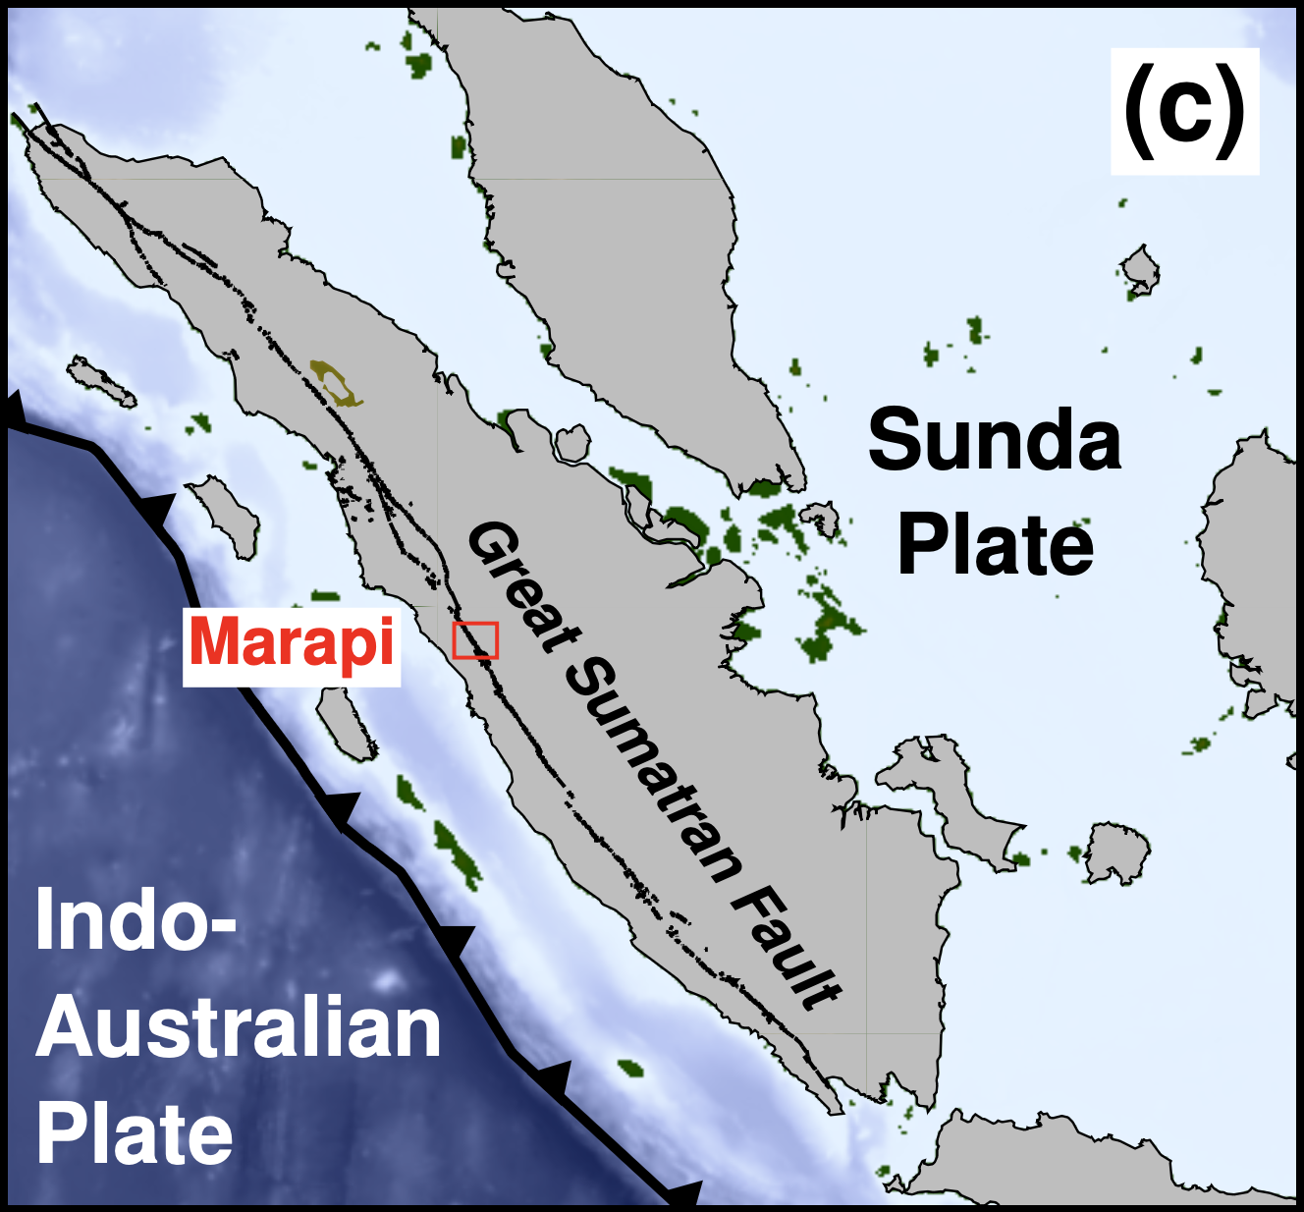

Machine Learning Identifies Precursory Long-Period Earthquake Signals Preceding Gas-driven Eruptions at Marapi Volcano, Indonesia
Research in progress ...
Mingye Feng
Research Fellow, Earth Observatory of Singapore
Nov 18, 2025
Collaborating with EOS volcanological group,
seismological group, and CVGHM, Indonesia
Marapi volcanic eruption on Dec. 4, 2023
thehill.com

Slide 2
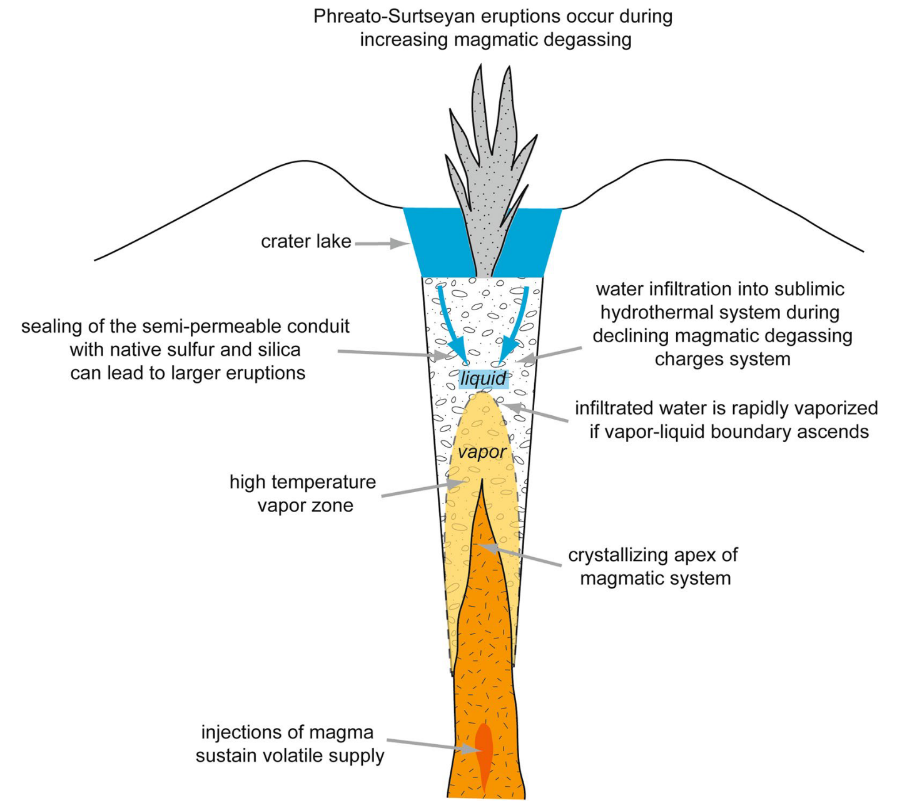
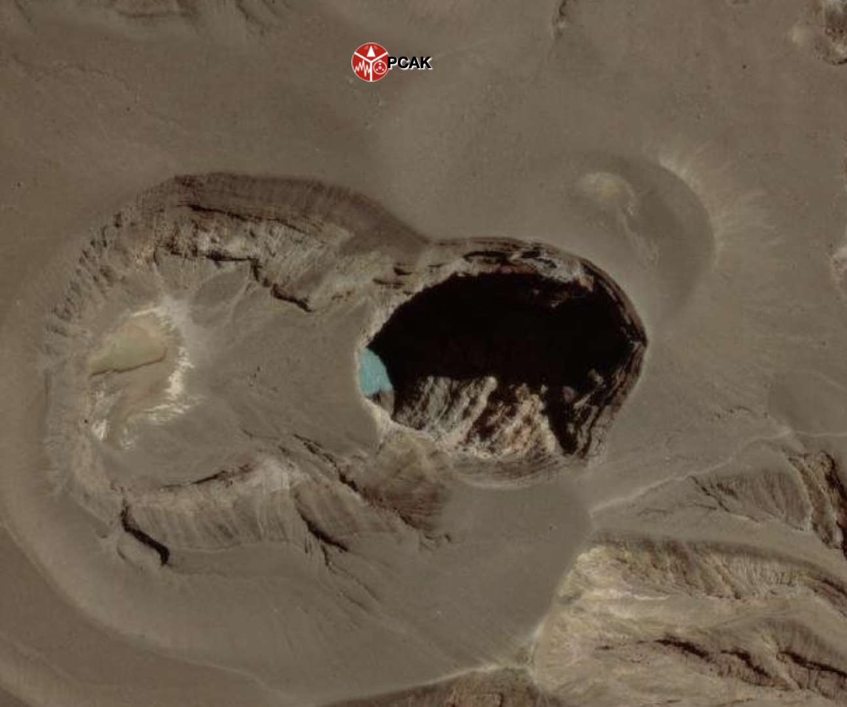
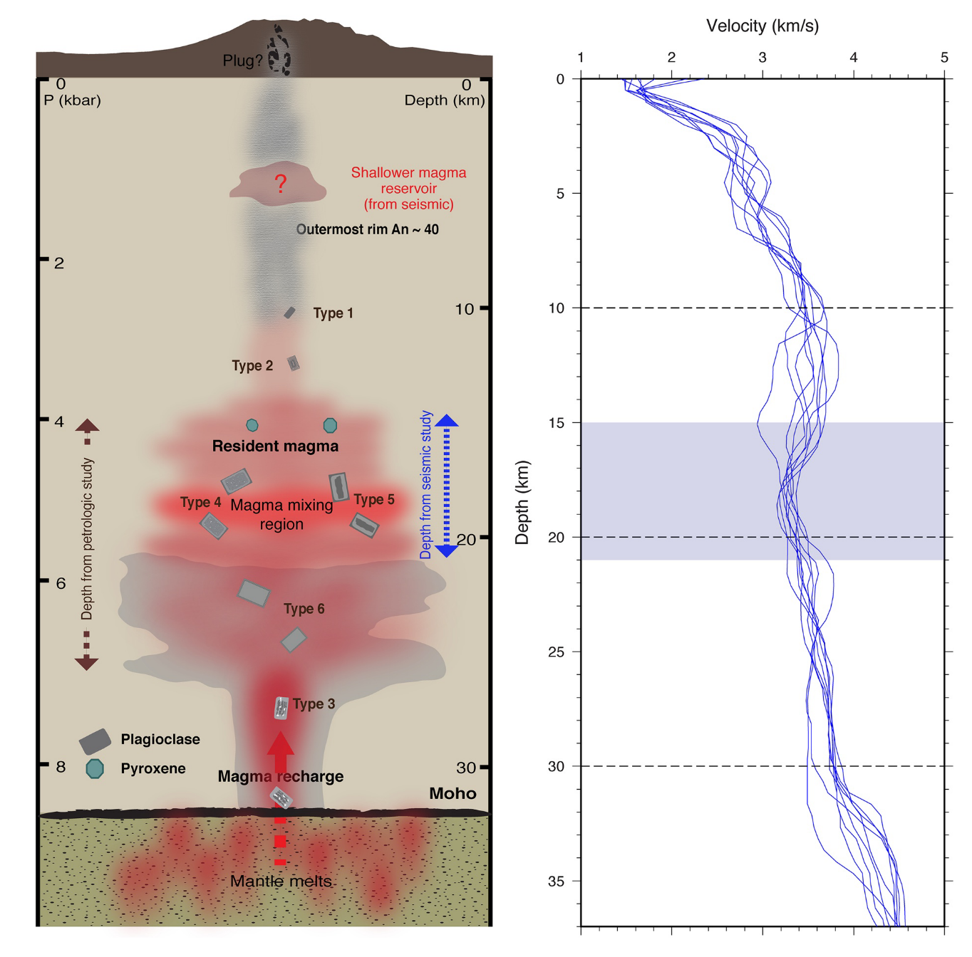
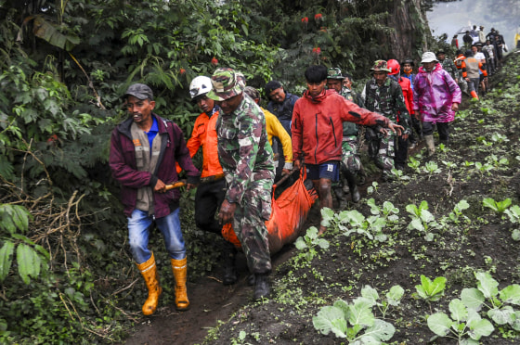
Marapi volcano has typical phreatic eruptions
Source from shallow magma chamber
Gas-driven eruption is difficult to predict
Marapi volcano
Velocity structure
Marapi Optical Satellite Image
from Esri World Imagery
A sudden eruption on 3 Dec 2023 killed 24 hikers
Nurfiani et al., 2021, G-cubed; Stix & de Moor, 2018, EPS
thehill.com; en.wikipedia.org; www.nbcnews.com

Slide 3
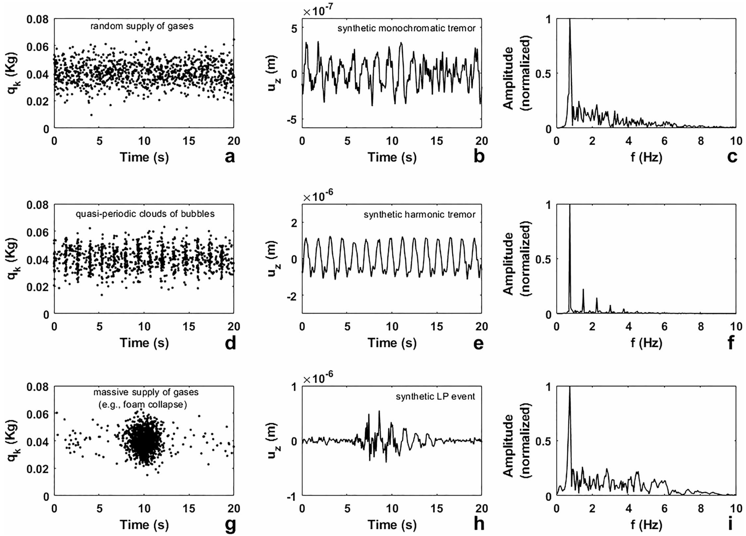
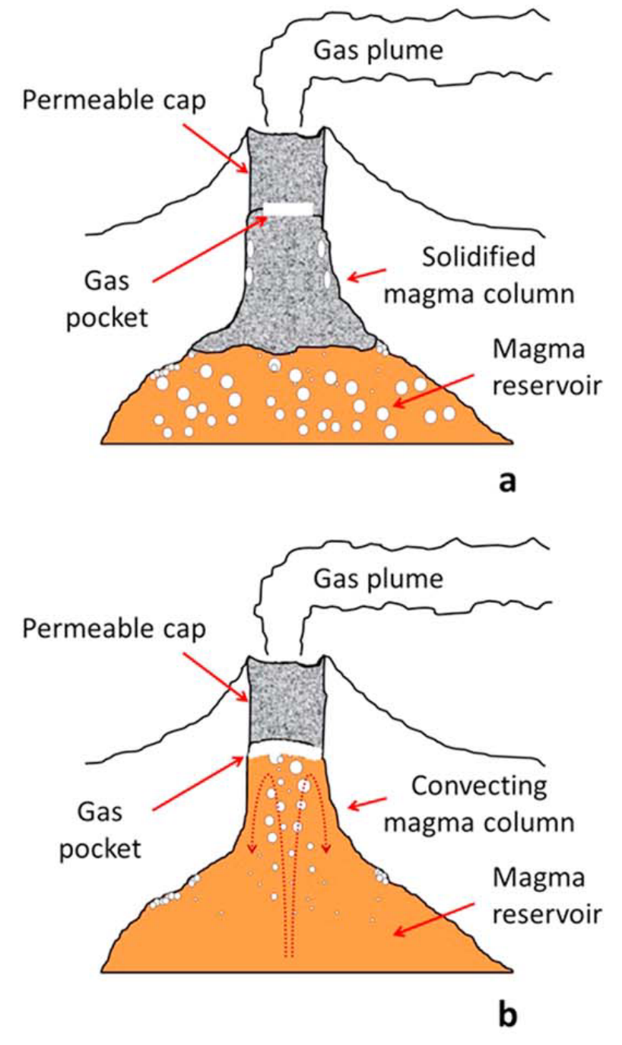
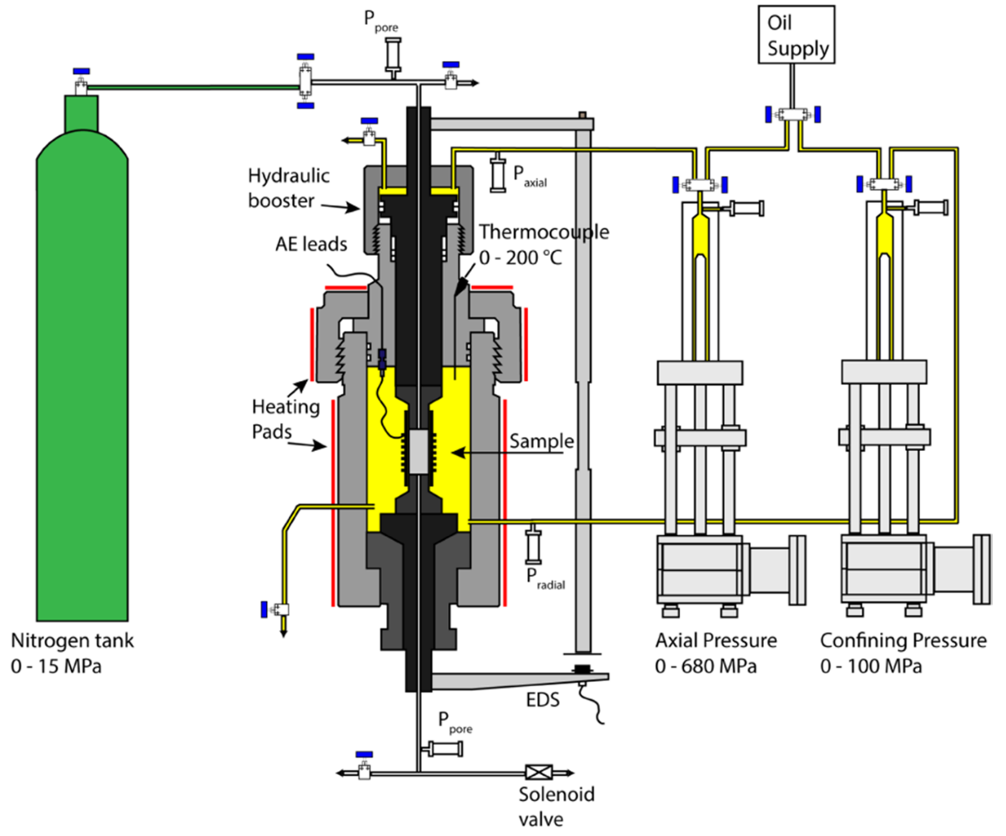
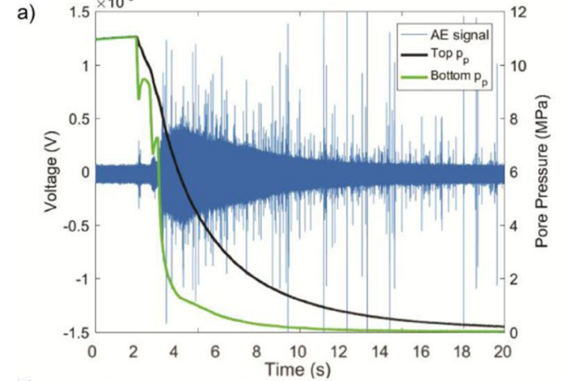
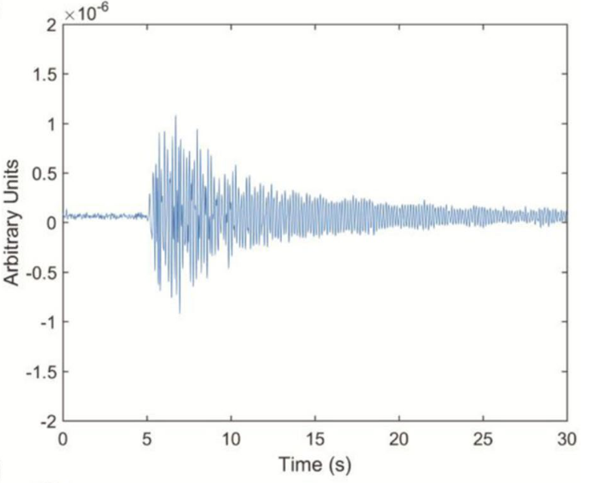
Gas supply --> long-period seismic signal: Precursor?
Shallow tremor signal modelling
(<1 km depth)
Sudden & massive gas supply
Long-period events (LPs)
Permeable cap
Solidified magma column
Gas pocket
Gas pressure gradient & resonance
Tornillo events
Laboratory
Field
Permeable cap
tornillo
Convecting
magma column
Gas pocket
Fazio et al., 2019, SR
Girona et al., 2019, JGR-SE

Slide 4
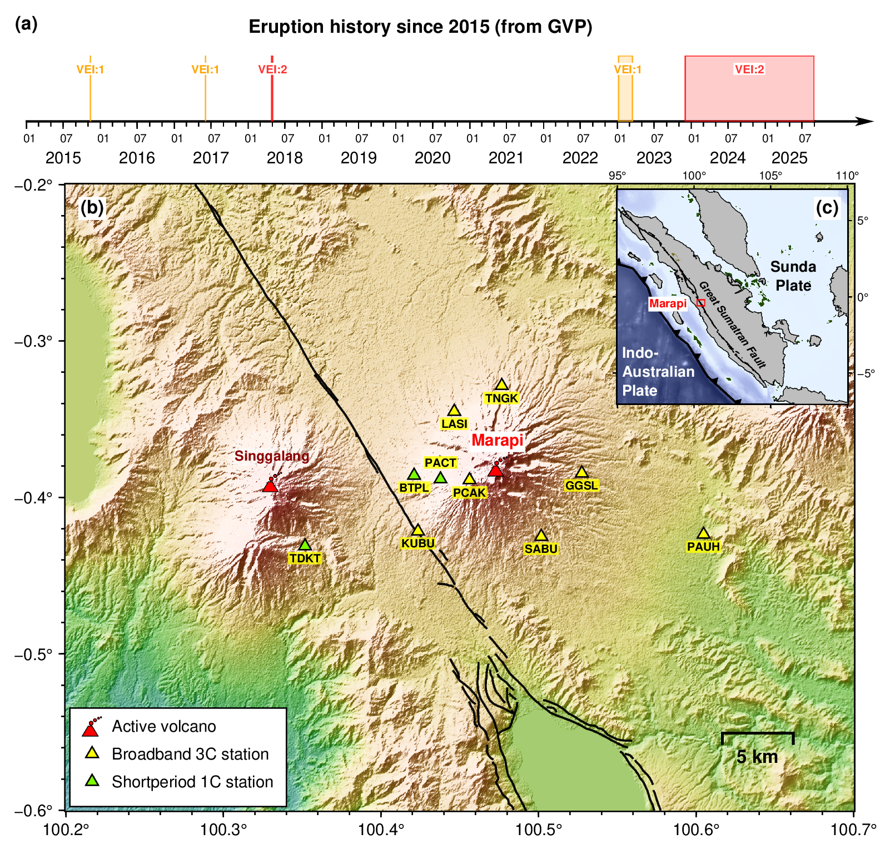
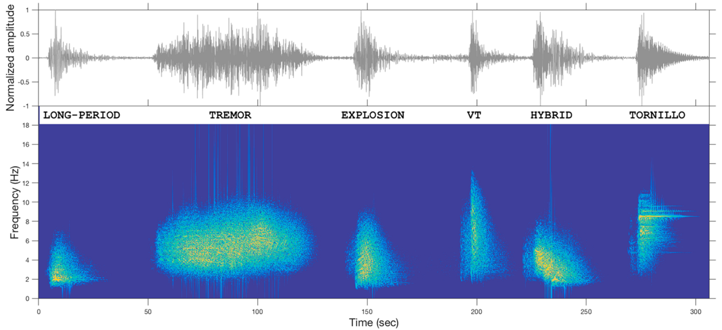
Seismic monitoring network installed since late 2014
7 3-C broadband seismic stations
3 1-C short period seismic stations
Volcano-related seismicity can be identified by
frequency spectrum
Malfante et al., 2018, JGR-SE
manual inspection

Slide 5
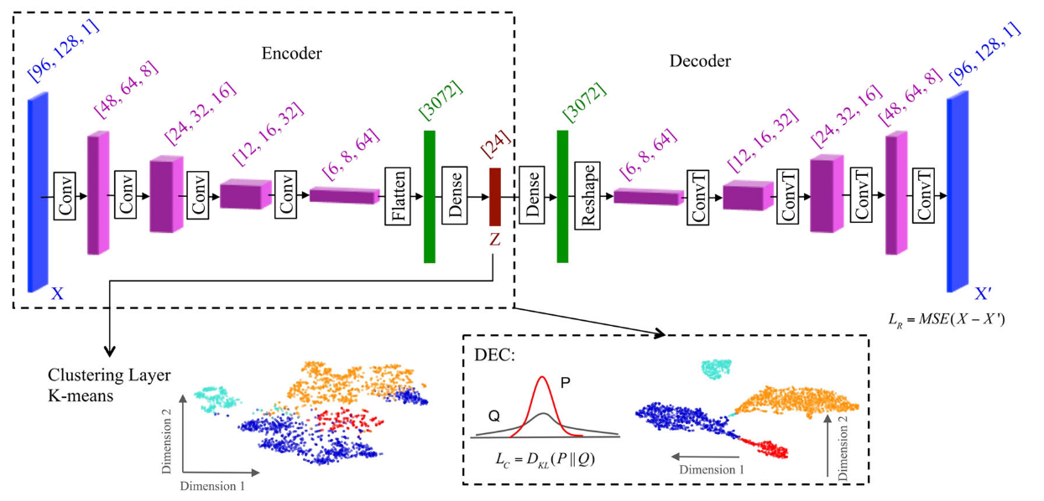
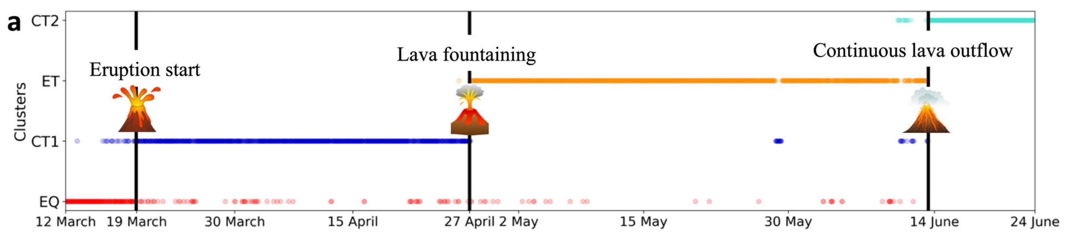
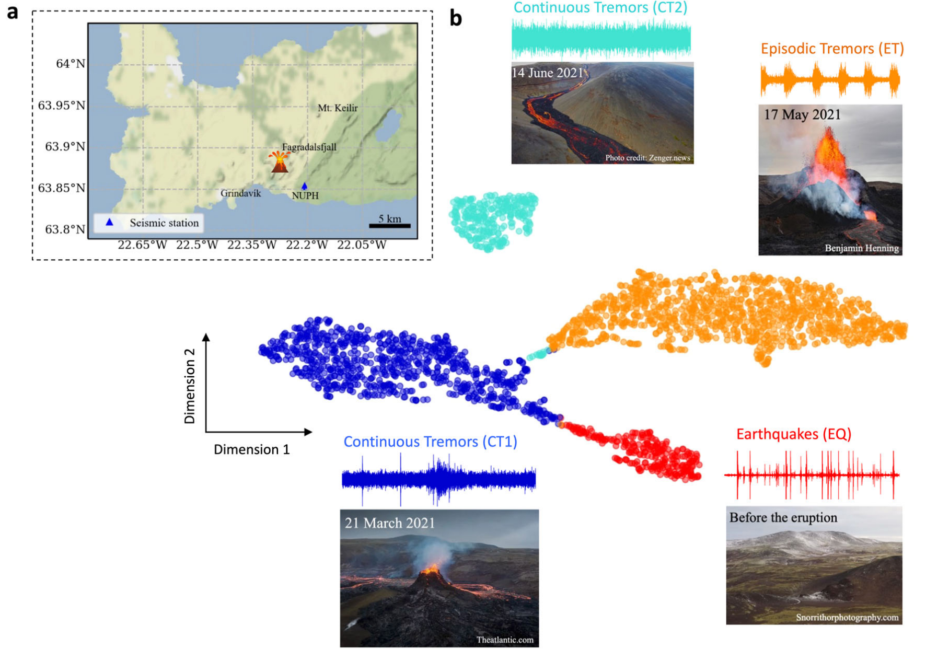
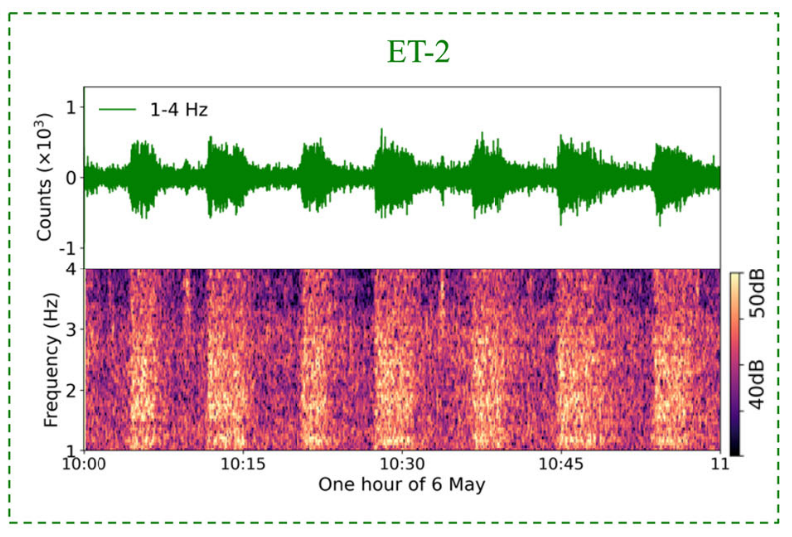
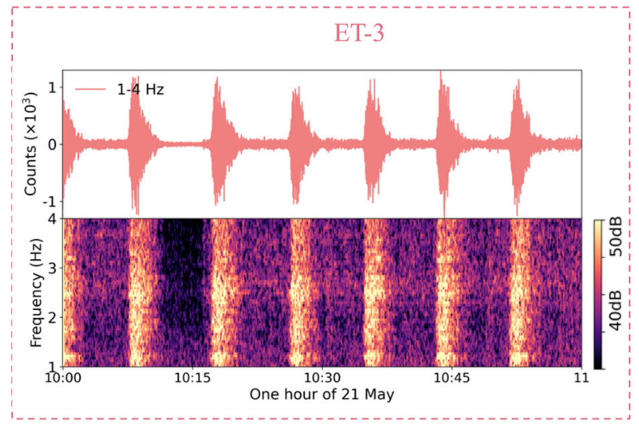
Unsupervised Machine learning for clustering
Deep Embedded Clustering (DEC)
One-hour-long continuous waveform as the input
Zali et al., 2024, CEE

Slide 6
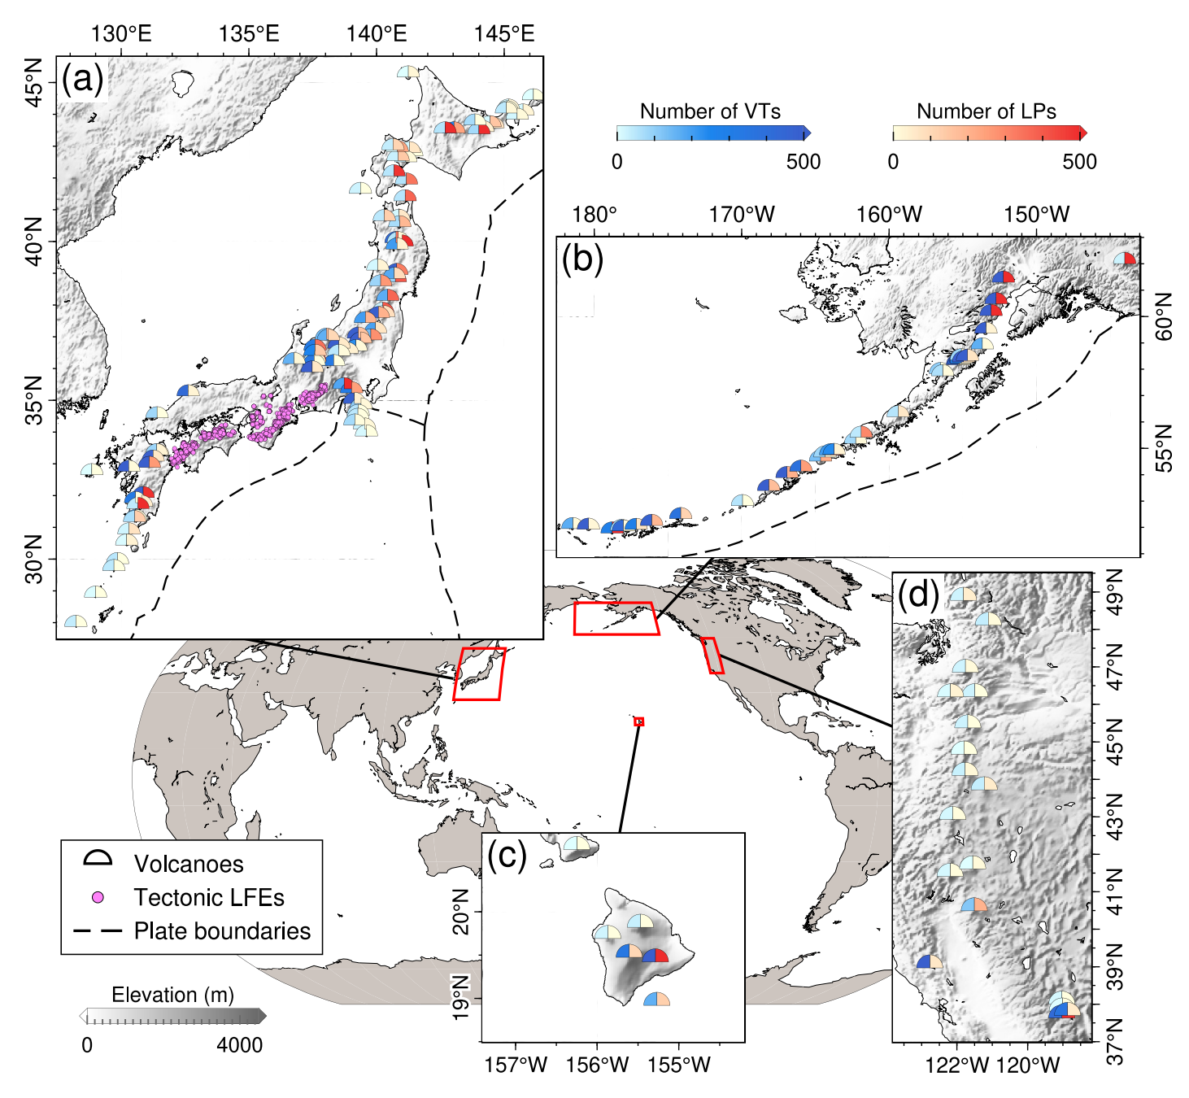
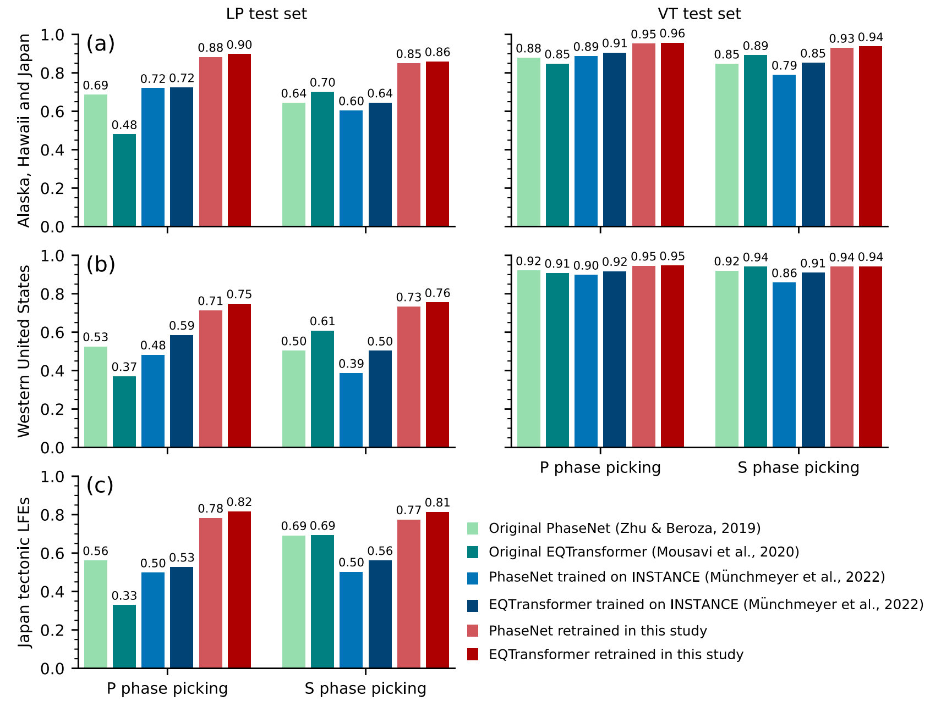
Supervised Machine Learning for event detection
Popular ML models:
1 Earthquake Transformer (EQT) (Mousavi et al., 2020)
2 PhaseNet (Zhu et al., 2019)
Global volcano seismic dataset: 35,181 LPs & 38,335 Volcano Tectonic events (VTs)
From 146 global volcanos
Volcanic EQT & PhaseNet
Better than the original for LPs
Zhong & Tan, 2024, GRL

Slide 7
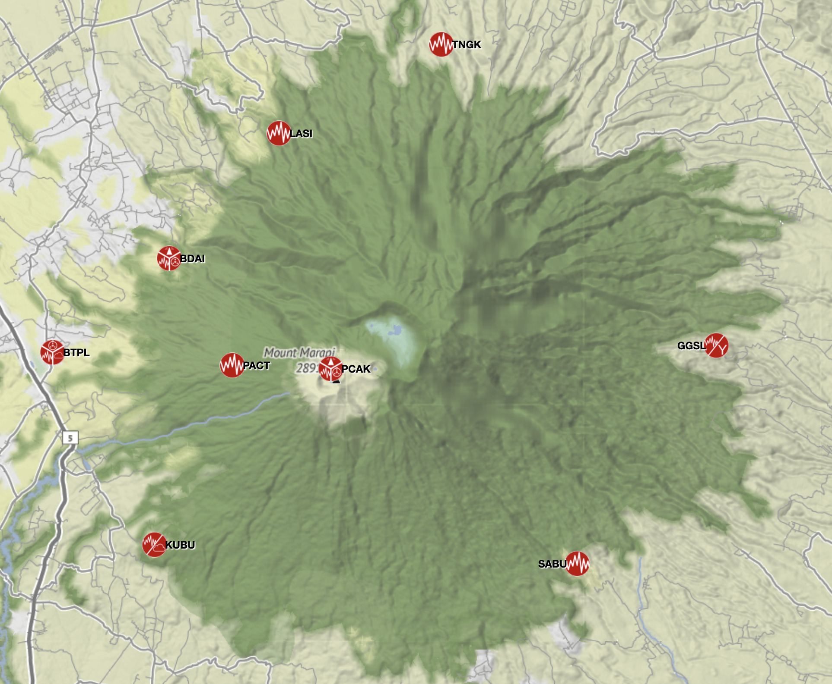
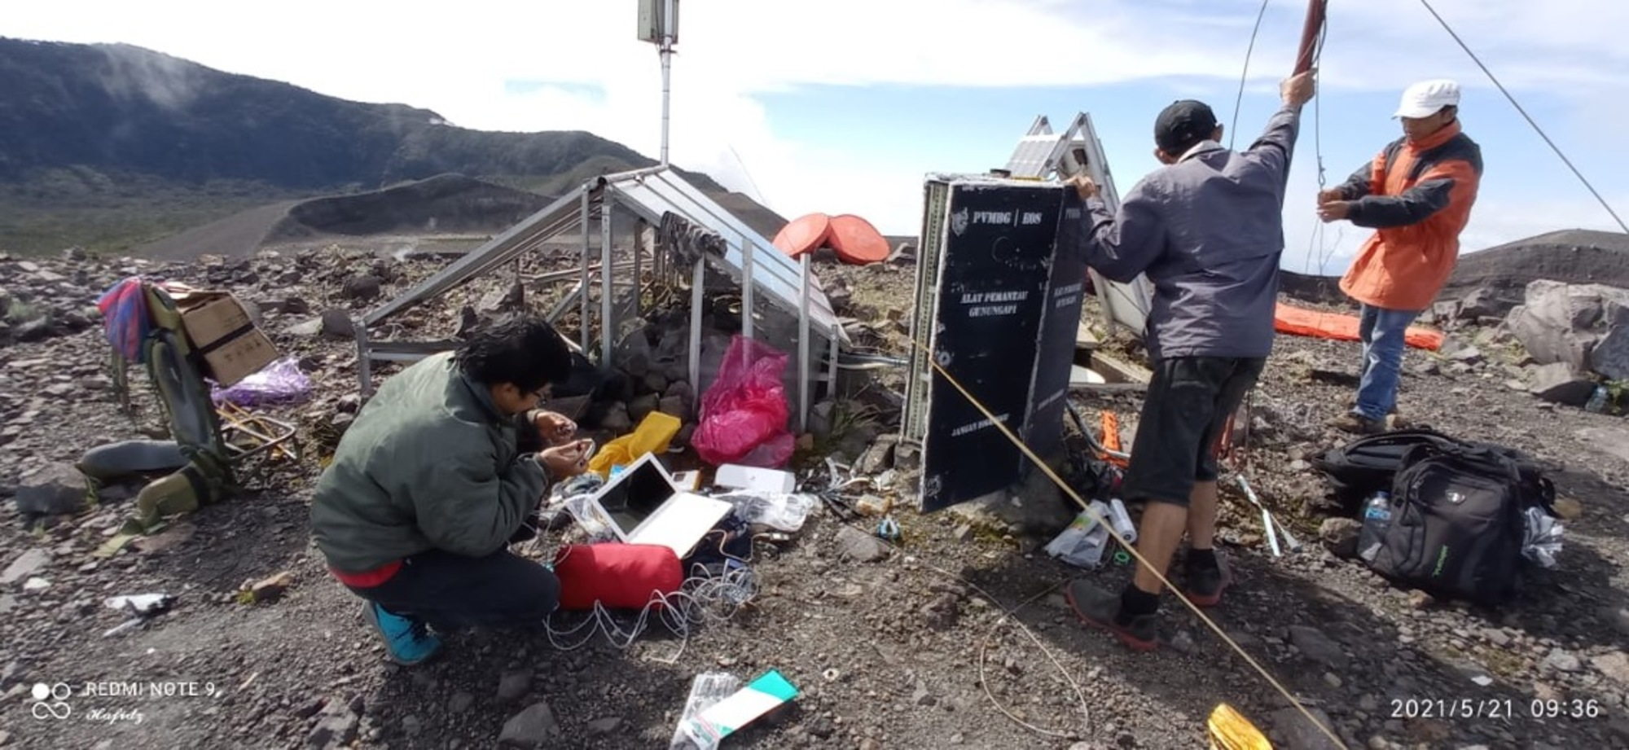
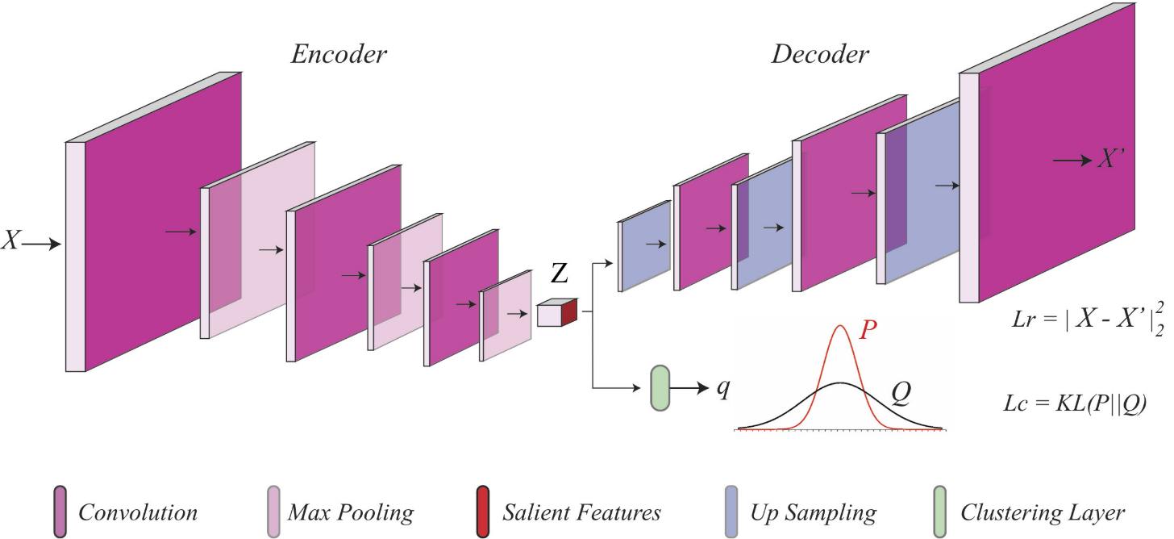
Our workflow
PCAK was destroyed by an eruption in 2023
detection
21,924,945
Volcanic EQT picker (Zhong & Tan, 2024)
trained by global volcano-seismic dataset
111,627
association
PyOcto associator (Münchmeyer, 2024)
binary space-time partitioning by pick number
based on homogeneous velocity model
PCAK
training data
36,627
Event waveform at PCAK station on summit
1-min-long time-frequency spectra
data from 2015 to 2023
Deep Embedded
Clustering (DEC)
https://cgodisplay.earthobservatory.sg
Mousavi et al., 2019, IEEE-GRSL

Slide 8
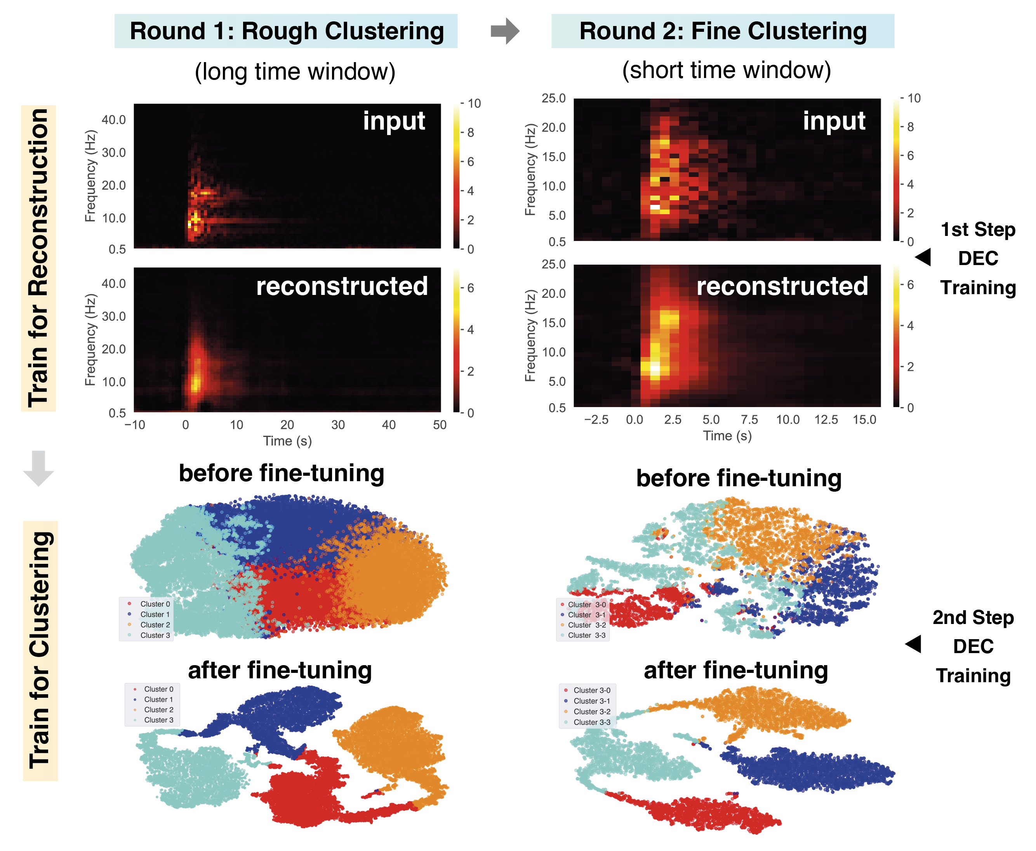
Clustering by Deep Embedded Clustering (DEC)
Round 1 Training dataset:
PCAK station Z component
36627 qualified events (association catalog)
80% for training, 20% for testing, 100 iterations
60-second-long
20-second-long (zoom in)
Round 2 Training dataset:
8667 qualified events
Zali et al., 2024, CEE

Slide 9
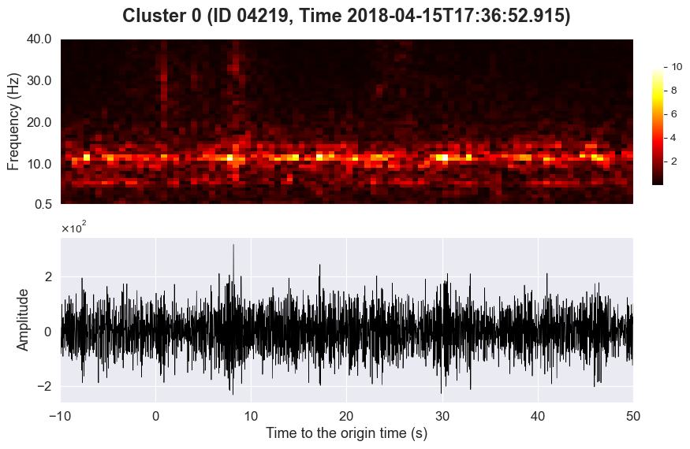
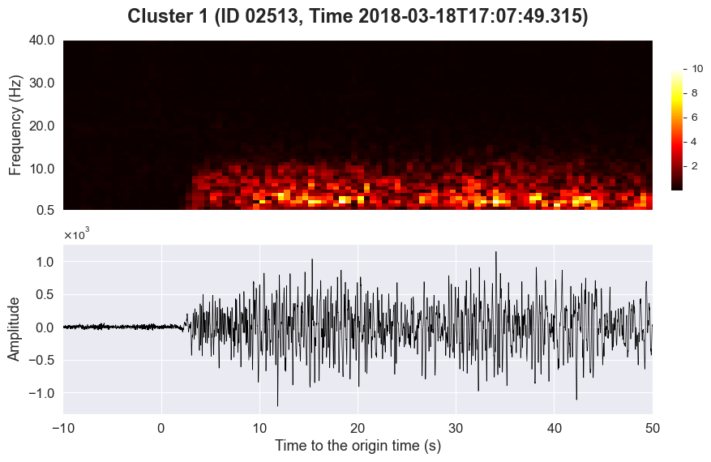
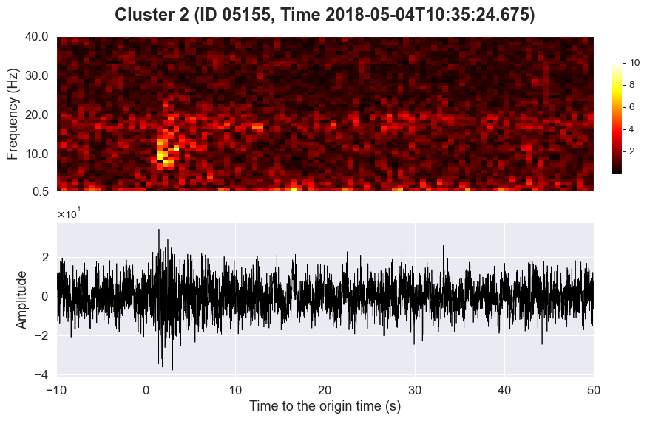
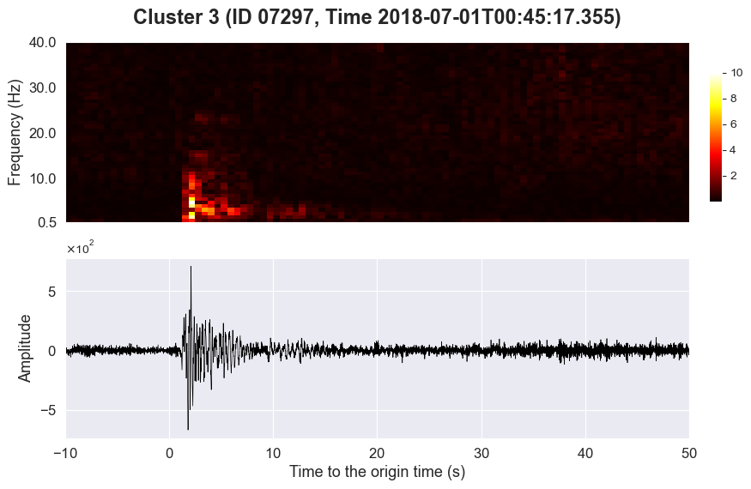
Rough Clustering to isolate short-duration events
A range of consistent and
dominant frequency
long-duration & low frequency
low signal-to-noise ratio
short-duration & focused energy

Slide 10
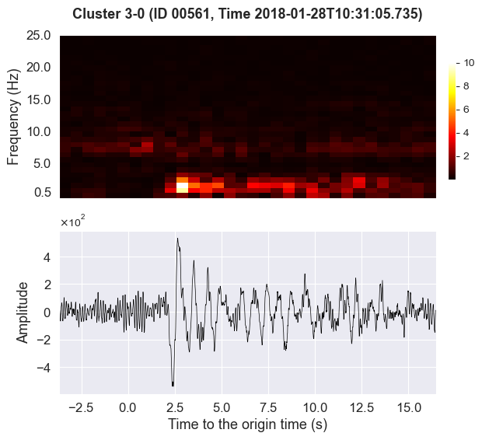
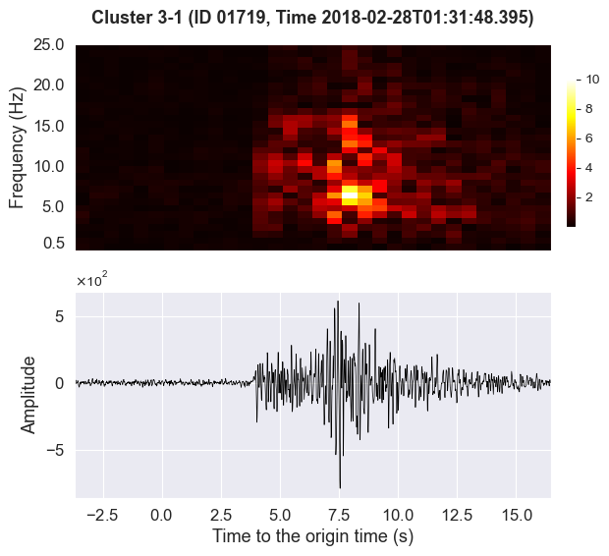
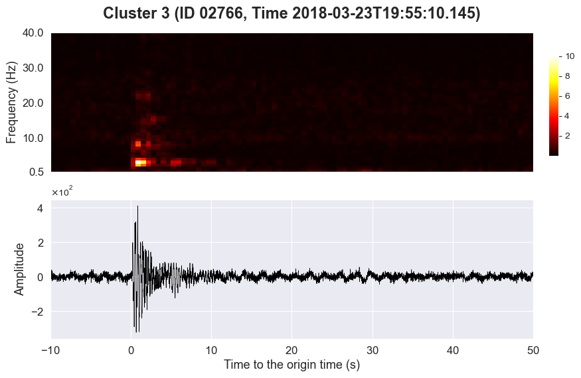
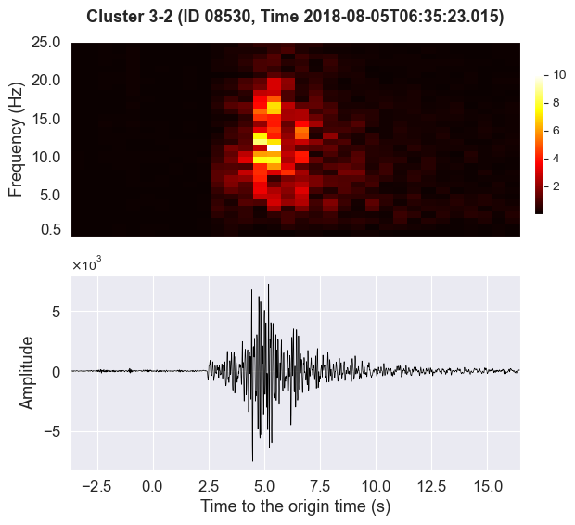
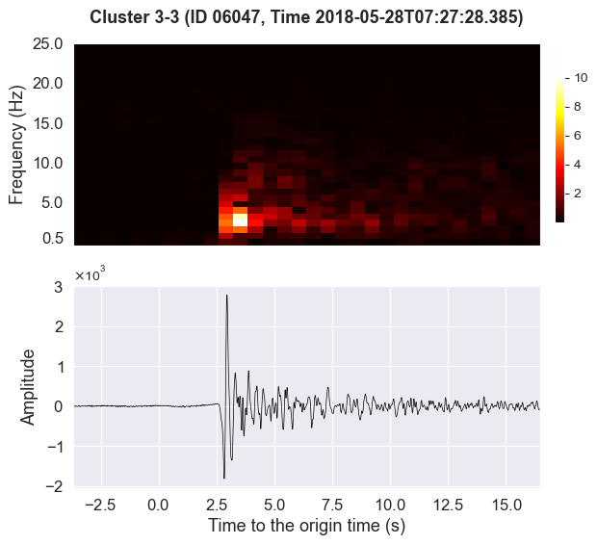
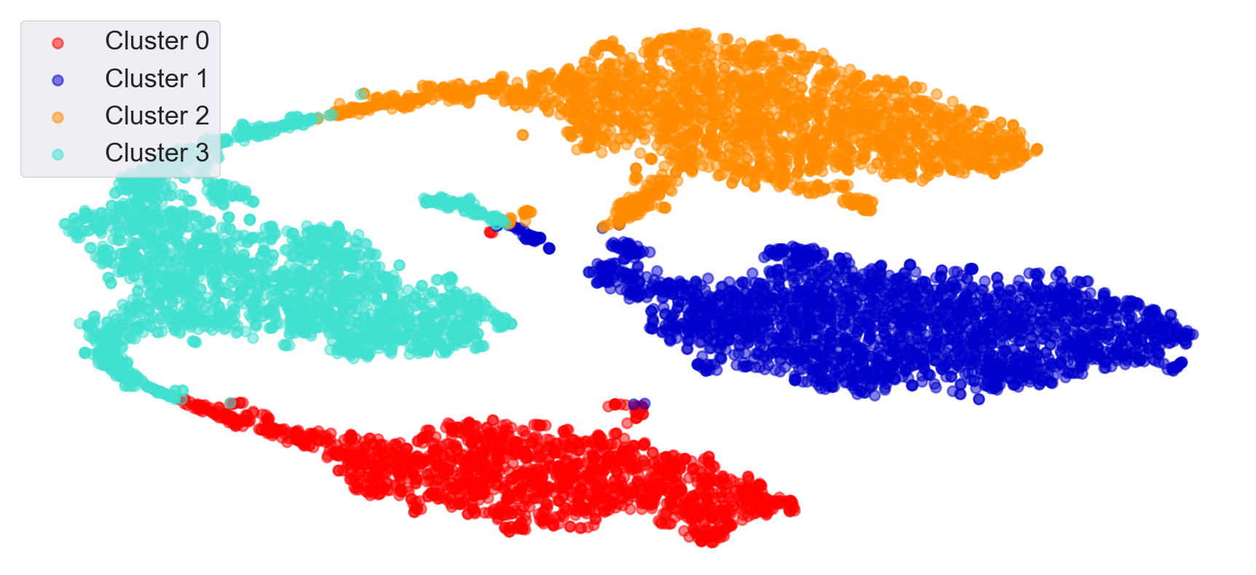
Round 2 Clustering
Low frequency & Long duration
Cluster 3-0
Tectonic events
Cluster 3-1
zoom-in window for re-clustering
Several
energy
masses
Cluster 3-2
One focused energy mass
Cluster 3-3

Slide 11
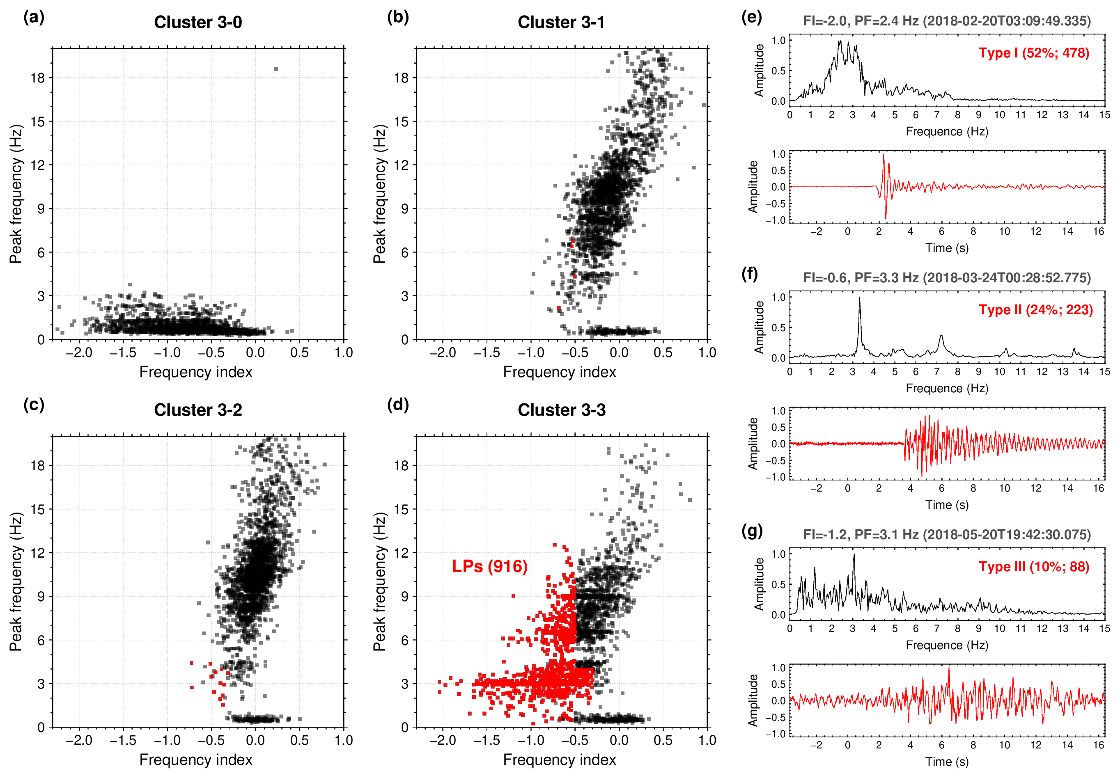
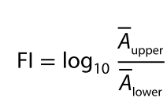
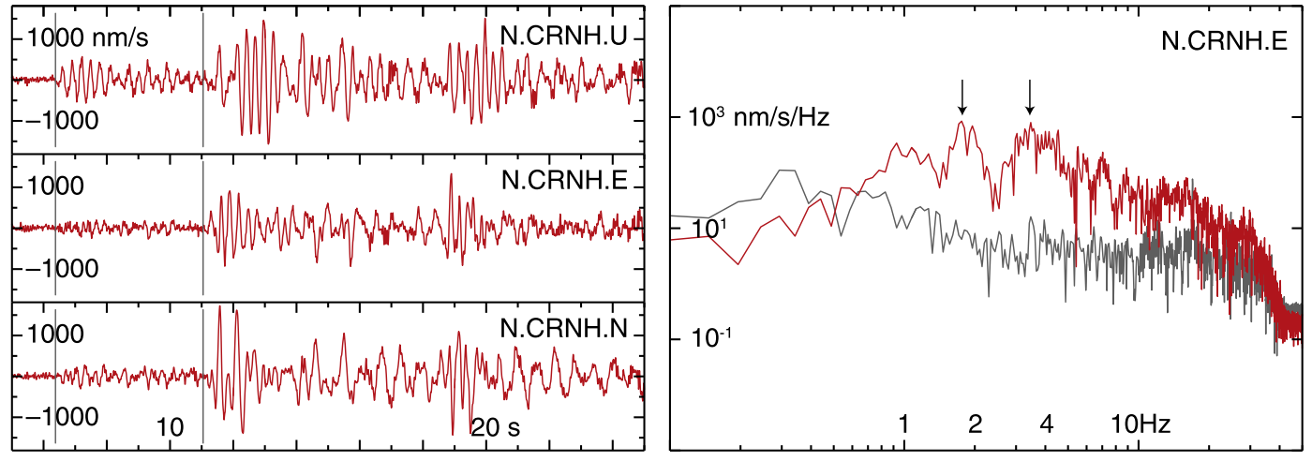

Distinct frequency pattern at sub-cluster 3
Long-period events (LPs): FI<~-0.5
(Wilding et al., 2023)
Frequency index (FI):
(13-20 Hz)
(0.5-10 Hz)
$\overline{A}$: mean amplitude in a range of frequencies
lower
upper
Aso et al., 2013

Slide 12
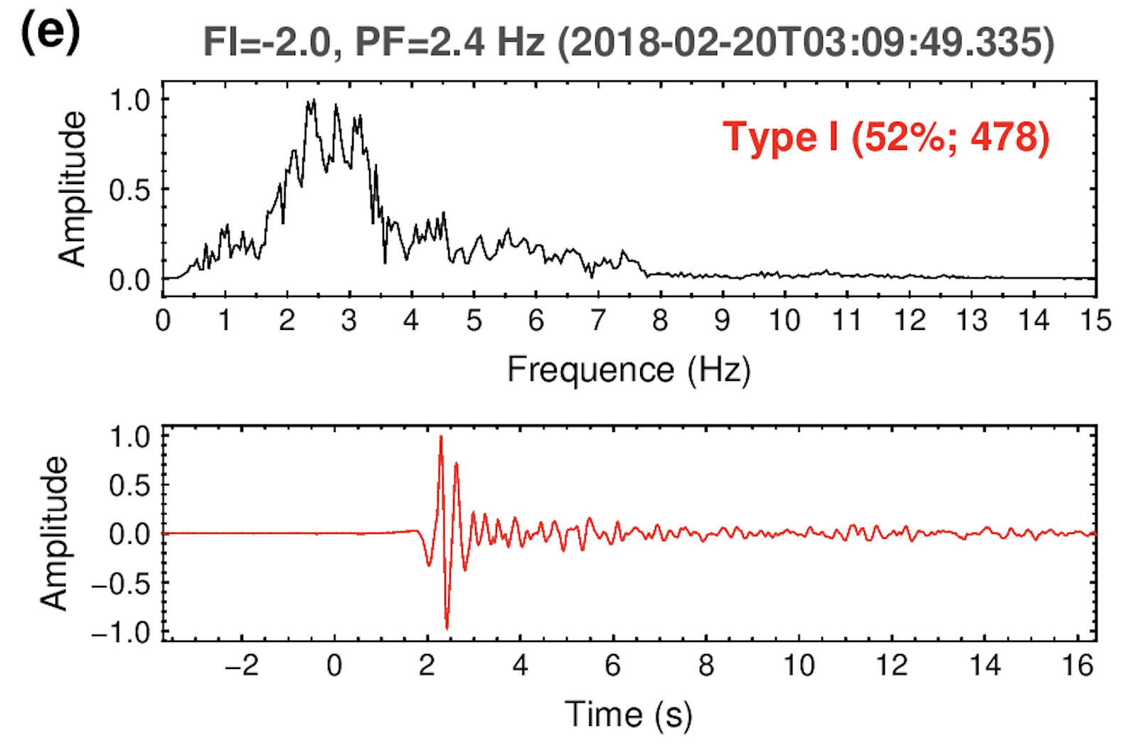
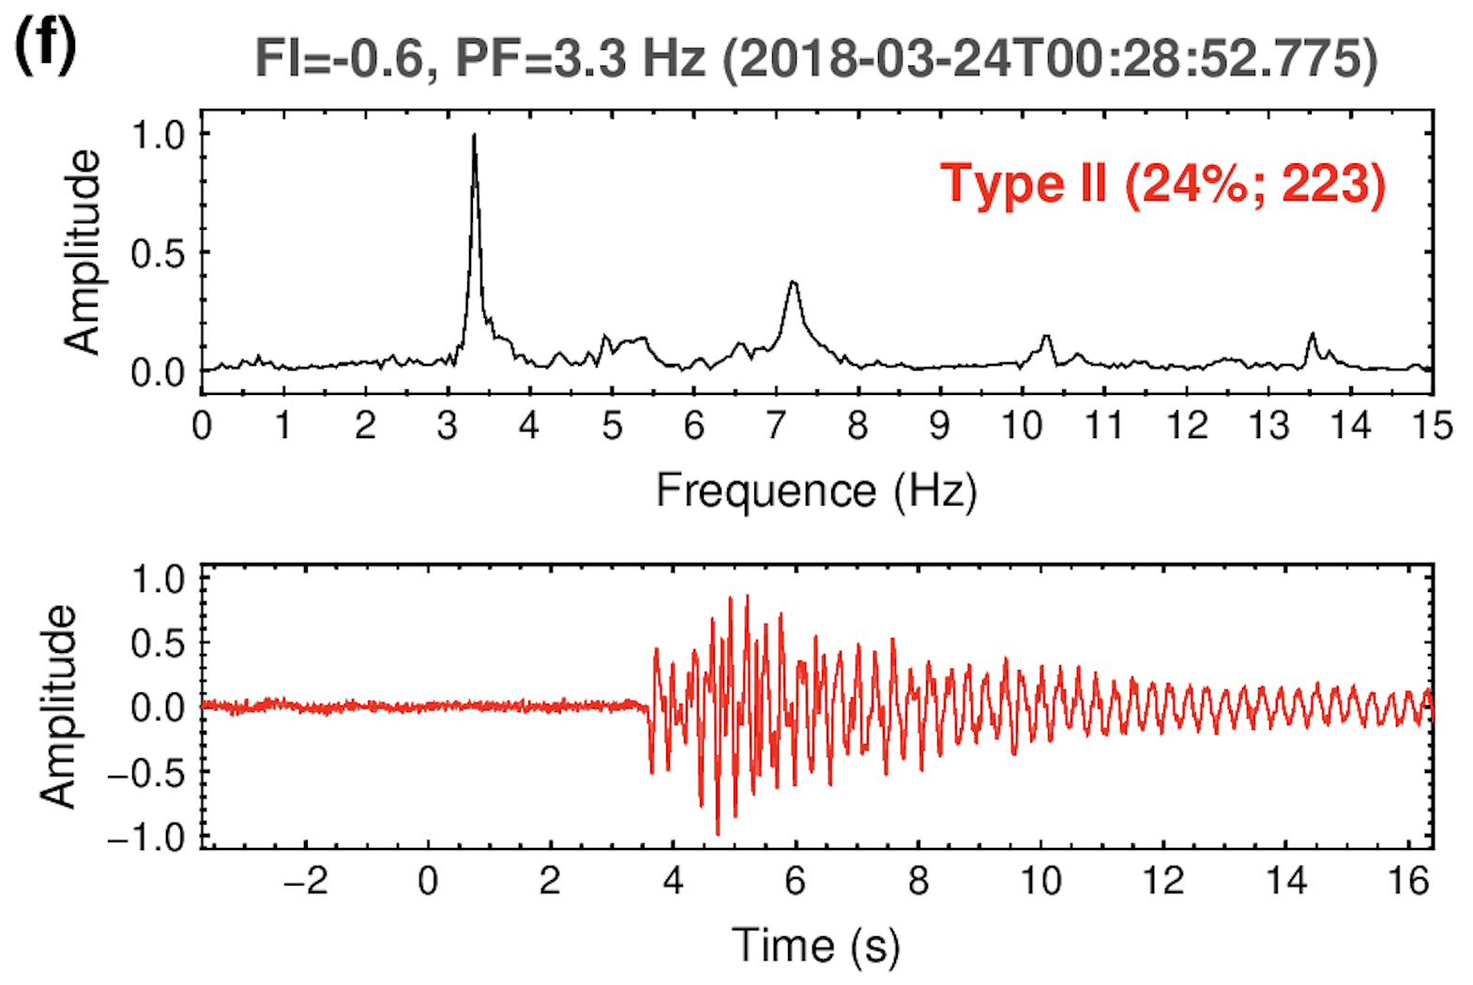
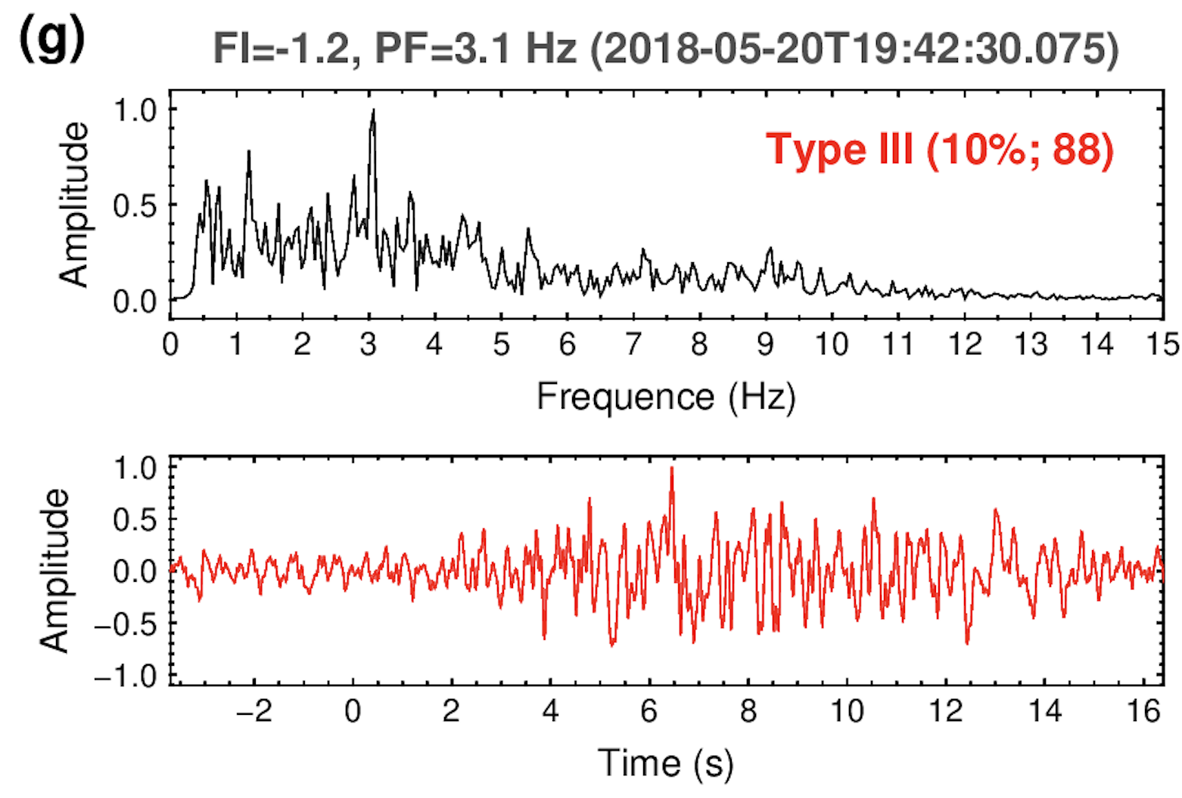
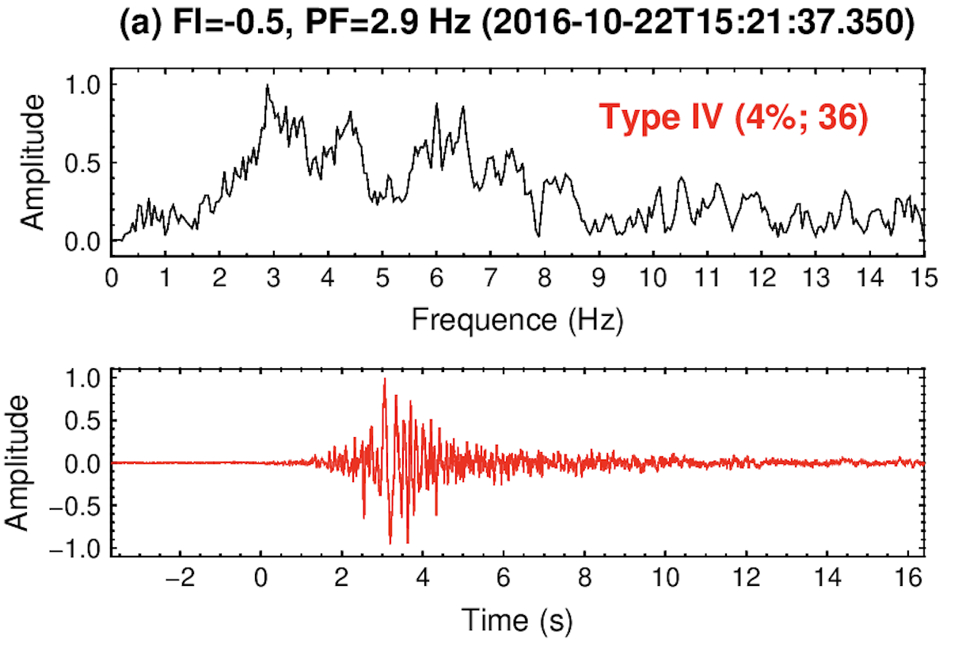
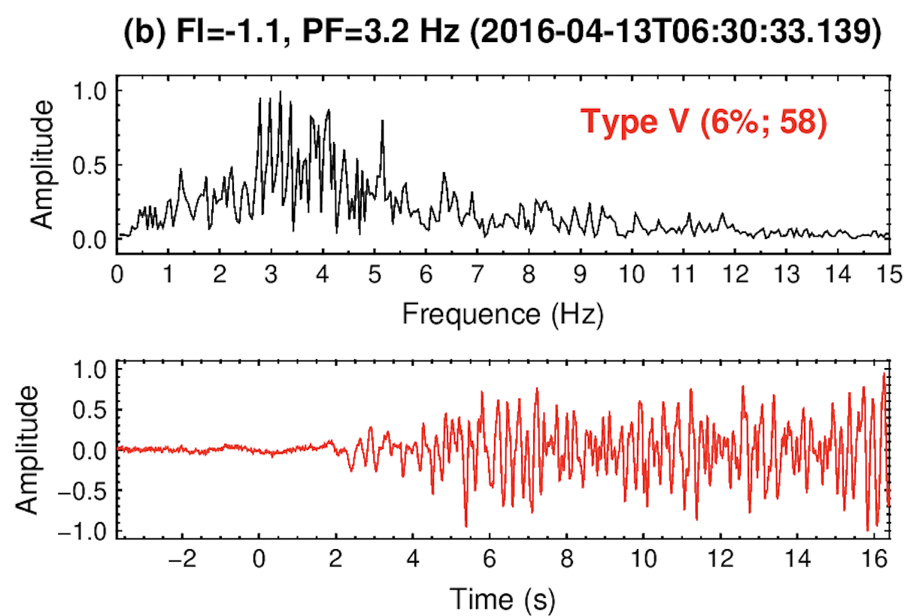
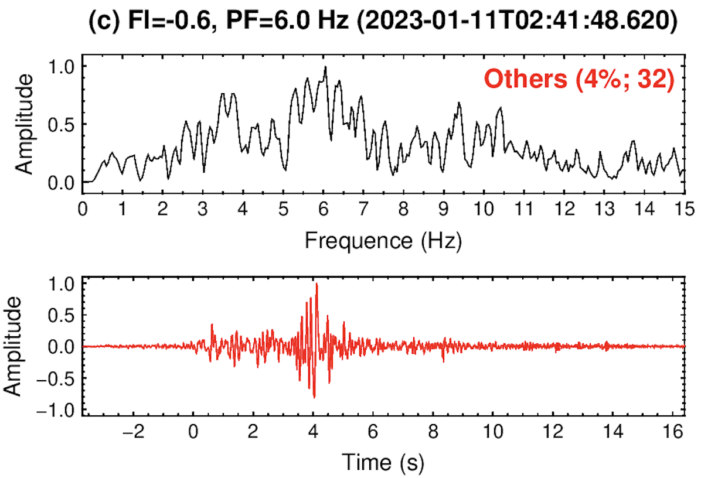
916 LPs in two major patterns are found
General pattern (52%; 478)
Tornillo pattern (24%; 223)

Slide 13
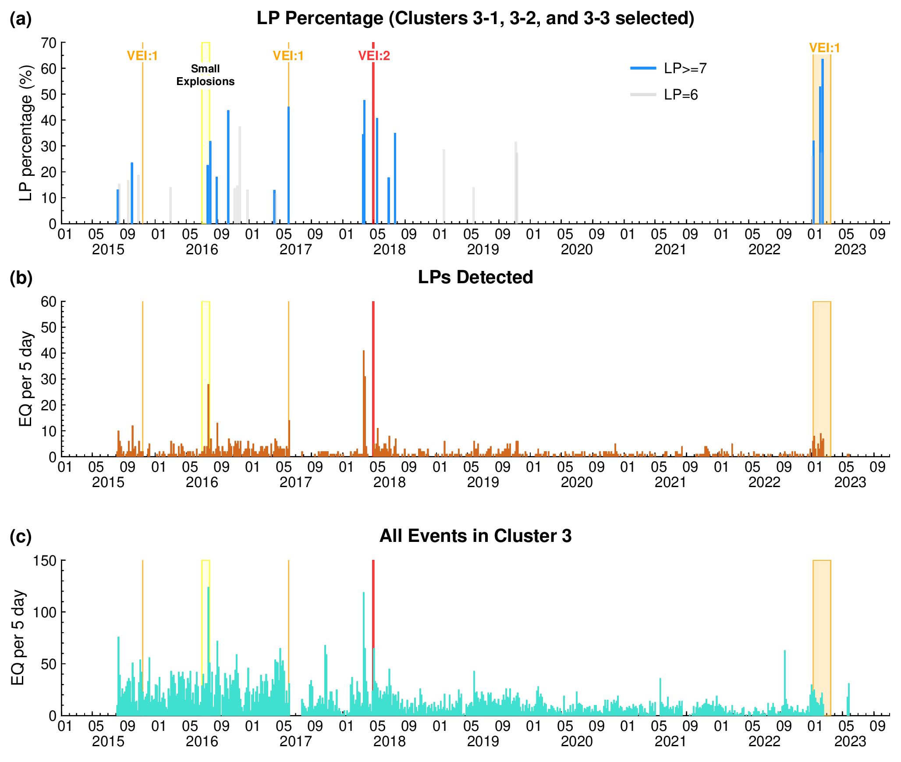
LPs strongly linked with the volcanic eruptions
Percentage of LPs over 5 days
LP frequency over 5 days
Event frequency in Cluster 3 over 5 days
Small explosions in July 2016
are reported by Hidayat et al.,
(2016, AGU Abstract)

Slide 14
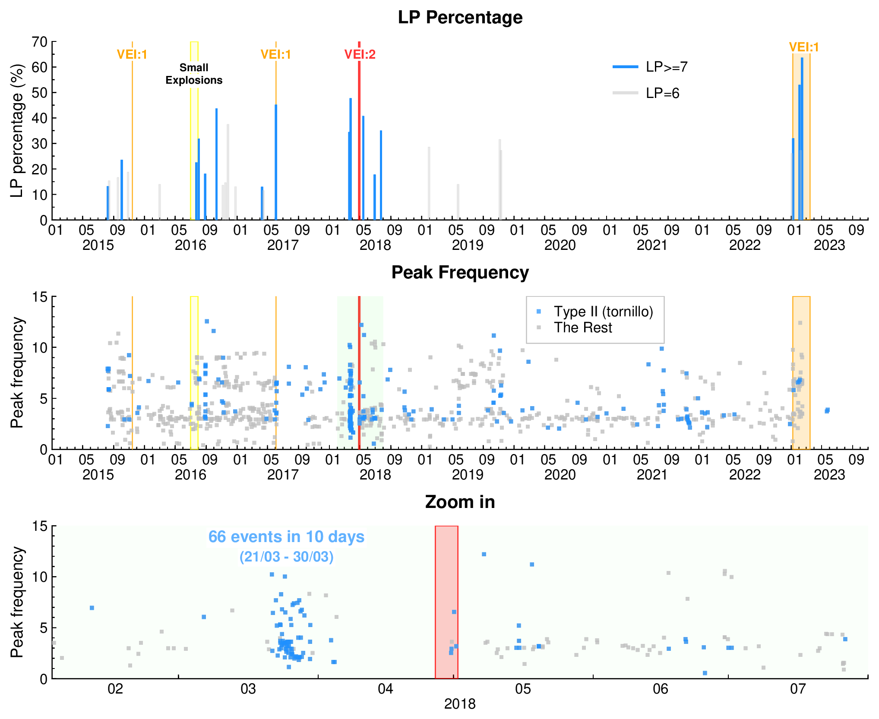
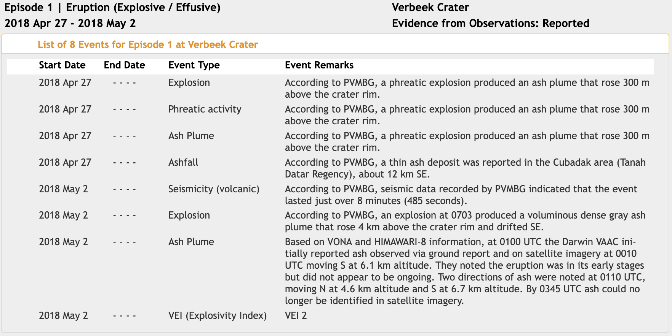
Tornillo: 1-month precursor to phreatic eruptions in 2018
66 such tornillos occurred over 10 days
~1-month before the eruption onset
1-month
Global Volcanism Program (GVP), 2025

Slide 15
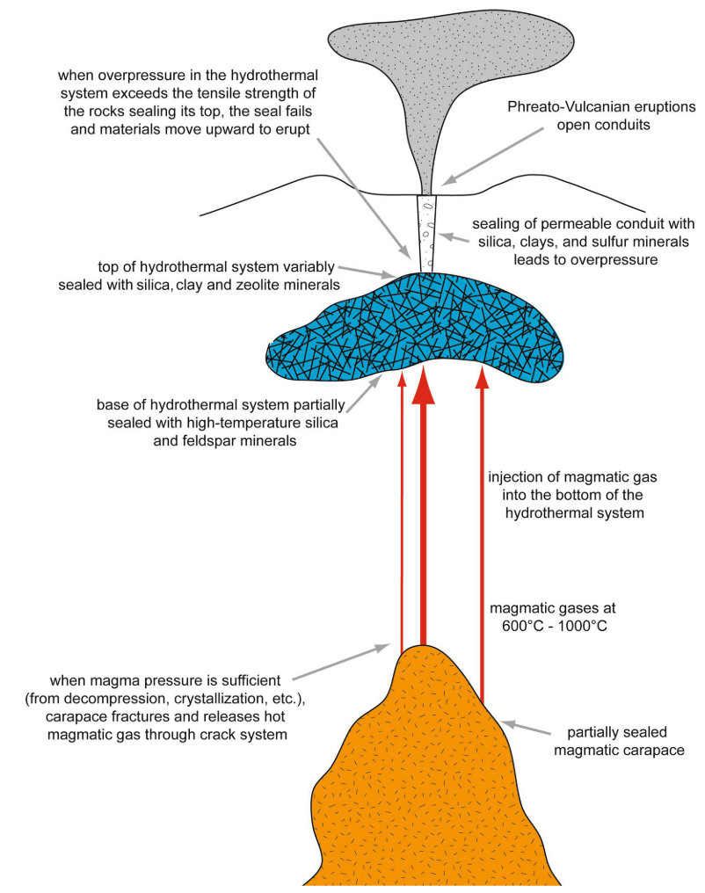
General LPs suggest sudden massive gas supply
Our observation
Synthetics
Girona et al., 2019, JGR-SE
Stix & de Moor, 2018, EPS

Slide 16
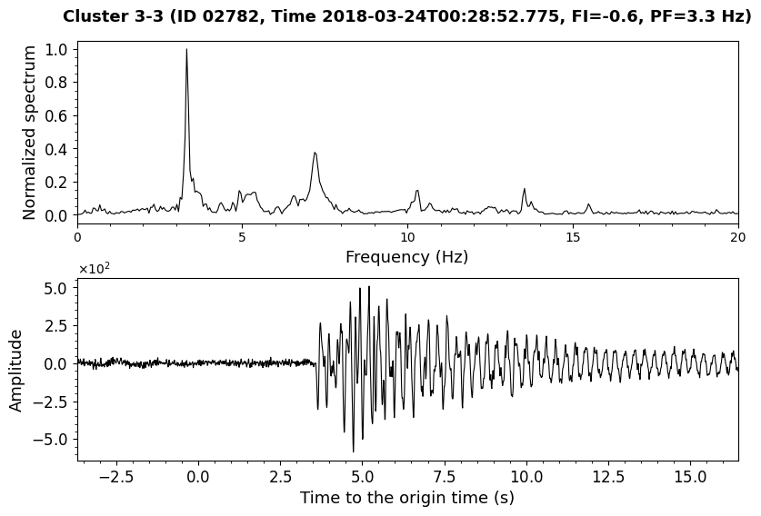
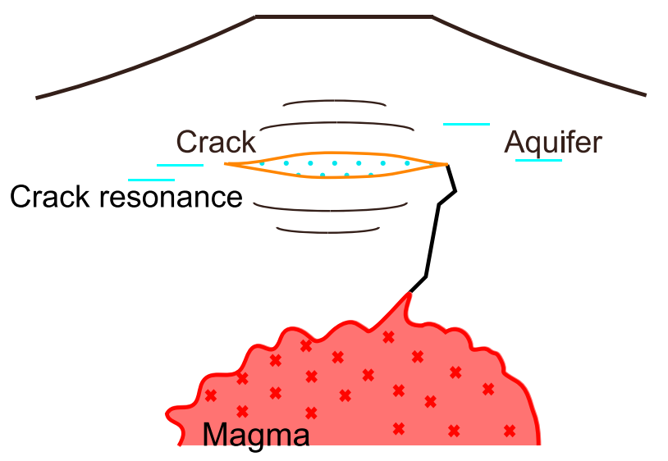
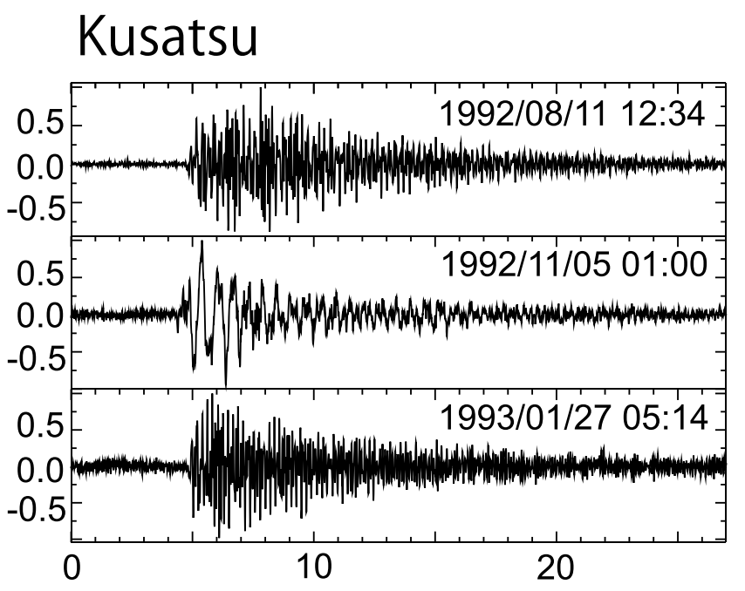



Tornillos indicate oscillations of mist or dust filled cracks
Our observation
in Marapi
Kusatsu-Shirane Volcano, Japan
Our observation
in Marapi
Taguchi et al., 2018, JGR-SE

Slide 17

Summary
New finding
900+ LPs, 24% of them are tornillos
New approach
Gas-filled crack
oscillations
Sudden, massive
gas supply
Seismic Signal Data Mining by
supervised and unsupervised
machine learning methods
Significance
Potential precursor of gas-driven eruptions of Marapi
tornillo
1-month

Slide 18
Future studies
Detecting precursory signals of the 2023 eruption event from other stations
Find a way to reliably locate the LP events (on the way)
PCAK was destroyed
PCAK

Slide 19
Thank you!
Research in progress ...
Mingye
Nov 18, 2025
Appreciate Benoit, Christina, Yizhou, Tania, Andika, CVGHM staffs for support and discussions

Slide 20



Clock errors were found and corrected
Teleseismic P-wave cross-correlation
Method
ambient noise & teleseismic P-wave cross-correlation methods
Ambient noise cross-correlation

Slide 21

Location and relocation catalogues
Absolute location (rough)
Relocation (accurate)

Slide 22

The detected LPs are located around the crater
LFEs are located near the crater, not along the fault
Detailed analysis is needed
location
relocation

Slide 23
Comparison between original and volcanic EQT picking
Using the same parameters
Year | Original EQT |  | Volcanic EQT
 | P | S | P | S
2015 | 26666 | 25948 | 979733 | 1007990
2016 | 33234 | 35104 | 1197978 | 1185905
2017 | 25898 | 25013 | 1068826 | 1065253
2018 | 19122 | 18207 | 1241364 | 1276879
2019 | 18208 | 16225 | 1190951 | 1205707
2020 | 18131 | 16808 | 1217787 | 1221371
2021 | 18479 | 17142 | 1188985 | 1183724
2022 | 16608 | 15689 | 1042324 | 1050500
2023 | 17260 | 15520 | 864593 | 863485
2024 | 20812 | 17212 | 953289 | 918301
Total | 214,418 | 202,868 | 10,945,830 | 10,979,115
Original: 417,286
vs
Volcanic: 21,924,945
(~50 times larger)

Slide 24



Slide 25


Slide 26





Pattern 1/3: Long-period event dominant at ~3 Hz

Slide 27





Pattern 2/3: Resonance-related events

Slide 28






Pattern 3/3: Weak long-period events?
Ash venting or explosion

Slide 29



Cluster 3-0
Cluster 3-3

Slide 30



Data, CNN Model, and training
Training dataset:
PCAK station (close to the crater) Z component
36627 qualified events (association catalog)
1-min-long time-frequency spectra
80% for training, 20% for testing
100 iterations
Zali et al., 2024
training input

Slide 31




Reconstruction & K-means clustering
Examples of spectrum reconstruction
Determine cluster number by “L-curve”
real
real
real
reconstructed
reconstructed
reconstructed
t-SNE visualization: high-dimension (24) to low-dimension (2) projection
K-means clustering
before fine tuning
after fine tuning

Slide 32




Subclustering for Cluster 3 with 8667 data
Much enlarged dataset (Previously: 1532 data)
real
reconstructed
before fine tuning
after fine tuning

Slide 33


Unpredictable? New seismic precursors are needed
Displacement Seismic Amplitude Ratio (DSAR):
$$DSAR=\frac{A_{low}(4.5−8 Hz)}{A_{high}(8−16 Hz)}$$
measures increased scattering attenuation before explosion
small-scale gas-driven
eruption
large-scale gas-driven
eruption
Caudron et al., 2019, Geology

Slide 34




Similar waveform as exploration events
Explosive gas emission caused by serpentinization
Nuclear test explosion waveform
from USGS
earthquake
North Korea nuclear explosion, Oct 9, 2006
Xiao et al., 2025, SA

