Slide 1
Classification of Volcano-Seismic Events Using
K-means Clustering and Dynamic Time Warping
Eisuke FUJITA (NIED), Yoshiaki IDA (Advancesoft Corporation), Takashi HIROSE (Tohoku U.)
10.1016/j.jvolgeores.2022.107616
11/18/2025 @Workshop on “Automatization and Standardization of Volcano Seismic Data Processing Workflows”

Slide 2
Objectives
Automating the classification of volcanic earthquakes with artificial intelligence (AI)
applicable to waveforms because they consist of individually different data lengths.
This study develops a simple method in which the distance between waveforms is evaluated by dynamic time warping and waveforms are classified by k-means clustering.
In this method the centroid of each classified group is one of the waveforms that may well represent the group and some good classifications are selected considering high generality and good fitting to the members.

Slide 3
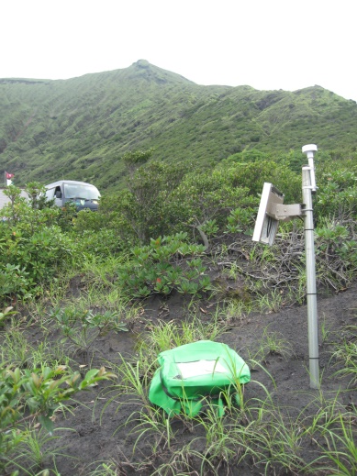
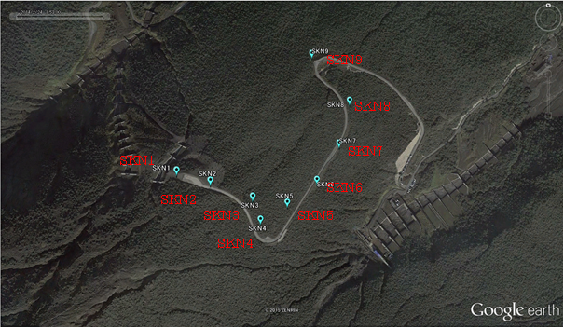
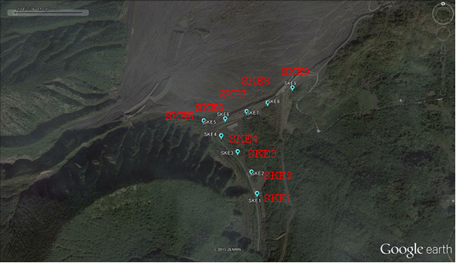
Data
Sakurajima Volcano, Japan
Failed eruption on Aug 15, 2015
Seismic array
Seismic array

Slide 5
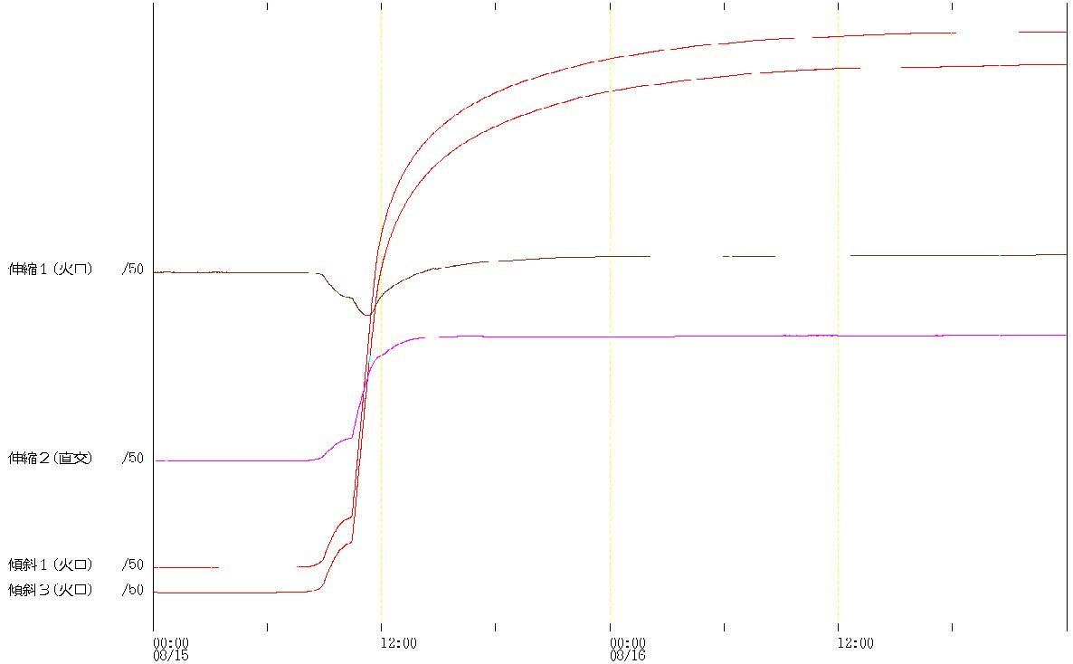
strain-radial
strain-perpendicular
tilt-radial
tilt-perpendicular
Aug. 15
Aug. 16
Temporal changes in tilt and strain at Arimura station in the period from August 15 to August 16, 2015
Report of CCVEP, 122, 2016

Slide 6
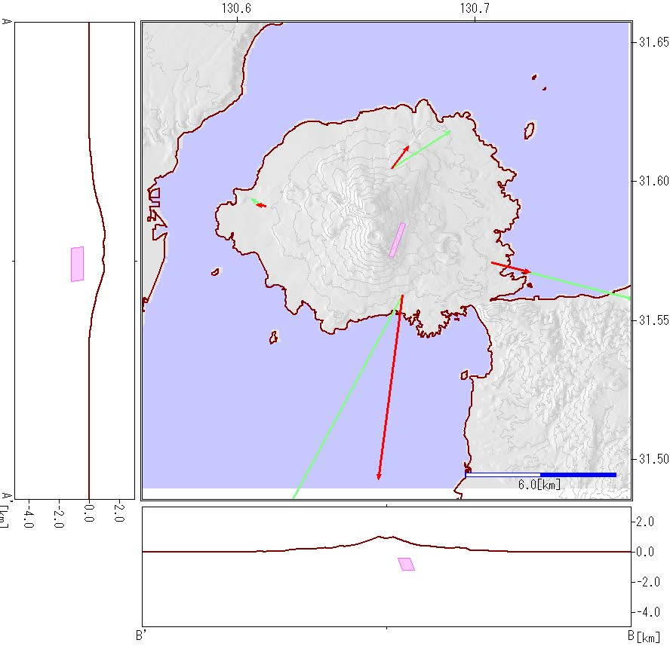
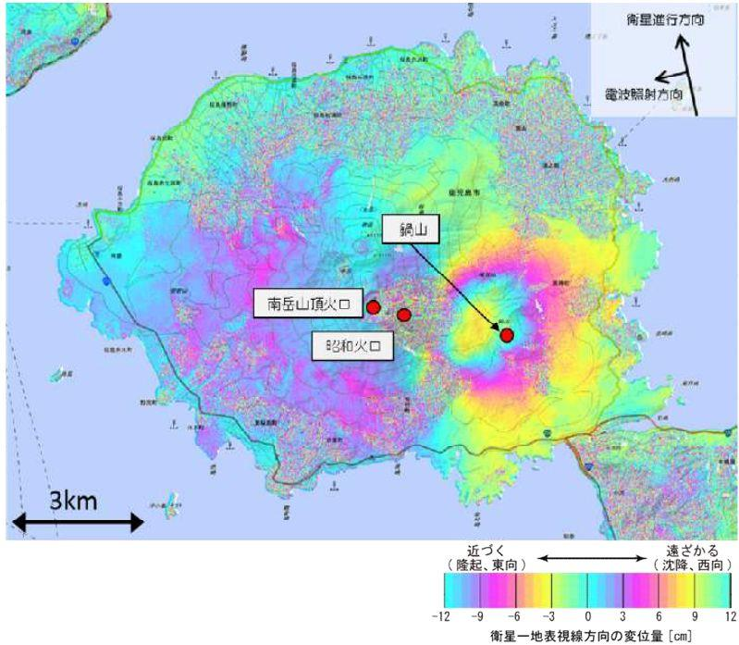
SAR (Synthetic Aperture Radar)Interferograms around Sakurajima by Geospatial Information Authority of Japan.
January 4,2015 –August 16, 2015
Tilt vectors during the period from 10:26 on August15to August 16, 2015. The red and green arrows show the observation and calculated vectors, respectively. The red rectangular indicates the location of the dike pressure source.
Report of CCVEP, 122, 2016

Slide 7
Dynamic Time Warping (DTW)
The quantitative difference between two vectors of different lengths is represented by finding a path (warped path) on the plane formed by the two components of the vectors.
The cumulative difference between components along the path is minimized, and expressing the minimum cumulative value along the path.
To construct the path, the cumulative differences are compared for three cases: when both components increase, when each component increases one at a time, and the combination of components that yields the minimum difference is followed.
The cumulative difference calculated along this path is called the cost.
S₁₁ = (u₁ – v₁)²
S_{ij} = min(S_{i–1 j}, S_{i j–1}, S_{i–1 j–1}) + (u_{i} – v_{j})²

Slide 8
k-means clustering
Members to be classified (generally vectors with multiple components) are divided into k groups by specifying the number of groups (clusters) k.
A central vector is determined for each group, and each member is assigned to the group whose central vector is closest (has the smallest difference between vectors).
For application to volcanic earthquakes, the difference between vectors is evaluated using the cost from the DTW method.
The central vectors of the groups and their member assignments are calculated iteratively.
In each iteration step, the member that minimizes the sum of differences with all members belonging to each group is reassigned as the central vector, and members are regrouped around this central vector.
This step is repeated until all central vectors no longer move.

Slide 9
Flowchart

Slide 10
The maximum amplitudes of the analyzed volcanic earthquakes of Sakurajima volcano at their outbreak times.
Events 59, 75 and 85 work as the centroids of group A, B and C, respectively

Slide 11
Results
The projection of the waveform members on two cross-sections of DTW distances
to the centroid events for the best classification into three groups.
(a) The cross-section to centroids 59 and 75.
(b) The cross-section to centroids 59 and 85.

Slide 12
Group A centroid
Group B centroid
Group C centroid
A : large initial vibrations that quickly dampen
B : vibrations that dampen while continuing for a long time
C : has small damping

Slide 13
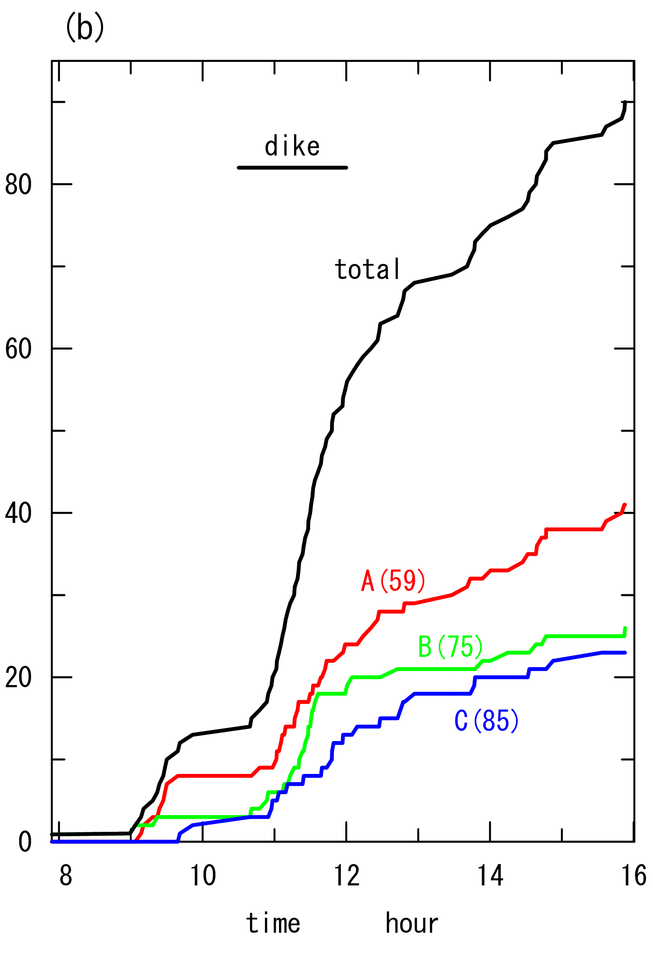
The cumulative numbers of volcanic earthquakes of Sakurajima volcano for the classification into three groups A, B and C.
A: occur gradually.
B: occurs from the early to middle stages of the dike intrusion period.
C: tends to be concentrated in the middle of the eruption period.

Slide 14
The hypocenter distribution of volcanic earthquakes classified into three groups A, B and C (Koike and Nakamichi, 2021).
Group B tend to distribute closer to the magmatic fissure.

Slide 15
Conclusions
Waveform classification using k-means clustering with dynamic time warping (DTW).
Applicable to the waveforms with mutually different numbers of data points.
Centroids are optimized in an iterative way so as to meet the conditions between the members and centroids.
The method has been applied to the volcanic earthquakes of Sakurajima volcano.
From the waveforms and spectrums of the centroids the three groups of this best
classification may be identified with tectonic earthquakes, long-period earthquakes and
volcanic tremor, respectively.
Group B has an intimate connection with a magma ascent event beneath the active crater of the volcano.

Slide 17
Results
The plot of the waveform members on the plane of DTW distances to two centroid members for good classifications into two groups
(a) Classification into groups A and B
with centroids 59 and 75, respectively.
(b) Classification into groups A and C with centroids 59 and 85, respectively.

