Slide 1
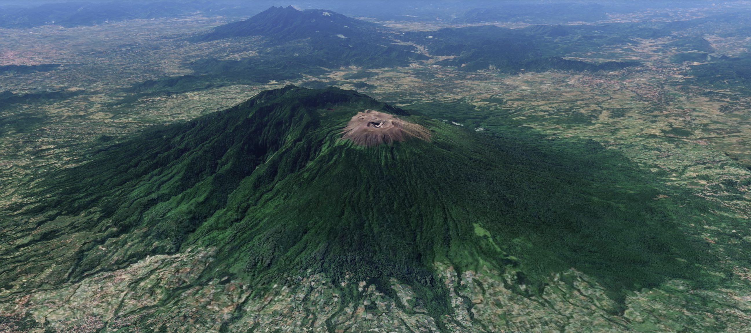

Unsupervised Classification and Displacement
Estimation of Very-Long-Period Seismic Signals
at Mount Marapi
T. Espinosa-Ortega¹, B. Taisne^{1,2}, J.W. Neuberg³ and Y. Suparman⁴
1 Earth Observatory of Singapore, Nanyang Technological University, Singapore.
3 School of Earth and Environment, University of Leeds,UK
4 Centre for Volcanology and Geological Hazard Mitigation, Geological Agency, Indonesia.

Slide 2
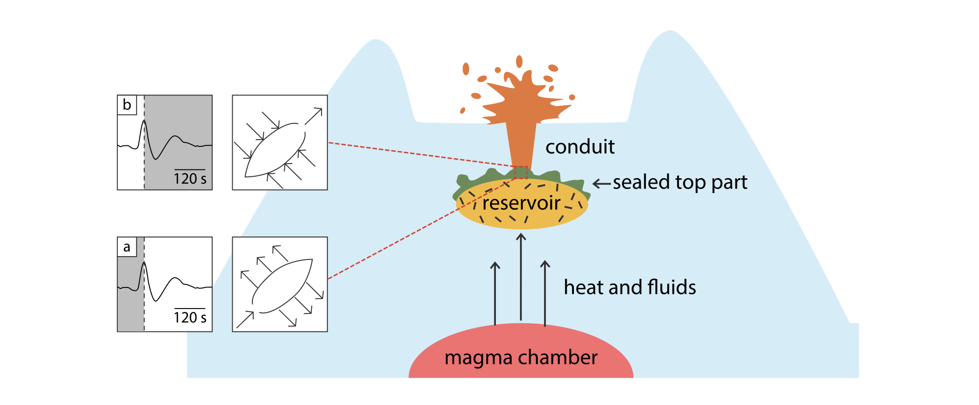
Very-Long-Period Seismic Signals
Interesting but often ignored…
Phreatic Eruptions
VLP events with frequencies < 0.1 Hz, travel from the source to the seismic stations without significant distortion (near field).
VLP seismic signals in volcanic areas indicate major ground deformation and are linked to fluid movement within the plumping system.
Observed during caldera collapse, phreatic eruptions, vulcanian eruptions, strombolian activity, and rockfalls at lava lakes.
*Fig from Konstantinou 2024, VLP’s from Nakamichi et.al 2009.

Slide 3
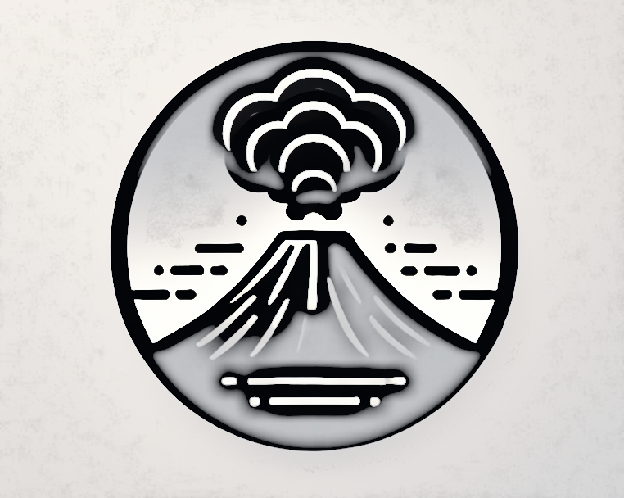


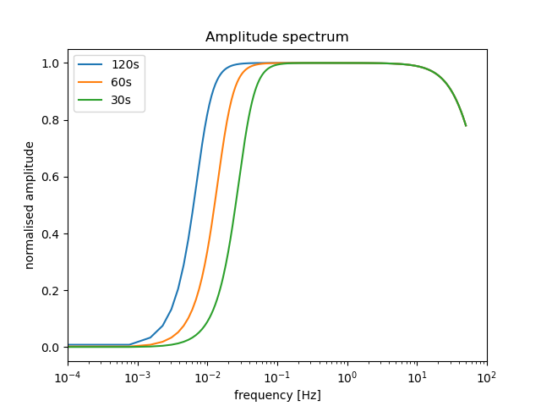
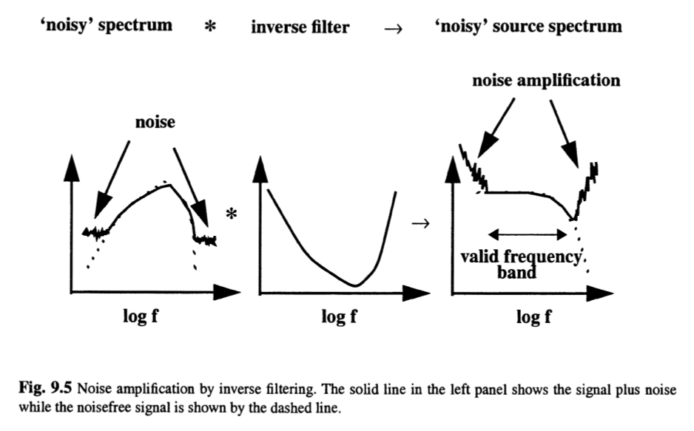
How are seismic signals processed?
Ground Deformation
Seismometer
Velocity Seismic Trace
To recover deformation from Seismic trace we have to make Signal Restitution
Signal Restitution:
Convolution of the Fourier transform of the velocity trace with the inverse of the instrument transfer function.
For VLP- Signal restitution amplify noise and low energy

Slide 4
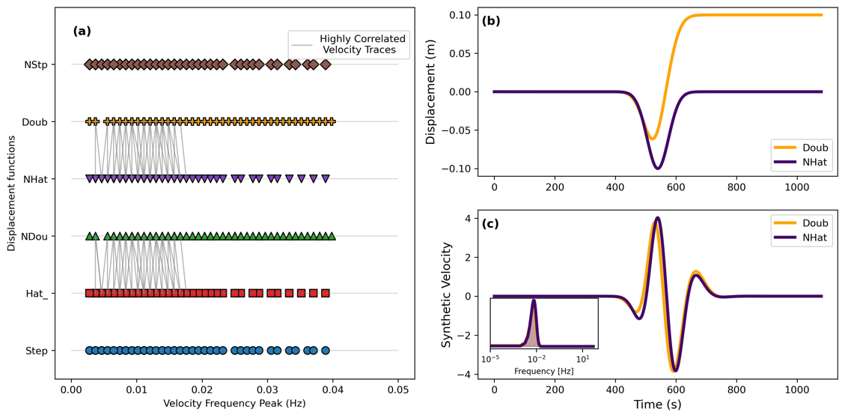
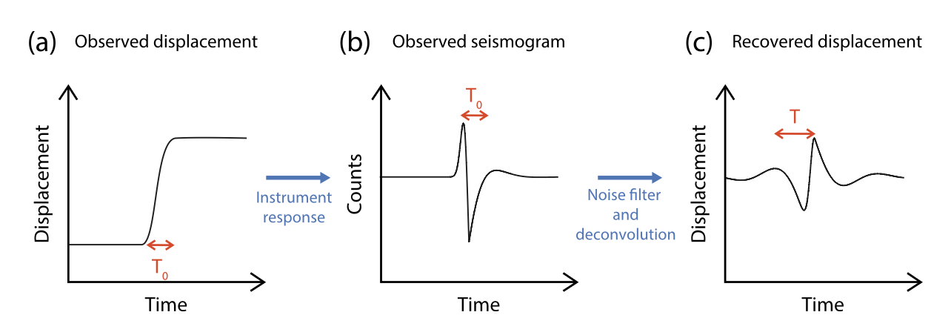
Very-Long-Period Seismic Signals
Main challenges:
Frequencies fall below the lower corner frequency of most seismometers. Bandpass data to minimize noise, distorts the signals.
Forward simulation
Different deformations produce similar seismic signals.
Bandpass data changes the period of deformation
Unlike Restitution, forward simulation can be done smoothly
Flinders et. al. 2020
Our approach to estimate the ground displacement from VLP events:
Progressively highpass the data to lower frequencies till the Forward restitution validate our approximation

Slide 5
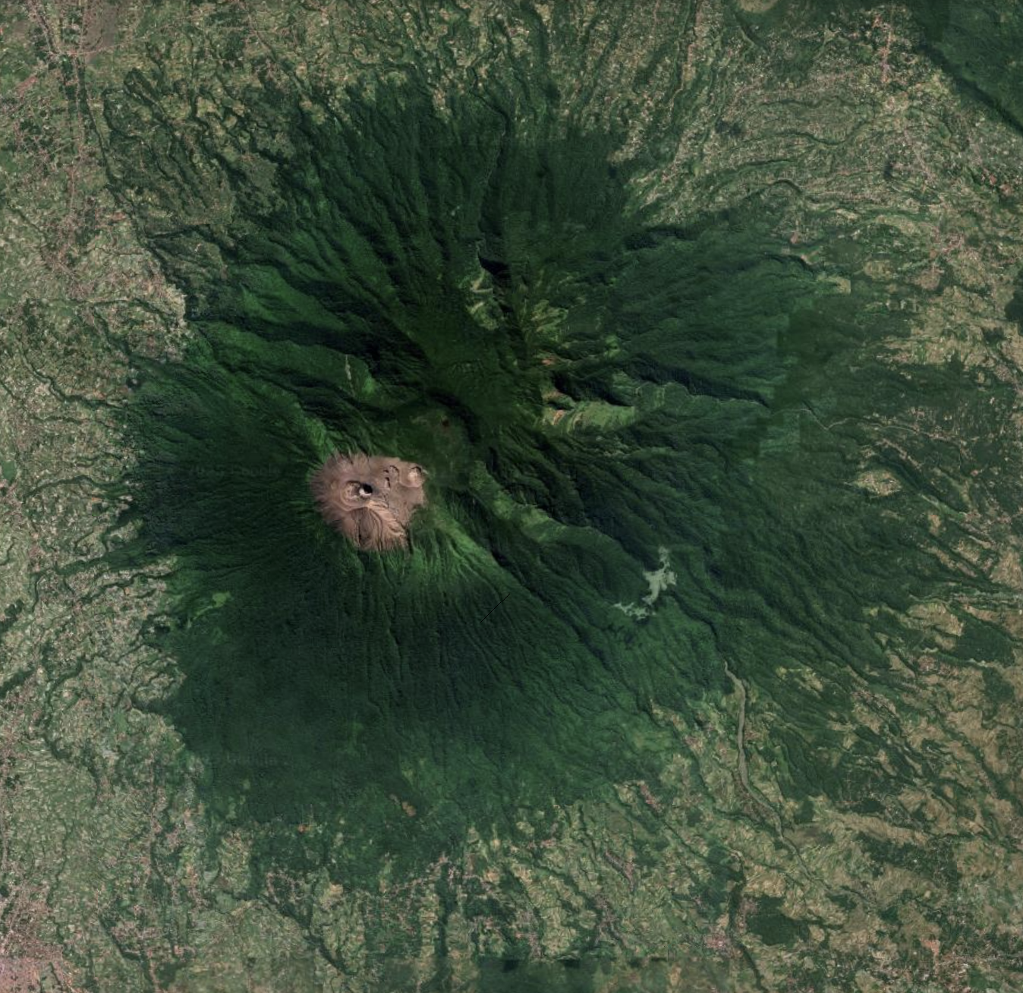
Objectives
Develop a general method to recover ground deformation of VLP seismic signals
Detect VLP
Clustering
Estimate displacement using restitution and Forward Simulation
Correlate with Physical process

Slide 6
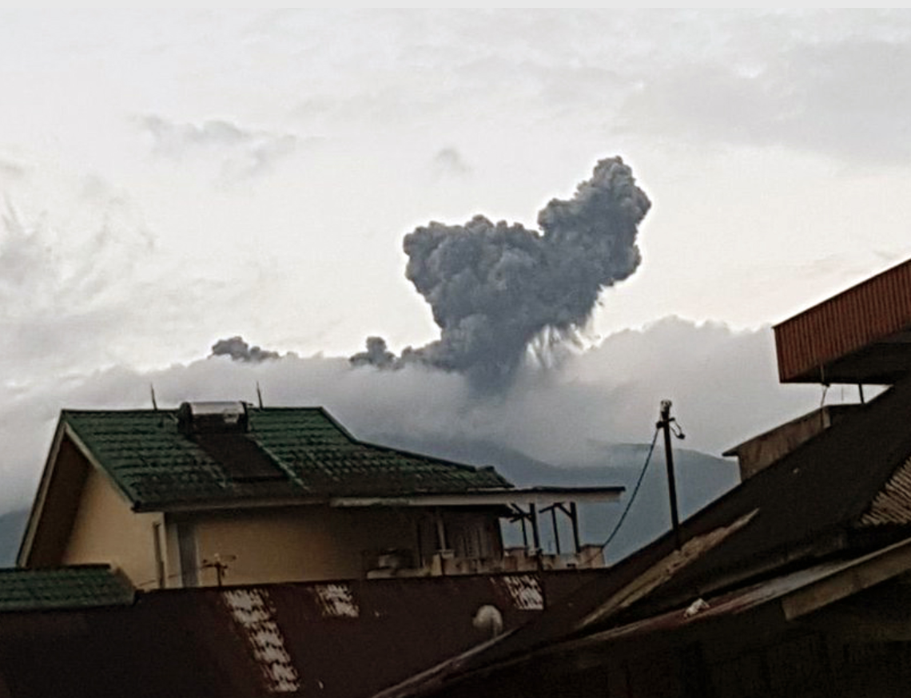
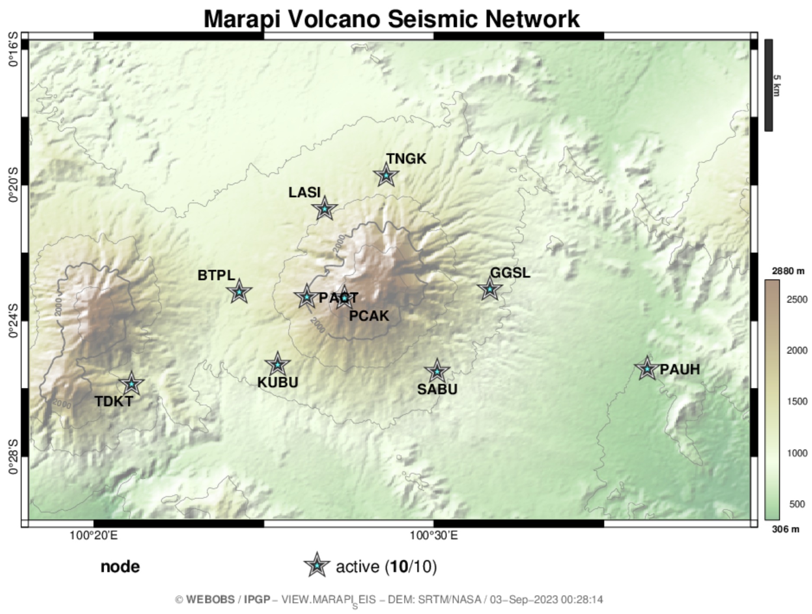
Background on Mount Marapi
  Active stratovolcano in Sumatra, Indonesia (2,116 m height).
  Over 50 eruptions since the late 18th century, with recent activity.
  Phreatic explosions in April and May 2018 produced significant ash plumes.
Seismic network with 10 stations
Focus in 3 Broadband stations closest to summit:
PCAK, KUBU and TNGK
Ash plume from a phreatic explosion at Marapi on 27 April 2018. Courtesy of Sutopo Purwo Nugroho (BNPB). (From GVP webpage)

Slide 7
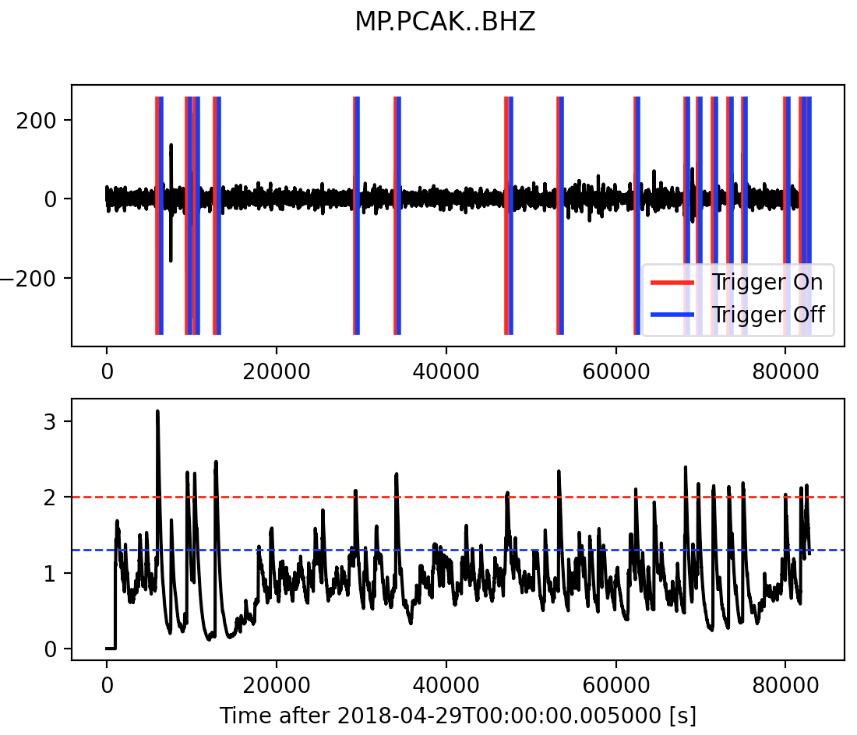
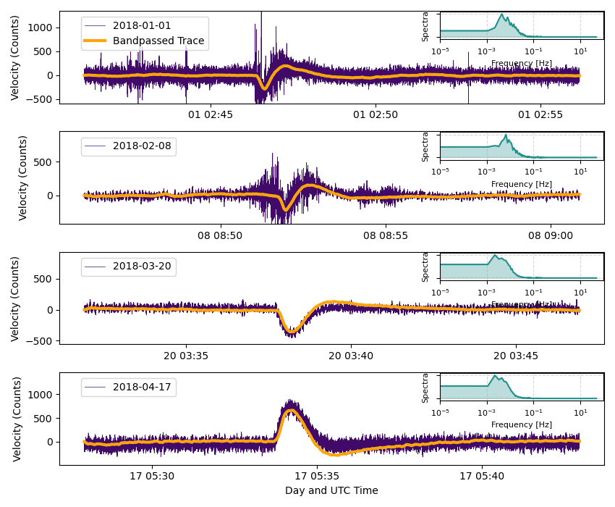
Identify Very Long Period signals
  Detect seismic signals in the raw seismic data from Marapi.
Use STA/LTA to detect onset of VLP, tune thresholds
We only detected VLP events at PCAK station

Slide 8

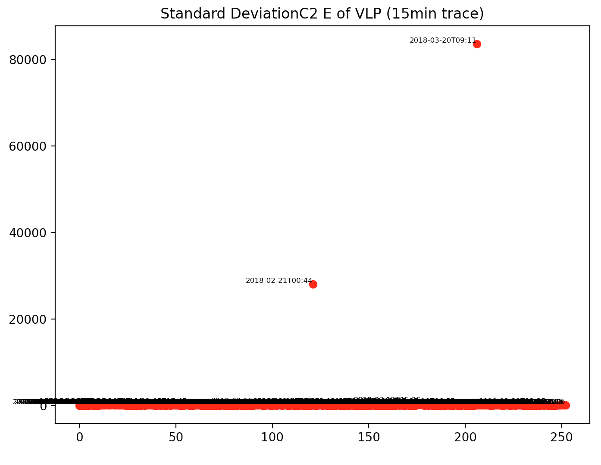
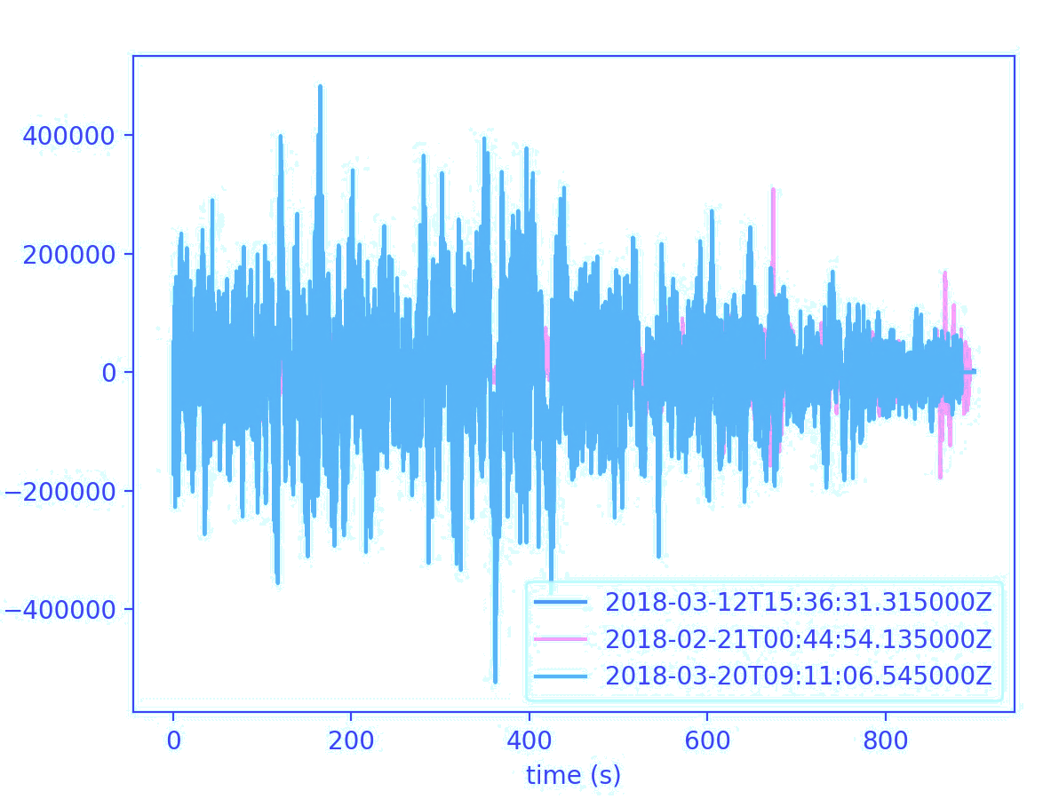
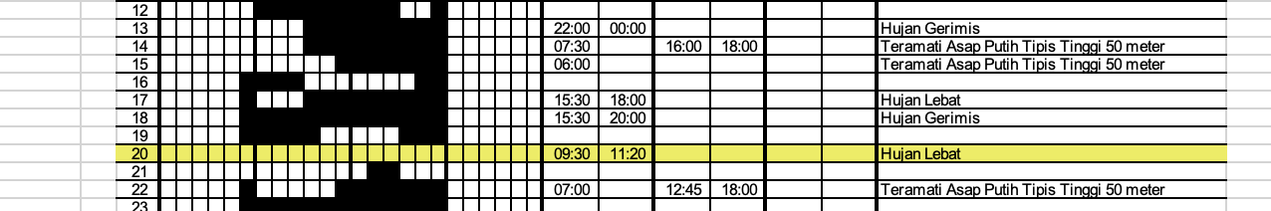

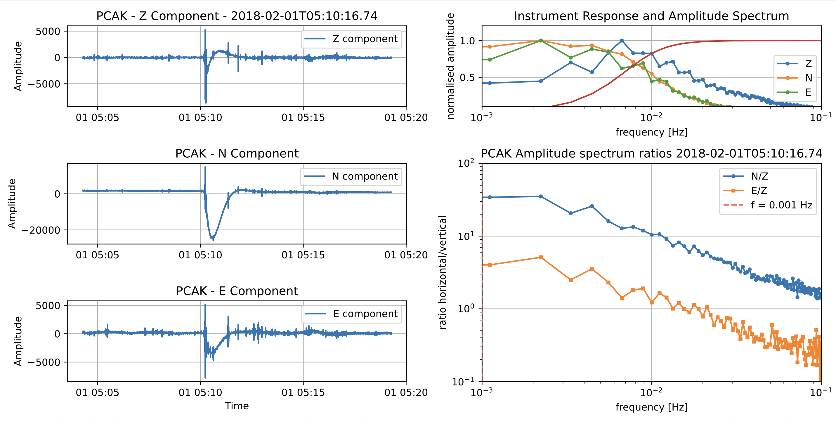
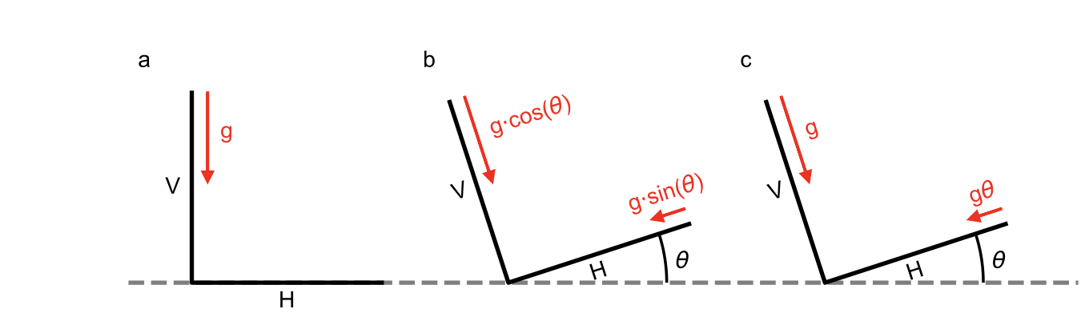
Weather
High noise (weather conditions) or tilt contamination
Outliers
Remove Outliers
Tilt
Image:Christoffensen et al 2024

Slide 9
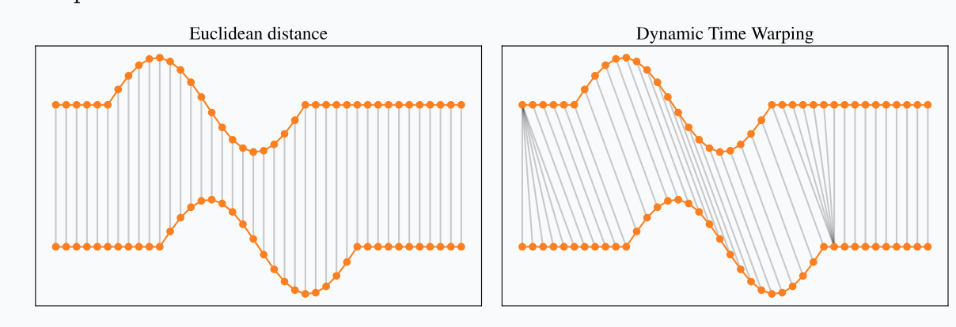
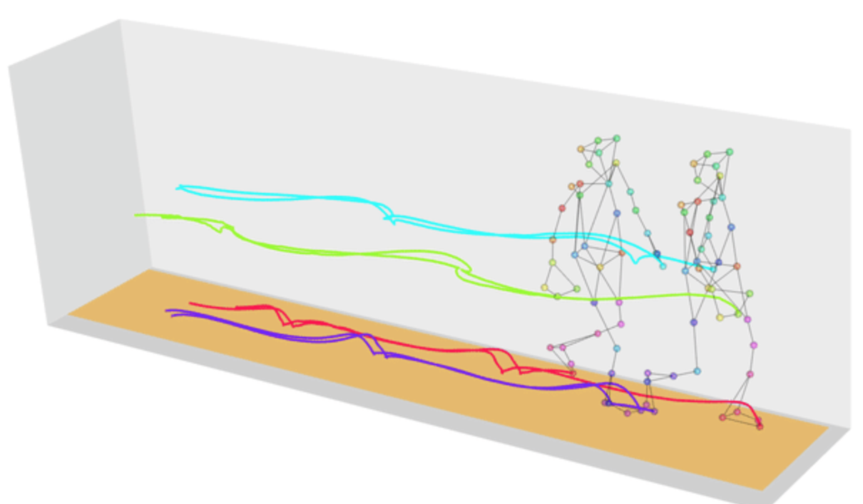
Clustering seismic events
We cluster the VLP seismic events detected at Marapi Jan-April 2018.
We use the Agglomerative algorithm and as a measure of distance we use the Dynamic Time Wrapping (DTW) algorithm.
  DTW measures similarity between waveforms, even if they vary in speed or length.
  Constructs a cost matrix to find the optimal alignment path.
  This method can use time series without the need to extract features.
Has been used to classify seismic events on volcanoes
e.g . Y. Ida et al 2022.

Slide 10
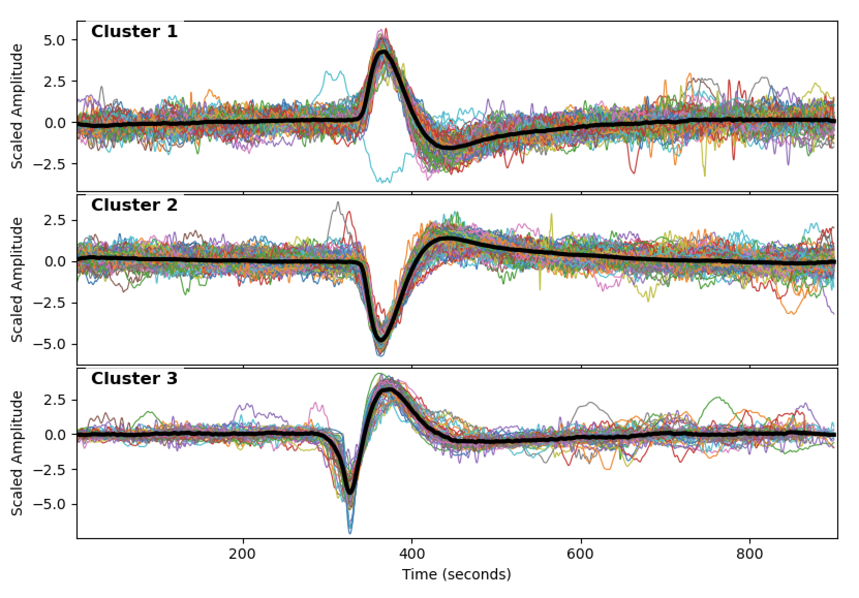
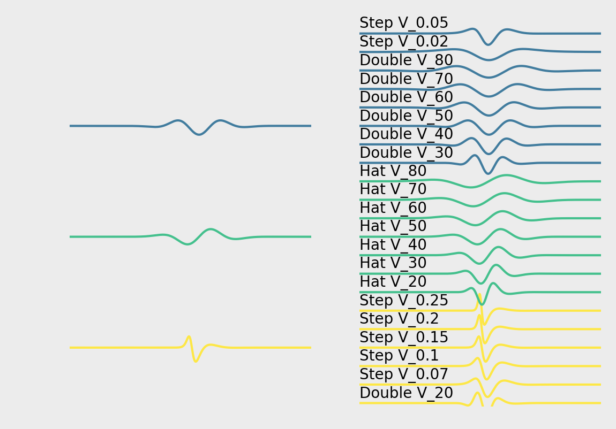
Clustering seismic events
We calculated the optimal number of clusters
with the Silhouette criteria.
We cluster the events using dtw as a distance
criteria between series and cross-correlation to
align events.

Slide 11
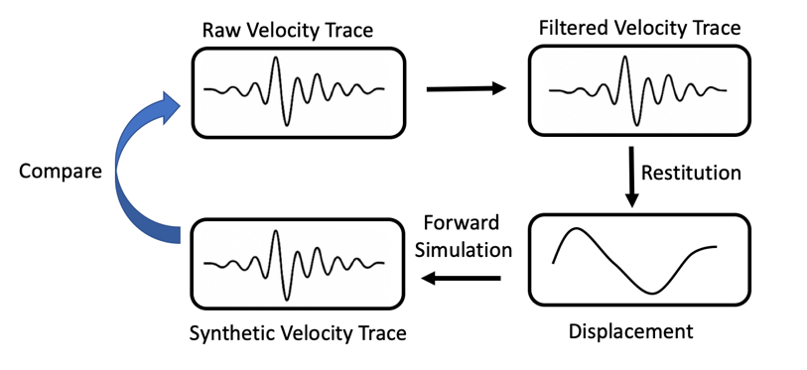
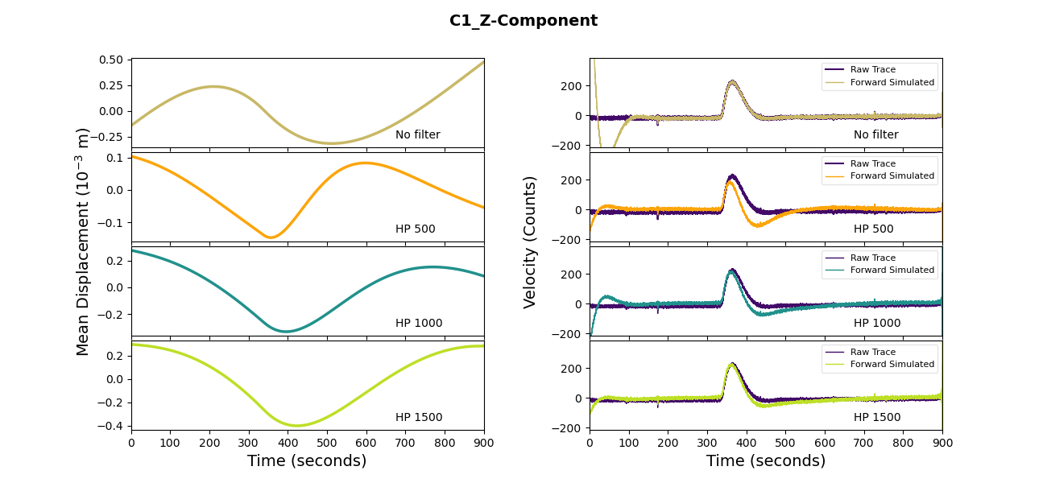
Systematic Restitution.
Frequency-Domain Processing: Highpass the signal at multiple frequency bands .
Restitution: Perform restitution for each filtered signal to estimate displacement.
Optimal Estimation Selection: Evaluate displacement estimates via forward-modelling, comparing synthetic velocities with the raw velocity trace. The best-fitting solution is selected based on this validation.

Slide 12
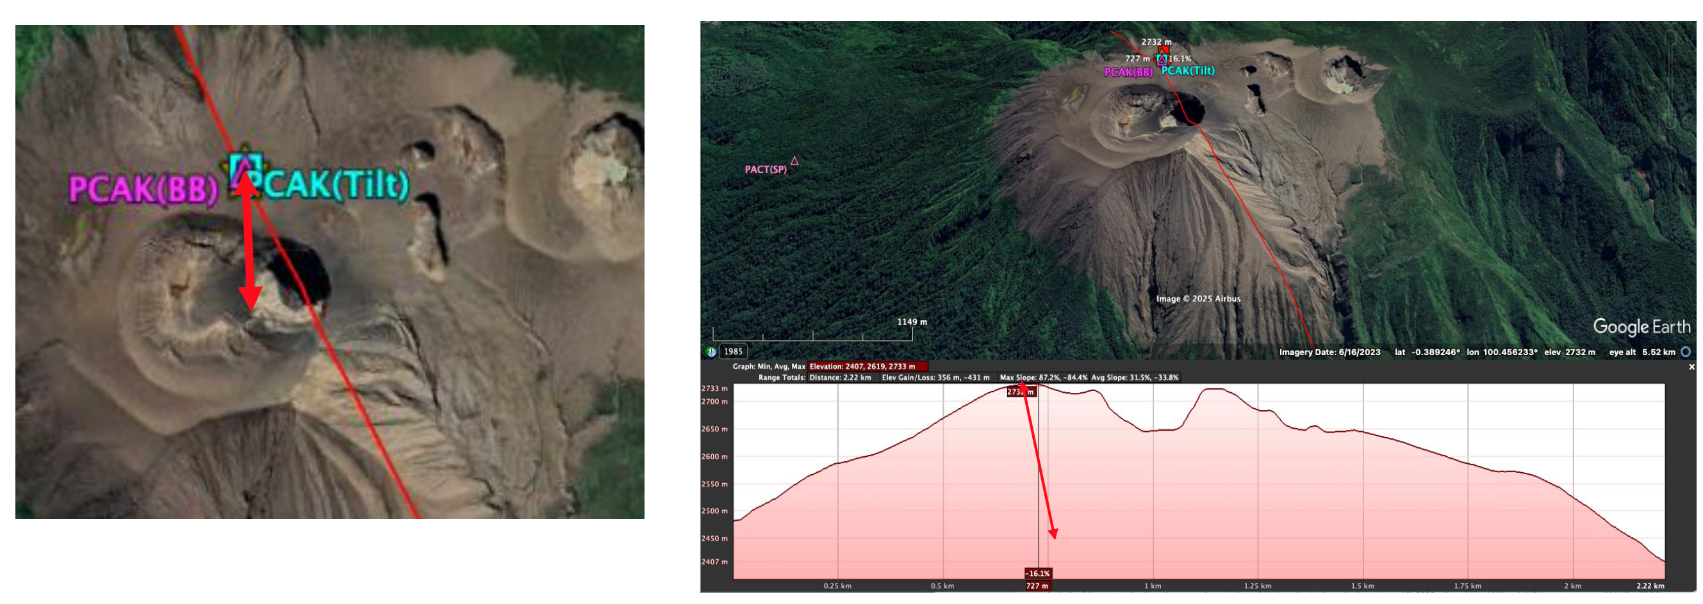
Tracking the source
Particle Motion. Projecting the deformation vectors we observed a shallower source for C3 which points to a surface source while cluster C1 and C2 point downwards.

Slide 13
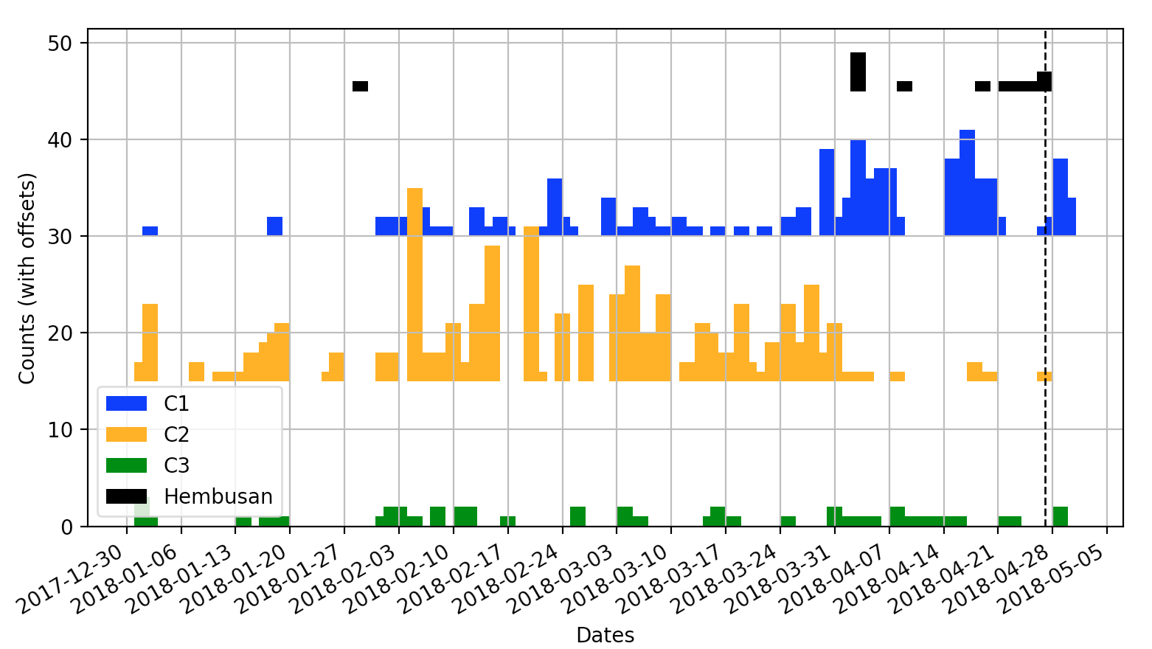
Hembusan- Emission

Slide 14
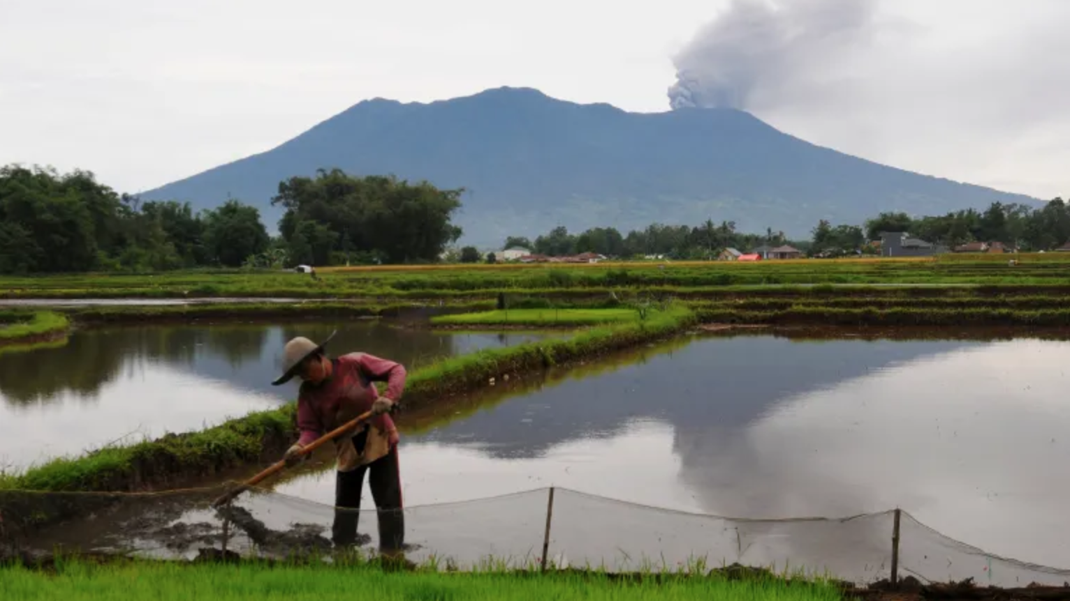
  Take aways
Challenge: VLPs carry important information but are overlooked due to seismometer frequency limitations.
Method:
Unsupervised clustering to group signals.
Restitution technique to estimate true ground displacement.
Findings:
Mt. Marapi (2018): Hundreds of very-long-period seismic signals detected before phreatic eruption.
Distinctive clusters.
One cluster likely from a shallow (near-surface) source

