Slide 1







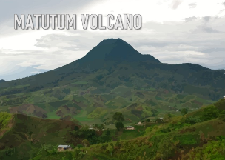

Significant Volcanic Seismic Signals Across Philippine Volcanoes: Observations and Monitoring Approaches
Christian Joseph Clarito
PHIVOLCS
Notes:
Good day everyone. My presentation is titled ‘Significant Volcanic Seismic Signals Across Philippine Volcanoes: Observations and Monitoring Approaches. We’ve been looking at the different seismic fingerprints of our active Philippine volcanoes — Kanlaon, Mayon, and Taal. Each one has its own personality: some produce deep LPs, some show VT swarms, others erupt almost quietly with rockfalls or tremor, and sometimes we even encounter ‘missing’ events because of attenuation or station geometry.
Our team has been using tools like 3-D relocation, frequency-based analysis, and some early-stage AI forecasting to better understand these signals and pick out the subtle changes that might matter for early warning.
And we’re also really interested in how other observatories handle these kinds of tricky signals — the ones that don’t fit neatly into standard categories. How do you detect or classify them? What tools or workflows have worked well for you? We’d love to learn from your approaches and compare notes.

Slide 2
Motivation
•Volcanoes in the Philippines erupt frequently, but with different styles of precursors.
• From waveform to warning, making every signal count.
Notes:
-I will talk about Kanlaon, Taal, and Mayon. So to speak they talk different dialects but we need to listen to them.
-every signal or waveform should be treated equally.

Slide 3
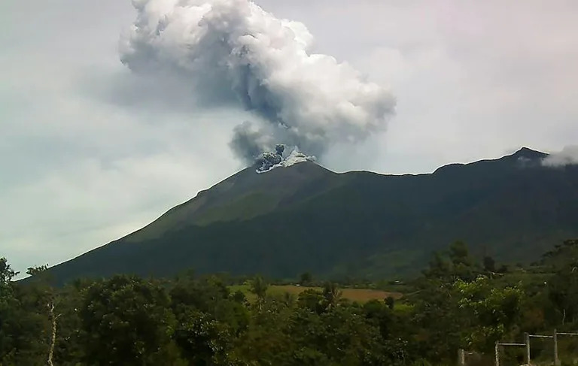
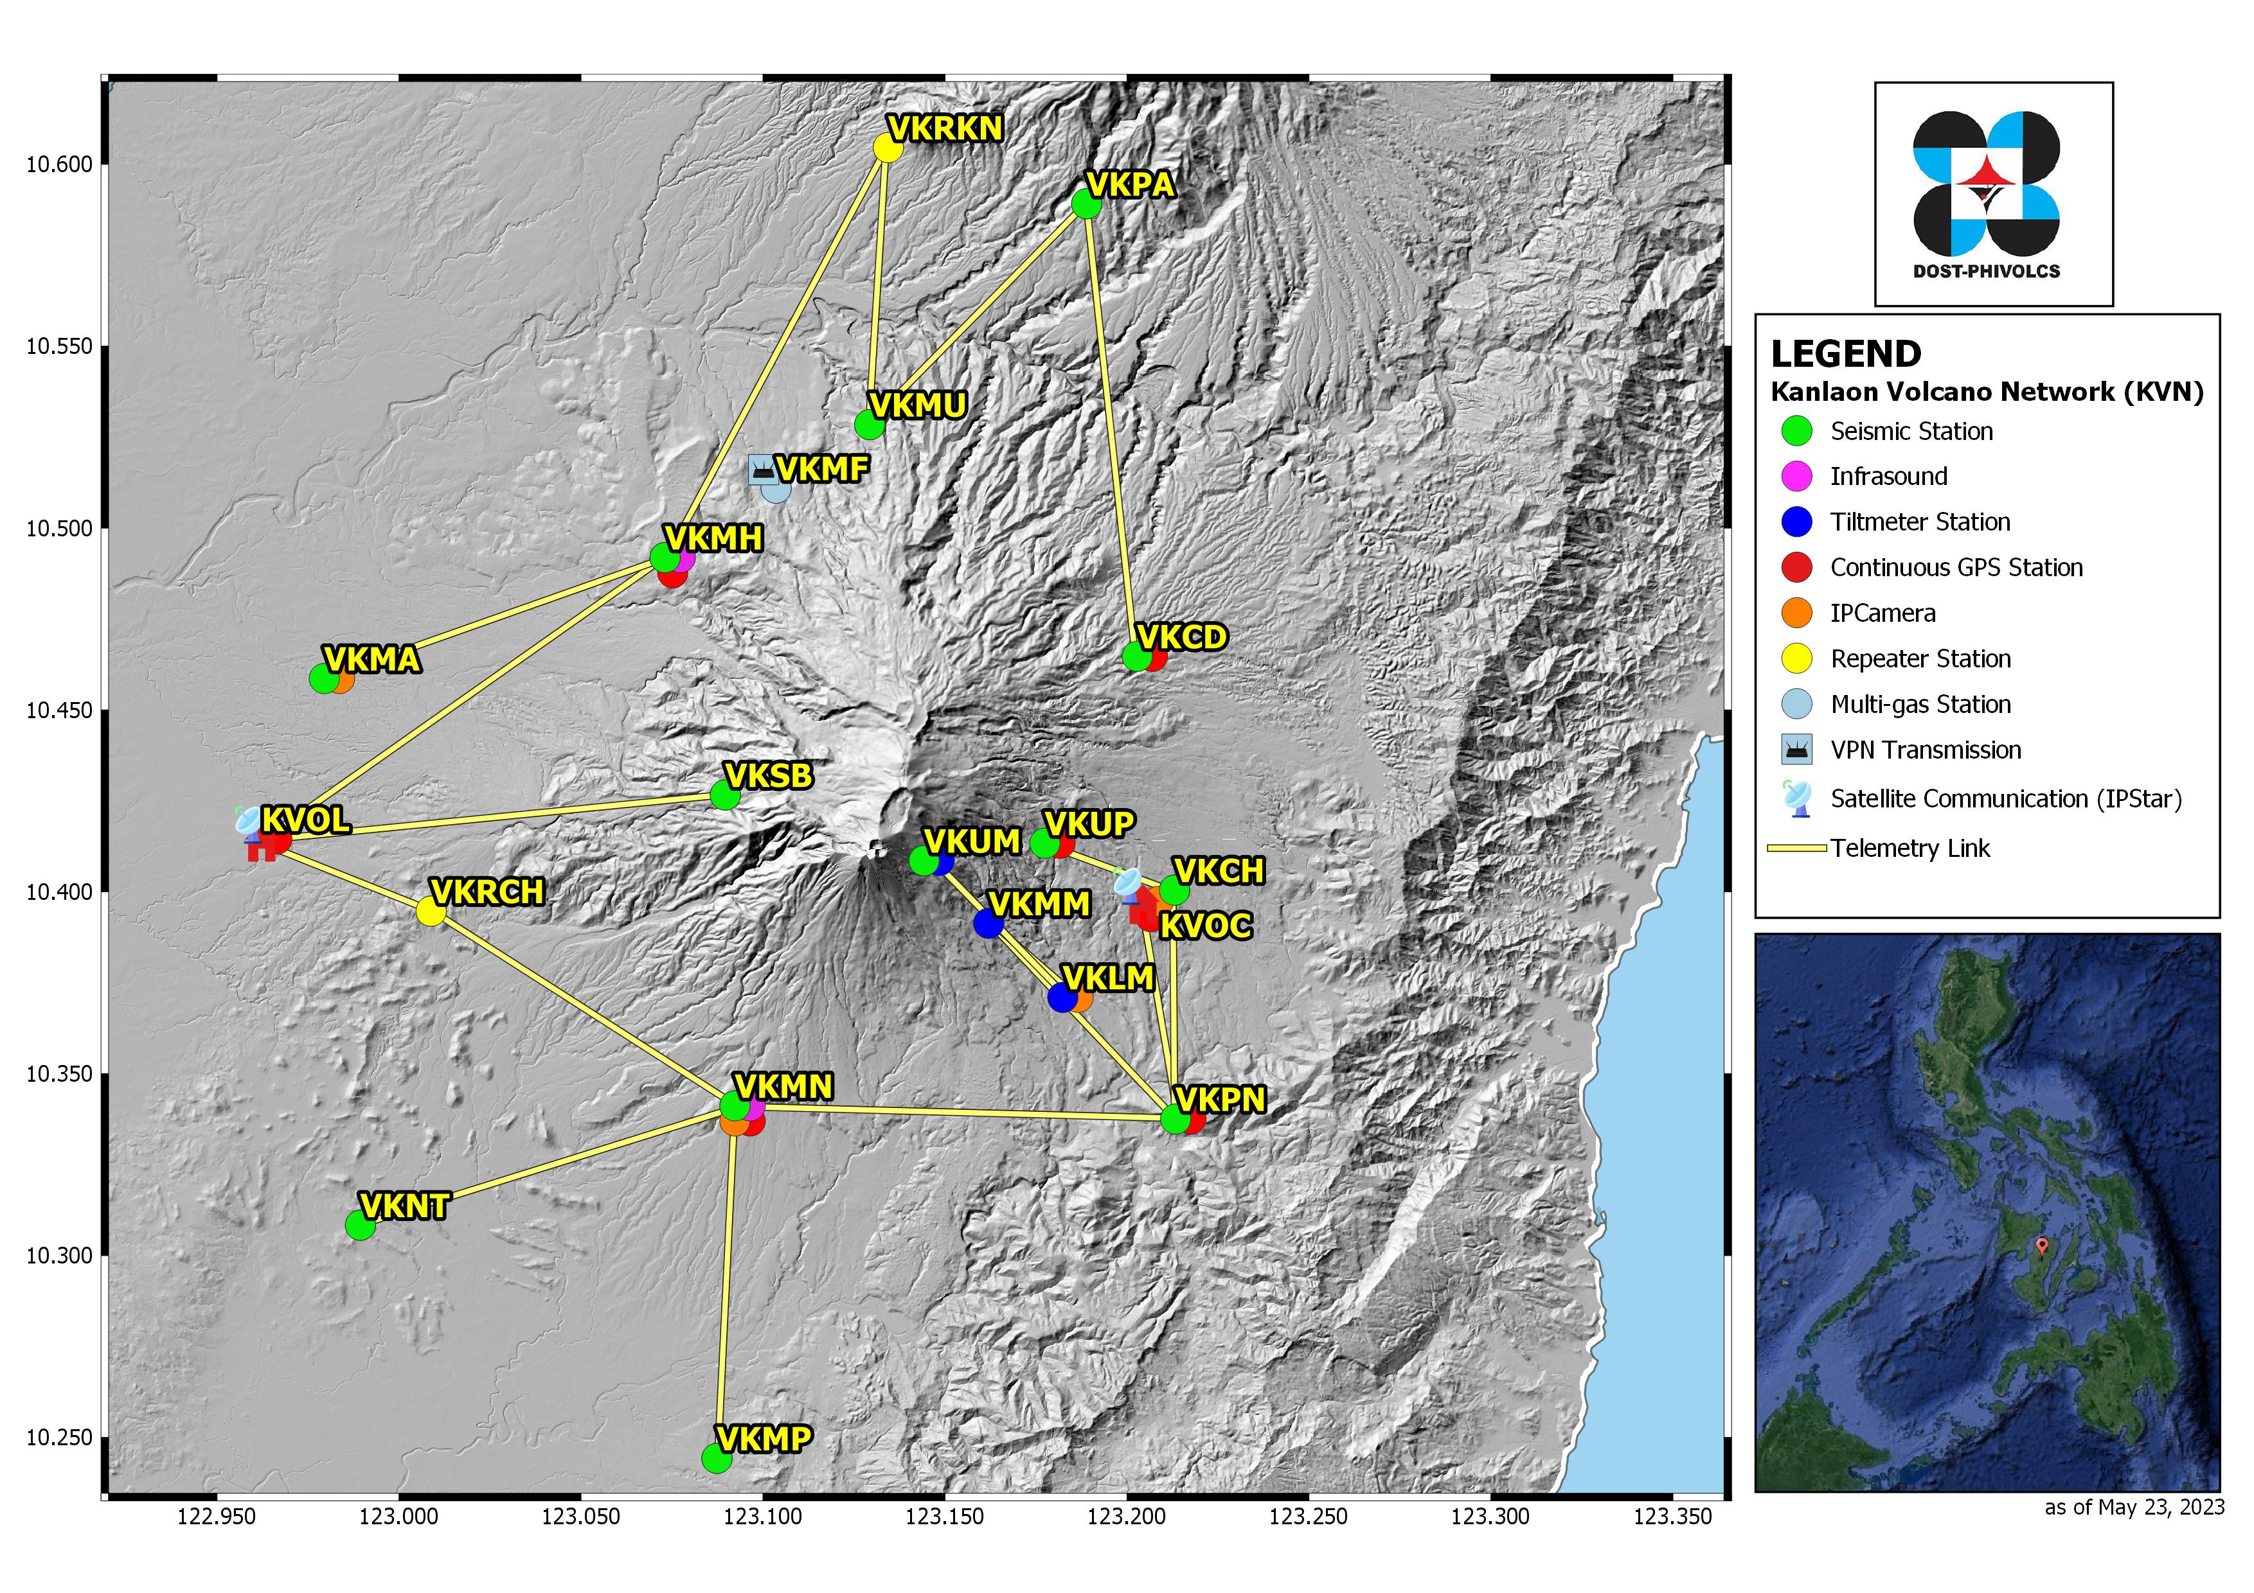
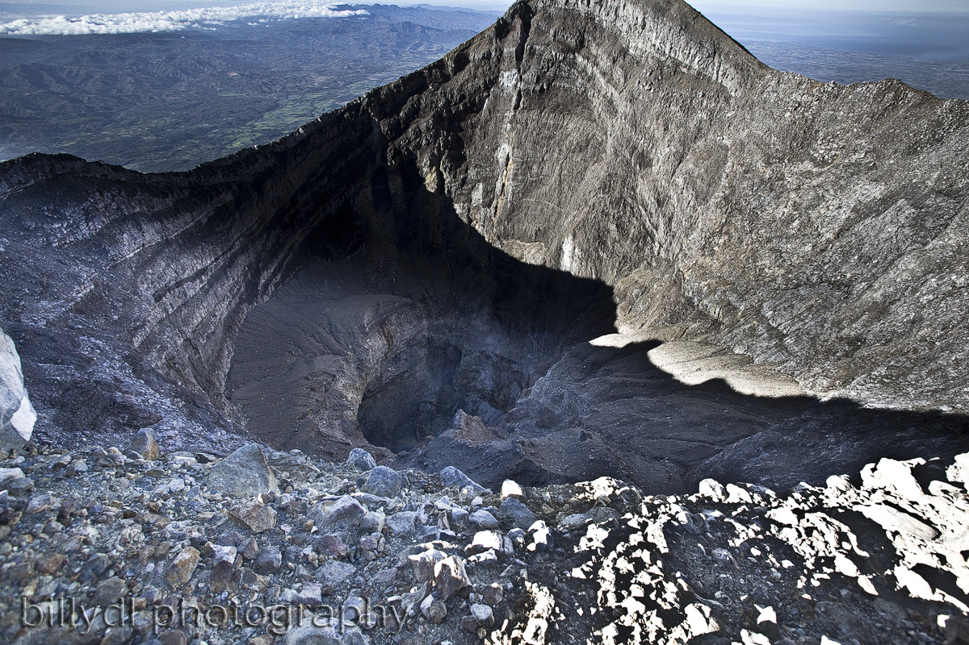
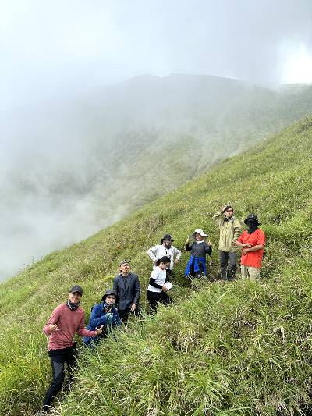
Bulkang KanlaoN
Notes:
June 2016 Kanlaon Eruption

Slide 4
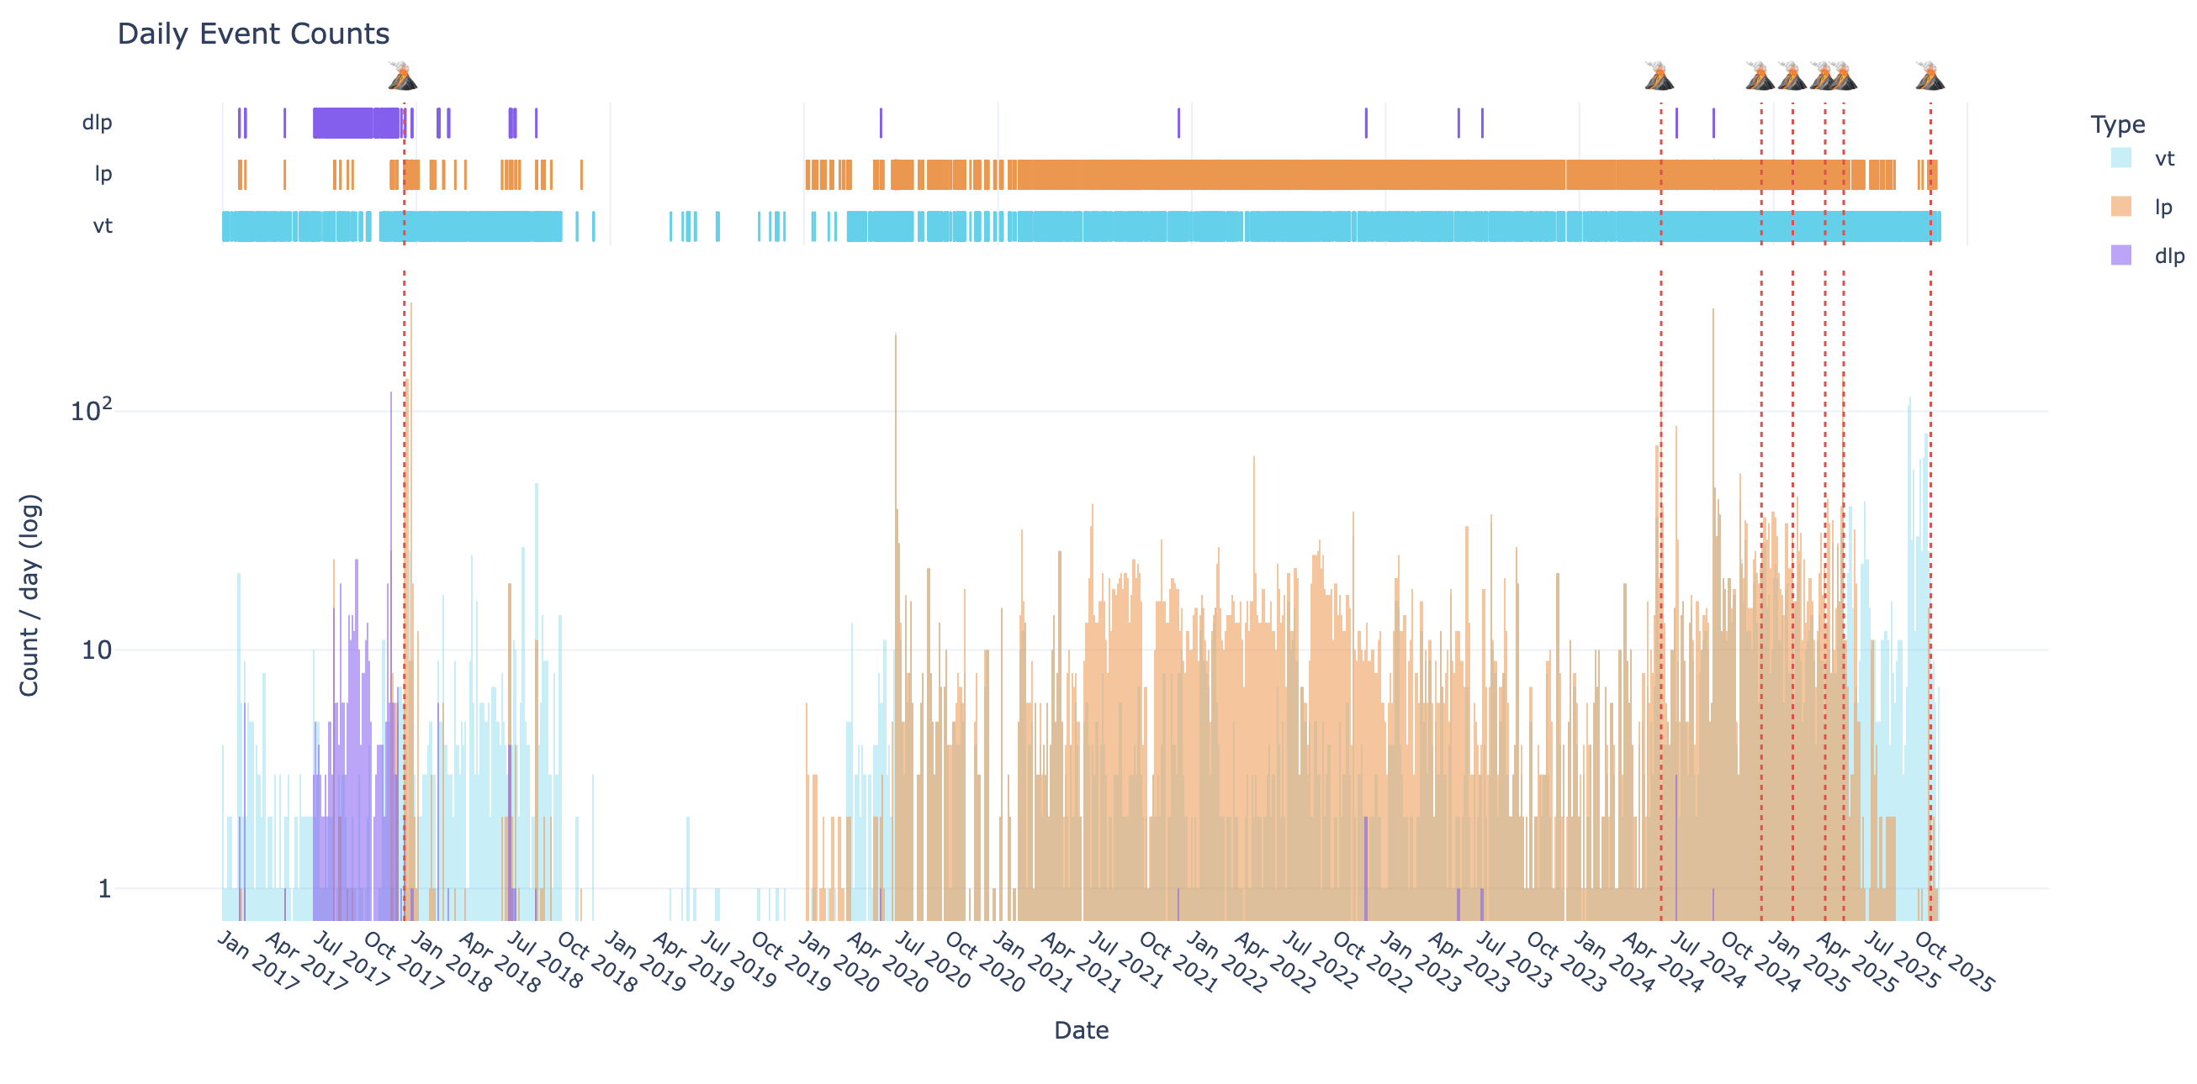
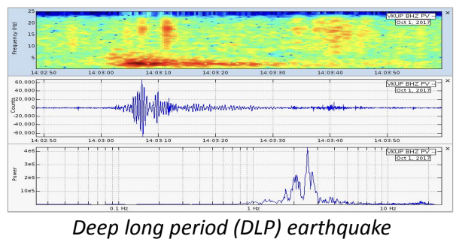
Kanlaon Volcano
From DLPs to “Missing VTs”: New Seismic Perspectives on Kanlaon’s Recent Unrest
Long-term seismic evolution at Kanlaon shows a progression from deep fluid-driven events (DLPs) to persistent brittle failure (VTs), with each eruptive episode preceded by increased LP and VT activity.
Notes:
Kanlaon is a good starting point because prior to the 2023 eruptive episode, we recorded a remarkably complete suite of seismic precursors — DLPs, LPs, spiky VTs, tremor, and even spatial migration. Few Philippine volcanoes express this level of seismic diversity in a single unrest period.
This makes Kanlaon an ideal case to examine how different signal types emerge, interact, and transition as the volcano approaches eruption
This plot gives us a long-term view of Kanlaon’s daily seismic activity from 2017 to 2025 with eruption markers.
Early on, we see a cluster of deep long-period events, which tells us something was happening deeper in the system. When we first detected these deeper earthquakes beneath, they appeared simply as deep VT-like events at around 20 to 30 km. But their waveforms looked different — more emergent, longer in duration, and with dominant low-frequency energy.
To confirm whether these were truly Deep Long-Period (DLP) events, we processed using REDPy to compute the Freq-index and grouped these deep events into a single waveform family and showed they shared similar low-frequency characteristics.
The FI values consistently showed strong low-frequency dominance exactly what we expect for DLPs.
Then starting around 2020, the pattern changes we see persistent VT activity, meaning the crust was cracking more often, likely due to magma intrusion.
Before each of the 2024 and 2025 eruptions, the LP and VT counts spike or cluster. So the sequence shows a clear progression: deep processes at first, then mid-crustal intrusion, then shallow unrest leading to the eruptions.
This long-term shift is a strong indicator of a magma system migrating upward over time.

Slide 5
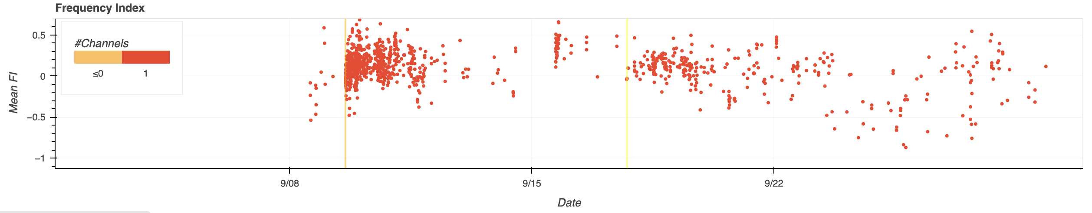
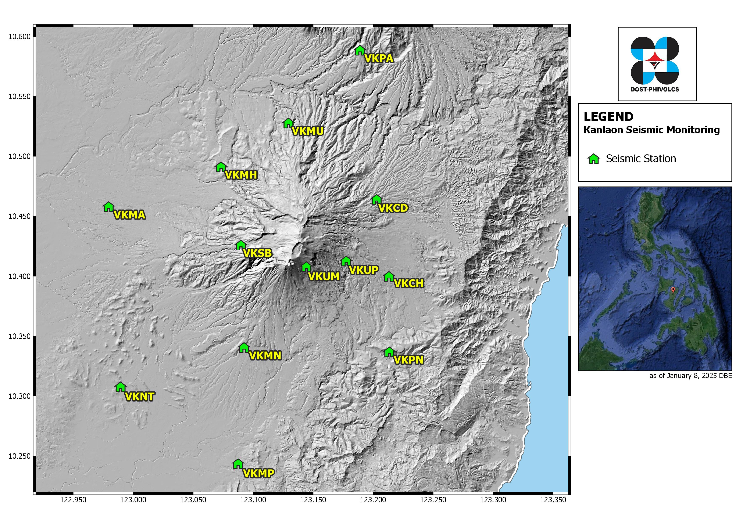
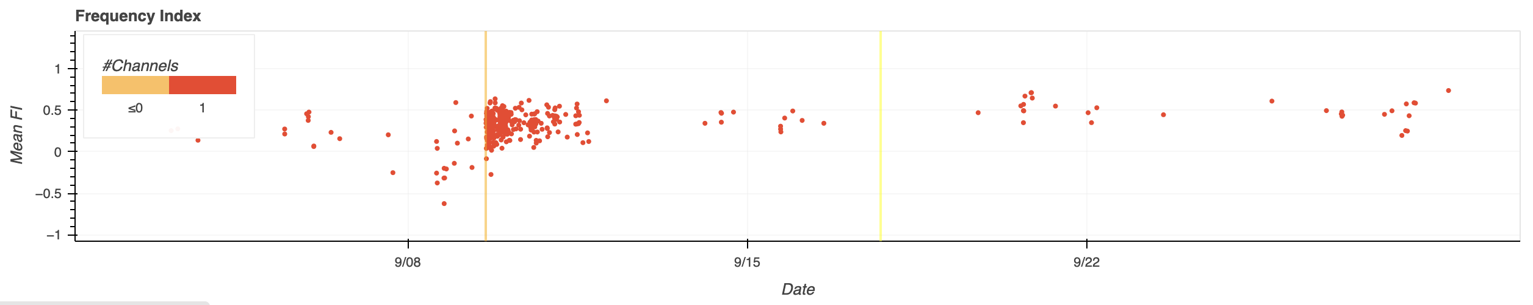
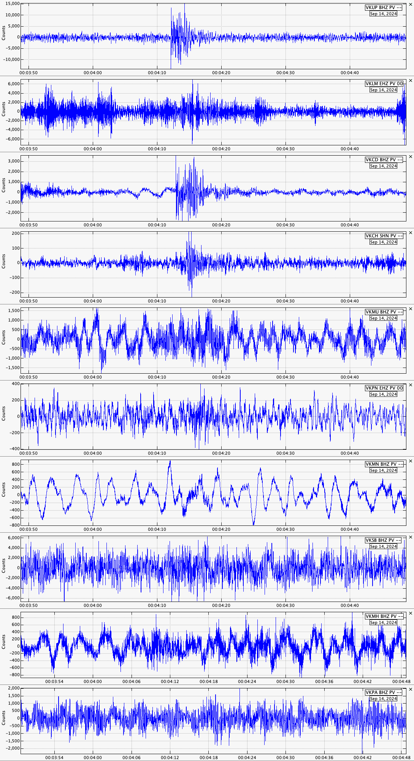
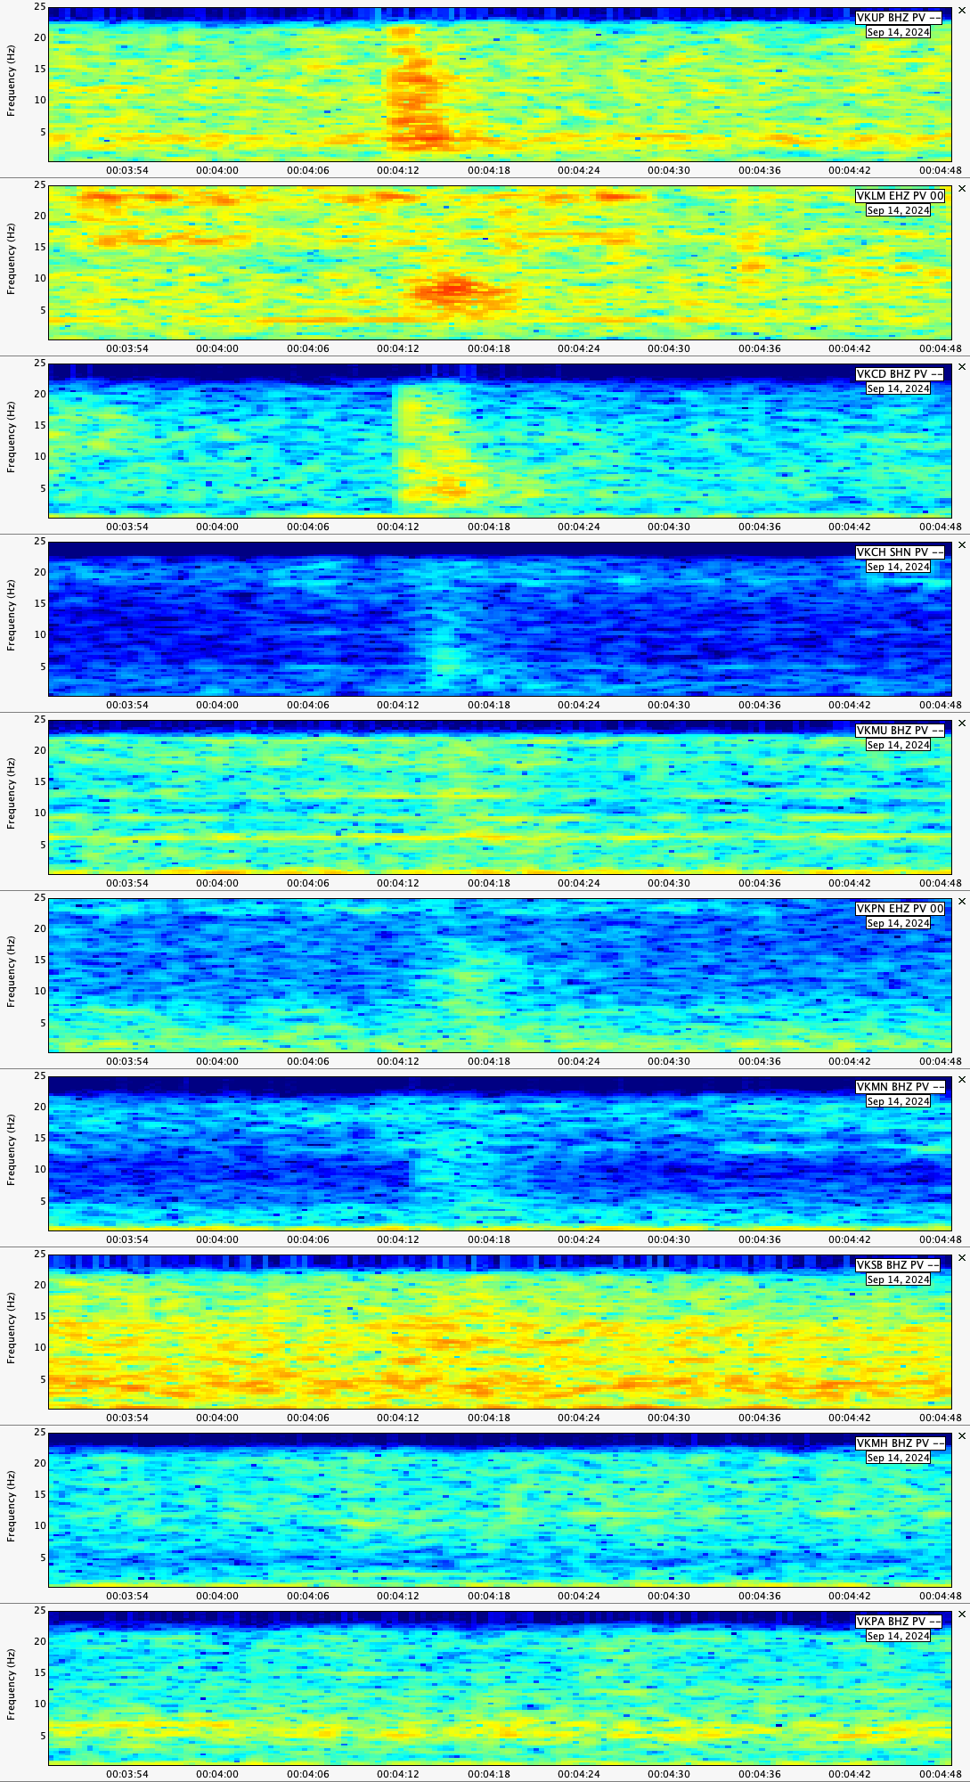
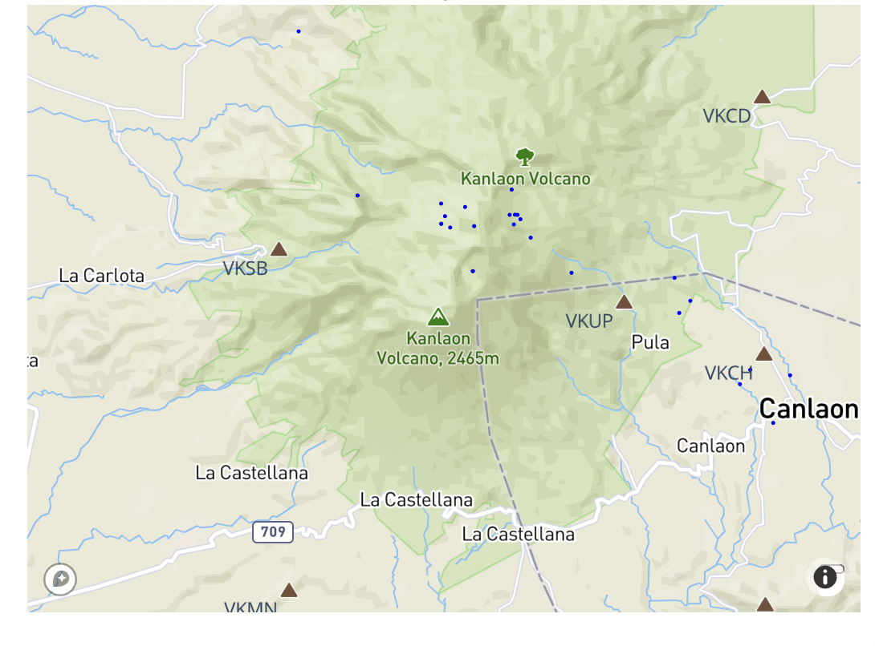
Kanlaon Volcano
From DLPs to “Missing VTs”: New Seismic Perspectives on Kanlaon’s Recent Unrest
VKUP
VKSB
Shallow VTs (<3km depth) beneath Kanlaon’s north to northeast flank were clearly recorded on east-side stations but became nearly invisible on the west, illustrating strong attenuation and the localized nature of the 2024 swarm
hypoDD Relocated events from 15-30 Sept 2024
Notes:
Here I’m showing the frequency-index summary from REDPy for two key stations at Kanlaon, VKUP on the eastern flank, and VKSB on the western flank.
The orange line shows the increase in seismic activity beginning September 9, 2024, and the yellow line marks the onset of what we later identified as the 'seismic anomaly' phase.
What’s important here is the difference in detections between the two stations. VKUP, on the east, detected 298 events over this period, while VKSB on the west detected only 177.
This is consistent with what we observed in the waveforms and spectrograms: many of the shallow VT events during the September swarm were only strong on the east side. The signals attenuate significantly as they travel westward across the edifice.
As we move west and northwest, the amplitudes collapse into the noise and the event becomes nearly invisible.

Slide 6
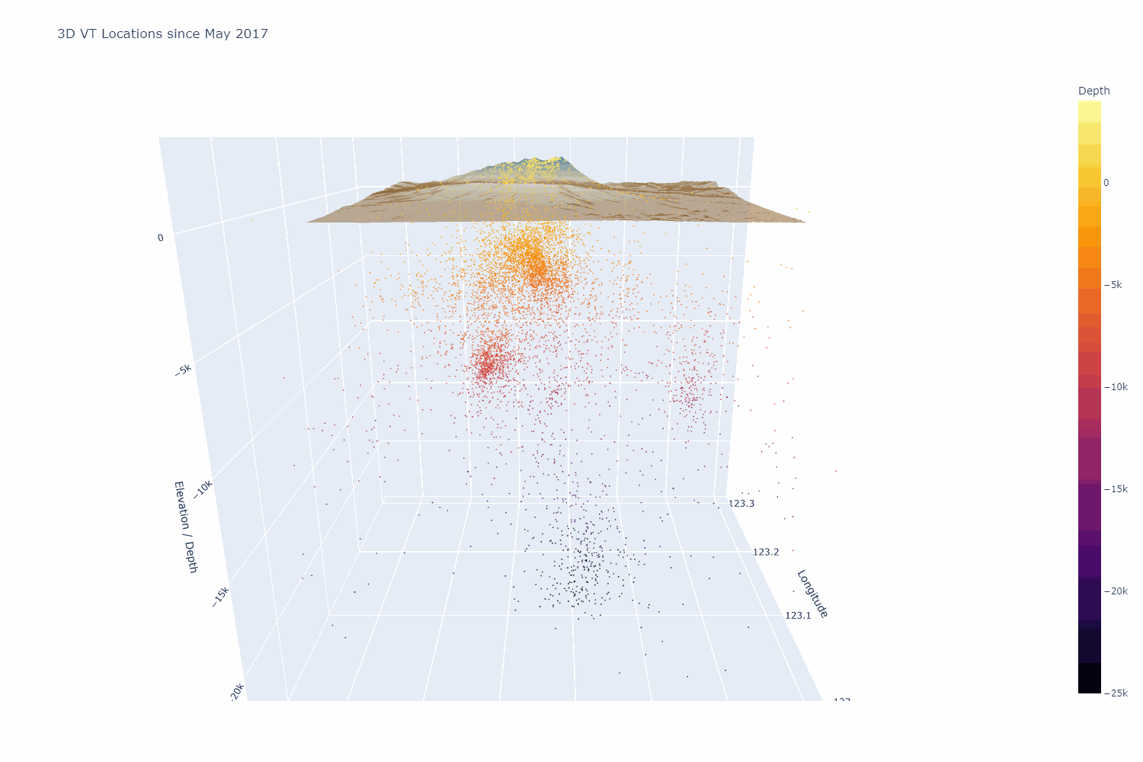
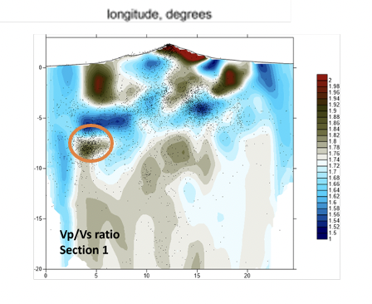
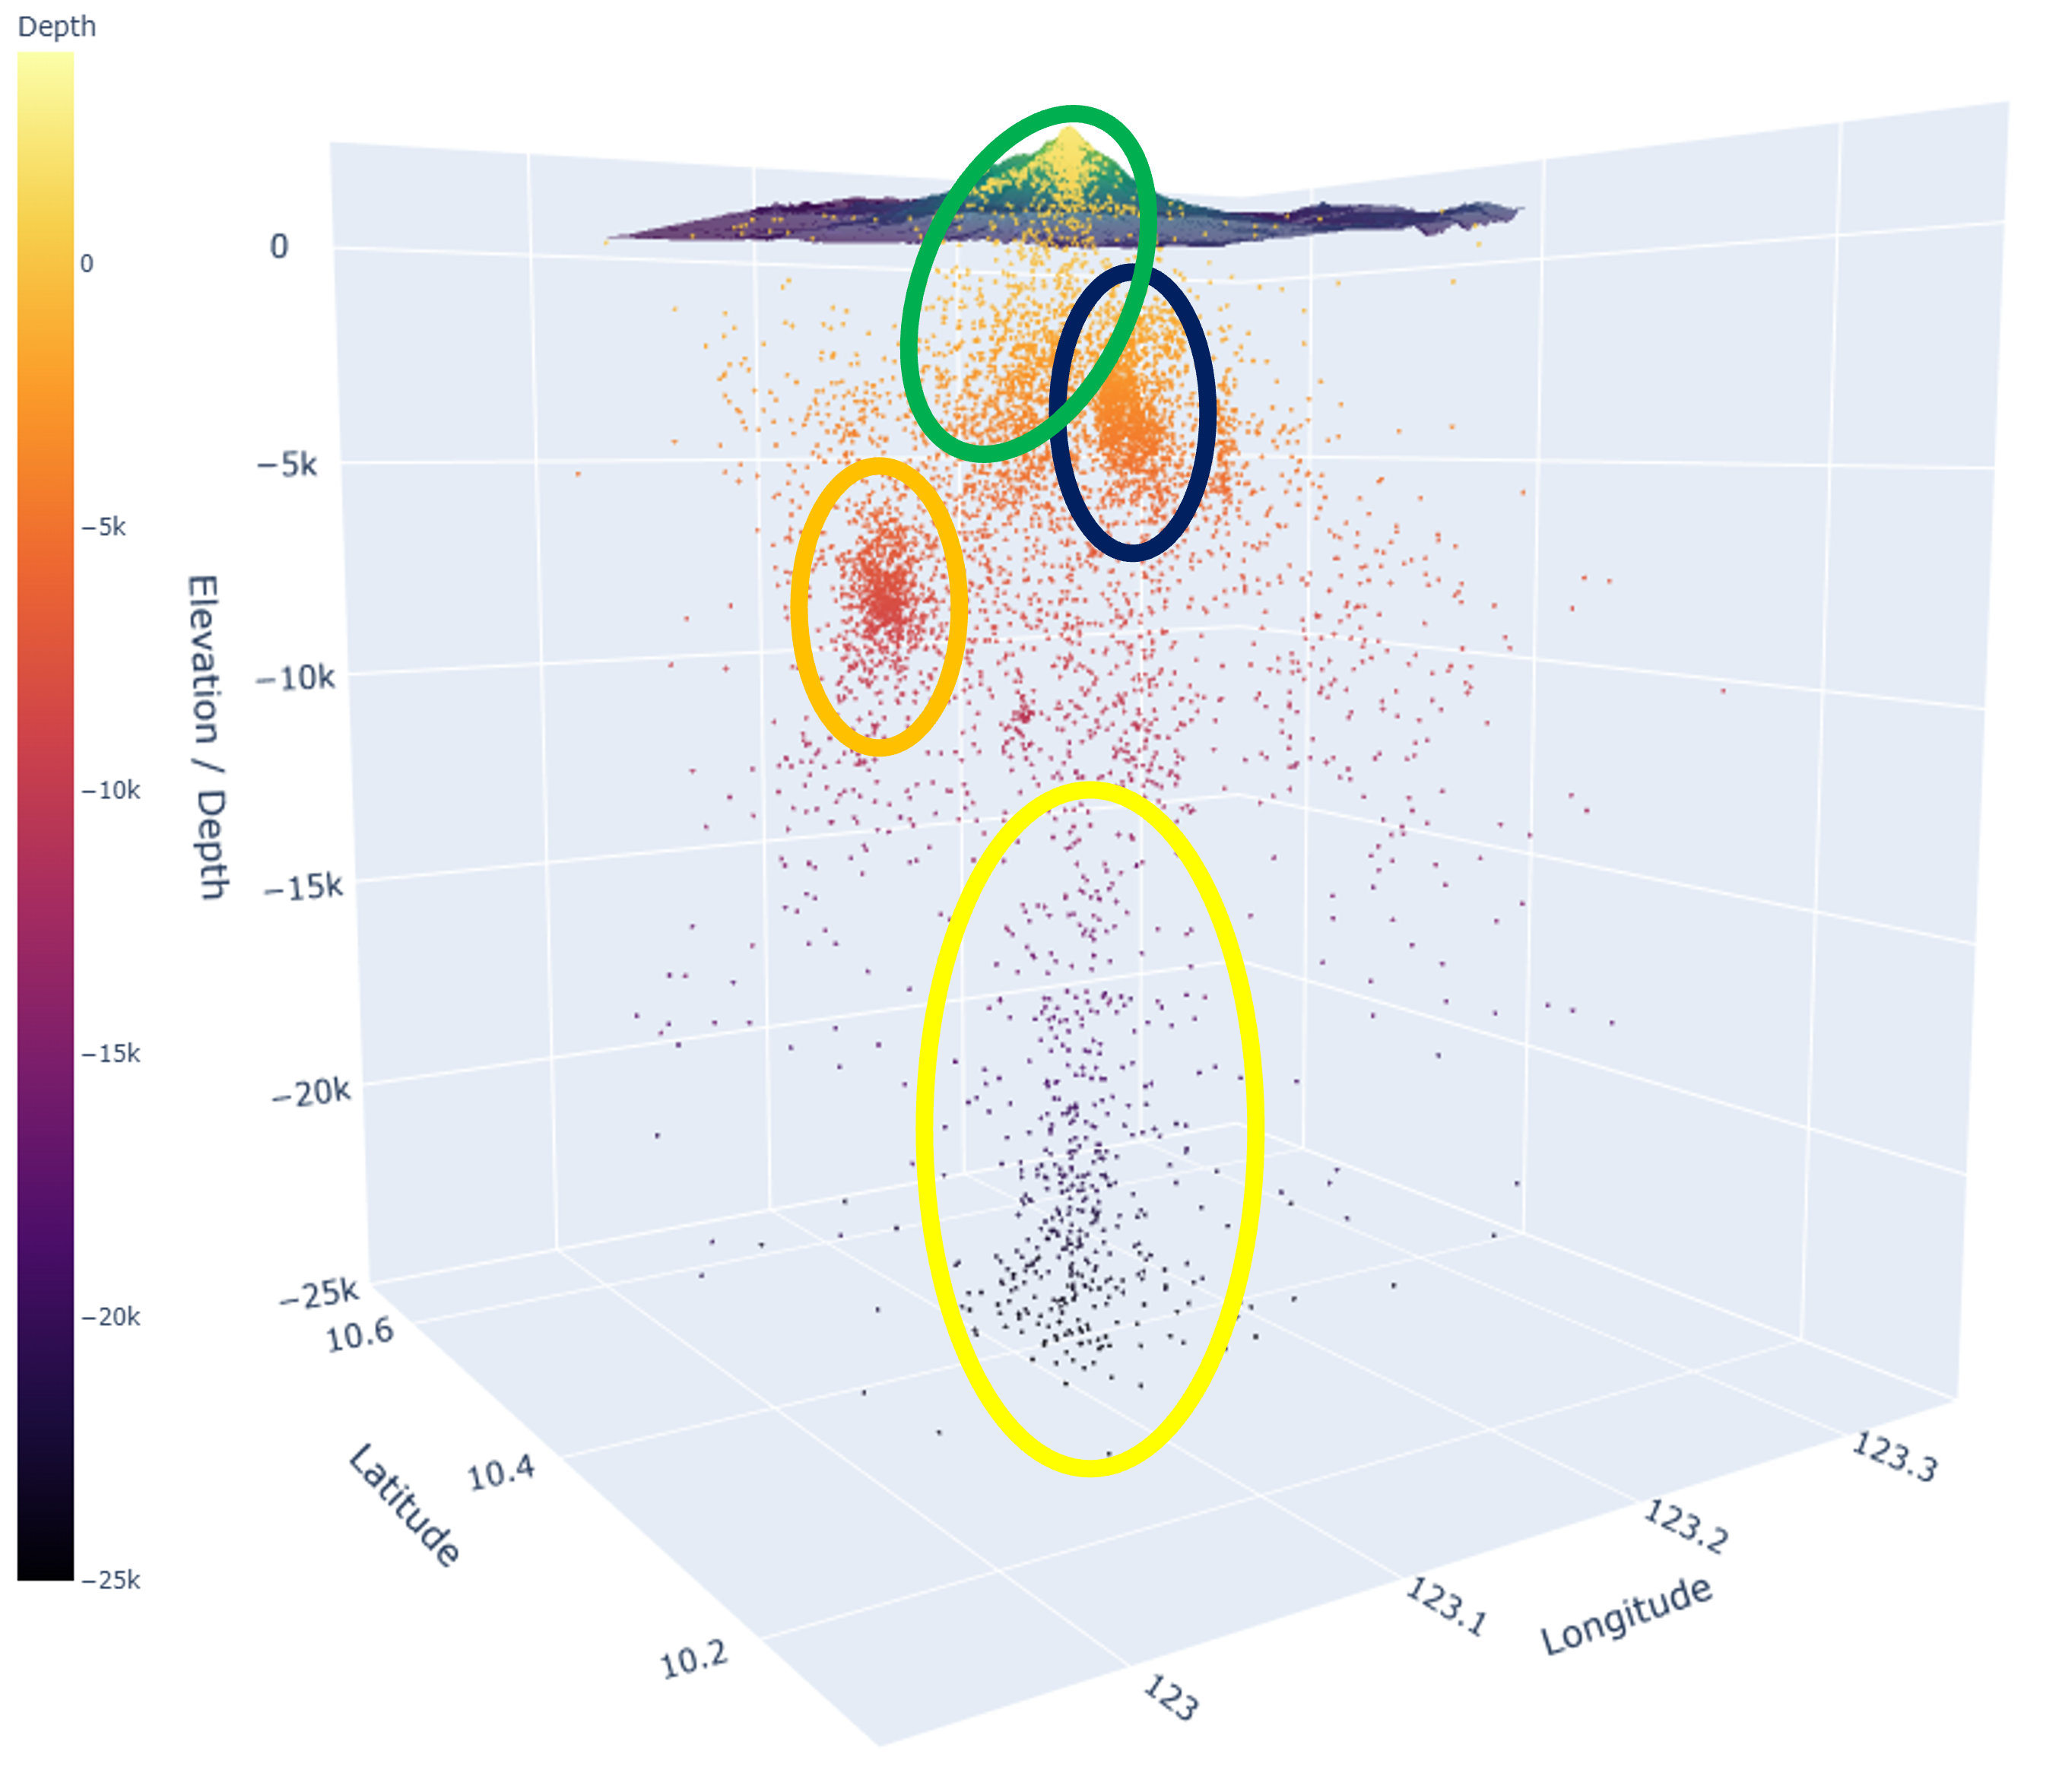
Kanlaon Volcano
From DLPs to “Missing VTs”: New Seismic Perspectives on Kanlaon’s Recent Unrest
Initial Tomo result: Strong high Vp/Vs anomalies occur beneath the summit and adjacent flanks, consistent with fluid-saturated or partially molten zones. A significant high Vp/Vs anomaly is associated with the June 2020 seismic swarm (orange ellipsoid), located at ~6-10 km depth. This anomaly sits atop a low Vp/Vs region, suggesting a zone of fluid accumulation or pressure build-up. The swarm may mark the onset of a magma intrusion at intermediate depths.
Final source locations using 3D velocity grid. Apparent features are highlighted by colored ellipsoids:
1. (Green) A cluster of shallow events from the crater down to ~4km
2. (Blue) A shallow VT swarm on the eastern to north-eastern flank (September 2024)
3. (Orange) VT swarm at intermediate depths NW of Kanlaon (June 2020 swarm)
4. (Yellow) Deep long-period events observed in 2017
Notes:
We used LOTOS software for 3D relocation. Here is the final 3-D distribution of all Kanlaon VT events using the LOTOS algorithm.
In our final relocation, we observe four major clusters, each likely representing distinct portions of the magmatic–hydrothermal system:
1. Green - This uppermost cluster sits just beneath the summit crater at depths of ~0–4 km.
It likely represents shallow fracturing, degassing, and the brittle response of the conduit region.
2. blue -A second shallow cluster extends toward the N-NE flank
This corresponds to the area where we observed the ‘missing VTs’ in VKSB — the activity was there, but attenuation and station geometry prevented detection on the western array.
3. orange -Around 5–10 km depth reveals a tight mid-crustal cluster. Could be the start of intrusion
This is often interpreted as a transitional zone, possibly where ascending fluids or magma interact with pre-existing structures.
4. At depths of 17–25 km are the DLPs observed in 2017. It resolves a broad, deeper reservoir-scale zone.
This is a strong candidate for the lower magma storage region, feeding the mid-crustal pathway during episodes of unrest.
Together, these clusters outline a vertically connected system, from the deep reservoir to the shallow summit.

Slide 7
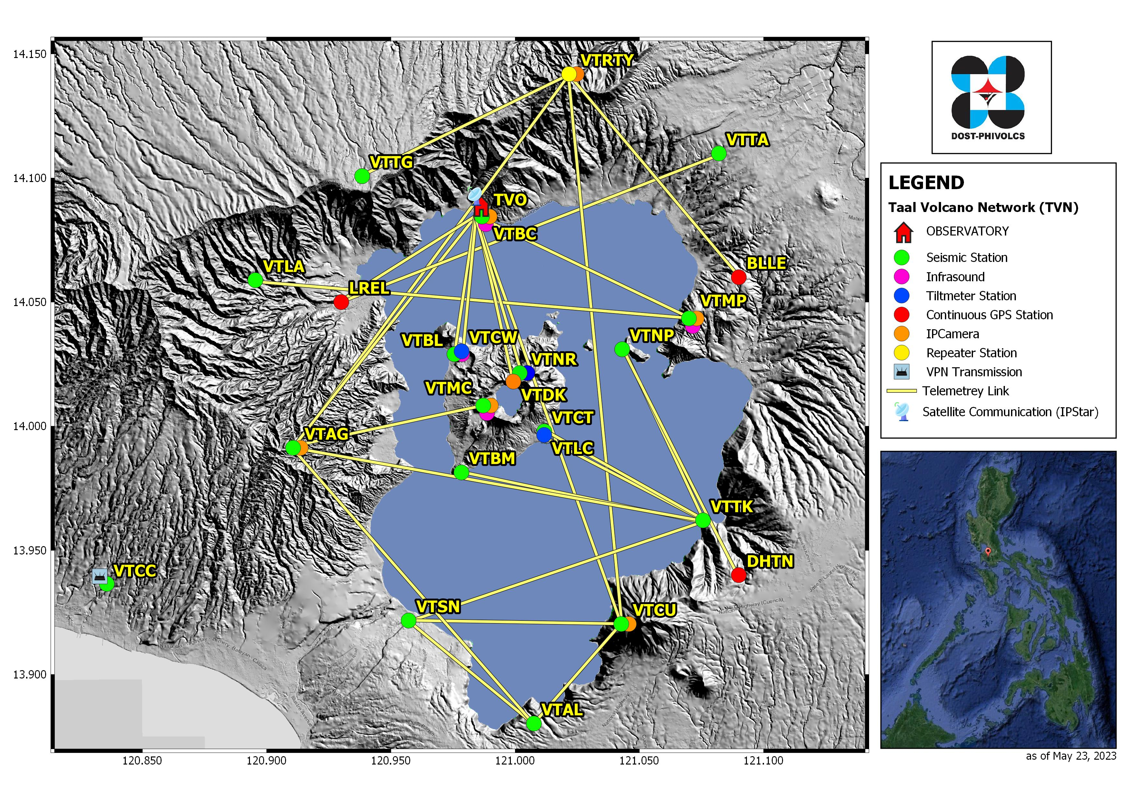
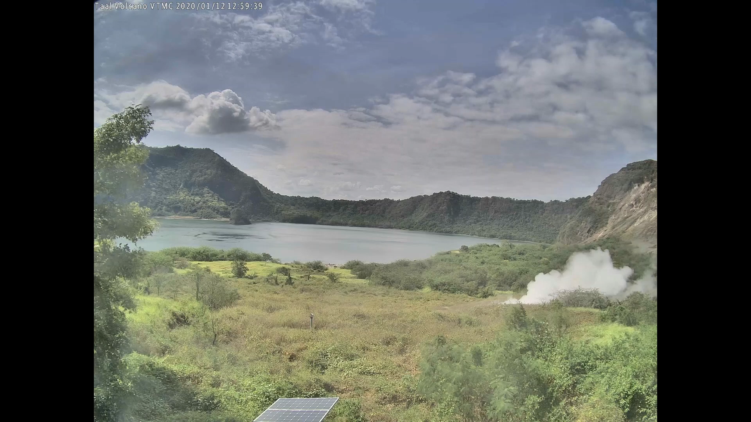
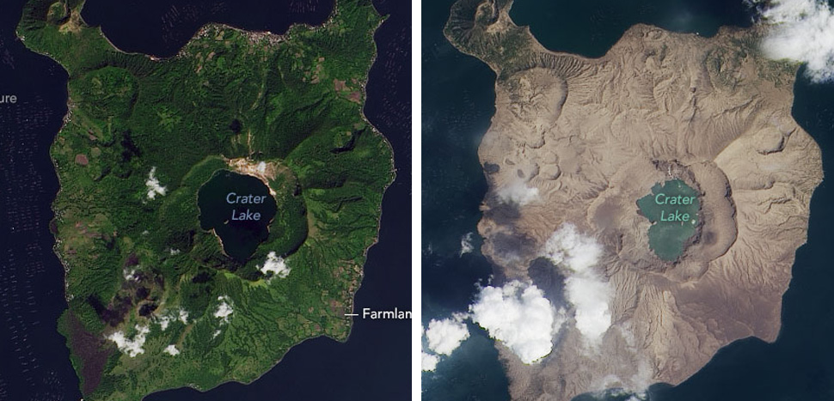
Bulkang
TAAL
Notes:
From deep LPs and migrating VTs, we now shift to a very different volcano —
where low-frequency tremor and degassing dominate the precursors.

Slide 8
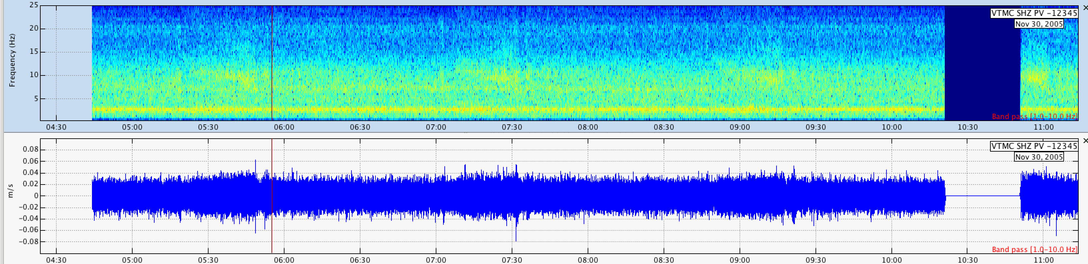
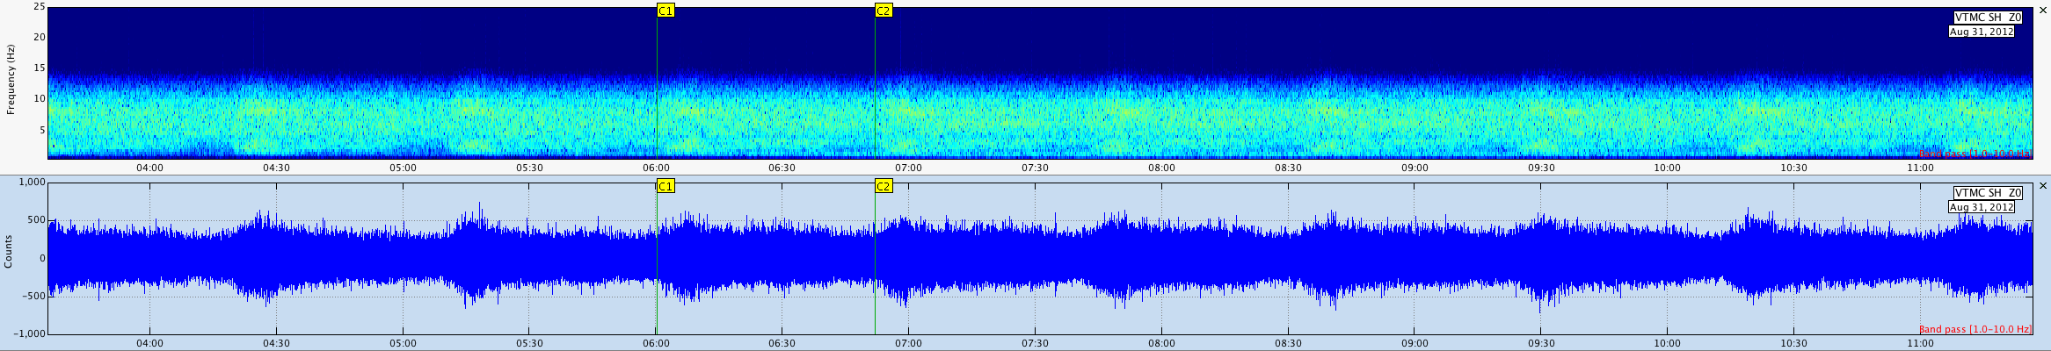
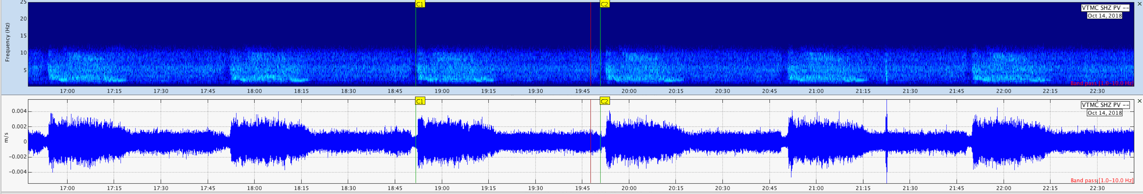
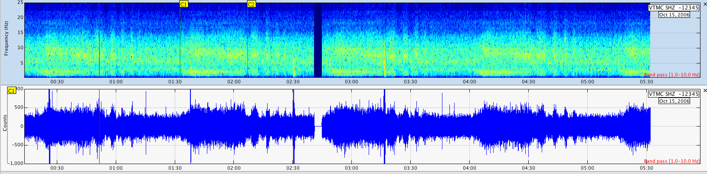
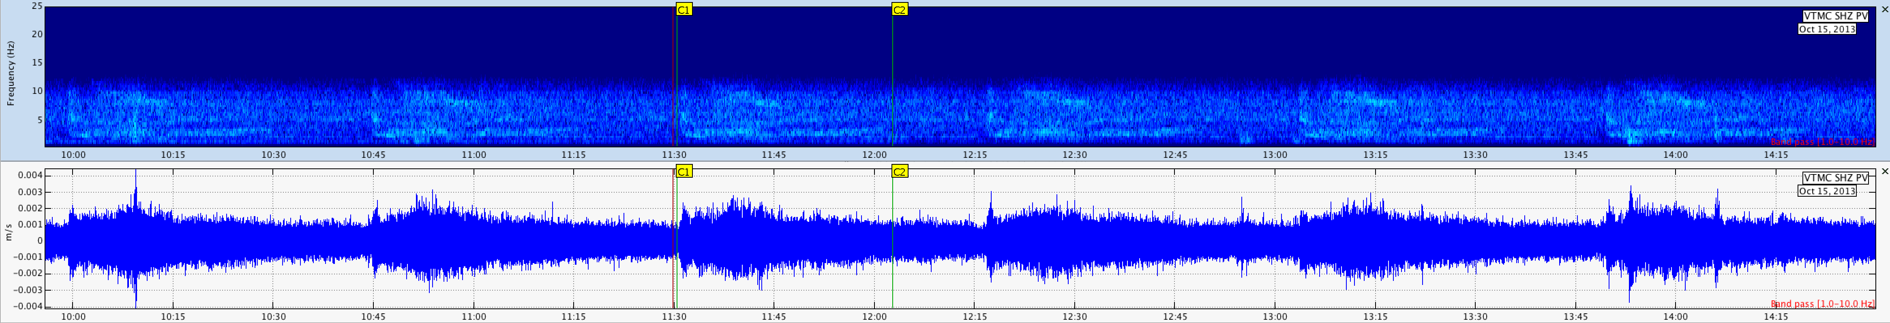
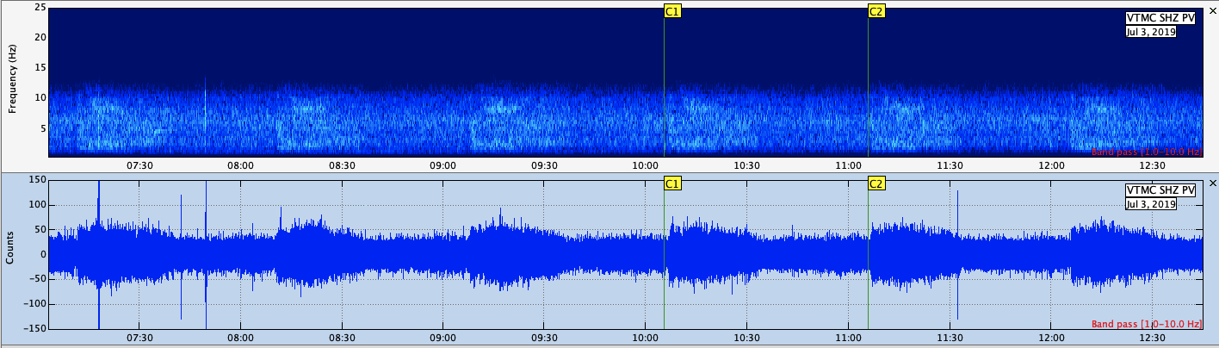
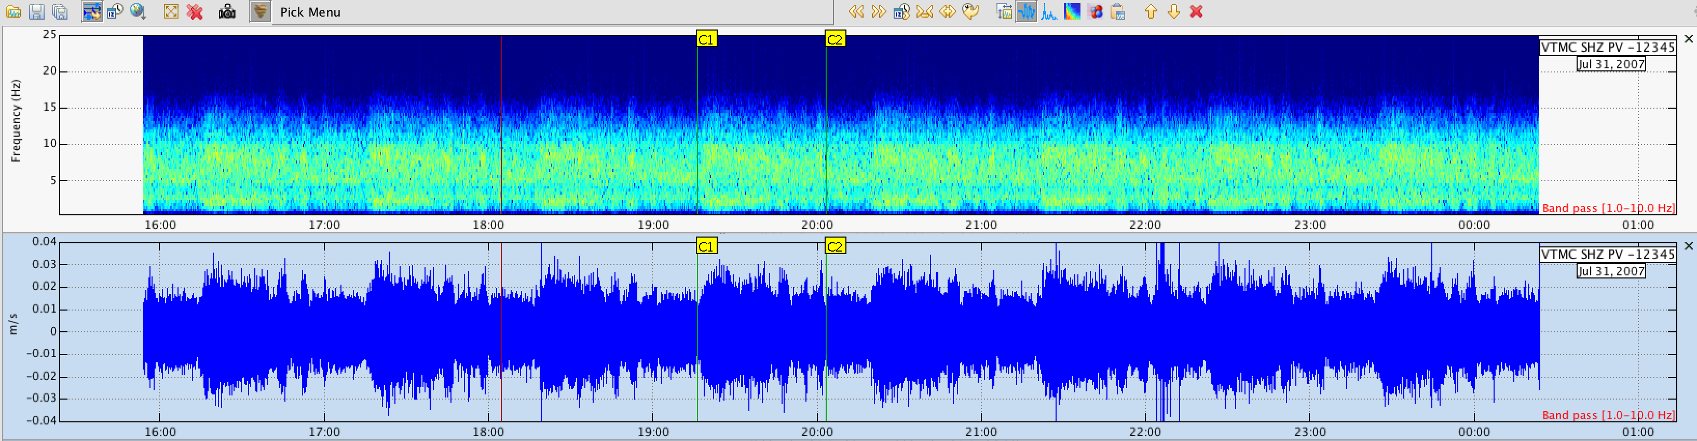
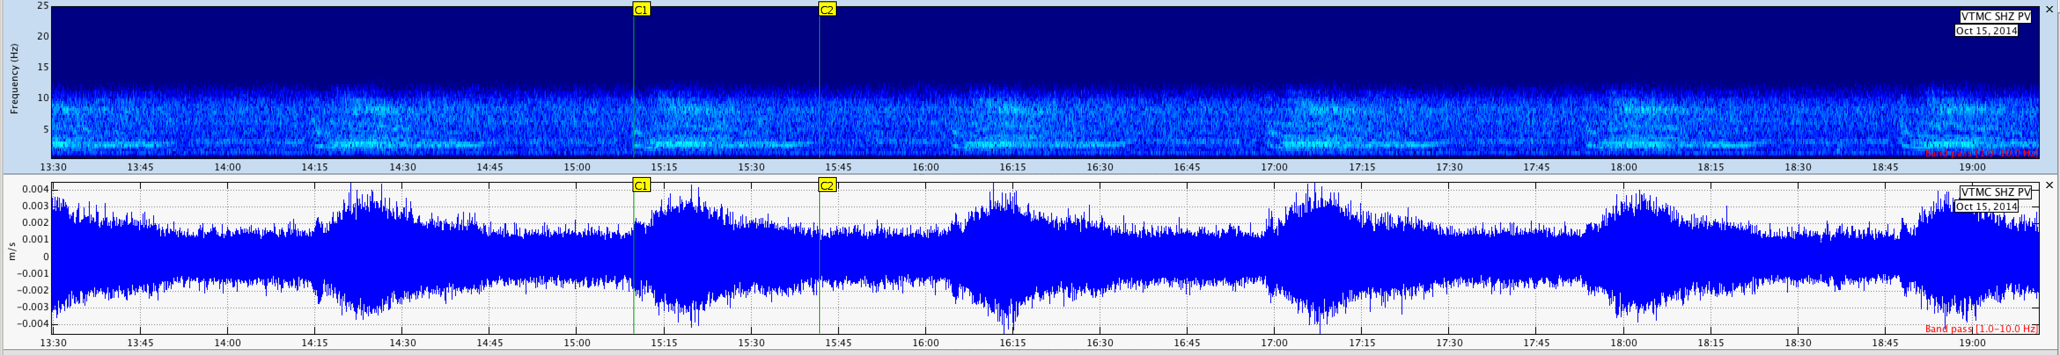
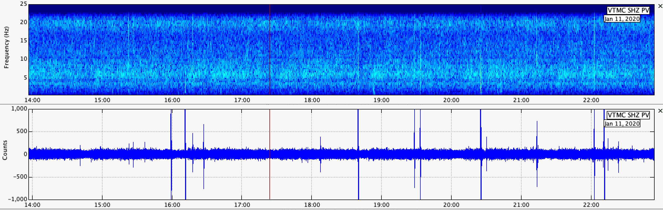
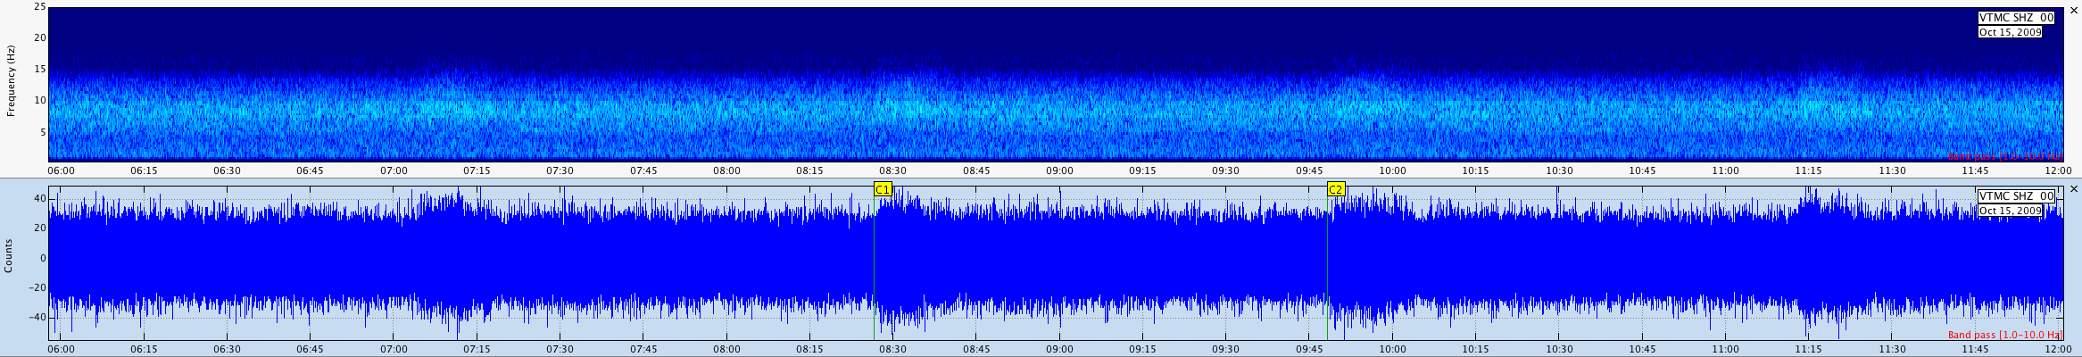
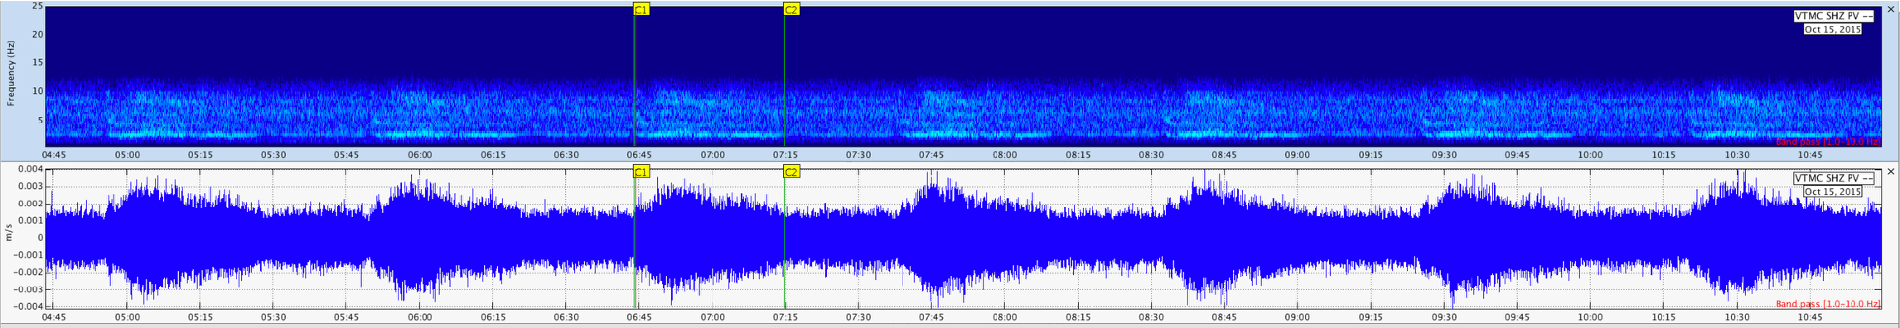
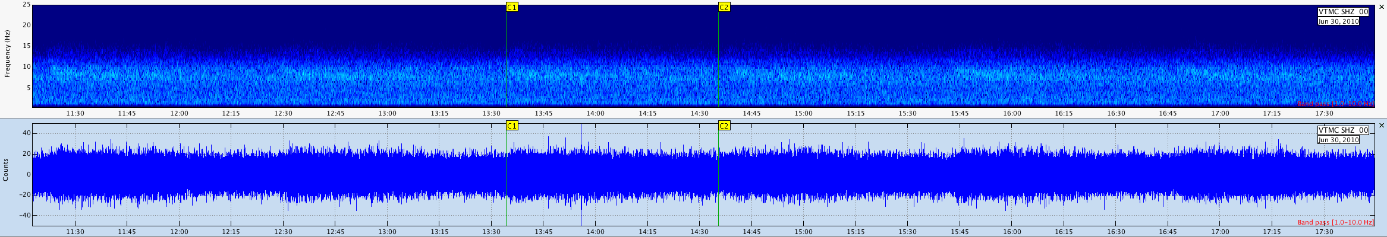
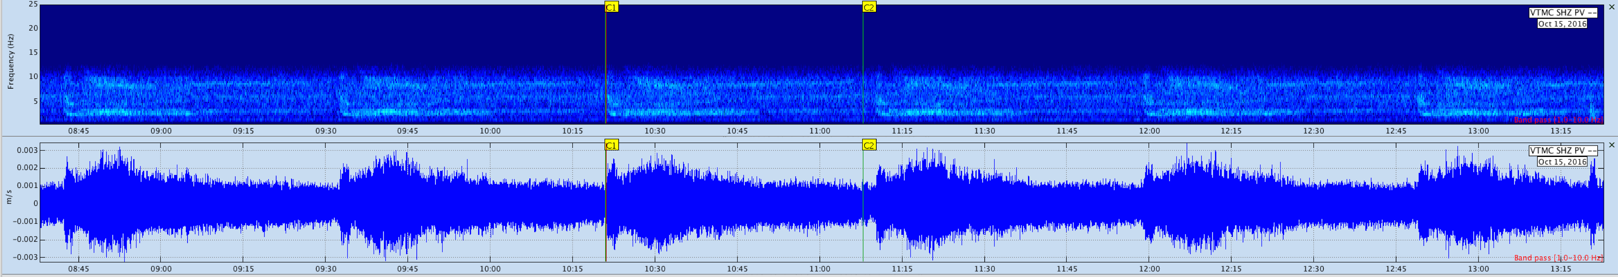
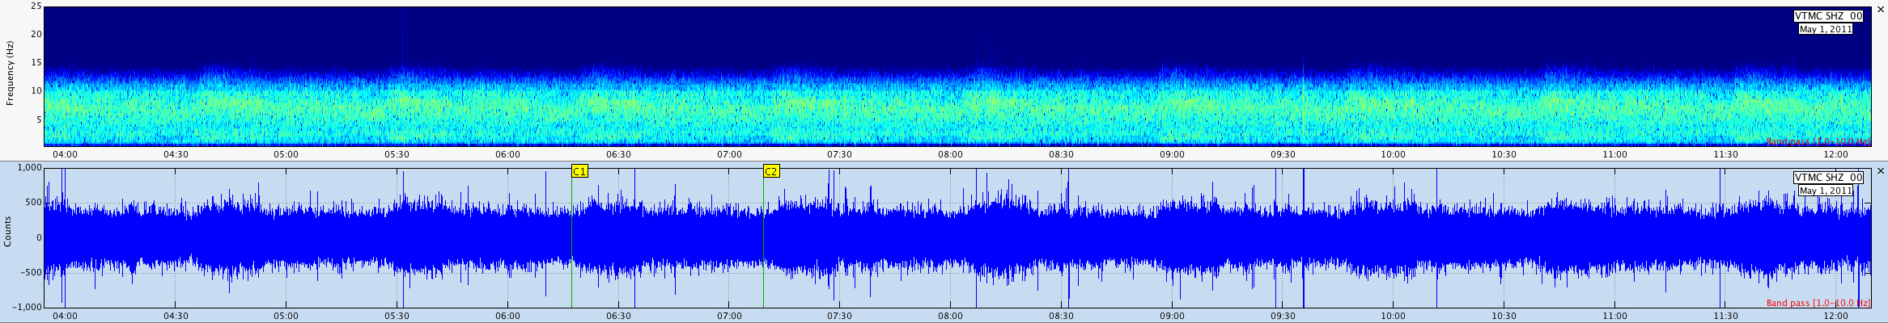
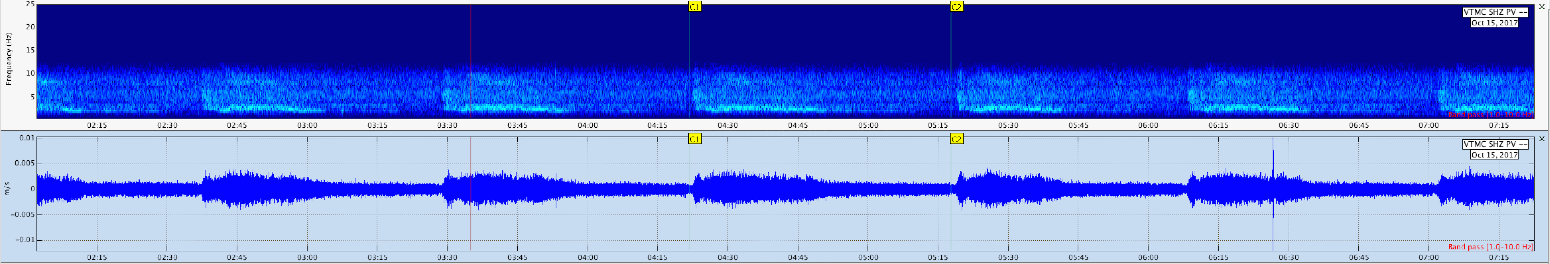
Taal Volcano
VolcaNotes: The Hidden Symphony of Taal’s Pre-Eruptive Signals
How a small vent may have played the prelude to a major eruption
2006
2012
2018
2007
2013
2019
2008
2014
2020
2009
2015
2010
2016
2011
2017
Notes:
Here is another interesting case from Taal Volcano that still not in the open. You guys are lucky, you’ll be the first one to hear it.
Inside the main crater, there is a small hydrothermal vent we informally call ‘Tak’s Vent.’
From as early as 2006 up to 2019, this vent consistently generated repeating seismic signatures , almost like its own heartbeat. But when we compare
the spectrograms year by year, we start to see something important:
The character of the signal slowly evolves.
From 2006 to around 2012 it is stable, harmonic, and low in variability.
But beginning around 2014–2019, the signal becomes more energetic, broader in frequency, more tremor-like…
These changes suggest a strengthening hydrothermal system, possibly reflecting higher heat flow, more vigorous degassing, or the pressurization of shallow fluids. And as we all know in January 2020, Taal erupted after more than 40 years of relative quiet.
This raises a compelling question:
Was Tak’s Vent already telling us something years before the eruption?
This dataset is a perfect candidate for retrospective analysis: applying modern tools such as machine learning, tremor
characterization to extract subtle trends that may not have been obvious at the time (or maybe listen to it’s sonified version.)
Or it might hold important clues for understanding early hydrothermal precursors at Taal

Slide 9
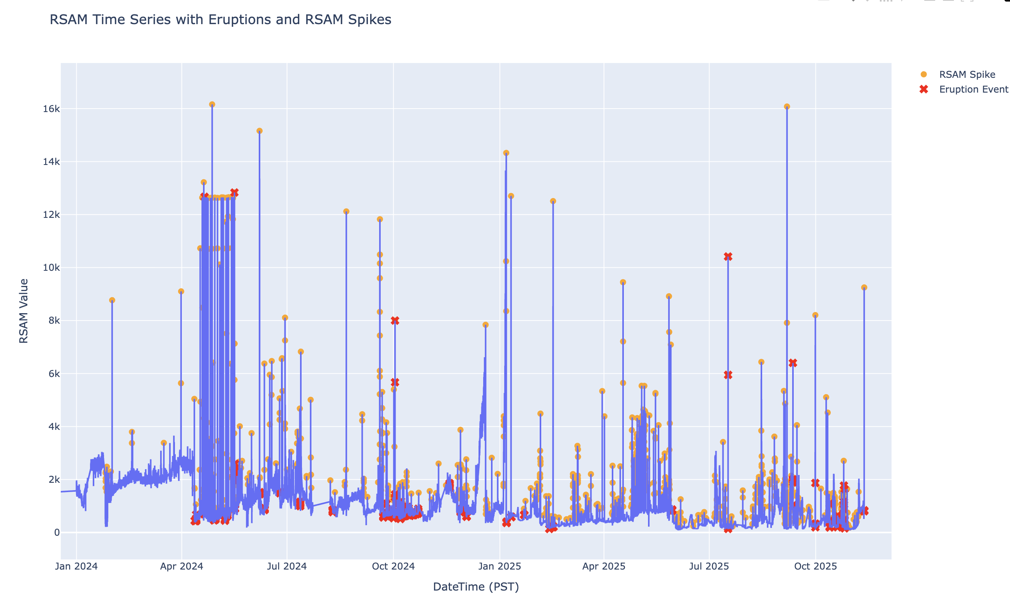
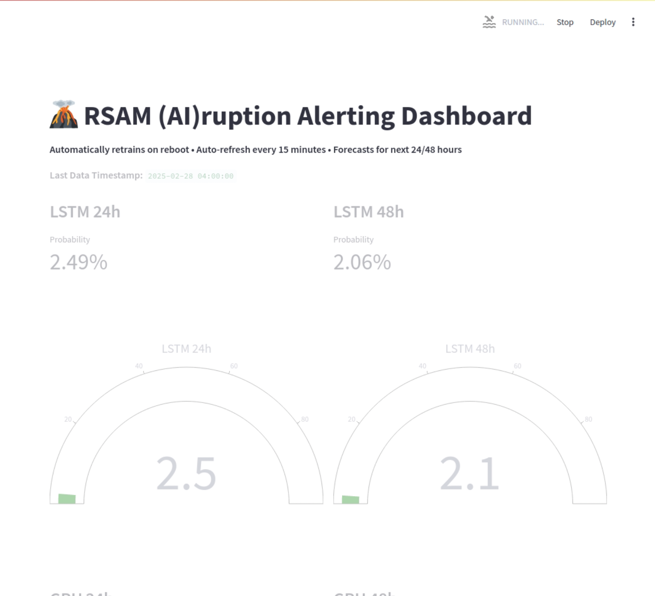
Taal Volcano
RSAM (AI)ruption Forecasting System
RSAM-based Experimental Eruption forecasting using advanced time-series deep-learning models (Supervised Learning).
Notes:
This prototype applies supervised deep-learning specifically LSTM and GRU recurrent neural networks: to perform short-term eruption probability
estimation from RSAM data. What it does is very simple in concept: we feed long RSAM time-series into deep-learning models — specifically LSTM and GRU networks — and the system tries to learn the rhythm of unrest. The network is retrained after every eruptive episode so its internal weights adapt to Taal’s evolving behavior. It runs on
rolling 24/48-hour window and updates every 15 minutes. It’s strictly experimental and used only for research validation.

Slide 10
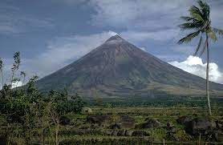
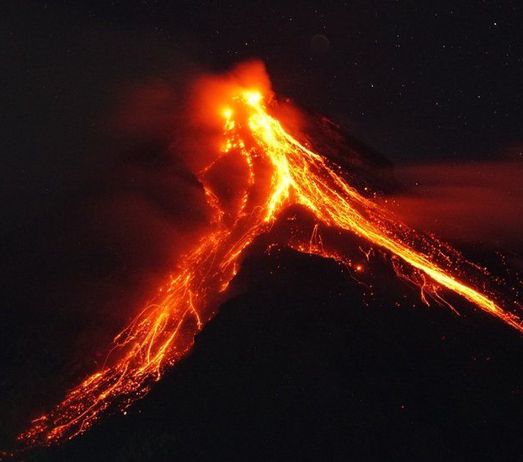
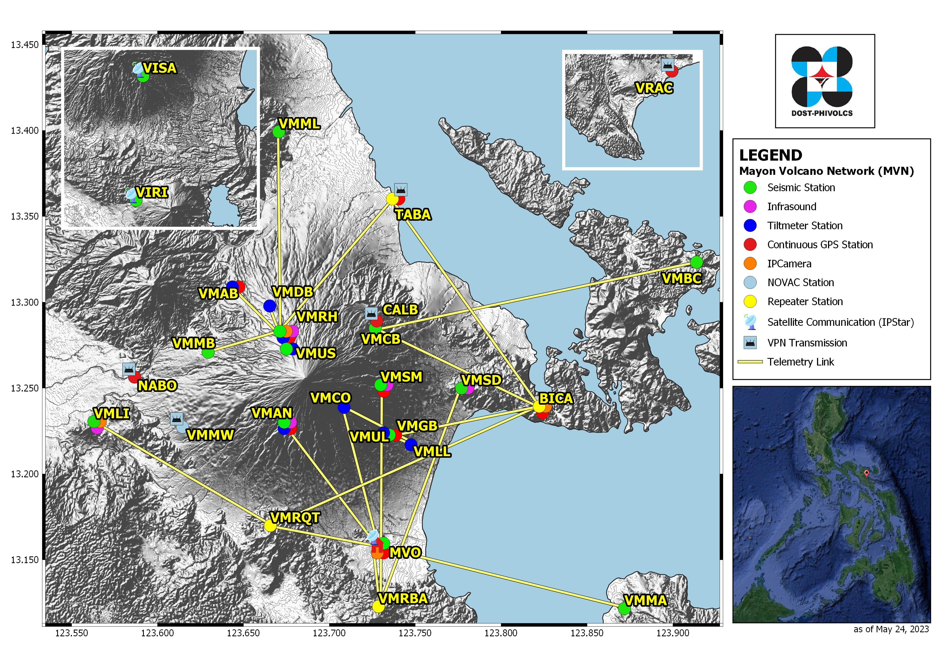
BULKANG MAYON

Slide 11
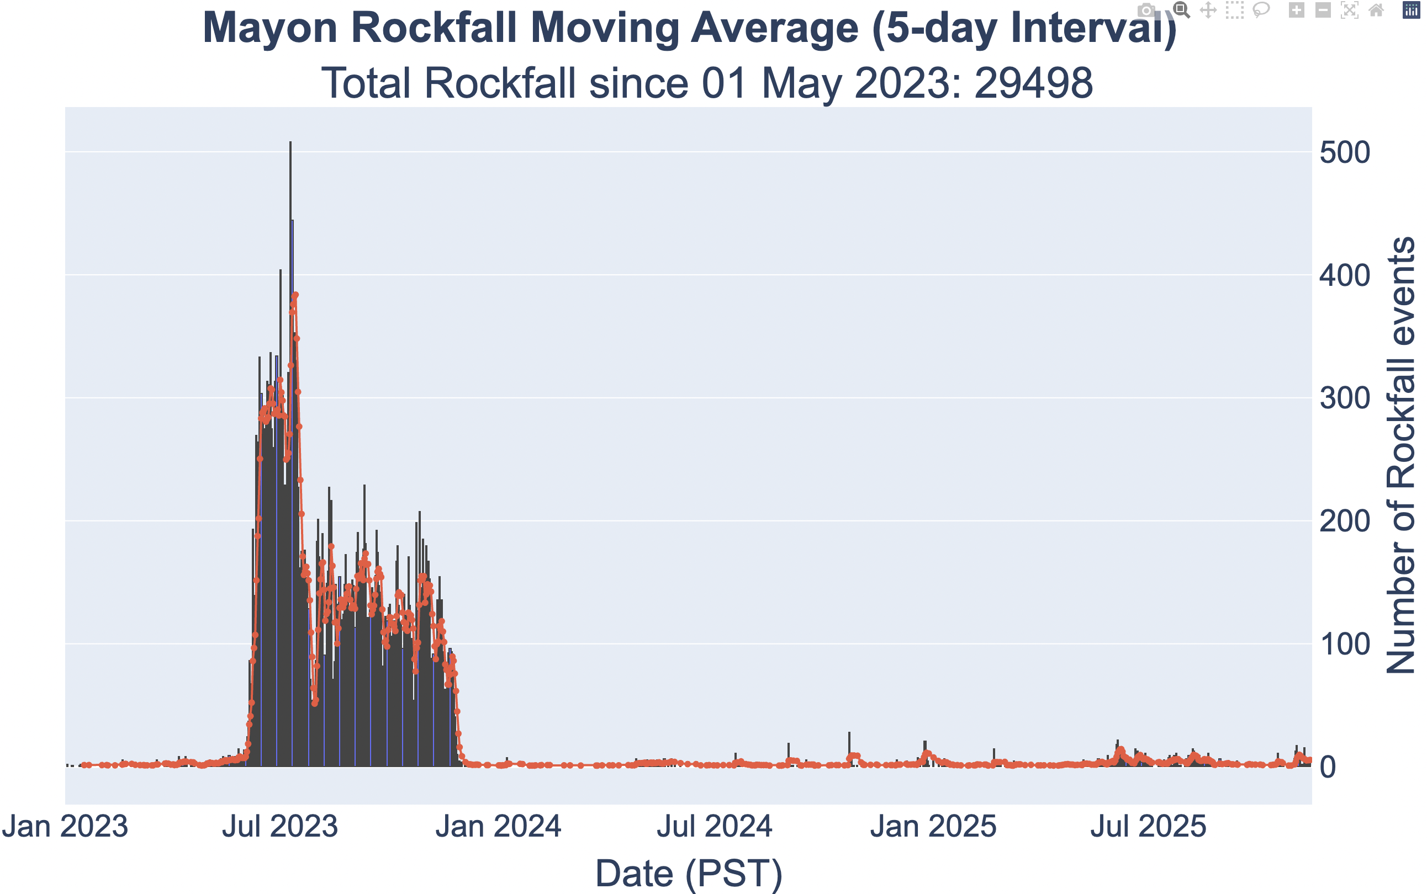
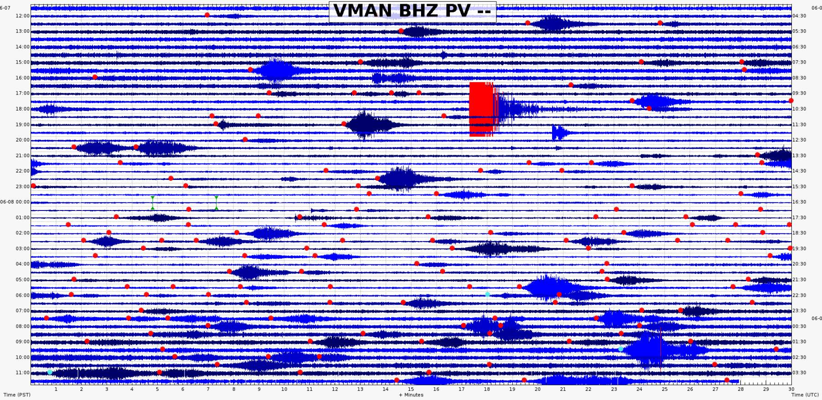
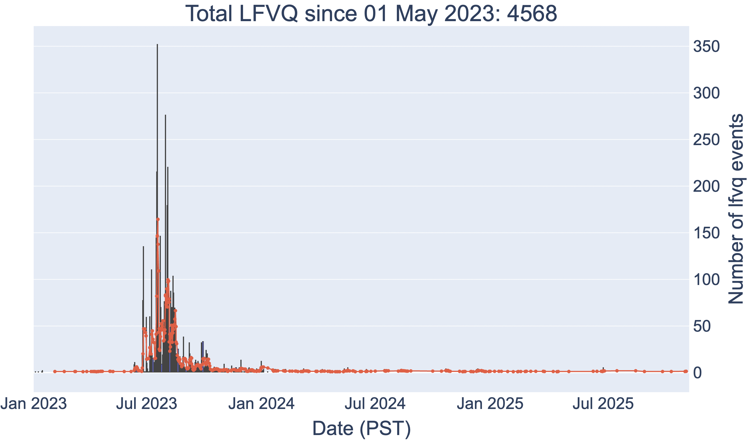
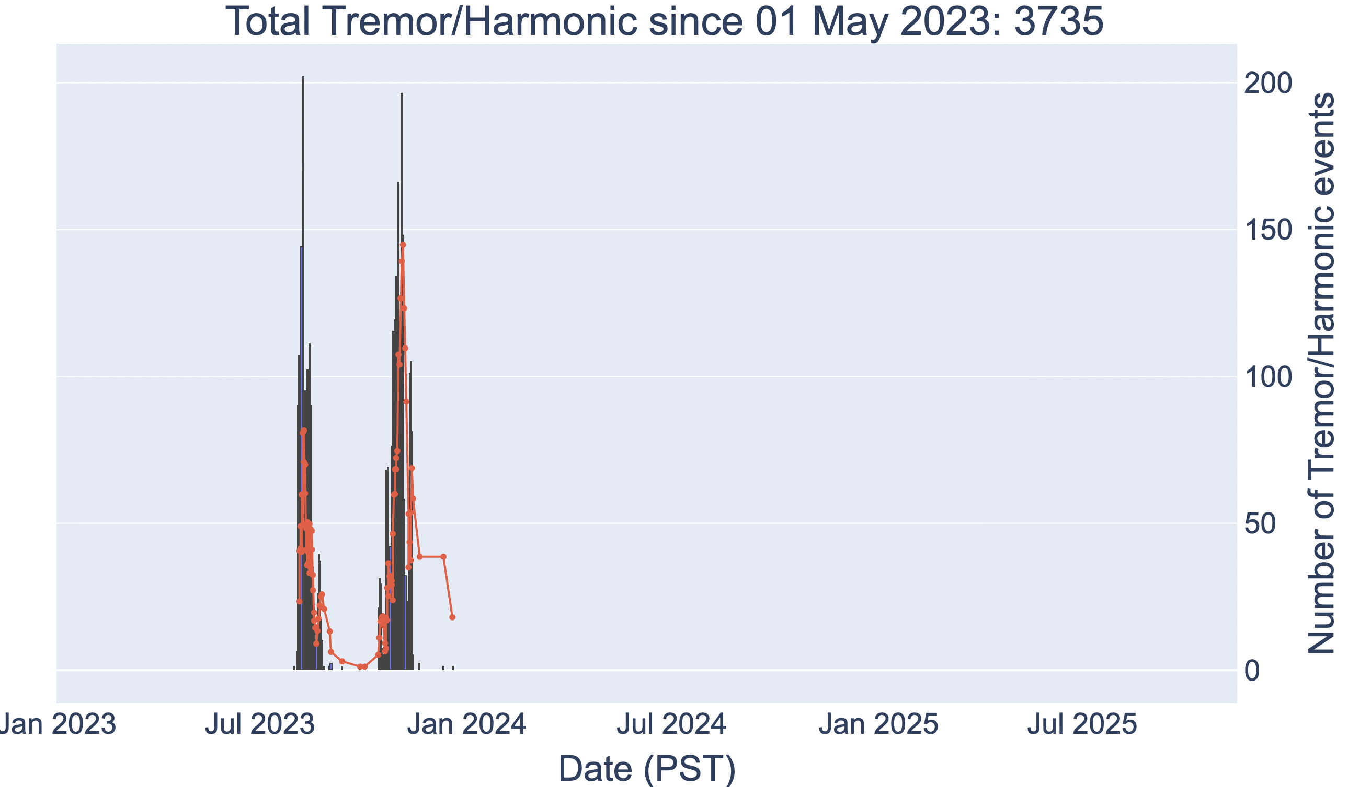
Mayon Volcano
“When rocks start falling, the volcano starts talking”
Rockfall energy/frequency characterization
For future study/ies:
proportion of large vs small rockfalls
energy trends
time-of-day clustering
spectral changes
Evaluate whether rockfalls are:
Random
correlated with micro LPs
Notes:
This eruption taught us that Mayon can erupt quietly, without VT swarms.
In future work, we want to test whether rockfalls are really just random slope failures, or if some of them are quietly
triggered by small low-frequency pulses. We can use ML to first detect tiny LP or tremor bursts hidden in the noise,
and then look statistically at whether rockfalls tend to occur right after these pulses more often than expected by
chance. If that relationship is real, rockfalls could become an indirect indicator of shallow gas pulses in otherwise
‘quiet’ eruptions like Mayon 2023.

Slide 12
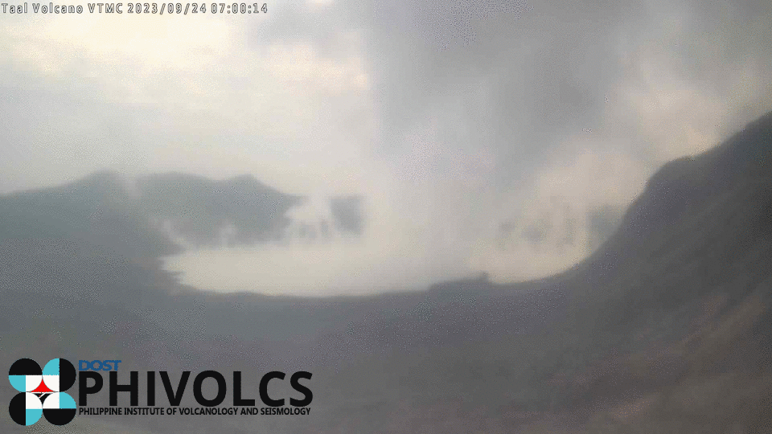
THANK YOU FOR YOUR ATTENTION
VMEPD:
mail.vmepd@phivolcs.dost.gov.ph
https://www.phivolcs.dost.gov.ph
Notes:
Our goal now is simple:
to continue improving our ability to detect, interpret, and respond to these seismic fingerprints so that communities at risk can be protected sooner.
Because in the end, if we can learn to hear the quiet signals,
we might just predict the loud ones.
Thank you.

