Slide 1
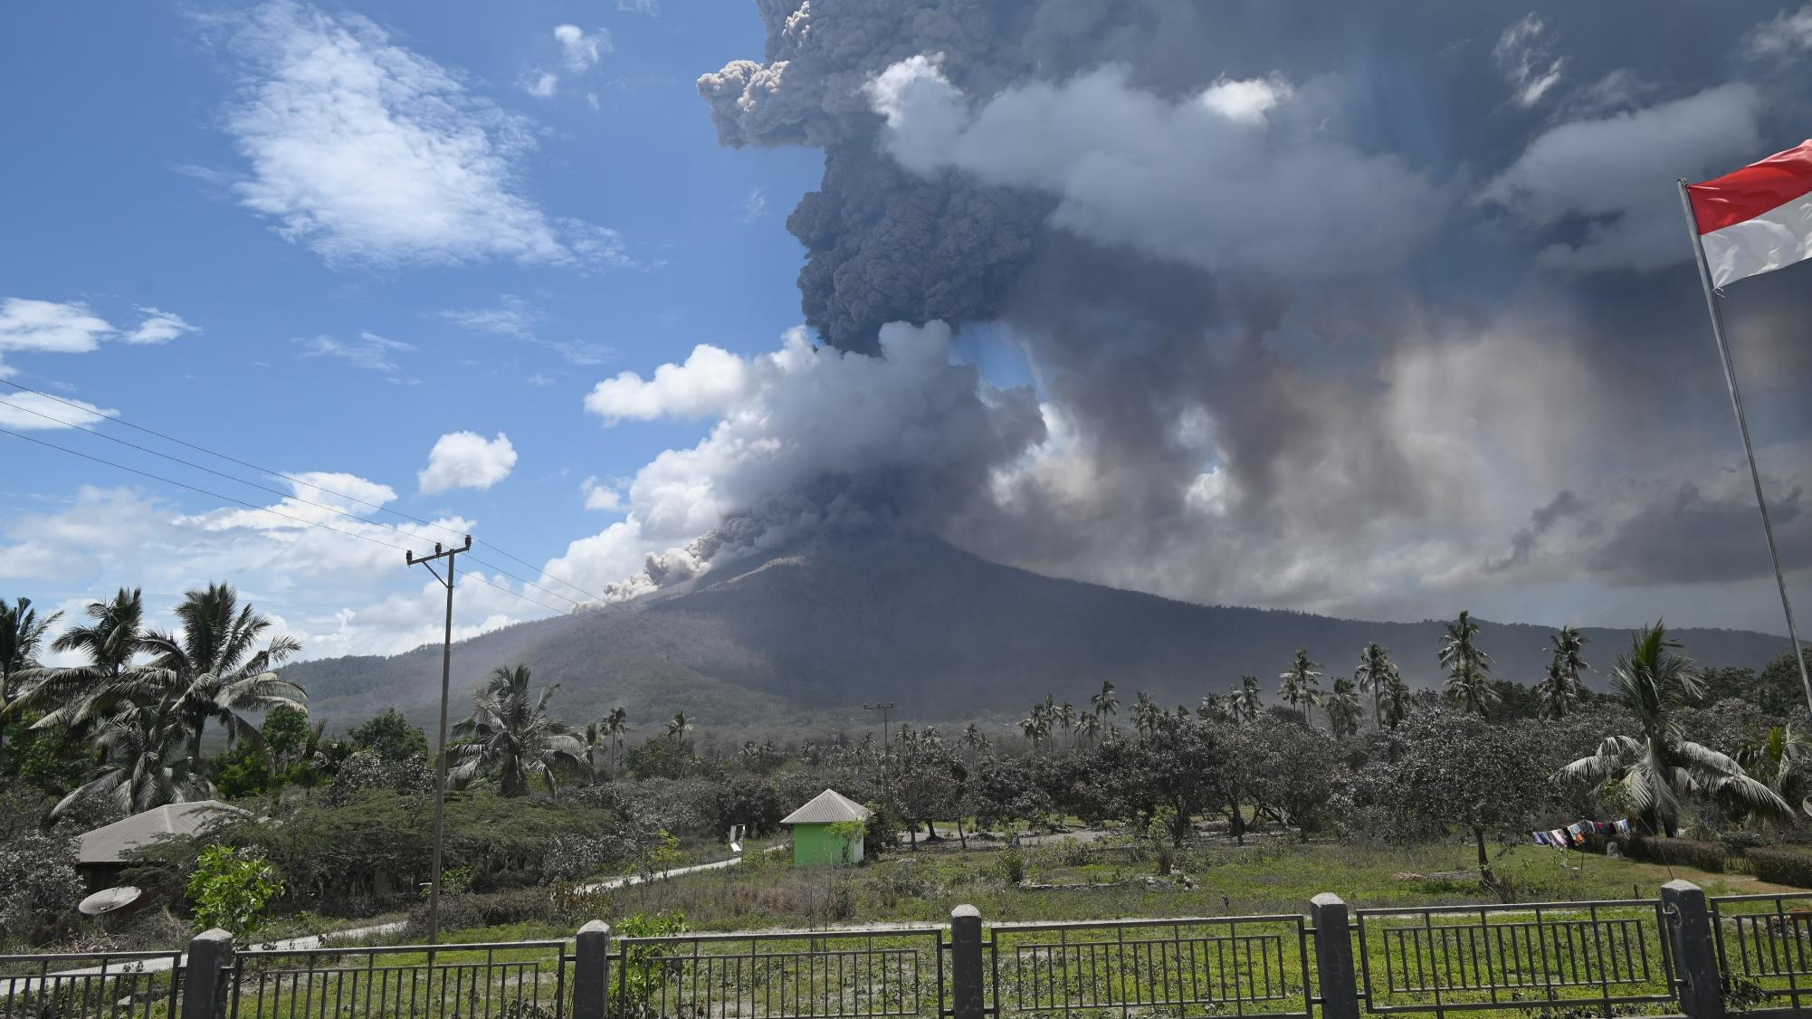

Mitigating Hazards at Lewotobi Volcano: Lessons from Successful and Limited Monitoring Efforts
Workshop on “Automatization and Standardization of Volcano Seismic Data Processing Workflows” 17 – 21 November 2025
Earth Observatory of Singapore
Nanyang Technological University (NTU)
BADAN GEOLOGI
ESDM
Ahmad Basuki, Herman Y. Mboro, Emanuel R. Bere, Yohanes K. Sorywutun,Martanto, Ardi Prayoga, Zakarias G., Heruningtyas D.P

Slide 2
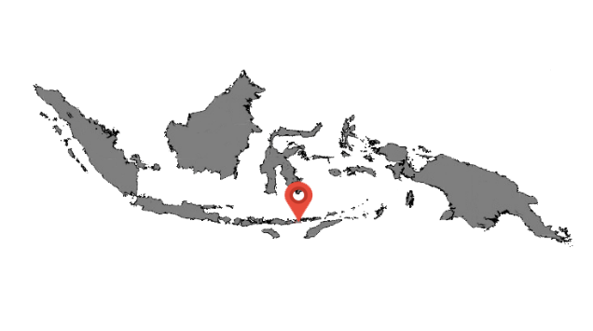
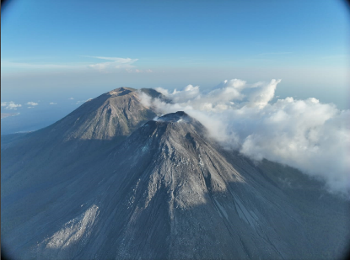
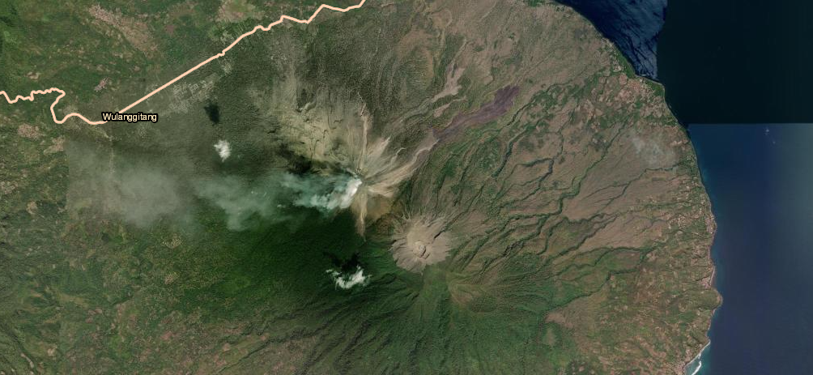
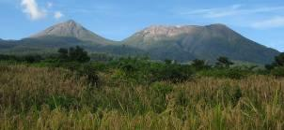
Introduction
Lewotobi Laki-laki
Lewotobi Perempuan
Lewotobi volcano is located in Wulanggitang District (15,262 Population), Flores Island, East Nusa Tenggara Province (200 km north of Kupang, Capital of The Province or 800 km east of Bali).
Lewotobi is a stratovolcano with lava dome and often called a twin volcano because it has two peaks, namely Lewotobi Laki-laki with a height of 1584 m and Lewotobi Perempuan with a height of 1703 m above sea level in the south.
Lewotobi Laki-laki is currently at Alert level III (SIAGA), since October 25, 2025
Eruption episode started on December 23, 2023 until Now
MAGMA Indonesia | Badan Geologi, ESDM, Earthstar Geographics
Lewotobi Laki-laki
Lewotobi Perempuan
ESDM

Slide 3
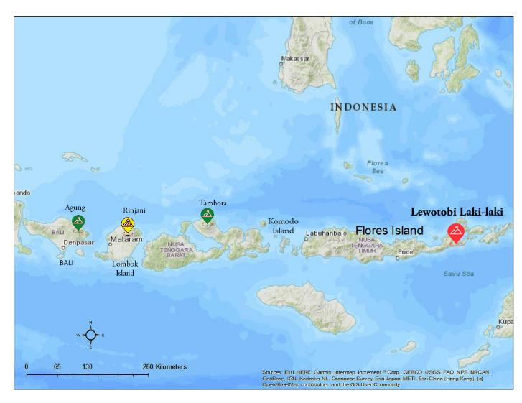
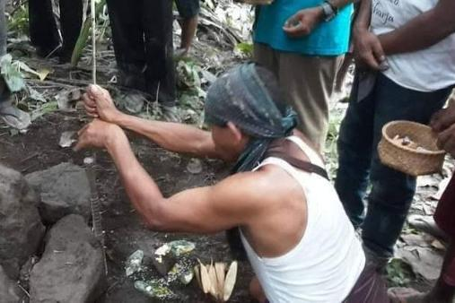
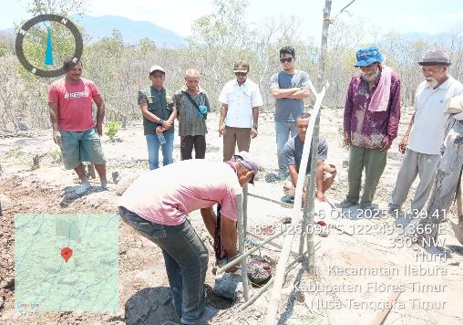
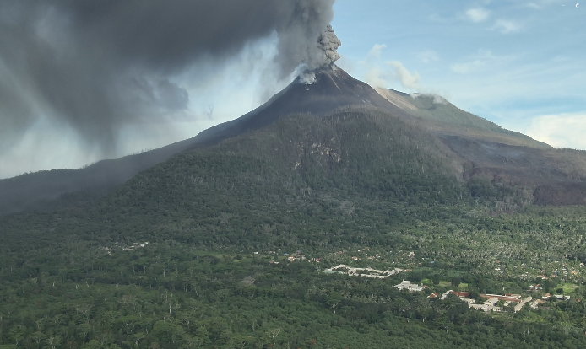
Introduction
Volcano with Culture
The Lamaholot Tribe, who live around Mount Lewotobi, have strong ties to the mountain, which they believe is their ancestral home. the villagers have promised and sworn that they will never leave the village. For them, breaking this promise would be a form of disobedience to the ancestors they believe are protecting them.
Some rituals have special customary rules, such as a prohibition on women entering certain villages during the ritual.
Tuba Ile : The ritual of "feeding" Mount Lewotobi, which is carried out as a form of asking forgiveness to volcano, for human actions that disturb nature
Sera Lewo : Often performed when a volcano begins to show activity. A ritual performed to ask for safety from nature.
Tito Bado Odong Gahu : A ritual to ward off evil spirits that aims to ward off all negative things resulting from volcanic eruptions.
Letu Umne : the ceremony of "filling the hole" that has been dug for the foundation of a house. This may involve offerings or prayers while digging the post hole.
Tube Ile Ceremony : Asking Forgivenes
Letu Umne :Ceremony before installation
Seismic station
Klatanlo Village where Lamaholot tribe live
ESDM

Slide 4
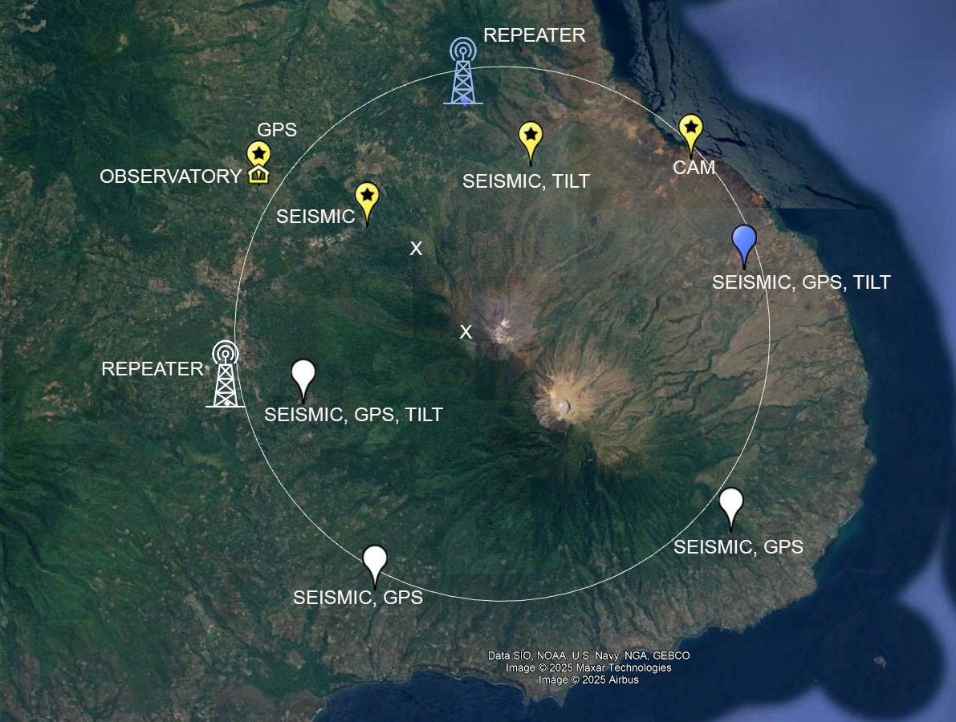
Limitations in Monitoring Network
Existing Station :
2 Seismic Analog Stations
1 Tiltmeter Station
2 Monitoring Camera
1 Infrared Camera
1 GPS Station (BIG)
At the onset of the 2023 eruption, monitoring relied solely on two short-period seismic stations, (WLR 1 km from the cratervand KLT 3 km from the crater). with no deformation or geodetic instruments in place
(WLR2)
(OJN)
(KLT)
The eruption occurred on December 23, 2023 and then the WLR station was not functioning on February 17, 2023.
February 17 – April 27, 2024 used only KLT Station
April 27 – July 17, 2024 used WLR and KLT Stations after observer fix WLR station.
July 18 – September 3, 2024 new seismic station (OJN) built after KLT and WLR not functioning.
September 4 – November 20, 2024 used KLT and OJN stations
21 November – December 13, 2024 New temporary station (WLR2) built after KLT and OJN damageg by eruption and Lahar.
December 14, 2024 – Now, used 2 seismic stations (OJN and WLR2)
(WLR)
X : Destroyed Station
Yellow : Existing Station
Blue : Under Construction
White : Will be built next year

Slide 5
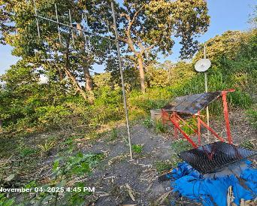
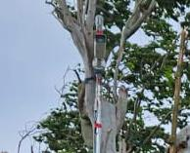
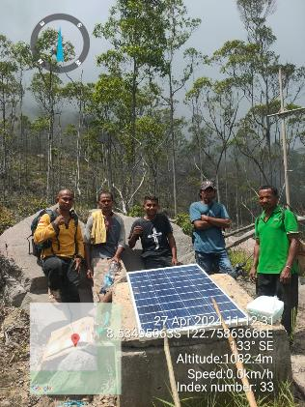
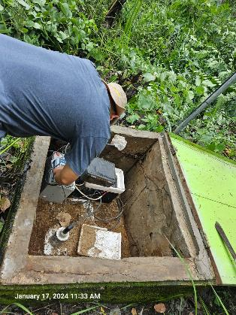
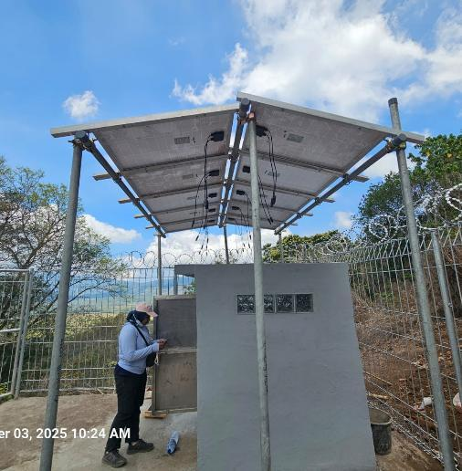
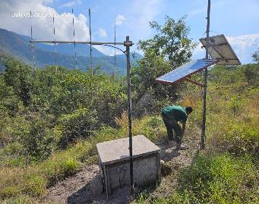
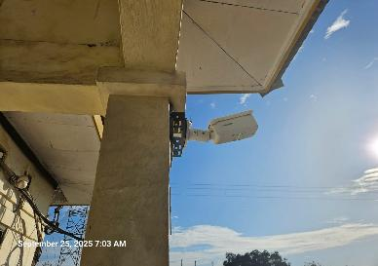
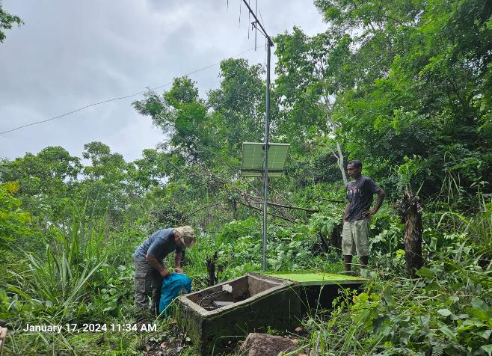
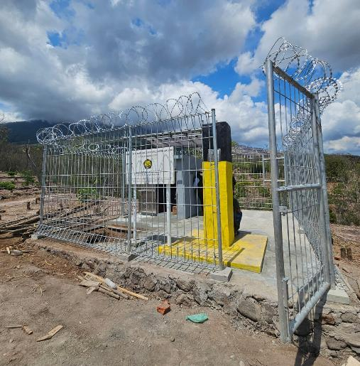
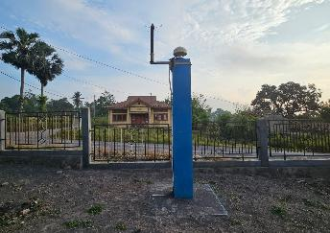
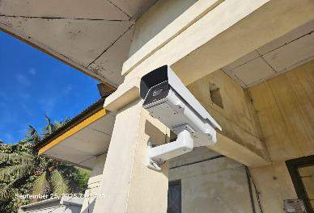
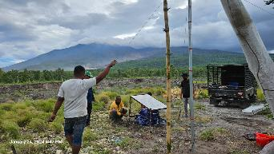
EXISTING INSTRUMENTS
DESTROYED ANALOG STATION
UNDER CONTRUCTION
WOROLONA2 (SEISMIC AND TILT)
CAM STATION
WLR
KLT
Ile Muda Repeater Station
WLR
OJAN (SEISMIC)
MONITORING CAMERA AT OBSERVATORY
GPS STATION
OJAN STATION
THERMAL CAMERA AT OBSERVATORY
CAM STATION
Nurabelen Station

Slide 6
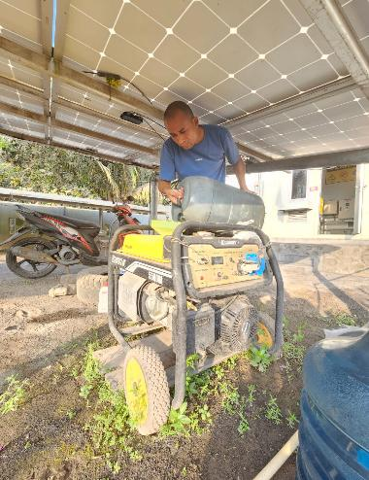
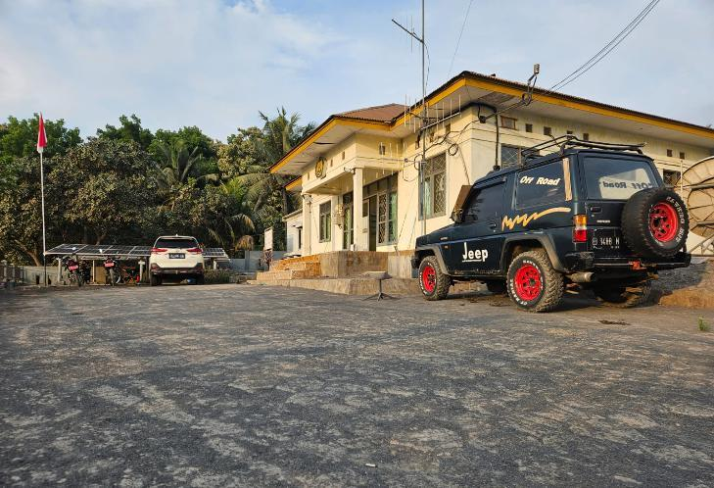
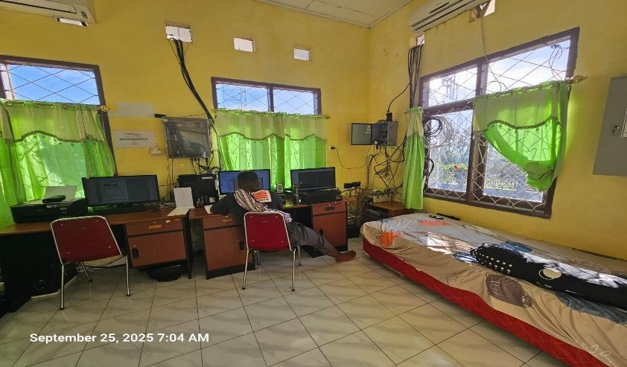
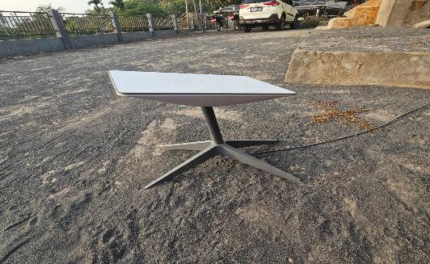
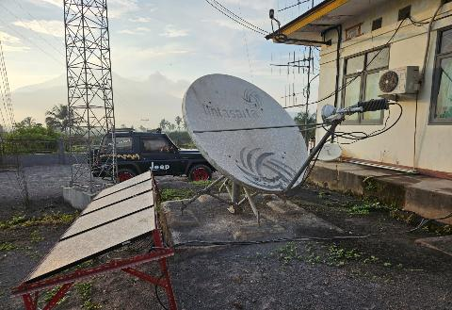
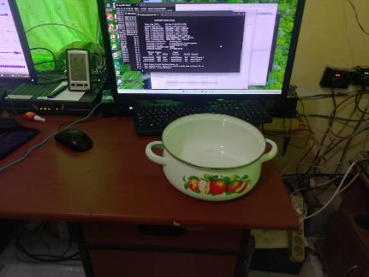
2. At the Observatory there are only 4 people working in shifts for 3 volcanoes (Lewotobi Laki-laki, Lewotobi Perempuan, Lere Boleng) and there are no scientists, The Electricity often goes out, clean water is limited, and when it rains it sometimes leaks
Pululera Village, Wulanggitang district, East Flores Regency
GENERATOR
MONITORING ROOM
STARLINK
VSAT

Slide 7
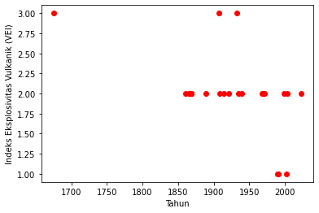
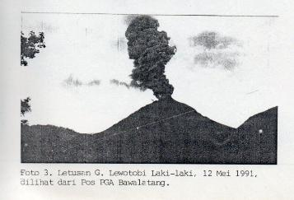
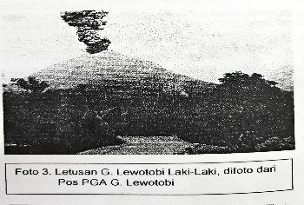
Background History
1675
The earliest recorded eruption is dated approximately to 1675 ± 25 years, with a VEI of 3, marking it as one of the most significant in the volcano’s history.
19th Century
Lewotobi erupted multiple times between 1861 and 1889, all with a VEI of 2. A few eruptions were closely spaced in time, suggesting sustained activity during that era
Early 20th Century and Late 19th Century
Notable eruptions include those in 1907 (VEI 3) and 1932 (VEI 3), which were among the more powerful in recorded history. The 1907 eruption was an explosive eruption accompanied by lava flows. a lava dome formed and caused pyroclastic flow. Other eruptions during this period mostly had a VEI of 2.
21st Century
20th to 21st Century Activity:
Multiple eruptions occurred in 1990, 1991, 1999, 2002, and 2003. These were typically VEI 1 to 2, suggesting relatively small to moderate eruptions.
23 Dec. 2023
Recent Activity:
The most recent confirmed eruption began on December 23, 2023, and is still ongoing as of October 2025, with a Volcanic Explosivity Index (VEI) of 2 - 3
1991 eruption
2003 eruption

Slide 8
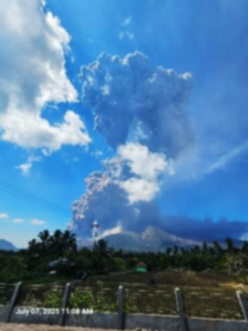
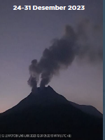
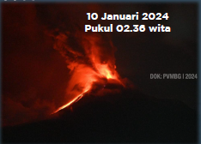
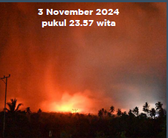
Eruption 2023 - 2025
December 23, 2023
First Eruption
II. January 9 – February 23, 2024 :
The beginning of an effusive eruption, marked by increased avalanche earthquakes and pyroclastic flows. This eruptive period ended around February 24, 2024.
III. February 24 – November 2, 2024
Vulcanian Eruption (VEI < 2)
IV. November 3 – 13, 2004 :
Eruptions with high explosiveness characterized by the occurrence of directed blast eruptions and Pyroclastic flows
V. November 14, 2004 – March 19, 2025
Vulcanian Eruption (VEI < 2)
VI. March 20 - October 18, 2025
eruptions are rare but the level of explosiveness is high, ranging from 5 - 18 km above the summit.
7 Juli 2024, 11.08 WITA
18 km above summit
I
II
III
IV
V
VI
Number of Rockfalls Eq.

Slide 9
Change in Lewotobi Laki-laki Alert Level
III
February 20, 2025 (28 days)
IV
March 20, 2025 (10 days)
I
NORMAL
Visual observations and instrumental records show normal fluctuations and no change of activity.
III
March 30, 2025 (49 days)
II
WASPADA
IV
May 18, 2025 (4 days)
There are indications of increasing volcanic activity.
III
May 22, 2025 (28 days)
There are prominent indications of increasing volcanic activity. Eruptions may take place, but do not threaten settlements and/or activities of communities near the volcano.
III
SIAGA
June 17,, 2025 (52 days)
IV
IV
III
August 9, 2025 (7 days)
AWAS
There are significant indications of ongoing volcanic activity, with eruptions that potentially threaten settlements and or communities around the volcano.
IV
August 16, 2025 (7 days)
Andreastuti et al, 2019
III
August 23, 2025 (14 days)
II
March 1, 2024 (101 days)
2023
IV
September 6, 2025 (10 days)
III
June 10, 2024 (146 days)
I
Before December 17, 2023
III
September 16, 2025 (3 days)
II
IV
November 3, 2024 (52 days)
December 17, 2023 (15 days)
IV
September 19, 2025 (10 days)
2024
III
December 24, 2024 (51 days)
September 29, 2025 (15 days)
III
III
January 1, 2024 (8 days)
2025
IV
October 14, 2025 (11 days)
IV
January 9, 2024 (20 days)
IV
February 13, 2025 (7 days)
III
October 25, 2025 - NOW
III
January 29, 2024 (32 days)

Slide 10
“How CVGHM addresses eruptions that vary in character and threat level with limited volcanic monitoring equipment.”
ESDM

Slide 11
“Strengthening volcanic earthquake classification to identify eruption precursors.”
Currently there are 20 types of volcanic earthquakes in the classification used by CVGHM. Each type of earthquake is intended to describe the processes occurring within the volcano, making it easier to predict the type and size of an eruption.
Letusan/Erupsi (Explosion/eruption)
Awan Panas Letusan (Pyroclastic Fall)
Awan Panas Guguran (Pyroclastic Flow)
Guguran (Avalanche/Rockfalls)
Hembusan (Emission)
Harmonik (Harmonic Tremor)
Tremor Non-Harmonik (Spasmodic Tremor)
Tornillo
Low Frequency
Hybrid/Fase Banyak (multiphase)
Vulkanik Dangkal (shallow VT/VTB)
Vulkanik Dalam (Deep VT/VTA)
Veri Long Period (VLP)
Tektonk Lokal (Local Tectonic/Distal VT)
Terasa (felt Earthquake)
Tektonik Jauh (Tectonic Eq/Teleseismic)
Double Event
Getaran Banjir (Flood or Lahar)
Deep tremor
Tremor Menerus (Tremor)
19.2 km

Slide 12






















“Strengthening internal communication as well as communication with the public and stakeholders.”
ESDM
CVGHM Volcanologist
Alert Level
Hazard Map
6-hour report
VEN, Warning
Local Public
PIC of Lewotobi
Laki-Laki
CVGHM
Head of CVGHM
Leader of Volcano
Team CVGHM
Observer
6-hour report
National
VEN, Warning
VEN, VONA
Ministry,
BNPB
Local Government,
BPBD
Head of Geological
Agency

Slide 13
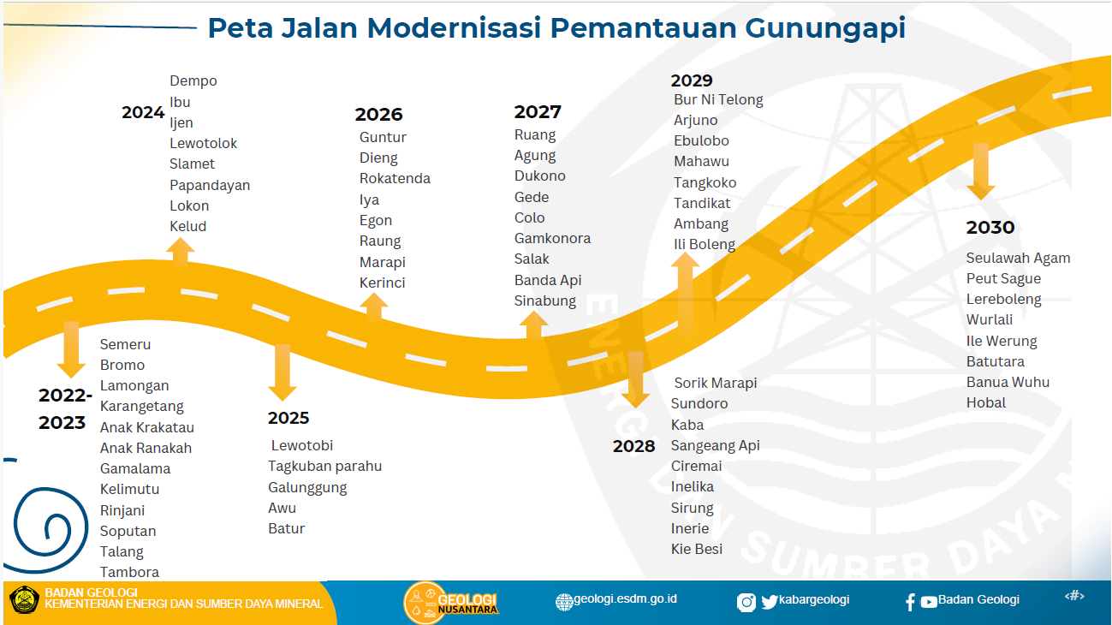
“Modernizing volcanic monitoring instruments across Indonesia’s volcanoes.”
ESDM

Slide 14
2023 – 2025 Eruptions

Slide 15
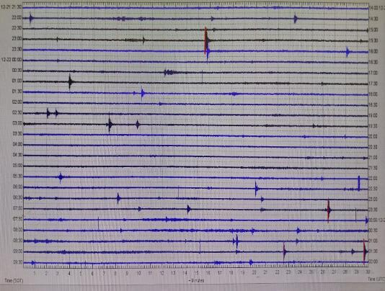
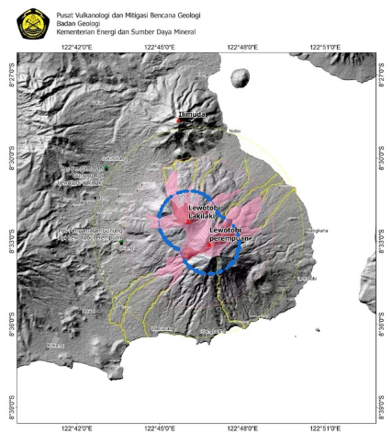
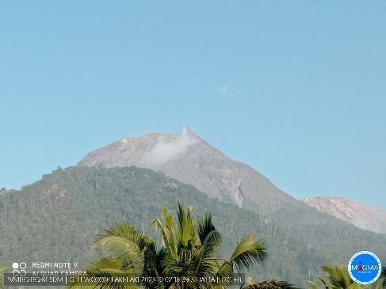
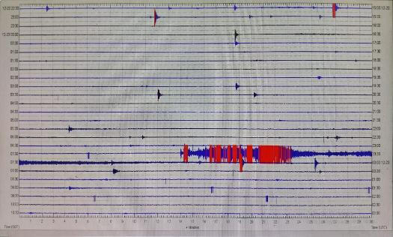
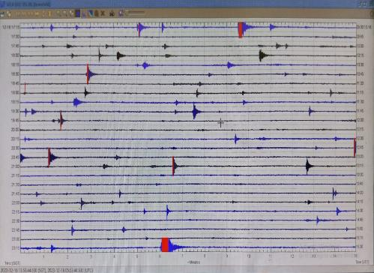
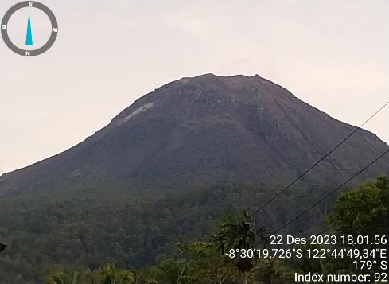
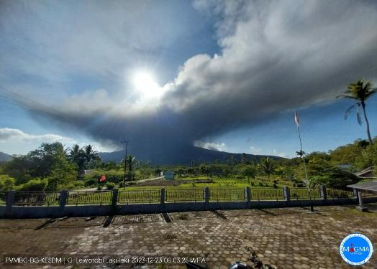
Stage 1. Increasing Seismicity to First Eruption
Recommendation Alert Level II: No community activity within 2 km of the crater of Lewotobi Laki-laki dan Perempuan
October 2, 2023
An increase in earthquakes occurred again on December 16, 2023, so PVMBG raised the alert level of Both Lewotobi Perempuan dan Laki-laki to Level II (Waspada),
eruption occurred on December 23, 2023, at 07:14 WITA with ash column height of ± 1500 m, Pyroclastic Flow reached 2 km to the north of the crater. Ashfall was reported up to 5 - 6 km from the crater.
Still No evacuation
No Plume Observed during Daily Activities (Level I : Normal)
Increasing VT and Tornillo Earthquakes started on December 12, 2023 and peak on December 16, 2023. After that, the earthquake decreased slightly
Still No Sign of Impending Eruption from visual observation on December 22, 2023
December 23, 2023

Slide 16
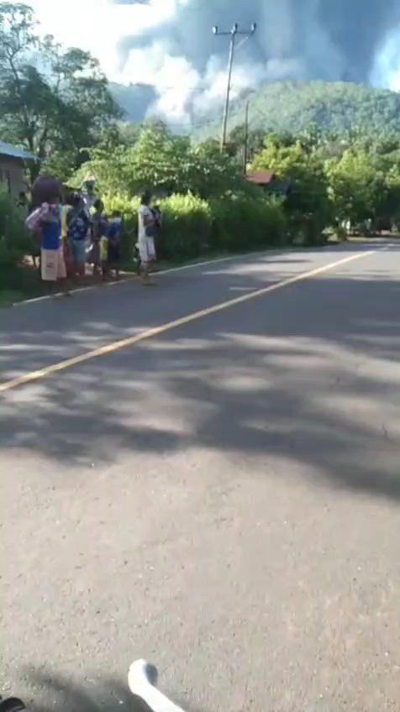
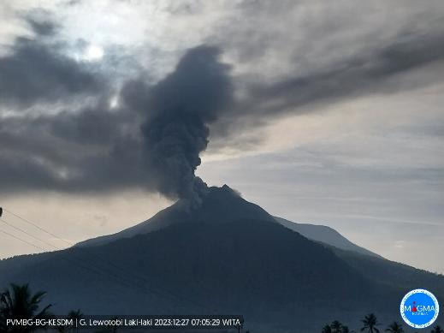
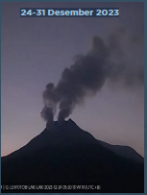
After the first eruption, On December 27, 2023, there were 3 eruptions with a height of 1000 meters above the peak, which was followed by an increase in VT earthquakes.
Level I
Level II
a new eruption center was observed originating from a fissure to the southeast of the summit of Mount Lewotobi Lak-Laki.

Slide 17
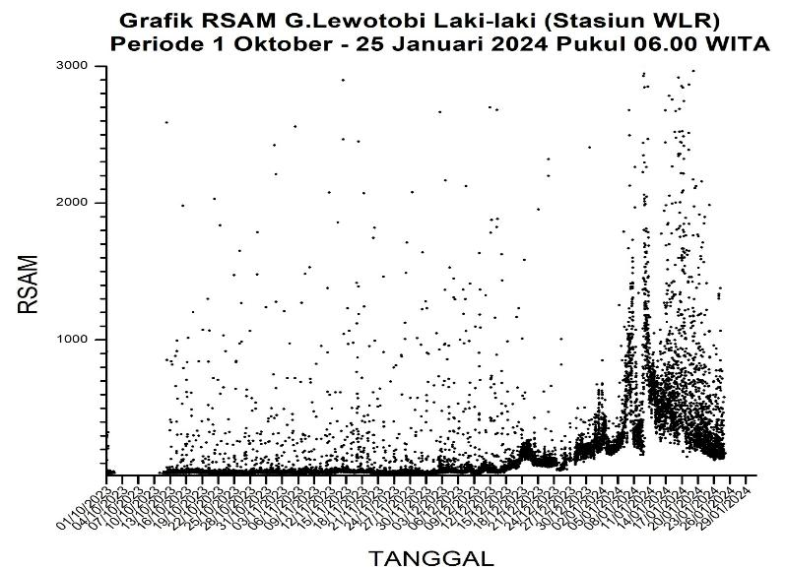
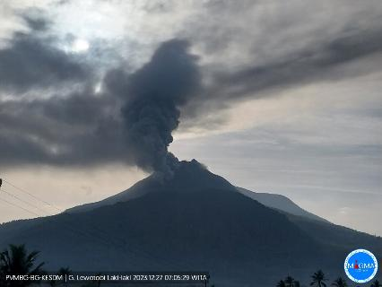
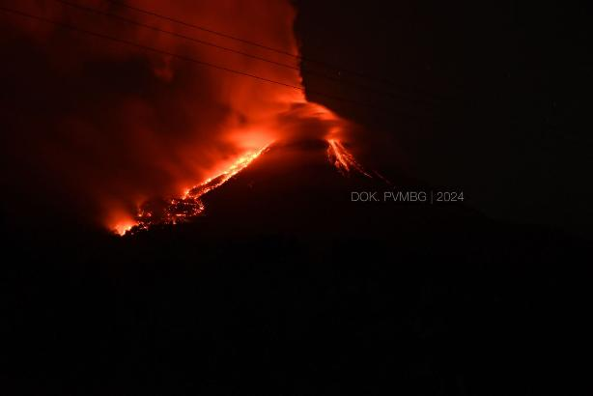
Stage 2. Effusive Eruption
On January 1, 2024 at 00.03 WITA, there was an increase in continuous tremor earthquakes with an amplitude reaching 7 mm. CVGHM increased the alert level to Level III (SIAGA).
Almost all residents around Mount Lewotobi evacuated by them selves, due to a very loud rumbling sound and the beginning of ash rain. 6 villages evacuated:Bawalatang, Duang, Nawakote, Klatanlo, Goleriang, Dulipali.
The increase in VT earthquakes on January 5, 2025 coincided with the start of the appearance of glowing from crater and then continue by increasing LF and Avalanche Eq.
Level IV
Level III
Avalanche
Level I
Level II
Level IV
Level III
Level II
Level I
January 5, 2024
January 10, 2024
The lava flow from January 10 to 17, 2024, moved northeastward at a slow speed, and the last drone measurement was 4.2 km from the eruption center.

Slide 18
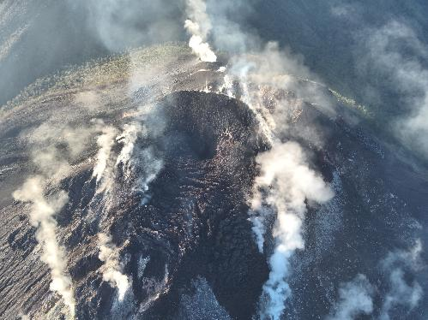





On January 9, 2024 at 00.03 WITA, there was an increase in continuous tremor earthquakes with an amplitude reaching 7.4 mm. CVGHM increased the alert level to Level IV (Awas). The community around the Lewotobi Laki-Laki volcano and tourists are advised not to carry out any activities within a radius of 4 km from the eruption center and a sectoral 5 km in a northwest-northwest direction.
Visual monitoring also shows the occurrence of lava flows to the northeast as far as 3 km, avalanches to the north-northeast as far as 1500 meters, and Pyroclastic flow as far as 2 km to the north-northeast.
The presence of lava flows in a new direction, namely southwest-west that reached a distance of 2 km, shows that lava flows can currently occur in all directions considering the very intensive movement of magma to the surface.
January 15, 2024

Slide 19







Stage 3. Vulcanian Eruption
characterized by the height of the eruption column ranging between 100 - 1500 meters above the summit.
There was an increase in VT earthquakes, but this did not have a direct effect on the height of the eruption column.
Height of Eruption
Column
April 9, 2024
8 April 2024
May 3, 2024
June 13, 2024
July 11, 2024
August 5, 2024
September 5. 2024
October 9. 2024
14 Mei 2024
7 Juni 2024

Slide 20




Stage 4. Directed Blast Eruption
Height of Eruption
Column
After the eruption on December 23, 2023, a crack was observed on the northwest side of the peak, 160 meters long, emitting thick white smoke 300 meters high.
Level III
Level IV
Level III
LF
Erupsi 3 November 3, 2024
Pukul 23.57 WITA
In early November 1-3, 2024, there was a significant increase in Deep Volcanic Earthquakes (VTa), with an average of more than 100 earthquakes per day, compared to the previous period of only dozens of VT events.
CVGHM has raised the alert Level to Level IV (AWAS) on November 3, 2024, at 24:00 WITA. PVMBG has asked the surrounding community not to approach the crater within a 7 km radius

Slide 21










Eruption On November 4, 2024
November 3, 21.00 wita
November 4, 00.00 wita
November 4, 00.03 wita
November 4, 00.05 wita
November 4, 01.26 wita
November 4, 01.29 wita
November 4, 03.47 wita
November 4, 10.44 wita
November 4, 17.13 wita

Slide 22








Before
After November 3, 2024 Eruption

Slide 23











Nuns' dormitory
School
Observer's house
Rock samples collected from the November 2024 eruption

Slide 24



Stage 5. Vulkanian Eruption
On 24 December 2024, CVGHM lowered the alert level to Level III. As of 19 March 2025, eruptive activity at Lewotobi Laki-laki has continued, producing eruption columns ranging from approximately 200 to 2,000 meters above the summit.”
An increase in VT earthquakes occurred in February 2025 but did not affect eruptive activity. Meanwhile, a relatively high number of Hembusan earthquakes were recorded.
Height of Eruption
Column
Level III
Level IV
Level III
March 01, 2025
CVGHM had raised the alert level to Level IV on February 13, 2023, but because there was no major eruption, the alert level was lowered again to Level III on February 20, 2023.
February 26, 2025
January 22, 2025

Slide 25


Stage 5. High Explosive Eruption
An explosive eruption occurred, accompanied by Pyroclastic flow and a loud explosion sound, heard as far away as Maumere (60 km), Larantuka (30 km) , recorded at the Lewotolok (85 km) and Inerie stations (200 km),Erupted material was ejected in all directions, with a distance of 3-4 km. The eruption was preceded by an increase in VT earthquakes, reaching up to 200 events in one day.
This eruption is the beginning of subsequent eruptions which have a high level of explosiveness, and are generally preceded by an increase in VT earthquakes and tremors.
March 20
Jul 07
Aug 01
Jun 17
Height of Eruption
Column
May 18
Apr 22

Slide 26






March 20,2025 (8000 m)
April 22, 2025 (continuous
Eruption that lasted 16 hours)
May 18, (6000 m)
June 17, (10.000 m)

Slide 27





July 07,2025 (18.000 m)
August 02,2025 (18.000 m)
September 06,2025 (continuous
Eruption that lasted 6 hours)
)

Slide 28



Tiltmeter and RSAM
The tiltmeter graph on the Y-axis (Radial) looks very helpful in predicting eruptions. In this case, the positive Y-axis is facing away from the crater.
The use of RSAM from raw data directly appears to be helpful in eruptions accompanied by sustained tremor, but for those preceded by increased VT it is still unclear.

Slide 29





Filtered RSAM
Band Pass Filter
0,1 – 20 Hz
2 – 5 Hz
4 – 8 Hz
5 – 15 Hz
8 – 16 Hz

Slide 30

DSAR (The displacement seismic amplitude ratio)
Displacement seismic amplitude ratio between medium (4.5–8 Hz) and high (8–16 Hz) frequency tremor bands.
Not all eruptions were detected using DSAR, including the eruptions with the highest eruption columns on July 7 and August 1, 2025. continuous Eruption that lasted hours on April 22, 2024 and September 19, 2024 have a high DSAR

Slide 31


msnoise
In general, every eruption is preceded by a decrease in dv/v, so it can be used for early warning before an eruption.

Slide 32

RedPy
Many earthquake events lack significant waveform similarity between events.
The earthquake source system is dominated by more variable processes (e.g., VT, VTA, or structural activity).
There are no highly stable and repetitive LP clusters.
FI positif → VT dominant

Slide 33





Slide 34
Summary
The sequence of eruptive activity at Lewotobi Laki-laki from 2023 to 2025 demonstrates a pattern of recurrent magmatic escalation, clearly reflected in the relationship between increasing seismicity, observable surface phenomena, and their associated impacts. Seismic data show that each eruptive phase was consistently preceded by a marked increase in VT, LF, Tremor or Avalanche Earthquake, indicating the mobilization of new magma and increasing pressure within the conduit system.
In general, upcoming eruptive episodes can be anticipated through changes in seismic activity and deformation, as these parameters reliably reflect the pressurization and movement of magma within the system. However, the magnitude of impending eruptions and their potential impacts remain difficult to quantify precisely and will require further data integration and continued refinement of multi-parameter monitoring.
The mitigation experience at Lewotobi also highlights that the processes leading to an eruption can shift rapidly and unpredictably, underscoring the need to expand monitoring networks, strengthen our analytical capacity, and remain humble in the face of natural systems that remain only partially understood.

Slide 35
THANK YOU
ESDM

