Slide 1


Workshop on
“Automatization and Standardization
of Volcano Seismic Data Processing Workflows”
17 – 21 November 2025

Slide 2

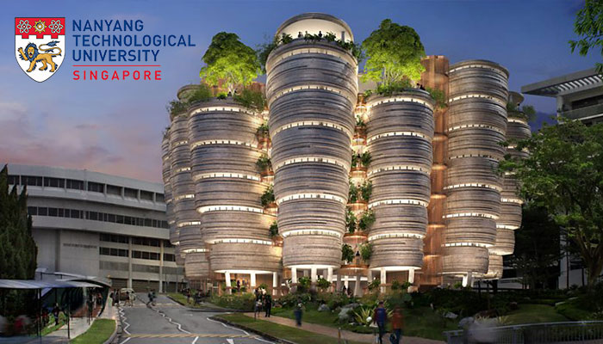
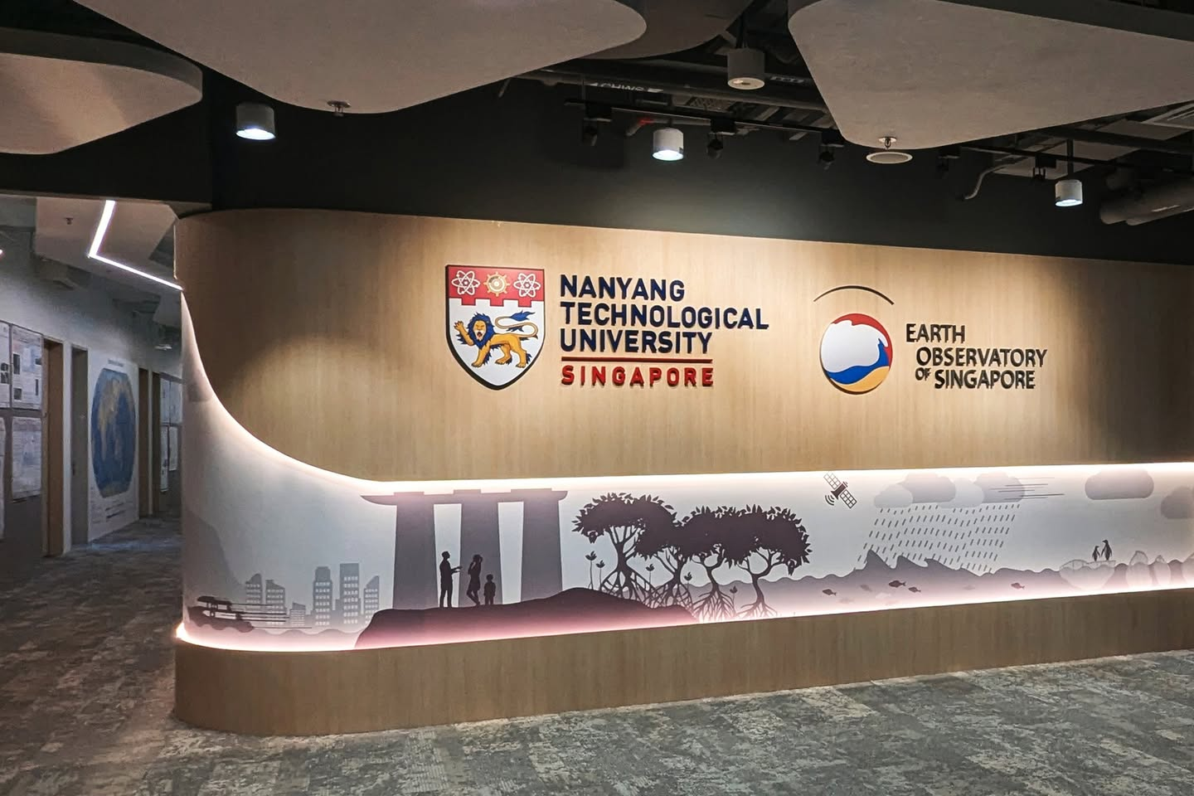

Warm welcome!

Slide 3

NRFi project
- National Research Foundation Investigatorship -
Developping a comprehensive volcano activity forecasting platform covering the full unrest cycle, built on a standardised model of volcano–seismic unrest for consistent interpretation across diverse volcanoes.
Key Objectives:
    ➔ Standardised event classification & feature extraction
    ➔ Physics-based linkage to volcanic processes
    Open-source tools
    Integration to WOVOdat

Slide 4
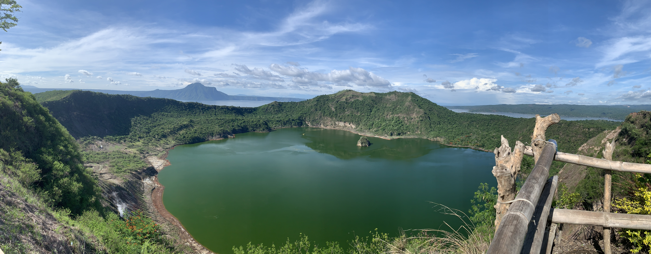

Slide 5

Objectives
Workshop objectives
To share the latest methods and technologies for automated detection, classification, and forecasting of volcano–seismic activity.

Slide 6
Objectives
Workshop objectives
To share the latest methods and technologies for automated detection, classification, and forecasting of volcano–seismic activity.
To develop a clearer understanding of how these workflows can be standardized and made interoperable across different observatories and research networks.

Slide 7
Objectives
Workshop objectives
To share the latest methods and technologies for automated detection, classification, and forecasting of volcano–seismic activity.
To develop a clearer understanding of how these workflows can be standardized and made interoperable across different observatories and research networks.
To strengthen regional collaboration and data-sharing practices, with a view toward integration with systems like WOVOdat and other global frameworks.

Slide 8
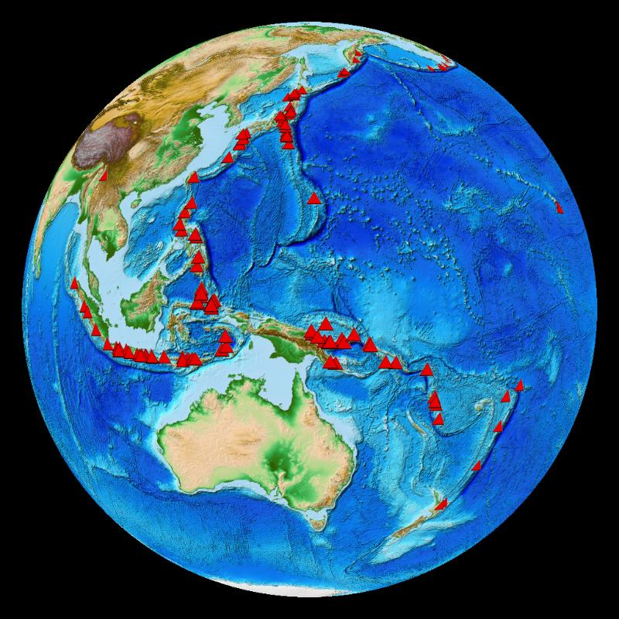

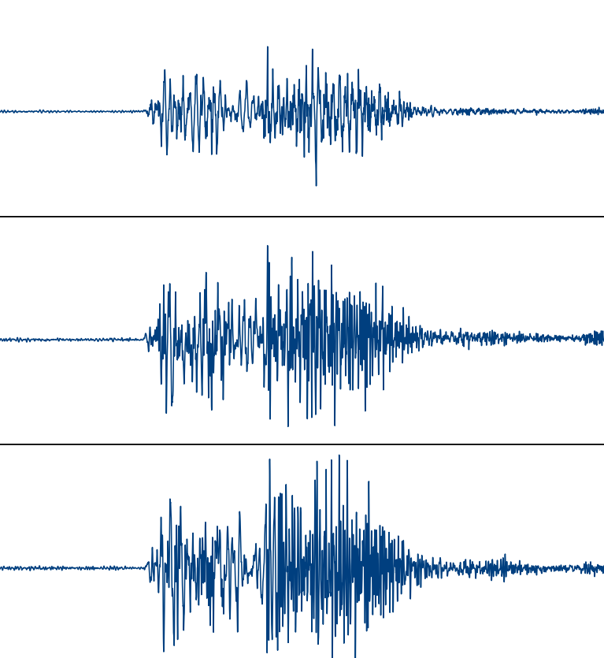
Overview
➔ Day 1 focuses on Advanced Monitoring Technologies and Regional Case Studies — highlighting new sensing tools and lessons learned from unrest events in Indonesia, New Zealand, and the Philippines.

Slide 9


Overview
➔ Day 1 focuses on Advanced Monitoring Technologies and Regional Case Studies — highlighting new sensing tools and lessons learned from unrest events in Indonesia, New Zealand, and the Philippines.
➔ Day 2 dives into Automated Detection, Classification, and AI/ML Approaches — combining research talks with hands-on tutorials using open-source tools like VOISS-Net.

Slide 10


Overview
➔ Day 1 focuses on Advanced Monitoring Technologies and Regional Case Studies — highlighting new sensing tools and lessons learned from unrest events in Indonesia, New Zealand, and the Philippines.
➔ Day 2 dives into Automated Detection, Classification, and AI/ML Approaches — combining research talks with hands-on tutorials using open-source tools like VOISS-Net.
➔ Day 3 emphasizes Workflow Automation and Standardisation, introducing tools like VEQTOR and exploring how we can structure reproducible data pipelines linked to WOVOdat.

Slide 11

Overview
➔ Day 4 looks at Data Management and Observatory Practices — hearing from observatories in Japan, New Zealand, Philippines, and Indonesia, and working on practical exercises in time-series metrics and metadata handling.

Slide 12


Overview
➔ Day 4 looks at Data Management and Observatory Practices — hearing from observatories in Japan, New Zealand, Philippines, and Indonesia, and working on practical exercises in time-series metrics and metadata handling.
➔ Finally, Day 5 will be our Synthesis and Action Planning day, where we’ll consolidate what we’ve learned and define next steps for collaboration and standardization.

Slide 13

Structure
The workshop program includes presentations, tutorials, breakout sessions, discussions, and game activities.

Slide 14
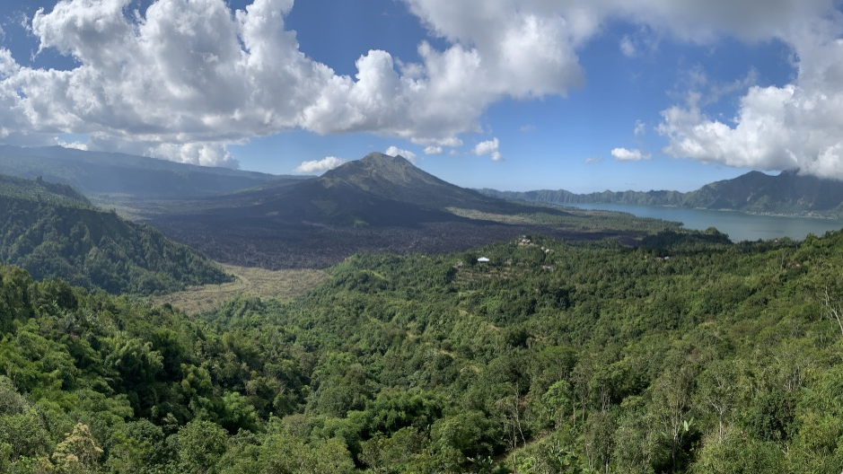

Presentation
Presentations
coordinated by Nang & Yizhou
Please submit your presentation (PPT or PDF) before your session begins — either by email to Nang or via USB drive.
Each talk is allocated 15 minutes, followed by 5 minutes of Q&A.

Slide 15
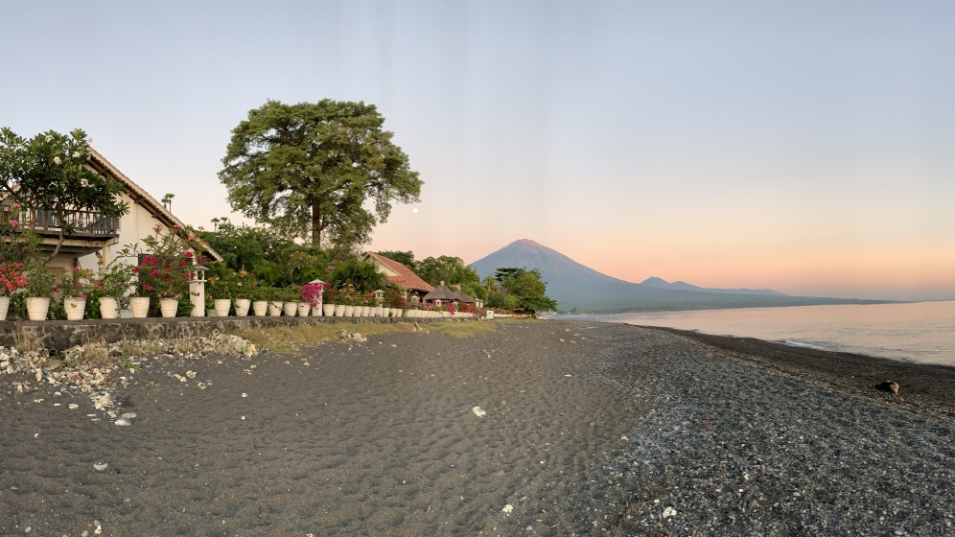

Tutorial
Tutorial Sessions
  VOISS-Net – Darren
  VEQTOR – Andika
  Time-Series Metrics Using ObsPy – Christina
  WOVOdat Input – Christina

Slide 16
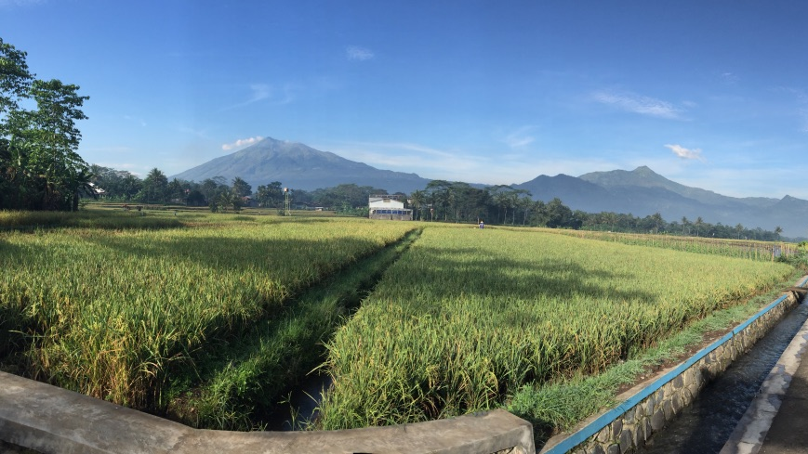

Breakout session
Breakout Sessions & Discussions (led by Julie and Christina)
Day 1: Lessons from Case Studies → Mapping Unrest Scenarios to Monitoring Objectives
Day 2: Integrating AI/ML in Real-Time Volcano Monitoring
Day 3: Working on Metadata Standards and Interoperability
Day 4: Gaps and Opportunities for Data Standardisation
Day 5: Optimising Seismic Data Products for Crisis Response and Towards a Common Standardised Workflow

Slide 17
Breakout session
Breakout Sessions & Discussions (led by Julie and Christina)
Day 1: Lessons from Case Studies → Mapping Unrest Scenarios to Monitoring Objectives
Day 2: Integrating AI/ML in Real-Time Volcano Monitoring
Day 3: Working on Metadata Standards and Interoperability
Day 4: Gaps and Opportunities for Data Standardisation
Day 5: Optimising Seismic Data Products for Crisis Response and Towards a Common Standardised Workflow
By the end of the week, we aim to develop a shared vision for streamlined, interoperable volcano–seismic workflows that support both scientific analysis and real-time crisis decision-making.

Slide 18
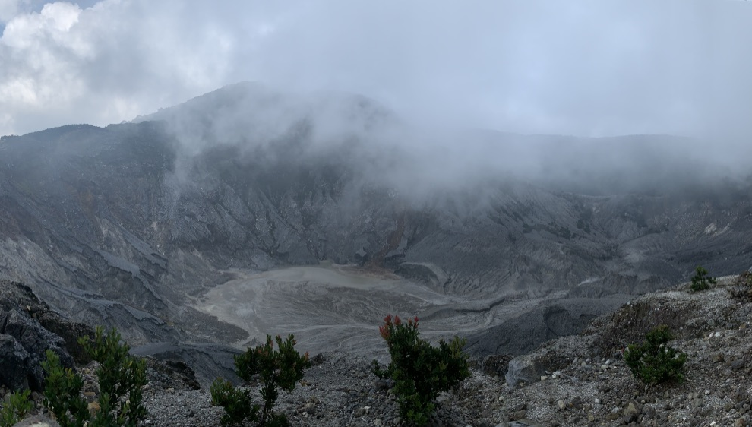


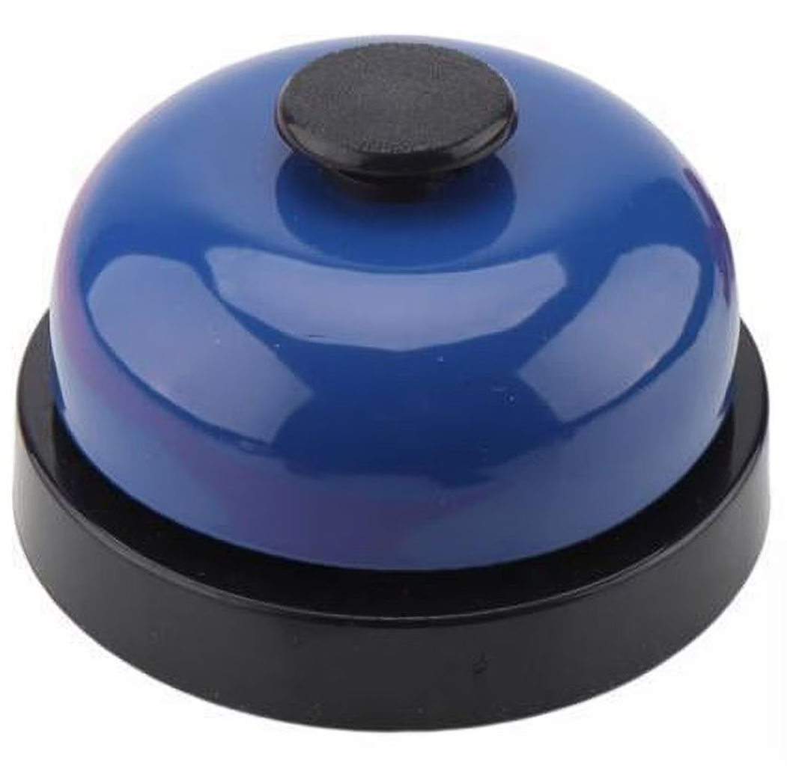
Game activities
Game Activities (led by Yizhou & Shaira)
Fun intermezzo activities will be sprinkled throughout the program to keep the energy up and help everyone connect.

Slide 19
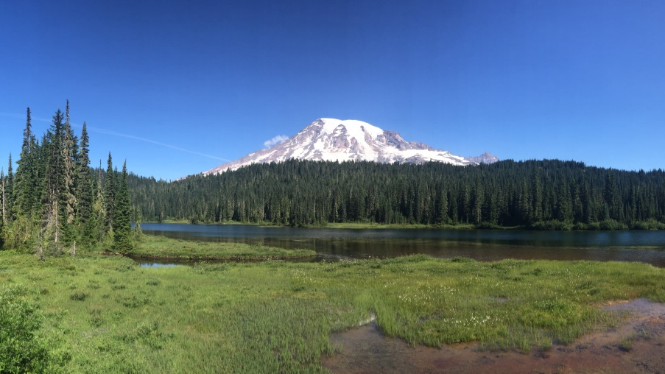

Support & Logistics
If you need assistance, please feel free to approach us.
Two office rooms are available if you have meetings or appointments during the workshop.

Slide 20
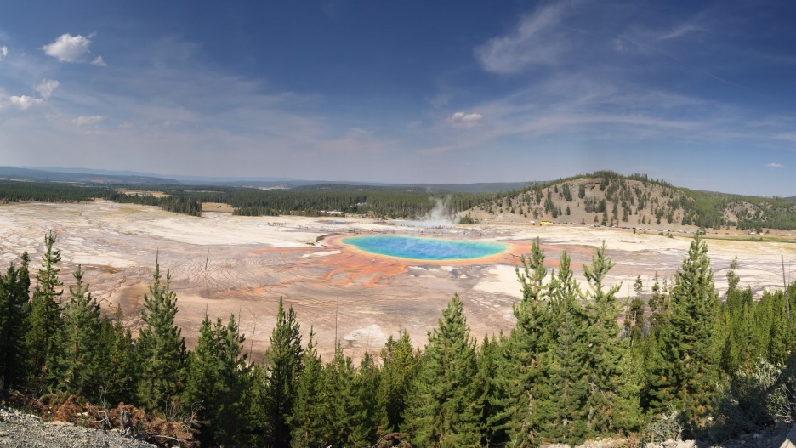

Enjoy the workshop!
Dive in and enjoy the workshop!
➔ Chat, ask, explore, and collaborate — we’re here to learn together and have a great time.
➔ This week is all about hands-on science and some fun along the way.
Have fun!

Slide 21
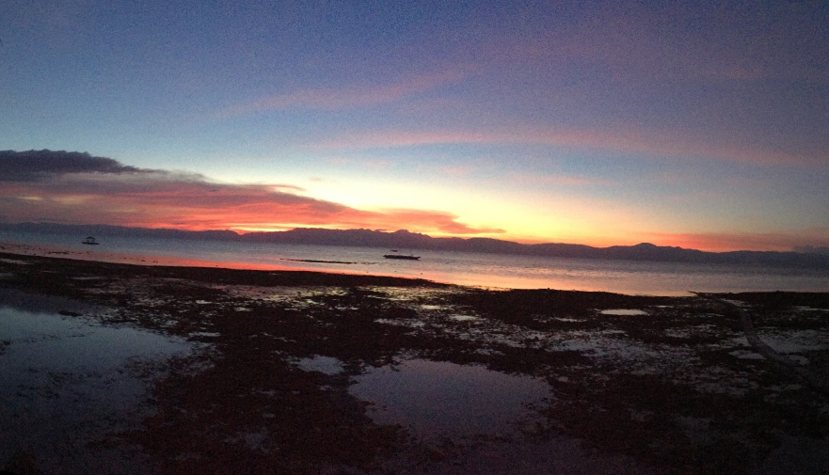

Slide 22

Technical setup
VOISS-Net Installation Guide — MacOS
Prerequisites
1. Check if libmamba is installed in your Anaconda base environment
Open your Mac Terminal and type: conda list
You should see something like:
(base) eos-14938ChristinaW:~ christinaw$ conda list
# packages in environment at /Users/christinaw/anaconda3:
#
# Name Version Build Channel
…
libmamba 2.3.3 h1370271_2 conda-forge
libmambapy 2.3.3 py312haad32af_2 conda-forge
...
If libmamba appears in the list, proceed to Step 2.

Slide 23
Technical setup
2. Check your current Conda solver
Still in Terminal, type:
(base) eos-14938ChristinaW:~ christinaw$ conda config --show solver
Example output:
solver: libmamba
If the solver is already libmamba, you can proceed to installation.
If the solver shows classic, you need to switch to libmamba:
(base) eos-14938ChristinaW:~ christinaw$ conda config --set solver libmamba
Confirm the change:
(base) eos-14938ChristinaW:~ christinaw$ conda config --show solver

Slide 24
Technical setup
Install VOISS-Net
1. Clone the VOISS-Net repository
(base) eos-14938ChristinaW:~ christinaw$ git clone --depth 1 https://github.com/darren-tpk/voiss-net.git
(base) eos-14938ChristinaW:~ christinaw$ cd voiss-net
2. Create and activate the environment
(voiss-net) eos-14938ChristinaW:~ christinaw$ conda env create
(voiss-net) eos-14938ChristinaW:~ christinaw$ conda activate voiss-net
Your voiss-net environment should now be active and ready to use.

Slide 25

Technical setup
VOISS-Net Installation Guide — Windows (Using WSL)
(Windows Subsystem for Linux is required because VOISS-Net relies on Linux-based tools)
1. Prerequisites
VOISS-Net on Windows requires:
Ubuntu (WSL) installed
Internet connection
Git
Miniconda (recommended lightweight Conda installer)
2. Install Miniconda (inside Ubuntu/WSL)
Download the latest Miniconda installer:
wget https://repo.anaconda.com/miniconda/Miniconda3-latest-Linux-x86_64.sh
Run the installer:
bash Miniconda3-latest-Linux-x86_64.sh
Follow the prompts:
Press Enter to review/accept the license
Confirm the installation path (default is fine)
Type yes to initialize Conda
Activate Conda:
source ~/.bashrc
conda --version

Slide 26
Technical setup
3. Clone the VOISS-Net Repository
git clone --depth 1 https://github.com/darren-tpk/voiss-net.gitcd voiss-net
4. Create the Conda Environment
VOISS-Net provides an environment.yml file containing all required dependencies.
conda env create -f environment.yml
💡 This step installs packages such as TensorFlow, SciPy, OpenCV, etc.
Initial setup may take 10–20 minutes depending on your machine.
When complete, Conda shows:
To activate this environment, use:
conda activate voiss-net
5. Activate the Environment
conda activate voiss-net
Your terminal prompt should change to:
(voiss-net) user@machine:~/voiss-net$

